Slide 1
Hodgepodge
CSE 312 Spring 21
Lecture 27

Slide 2
Announcements
Monday is a holiday, we’re listing changed office hours on a pinned Ed post.
Remember to find groups for the final (unless you want to work alone, of course). Ed post up – also consider filling out if you’re a group of two and want a third person.
We’ve made it through the core content!
Today we’re revisiting some old topics
Wednesday is an application lecture (probability and algorithms)
Friday will be a “victory lap” (wrap up the course/put it into context of what comes next/answer lingering questions).
Concept checks for this week due Tuesday (because of holiday)

Slide 3
Today
Cover a topic or two that you got a small taste of, but show up much more frequently in ML.
Random Vectors
More on Covariance
Multidimensional Guassians
More on Conditioning

Slide 4
Preliminary: Random Vectors
In ML, our data points are often multidimensional.
For example:
To predict housing prices, each data point might have: number of rooms, number of bathrooms, square footage, zip code, year built, …
To make movie recommendations, each data point might have: ratings of existing movies, whether you started a movie and stopped after 10 minutes,…
A single data point is a full vector

Slide 5
Preliminary: Random Vector
A random vector $X$ is a vector where each entry is a random variable.
$𝔼[X]$ is a vector, where each entry is the expectation of that entry.
For example, if $X$ is a uniform vector from the sample space
$\left\{\left[\begin{matrix}1 \\ 2 \\ 3\end{matrix}\right],\left[\begin{matrix}−1 \\ 2 \\ 3\end{matrix}\right],\left[\begin{matrix}0 \\ 2 \\ 6\end{matrix}\right]\right\}$
$𝔼\left[X\right]={\left[0,2,4\right]}^{T}$

Slide 6
Covariance Matrix
Remember Covariance?
$Cov\left(X,Y\right)=𝔼\left[(X−𝔼[X])(Y−𝔼\left[Y\right])\right]=𝔼\left[XY\right]−𝔼[X]𝔼[Y]$
We’ll want to talk about covariance between entries:
Define the “covariance matrix”
$Σ=\left[\begin{matrix}Cov(X_{1},X_{1}) & ⋯ & Cov(X_{1},X_{n}) \\ ⋮ & Cov(X_{i},X_{j}) & ⋮ \\ Cov(X_{n},X_{1}) & ⋯ & Cov(X_{n},X_{n})\end{matrix}\right]$

Slide 7
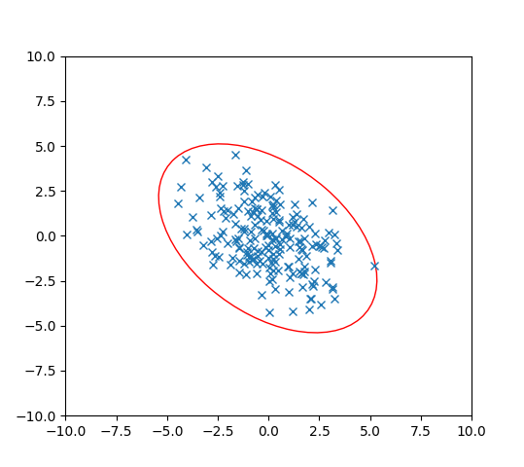
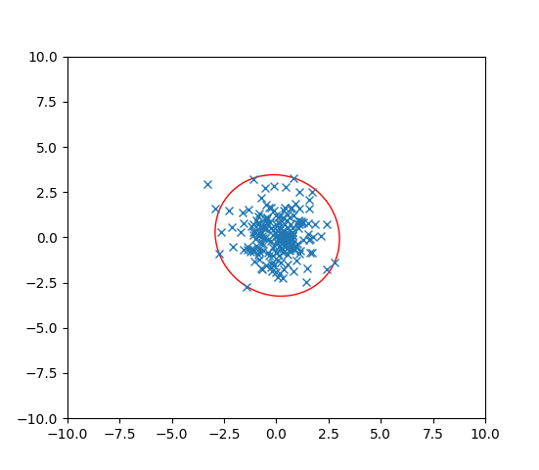
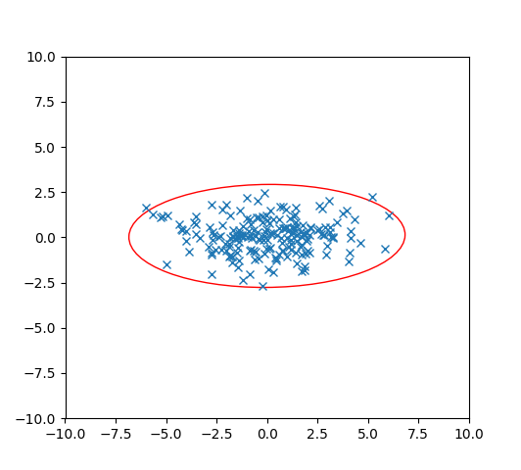
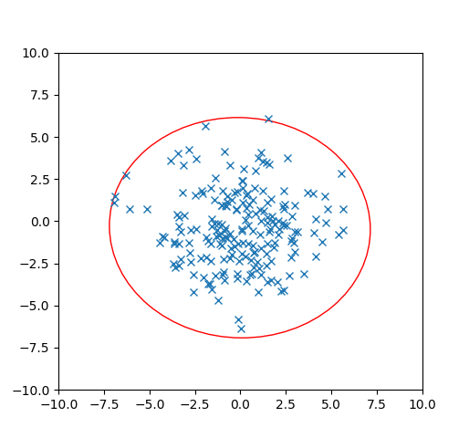
Covariance
Let’s think about 2 dimensions.
Let $X={\left[X_{1},X_{2}\right]}^{T}$ where $X_{i}\sim 𝒩(0,1)$ and $X_{1}$ and $X_{2}$ are independent.
What is $Σ$? Which of these pictures are 200 i.i.d. samples of $X$?

Slide 8
Covariance
Let’s think about 2 dimensions.
Let $X={\left[X_{1},X_{2}\right]}^{T}$ where $X_{i}\sim 𝒩(0,1)$ and $X_{1}$ and $X_{2}$ are independent.
What is $Σ$? Which of these pictures are 200 i.i.d. samples of $X$?
$$Σ=\left[\begin{matrix}1 & 0 \\ 0 & 1\end{matrix}\right]$$

Slide 9
Unequal Variances, Still Independent
Let’s think about 2 dimensions.
Let $X={\left[X_{1},X_{2}\right]}^{T}$ where $X_{1}\sim 𝒩(0,5)$, $X_{2}\sim 𝒩(0,1)$ and $X_{1}$ and $X_{2}$ are independent.
What is $Σ$? Which of these pictures are i.i.d. samples of $X$?

Slide 10
Unequal Variances, Still Independent
Let’s think about 2 dimensions.
Let $X={\left[X_{1},X_{2}\right]}^{T}$ where $X_{1}\sim 𝒩(0,5)$, $X_{2}\sim 𝒩(0,1)$ and $X_{1}$ and $X_{2}$ are independent.
What is $Σ$? Which of these pictures are i.i.d. samples of $X$?
$$Σ=\left[\begin{matrix}5 & 0 \\ 0 & 1\end{matrix}\right]$$

Slide 11
What about dependence.
When we introduce dependence, we need to know the mean vector and the covariance matrix to define the distribution
(instead of just the mean and the variance).
Let’s see a few examples…

Slide 12
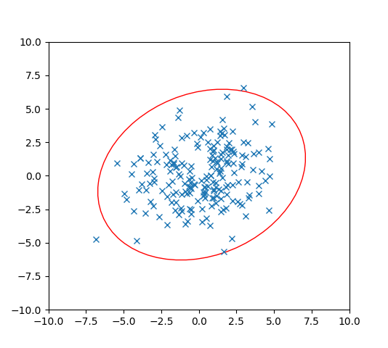
Dependence
Let’s think about 2 dimensions.
Let $X={\left[X_{1},X_{2}\right]}^{T}$ where $Var\left(X_{1}\right)=1$, $Var\left(X_{2}\right)=1$ BUT$X_{1}$ and $X_{2}$ are dependent. $Cov\left(X_{1},X_{2}\right)=5$
What is $Σ$? Which of these pictures are i.i.d. samples of $X$?

Slide 13
Dependence
Let’s think about 2 dimensions.
Let $X={\left[X_{1},X_{2}\right]}^{T}$ where $Var\left(X_{1}\right)=1$, $Var\left(X_{2}\right)=1$ BUT$X_{1}$ and $X_{2}$ are dependent. $Cov\left(X_{1},X_{2}\right)=5$
What is $Σ$? Which of these pictures are i.i.d. samples of $X$?
$$Σ=\left[\begin{matrix}1 & 5 \\ 5 & 1\end{matrix}\right]$$

Slide 14
Dependence
Let’s think about 2 dimensions.
Let $X={\left[X_{1},X_{2}\right]}^{T}$ where ${Var(X}_{1})=1$, $Var\left(X_{2}\right)=1$ BUT$X_{1}$ and $X_{2}$ are dependent. $Cov\left(X_{1},X_{2}\right)=−3$
What is $Σ$? Which of these pictures are i.i.d. samples of $X$?

Slide 15
Dependence
Let’s think about 2 dimensions.
Let $X={\left[X_{1},X_{2}\right]}^{T}$ where ${Var(X}_{1})=1$, $Var\left(X_{2}\right)=1$ BUT$X_{1}$ and $X_{2}$ are dependent. $Cov\left(X_{1},X_{2}\right)=−3$
What is $Σ$? Which of these pictures are i.i.d. samples of $X$?
$$Σ=\left[\begin{matrix}1 & −3 \\ −3 & 1\end{matrix}\right]$$

Slide 16
Using the Covariance Matrix
What were those ellipses in those datasets?
How do we know how many standard deviations from the mean a 2D point is, for the independent, variance $1$ ones
Well $(x_{1}−𝔼\left[X_{1}\right])$ is the distance from $x$ to the center in the $x$-direction.
And $(x_{2}−𝔼\left[x_{2}\right])$ is the distance from $x$ to the center in the $y$-direction.
So the number of standard deviations is $\sqrt{{\left(x_{1}−𝔼\left[X_{1}\right]\right)}^{2}+{\left(x_{2}−𝔼\left[x_{2}\right]\right)}^{2}}$
That’s just the distance!
In general, the major/minor axes of those ellipses were the eigenvectors of the covariance matrix. And the associated eigenvalues tell you how the directions should be weighted.

Slide 17
Probability and ML
You’re going to do a lot of conditional expectations, let’s talk about why…
Many problems in ML: Given a bunch of data points, you’ll find a function $f$ that you hope will predict future points well.
We usually assume there is some true distribution $𝒟$ of data points (e.g. all theoretical possible houses and their prices).
You get a dataset $S$ that you assume was sampled from $𝒟$ to find $f_{S}$
$f_{S}$ is a lot like an MLE – it depends on the data, so before you knew what $S$ was, $f$ was a random variable. You then want to figure out what the true error is if you knew $𝒟$.

Slide 18
Probability and ML
But $𝒟$ is a theoretical construct. What can we do instead? Get a second dataset $T$drawn from $𝒟$ (drawn independently of $S$)
(or actually save part of your database before you start).
Then $𝔼_{𝒟}\left[error of f\right]=𝔼_{T}\left[error of f_{S} | S\right]$
But how confident can you be? You’ll make confidence intervals
(statements like the true error is within 5% of our estimate with probability at least $.9$) using concentration inequalities.

Slide 19
Practice with conditional expectations
Consider of the following process:
Flip a fair coin, if it’s heads, pick up a 4-sided die; if it’s tails, pick up a 6-sided die (both fair)
Roll that die independently 3 times. Let $X_{1},X_{2},X_{3}$ be the results of the three rolls.
What is $𝔼[X_{2}]$? $𝔼[X_{2}|X_{1}=5]$? $𝔼[X_{2}|X_{3}=1]$?

Slide 20
Using conditional expectations
Let $F$ be the event “the four sided die was chosen”
$𝔼\left[X_{2}\right]=ℙ(F)𝔼\left[X_{2} | F\right]+ℙ\left(\overline{F}\right)𝔼\left[X_{2} | \overline{F}\right]$
$=\frac{1}{2}⋅2.5+\frac{1}{2}⋅3.5=3$
$𝔼[X_{2}|X_{1}=5]$ event $X_{1}=5$ tells us we’re using the $6$-sided die.
$𝔼\left[X_{2} | X_{1}=5\right]=3.5$
$𝔼[X_{2}|X_{3}=1]$ We aren’t sure which die we got, but…is it still 50/50?

Slide 21
Setup
Let $E$ be the event “$X_{3}=1“$
$ℙ\left(E\right)=\frac{1}{2}⋅\frac{1}{6}+\frac{1}{2}⋅\frac{1}{4}=\frac{5}{24}$
$ℙ\left(F | E\right)=\frac{ℙ\left(E|F\right)⋅ℙ(F)}{ℙ(E)}$
$=\frac{\frac{1}{4}⋅\frac{1}{2}}{5/24}=\frac{3}{5}$
$ℙ\left(\overline{F} | E\right)=\frac{ℙ(E|\overline{F})⋅ℙ(\overline{F})}{ℙ(E)}$ $=\frac{\frac{1}{6}⋅\frac{1}{2}}{5/24}=\frac{2}{5}$ (we could also get this with LTP, but it’s good confirmation)

Slide 22
Analysis
$𝔼\left[X_{2} | X_{3}=1\right]=ℙ\left(F|X_{3}=1\right)𝔼\left[X_{2} | X_{3}=1∩F\right]+ℙ\left(\overline{F}|X_{3}=1\right)𝔼\left[X_{2} | X_{3}=1∩\overline{F}\right]$
Wait what?
This is the LTE, applied in the space where we’ve conditioned on $X_{3}=1$.
Everything is conditioned on $X_{3}=1$. Beyond that conditioning, it’s LTE.
$=\frac{3}{5}⋅2.5+\frac{2}{5}⋅3.5=2.9$.
A little lower than the unconditioned expectation. Because seeing a 1 has made it ever so slightly more probable that we’re using the 4-sided die.

