Slide 1
Randomized Algorithms
CSE 312 Spring 21
Lecture 28

Slide 2
Announcements
Three Concept checks this week (to get to a total of 30)
Concept Check 28 is a “standard” one for today’s lecture
Concept Check 29 asks you to fill out the official UW course evals.
  Please fill these out! It’s super useful to know what you found valuable, what you found frustrating, what took too long,…we are always working to improve the course.
  Concept Check 30 asks you to fill out a different anonymous form with specific feedback about the real world assignments.
  They were new this quarter – asking about logistics (e.g., would you rather have had these as part of regular homeworks like the programming or as separate work like we did?), for any examples to add to suggested lists (like in real world 1/2), etc.

Slide 3
Final Logistics
What’s Fair Game?
All the content/theorems we learned.
Principles behind the programming questions, but not the code itself.
Applications lectures won’t be tested directly (that is to say we won’t give you a problem that would only make sense if you followed the application lectures.
But the principles behind the applications are absolutely fair game.
And we reserve the right to give a problem inspired by the applications lectures, as long as you could do it even if you didn’t see the applications.
E.g. we could ask a question about covariance (because you know the formula from main lectures) but we wouldn’t ask you to think about the ML implications of a picture of covariances.

Slide 4
What’s a randomized algorithm?
A randomized algorithm is an algorithm that uses randomness in the computation.
Well, ok.
Let’s get a little more specific.

Slide 5
Two common types of algorithms
Las Vegas Algorithm
Always tells you the right answer
Takes varying amounts of time.
Monte Carlo Algorithm
Usually tells you the right answer.

Slide 6
A classic Las Vegas Algorithm
Remember Quick Sort?
  Pick a “pivot” element
  Move all the elements smaller than the pivot to the left subarray (in no particular order)
  Move all elements greater than the pivot element to the right subarray (in no particular order)
  Make a recursive call
It’s sometimes implemented as a Las Vegas Algorithm.
That is, you’ll always get the same answer (there’s only one sorted array) but the time can vary.

Slide 7
Quick Sort
https://www.youtube.com/watch?v=ywWBy6J5gz8
0 | 1 | 2 | 3 | 4 | 5 | 6
20 | 50 | 70 | 10 | 60 | 40 | 30
0
10
0 | 1 | 2 | 3 | 4
50 | 70 | 60 | 40 | 30
0 | 1
40 | 30
0 | 1
70 | 60
0
30
0
60
0 | 1
30 | 40
0 | 1
60 | 70
0 | 1 | 2 | 3 | 4
30 | 40 | 50 | 60 | 70
0 | 1 | 2 | 3 | 4 | 5 | 6
10 | 20 | 30 | 40 | 50 | 60 | 70

Slide 8
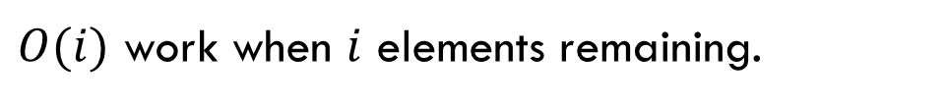


How long does it take?
Total time:
$$\sum_{i=1}^{n}{i}=O(n^{2})$$
Well…it depends on what pivots you pick.
About $n$ levels
…
$O(i)$ work when $i$ elements remaining.

Slide 9
For Simplicity
We’ll talk about how quicksort is really done at the end.
For now an easier-to-analyze version:
if(elements remaining > 1)
pick a pivot uniformly at random
split based on pivot
sortedLeft = QuickSort(left half)
sortedRight = QuickSort(right half)
return (sortedLeft pivot sortedRight)

Slide 10
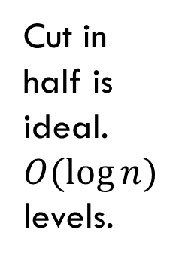
What leads to a good time?
Pivots closer to the middle would be better.
Cut in half is ideal.
$O(\log{n)}$levels.
$O(i)$ work when $i$ elements remaining. -- $O(n)$ per level

Slide 11
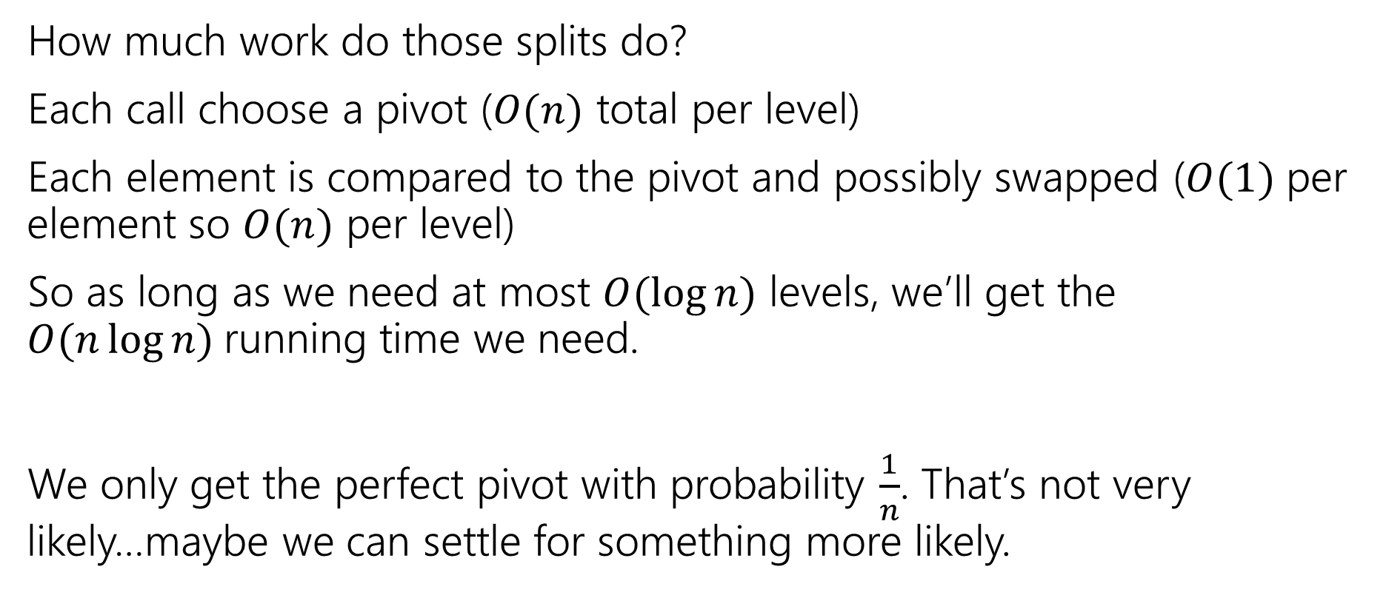
Work at each level
How much work do those splits do?
Each call choose a pivot ($O(n)$ total per level)
Each element is compared to the pivot and possibly swapped ($O(1)$ per element so $O(n)$ per level)
So as long as we need at most $O(\log{n})$ levels, we’ll get the $O(n\log{n)}$running time we need.
We only get the perfect pivot with probability $\frac{1}{n}$. That’s not very likely…maybe we can settle for something more likely.

Slide 12
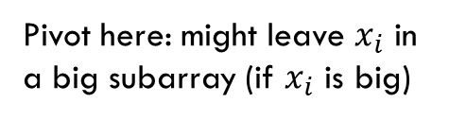
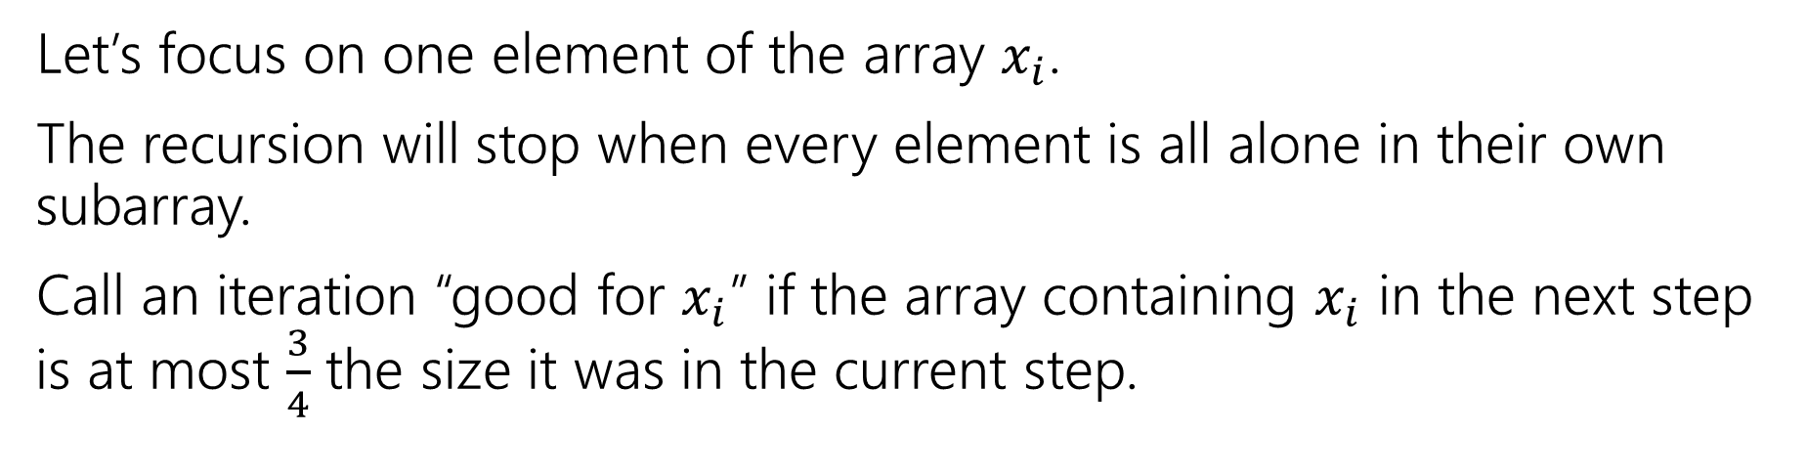

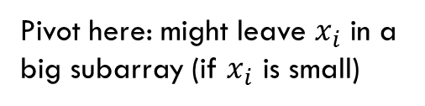
Focus on an element
Let’s focus on one element of the array $x_{i}$.
The recursion will stop when every element is all alone in their own subarray.
Call an iteration “good for $x_{i}$” if the array containing $x_{i}$ in the next step is at most $\frac{3}{4}$ the size it was in the current step.
Pivot here: might leave $x_{i}$ in a big subarray (if $x_{i}$ is big)
Pivot here: both subarrays $≤3/4$ size.
Must be good for $x_{i}$.
Pivot here: might leave $x_{i}$ in a big subarray (if $x_{i}$ is small)

Slide 13
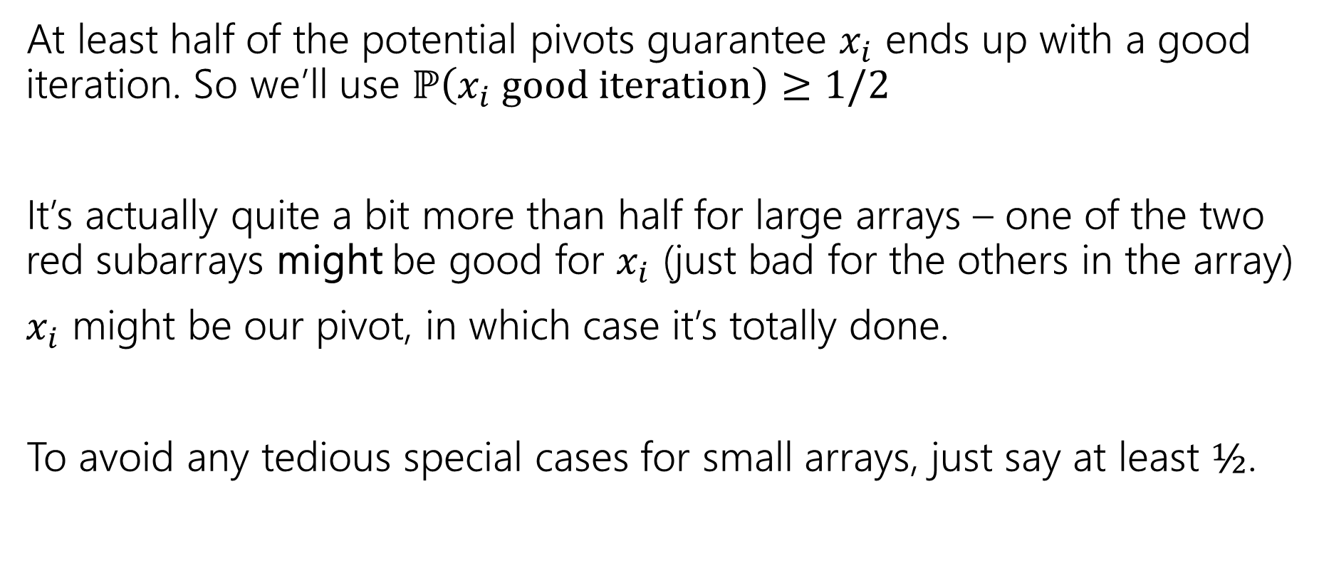

Good for $x_{i}$
At least half of the potential pivots guarantee $x_{i}$ ends up with a good iteration. So we’ll use $ℙ\left(x_{i} good iteration\right)≥1/2$
It’s actually quite a bit more than half for large arrays – one of the two red subarrays might be good for $x_{i}$ (just bad for the others in the array)
$x_{i}$ might be our pivot, in which case it’s totally done.
To avoid any tedious special cases for small arrays, just say at least $½$.

Slide 14
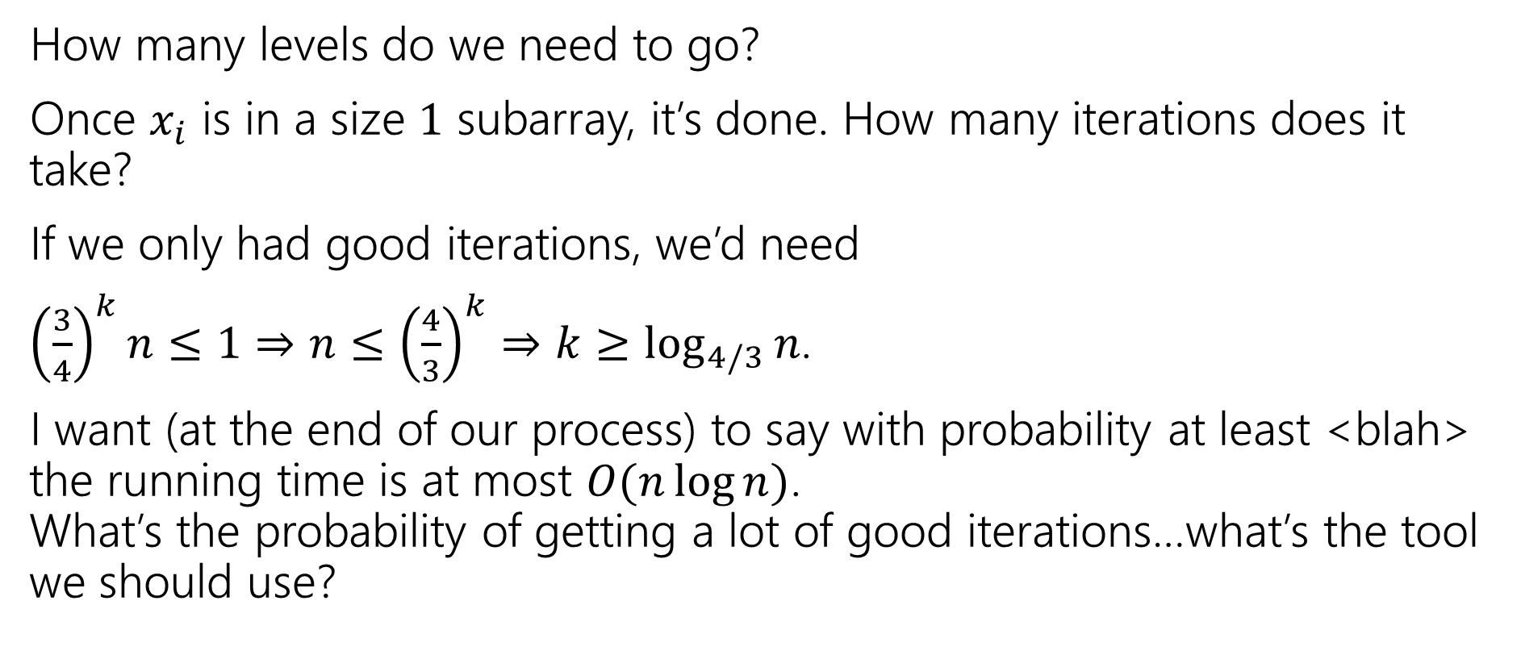
How many levels?
How many levels do we need to go?
Once $x_{i}$ is in a size $1$ subarray, it’s done. How many iterations does it take?
If we only had good iterations, we’d need
${\left(\frac{3}{4}\right)}^{k}n≤1⇒n≤{\left(\frac{4}{3}\right)}^{k}⇒k≥\log_{4/3}{n}$.
I want (at the end of our process) to say with probability at least <blah> the running time is at most $O(n\log{n)}$.
What’s the probability of getting a lot of good iterations…what’s the tool we should use?
Fill out the poll everywhere so Robbie knows how long to explain
Go to pollev.com/cse312

Slide 15
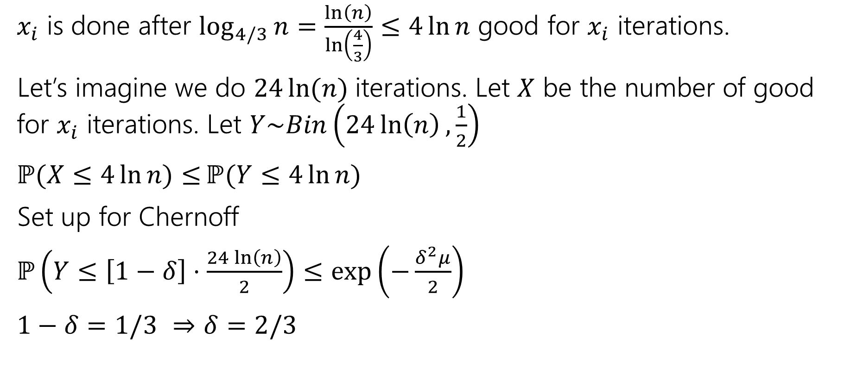
Needed iterations
$x_{i}$ is done after $\log_{4/3}{n}=\frac{\ln\left(n\right)}{\ln\left(\frac{4}{3}\right)}≤4\ln{n}$ good for $x_{i}$ iterations.
Let’s imagine we do $24\ln{(n)}$iterations. Let $X$ be the number of good for $x_{i}$ iterations. Let $Y\sim Bin\left(24\ln\left(n\right),\frac{1}{2}\right)$
$ℙ(X≤4\ln{n)≤}ℙ(Y≤4\ln{n) }$
Set up for Chernoff
$ℙ\left(Y≤\left[1−δ\right]⋅\frac{24\ln\left(n\right)}{2}\right)≤\exp\left(−\frac{δ^{2}μ}{2}\right)$
$1−δ=1/3$ $⇒δ=2/3$

Slide 16

Applying Chernoff
$ℙ\left(Y≤\left[1−δ\right]⋅\frac{24\ln\left(n\right)}{2}\right)≤\exp\left(−\frac{δ^{2}μ}{2}\right)≤\exp\left(−\frac{\frac{1}{3^{2}}⋅12\ln\left(n\right)}{2}\right)=e^{−\frac{8}{3}⋅ln⁡(n)}$
So, the probability that $x_{i}$ is not done after $24\ln{(n)}$iterations is at most $e^{−8ln⁡(n)/3}$ $=n^{−8/3}$

Slide 17
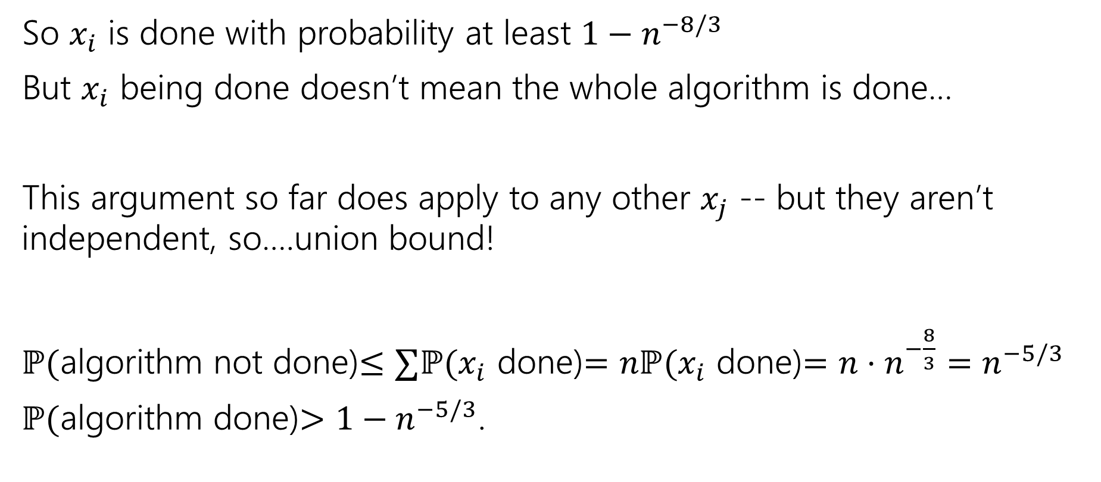
Finishing The bound
So $x_{i}$ is done with probability at least $1−n^{−8/3}$
But $x_{i}$ being done doesn’t mean the whole algorithm is done…
This argument so far does apply to any other $x_{j}$ -- but they aren’t independent, so….union bound!
$ℙ($algorithm not done)$≤∑ℙ(x_{i}$ done)$=nℙ(x_{i}$ done)$=n⋅n^{−\frac{8}{3}}=n^{−5/3}$
$ℙ($algorithm done)$>1−n^{−5/3}$.

Slide 18
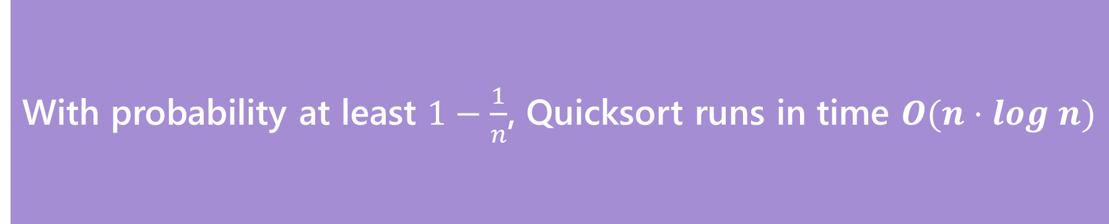
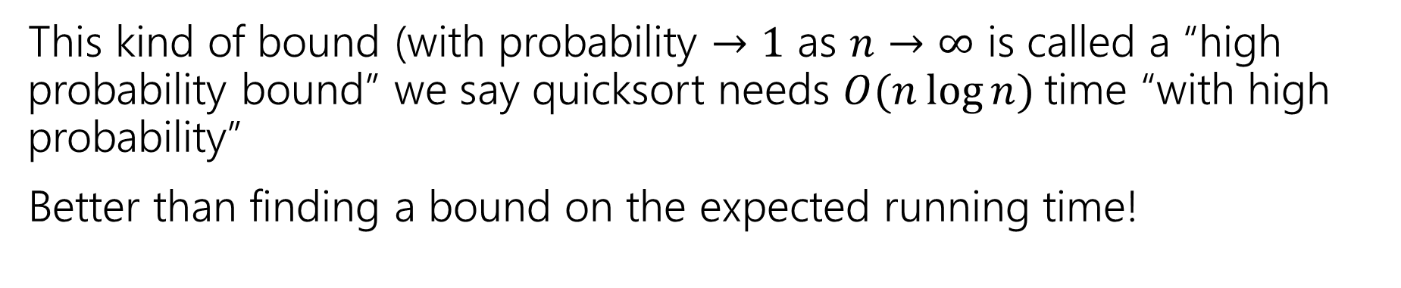
The Theorem
With probability at least $1−\frac{1}{n}$, Quicksort runs in time $O(n⋅log n)$
Quicksort
This kind of bound (with probability $→1$ as $n→∞$ is called a “high probability bound” we say quicksort needs $O(n\log{n)}$time “with high probability”
Better than finding a bound on the expected running time!

Slide 19
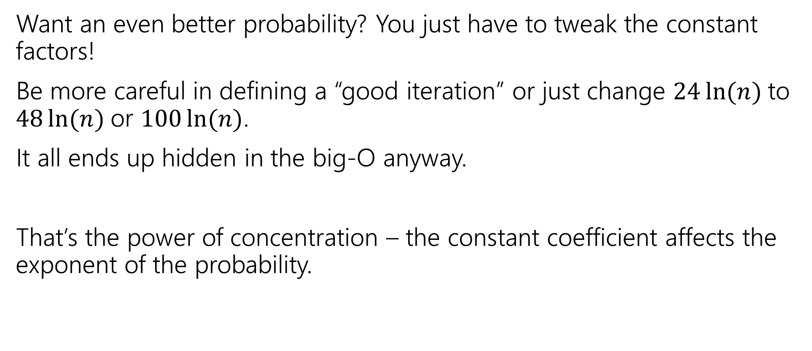
Want a different bound?
Want an even better probability? You just have to tweak the constant factors!
Be more careful in defining a “good iteration” or just change $24\ln{(n)}$to $48\ln{(n)}$or $100\ln{(n)}$.
It all ends up hidden in the big-O anyway.
That’s the power of concentration – the constant coefficient affects the exponent of the probability.

Slide 20
Common Quicksort Implementations
A common strategy in practice is the “median of three” rule.
Choose three elements (either at random or from specific spots). Take the median of those for your pivot
Guarantees you don’t have the worst possible pivot.
Only a small constant number of extra steps beyond the fixed pivot (find the median of three numbers is just a few comparisons).
Another strategy: find the true median (very fancy, very impractical: take 421)

Slide 21
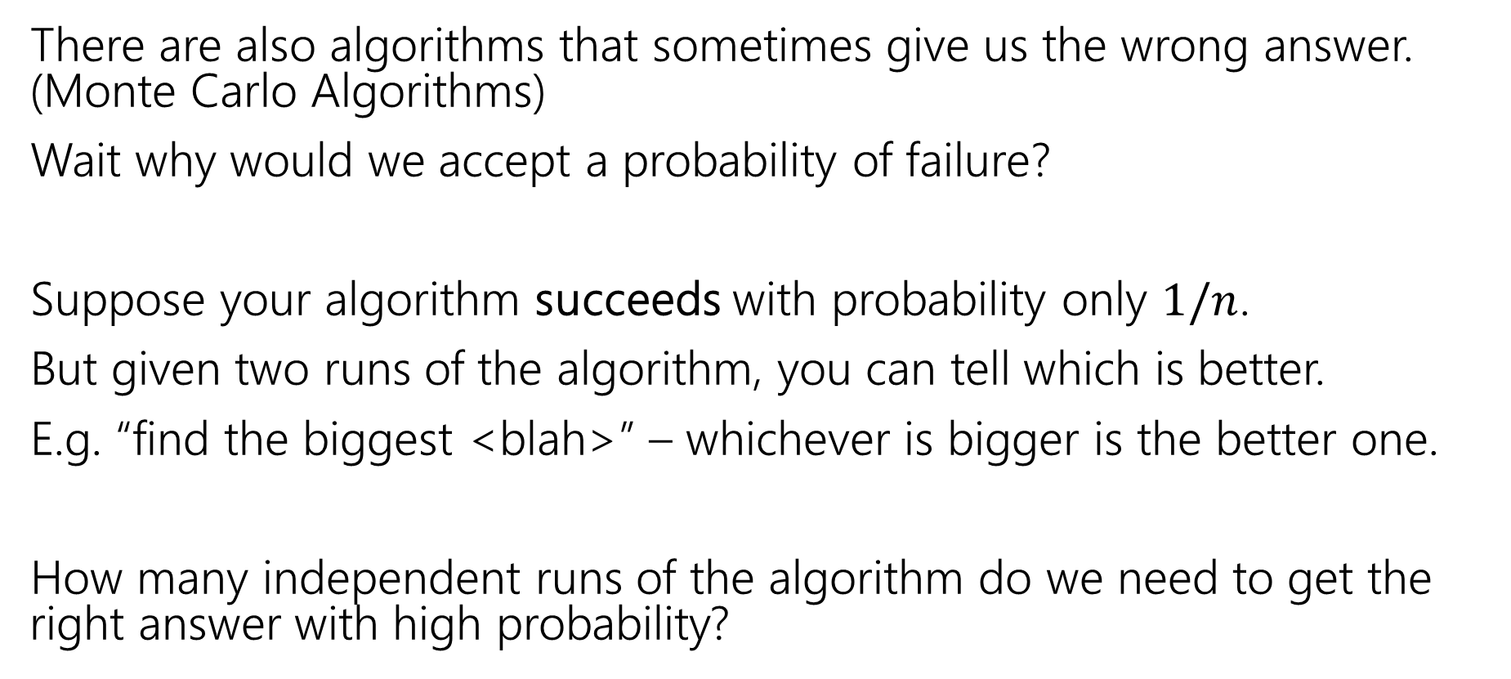
Algorithms with some probability of failure
There are also algorithms that sometimes give us the wrong answer. (Monte Carlo Algorithms)
Wait why would we accept a probability of failure?
Suppose your algorithm succeeds with probability only $1/n$.
But given two runs of the algorithm, you can tell which is better.
E.g. “find the biggest <blah>” – whichever is bigger is the better one.
How many independent runs of the algorithm do we need to get the right answer with high probability?

Slide 22
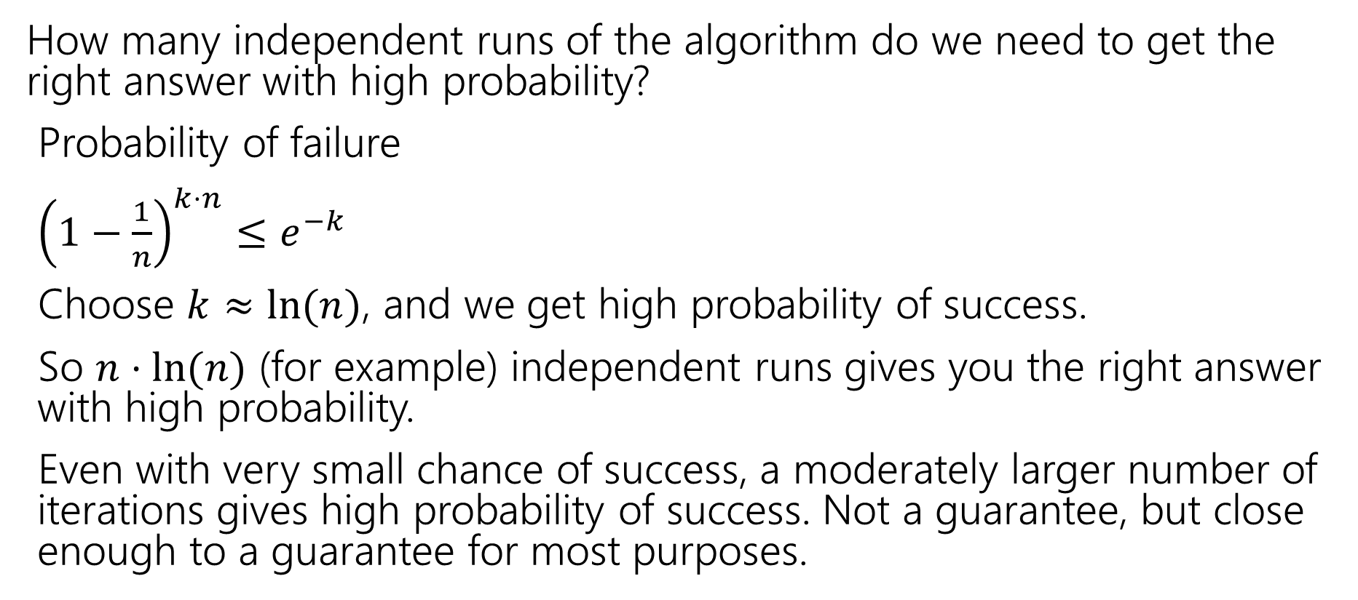
Small Probability of Failure
How many independent runs of the algorithm do we need to get the right answer with high probability?
Probability of failure
${\left(1−\frac{1}{n}\right)}^{k⋅n}≤e^{−k}$
Choose $k≈ln⁡(n)$, and we get high probability of success.
So $n⋅ln⁡(n)$ (for example) independent runs gives you the right answer with high probability.
Even with very small chance of success, a moderately larger number of iterations gives high probability of success. Not a guarantee, but close enough to a guarantee for most purposes.

