Slide 1
Welcome!
CSE 312 Summer 21
Lecture 1

Slide 2
Meet the Staff!
Instructor: Kushal Jhunjhunwalla
B.S. and M.S. from UW CSE with a focus in Distributed Systems and Security
First time lecturer
Interests: Cooking, Dancing!
Email: kushaljh@cs.washington.edu

Slide 3
Meet the Staff!
TA: Alice Wang
Rising Junior studying Computer Science
Interests: Drawing, pin-collecting, and watching anime
Email: alicew3@cs.washington.edu

Slide 4
Meet the Staff!
TA: Claris Winston
Rising Sophomore studying Computer Science
Interests: Gymnastics, drawing, and composing music
Email: clarisw@cs.washington.edu

Slide 5
Meet the Staff!
TA: Justin Tysdal
Rising Junior studying Computer Science and Mathematics
Interests: Cooking, reading, singing, practicing guitar, and playing osu!mania
Email: justinjt@cs.washington.edu

Slide 6
Meet the Staff!
TA: Pascal Sturmfels
Third-year PhD student in ML and Computational Biology
Email: psturm@cs.washington.edu

Slide 7
Remote Instruction Logistics
We will always have a TA watching chat – if you have a question, ask it there (either general or direct to a TA – Tas are co-hosts of the call).
Don’t send a direct message to me, I won’t see it
TA may answer directly, interrupt me, or wait a few minutes and have me answer at a good stopping point.
If you are comfortable to turn on your video (and have reliable infrastructure), please do!
Nodding/confusing looks/glazed over eyes help me know if I need to repeat myself or give an alternate explanation.
Recording of the lecture will be put up on Canvas.

Slide 8
Remote Instruction Logistics
Lecture meeting time: MWF 12 pm – 1 pm
Section meeting time: Thursday 12 pm – 1 pm
Both sections are meeting at the same time. Please go to your assigned section.
Sections will not be recorded for your privacy
We will have section “walkthrough” videos for those who cannot attend sections.

Slide 9
Syllabus
It may take a few days for the syllabus to be published.
When in doubt refer to the syllabus on the website:
https://courses.cs.washington.edu/courses/cse312/21su

Slide 10
Work Breakdown
Concept Checks (10%)
Short “quiz” for each lecture on Gradescope; helps identify misconceptions right away.
All three for a week due Monday morning; recommend you do them the day of lecture.
About 7 assignments (60%)
Mostly written problems, but a few programming exercises
2 Probability in the Real World mini-projects (10%)
A chance to think about applying concepts to real life / some ethical implications of the tools we are introduced to in this class.
3 Review Summaries – in place of a Midterm (10%)
Review assignment to reflect on what was learnt in the past few weeks.
Final (10%)
Details TBD. No proctor-based exams.

Slide 11
Communication
Ed Discussion board will be the primary means of communication
There will be FAQs for lectures, announcements, which you should check for frequently.
If you want to contact us:
Private post on Ed (only visible to staff)
Email Kushal (kushaljh@cs)
Anonymous feedback form on the webpage

Slide 12
Collaboration Policy
PLEASE collaborate! Please talk to each other and work with each other.
(subject to the policy – details in the syllabus)
Collaboration is difficult in this remote environment.
There are a few things to help you get started:
Message on the pinned Ed post to meet people
Stay after section to meet people
Let us know how we can help!

Slide 13
What is 312?
We are going to learn the fundamentals of probability theory
A beautiful and useful branch of mathematics
Applications in:
Machine Learning
Natural Language Processing
Cryptography
Error-correcting codes
Data Structures
Data Compression
Complexity Theory
Algorithm Design
and much more!

Slide 14
Content
Combinatorics (fancy counting)
Permutations, combinations, inclusion-exclusion, pigeonhole principle
Formal definitions of Probability
Probability space, events, conditional probability, independence, expectation, variance
Common patterns in probability
Equations and inequalities, common random variables, tail bounds
Continuous Probability
Density, sample distributions, Central Limit Theorem, Estimating probabilities
Applications
Across CS

Slide 15
Themes
Precise mathematical communication
Both reading and writing dense statements
Probability in the real world
A mix of CS applications
Some actual “real life” ones
Refine your intuition
Most people have some base feeling of what the chances of some event are.
We are going to train you to have better gut feelings.

Slide 16
Counting

Slide 17
Why Counting?
Sometimes useful for algorithm analysis
The easiest code to write for “find X” is “try checking every spot where X could be”
“Given an array, find a set of elements that sum to 0”
“Given an array, find a set of 2 elements that sum to 0”
Gut check of “we can ‘brute force’ this or we can’t” is super helpful
Generally: Question boils down to computing cardinality |S| of some set S.

Slide 18
Why Counting?
A building block toward probability theory
“What are the chances” is usually calculated by
$=\frac{how many ways can I succeed}{how many ways can I succeed+how many ways can I fail}$

Slide 19
Counting Rules
Sum Rule
Product Rule

Slide 20
Sum Rule
How many options do I have for dinner?
I could go to Sizzle & Crunch where there are 2 meals I choose from, or I could go to Noodle Nation where there are 8 meals I choose from (and none of them are the same between the two restaurants).
How many total choices?

Slide 21
Sum Rule
How many options do I have for dinner?
I could go to Sizzle & Crunch where there are 2 meals I choose from, or I could go to Noodle Nation where there are 8 meals I choose from (and none of them are the same between the two restaurants).
How many total choices?
2 + 8 = 10

Slide 22
Sum Rule
How many options do I have for dinner?
I could go to Sizzle & Crunch where there are 2 meals I choose from, or I could go to Noodle Nation where there are 8 meals I choose from (and none of them are the same between the two restaurants).
How many total choices?
2 + 8 = 10
Sum Rule: If you are choosing one thing between $n$ options in one group and $m$in another group with no overlap, the total number of options is: $n+m$.

Slide 23
Product Rule
I now want dessert
I decide to go to Sweet Alchemy. There are a variety of ways to customize my ice-cream:
One flavor (chocolate, vanilla, strawberry)
One cone (sugar, waffle)
One topping (fudge, oreos, sprinkles, caramel)
How many ice-cream choices do I have?

Slide 24
Ice-creams!
Chocolate
Strawberry
Step 1: choose one of the flavors
Step 2: regardless of the choice of ice-cream, choose one cone
Step 3: regardless of the previous choices, choose one topping
$3⋅2⋅4=24$
Vanilla
Sugar
Waffle
Fudge
Caramel
Oreos
Sprinkles
Product Rule: If you have a sequential process, where step $1$ has $n_{1}$ options, step 2 has $n_{2}$options,…,step $k$ has $n_{k}$ options, and you choose one from each step, the total number of possibilities is $n_{1}⋅n_{2}⋯n_{k}$

Slide 25
Counting Rules
Sum Rule: If you are choosing one thing between $n$ options in one group and $m$in another group with no overlap, the total number of options is: $n+m$.
Product Rule: If you have a sequential process, where step $1$ has $n_{1}$ options, step 2 has $n_{2}$options,…,step $k$ has $n_{k}$ options, and you choose one from each step, the total number of possibilities is $n_{1}⋅n_{2}⋯n_{k}$

Slide 26
Applications of the product rule
Remember Cartesian products?
$S×T=\left\{\left(x,y\right):x∈S, y∈T\right\}$
$\left\{1,2\right\}×\{a,b,c\}=\{\left(1,a\right),\left(1,b\right),\left(1,c\right),\left(2,a\right),\left(2,b\right),(2,c)\}$
How big is $S×T$? (i.e., what is $|S×T|$?)
Step 1: choose element from $S$
Step 2: choose element from $T$
Total options: $\left|S\right|⋅|T|$

Slide 27
Power Sets
$𝒫\left(S\right)=\{X:X⊆S\}$
$𝒫\left(\left\{1,2,3\right\}\right)=\{ ∅, \left\{1\right\},\left\{2\right\},\left\{3\right\}, \left\{1,2\right\},\left\{1,3\right\},\left\{2,3\right\}, \left\{1,2,3\right\} \}$
How many subsets are there of $S$, i.e., what is $\left|𝒫\left(S\right)\right|$?

Slide 28
Power Sets
$𝒫\left(S\right)=\{X:X⊆S\}$
$𝒫\left(\left\{1,2,3\right\}\right)=\{ ∅, \left\{1\right\},\left\{2\right\},\left\{3\right\}, \left\{1,2\right\},\left\{1,3\right\},\left\{2,3\right\}, \left\{1,2,3\right\} \}$
How many subsets are there of $S$, i.e., what is $\left|𝒫\left(S\right)\right|$?
If $S=\{e_{1},e_{2},⋯,e_{|s|}\}$
Step 1: is $e_{1}$ in the subset?
Step 2: is $e_{2}$ in the subset?
…
Step $\left|S\right|$: is $e_{|S|}$ in the subset?
Total options:$2⋅2⋯2, \left|S\right| times, i.e., 2^{|S|}$

Slide 29
Baseball Outfits
The Husky baseball team has three hats (purple, black, gray)
Three jerseys (pinstripe, purple, gold)
Three pairs of pants (gray, white, black)
How many outfits are there (consisting of one hat, a jersey, and a pair of pants) if we have the following constraints:
The pinstripe jersey cannot be worn with gray pants
The purple jersey cannot be worn with white pants
The gold jersey cannot be worn with black pants

Slide 30
Baseball Outfits
Step 1: 3 choices for hats
Step 2: 3 choices for jerseys
Step 3: 3 choices for pants???

Slide 31
Baseball Outfits
Step 1: 3 choices for hats
Step 2: 3 choices for jerseys
Step 3: 3 choices for pants???
Step 3: 2 choices for pants as we have 2 options for pants regardless of the jersey we choose (even though there are 3 options for pants overall)
$3⋅3⋅2=18$

Slide 32
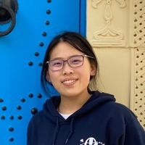
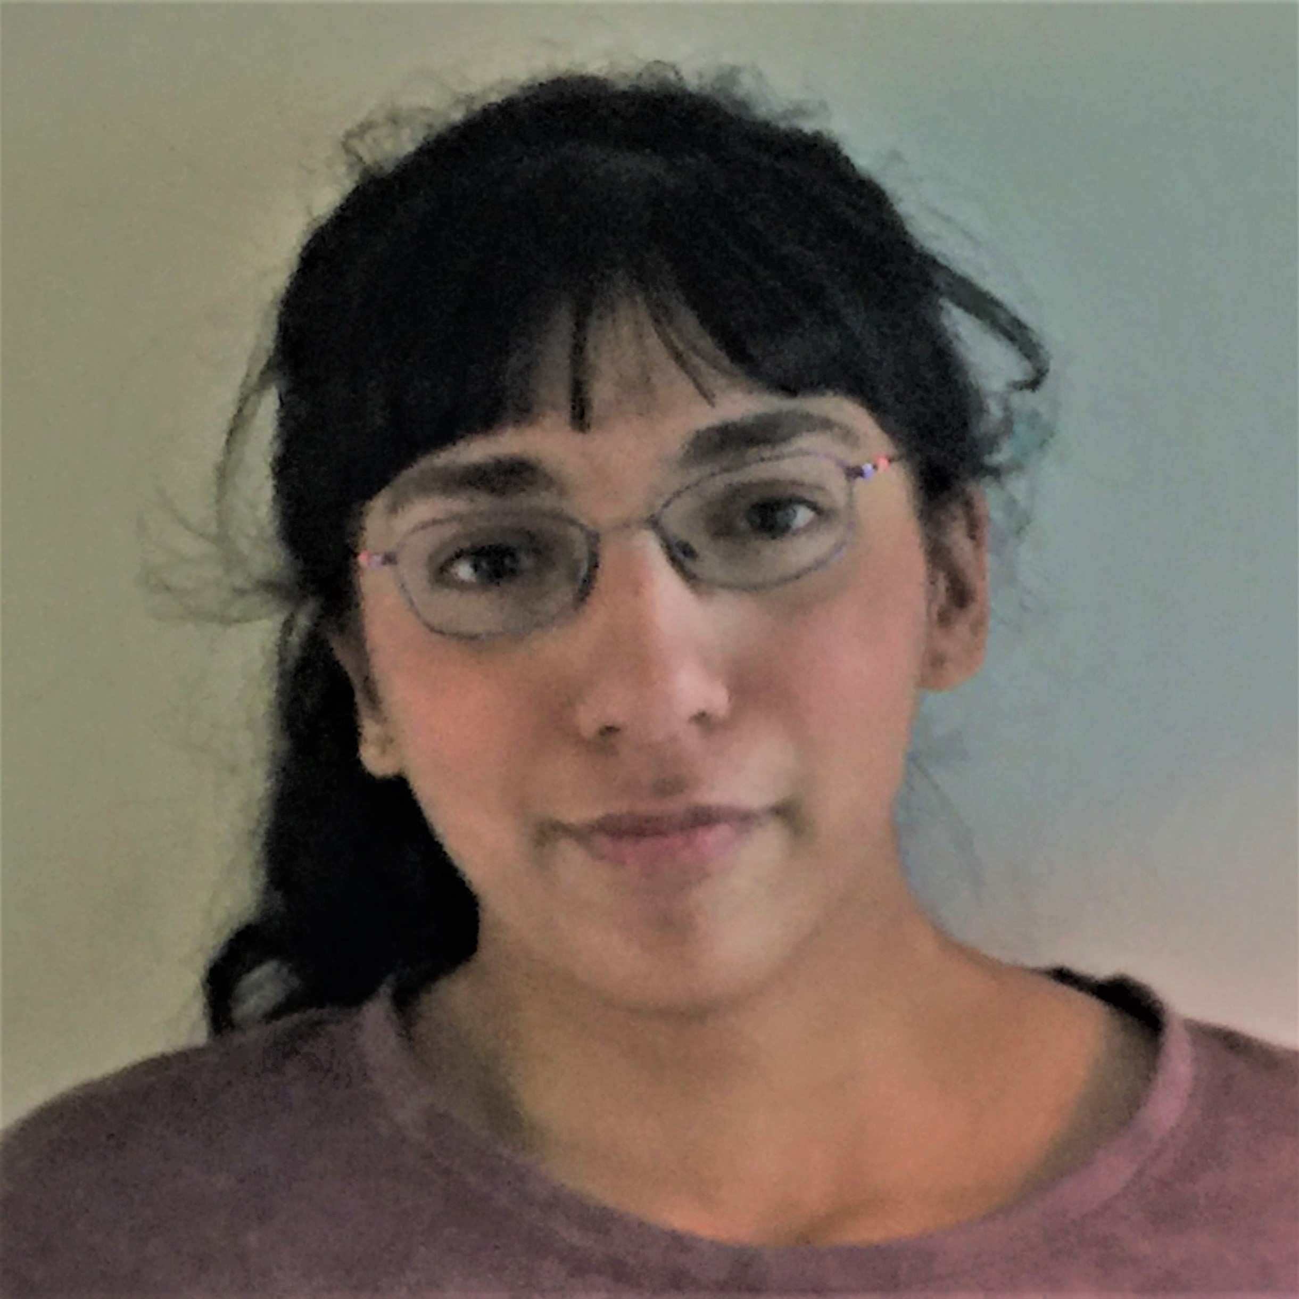
Assigning books
We have 5 books to split among 3 people (Alice, Claris, and Pascal)
Every book goes to exactly one person, but each person could end up with no books (or all of them, or something in between).
1
2
3
4
5

Slide 33
Assigning books
We have 5 books to split among 3 people (Alice, Claris, and Pascal)
Every book goes to exactly one person, but each person could end up with no books (or all of them, or something in between).
Attempt 1: We are choosing subsets!
Alice could get any of the $2^{5}=32$ subsets of books.
Claris could get any of the $2^{5}=32$ subsets of books.
Pascal could get any of the $2^{5}=32$ subsets of books.
The total is the product of the three steps: $32⋅32⋅32=32768$ assignments

Slide 34
Activity: Assigning books
Attempt 1: We are choosing subsets!
Alice could get any of the $2^{5}=32$ subsets of books.
Claris could get any of the $2^{5}=32$ subsets of books.
Pascal could get any of the $2^{5}=32$ subsets of books.
The total is the product of the three steps: $32⋅32⋅32=32768$ assignments
Introduce yourselves!
If you can turn on your video, please do.
If you can’t, please unmute and say hi.
If you can’t do either, please say hi in chat.
Choose someone to share screen, showing this slide
Fill out the Poll Everywhere for Kushal to adjust his explanation Go to pollev.com/cse312su21

Slide 35
Activity: Assigning books
Attempt 1: We are choosing subsets!
Alice could get any of the $2^{5}=32$ subsets of books.
Claris could get any of the $2^{5}=32$ subsets of books.
Pascal could get any of the $2^{5}=32$ subsets of books.
The total is the product of the three steps: $32⋅32⋅32=32768$ assignments
We overcounted!
If Alice gets books 1 and 2, Claris cannot get a subset of all 5 books, she can only get a subset of books {3,4,5}. Finally, Pascal can only be assigned what is leftover after Alice and Claris get their books

Slide 36
Fixing the Assignment!
We could
List out all the options for Alice.
For each of the above options, list out the possible options for Claris and Pascal
Use the Summation rule to combine
OR
We could come at the problem from a different angle.

Slide 37
Fixing the Assignment!
Instead of figuring out which books Alice gets, choose book by book which person they go to.
Step 1: Book 1 has $3$ options
Step 2: Book 2 has $3$ options
$…$
Step 5: Book 5 has $3$ options
The total is the product of the five steps: $3⋅3⋅3⋅3⋅3=3^{5}=243$ assignments

Slide 38
Lesson and Tips
Representation of what we are counting is very important!
Use different methods to double check your solution
Think about counter examples to your own solution

Slide 39
More Practice

Slide 40
Strings
How many strings of length $5$ are there over the alphabet $\{A,B,C,…,Z\}$? (repeated characters allowed)
E.g., LINDY, SALSA, SWING, TANGO, WALTZ
How many binary strings of length $n$ are there?
E.g., $0⋯0,1⋯1,1⋯01,…$

Slide 41
Strings
How many strings of length $5$ are there over the alphabet $\{A,B,C,…,Z\}$? (repeated characters allowed)
E.g., LINDY, SALSA, SWING, TANGO, WALTZ
${26}^{5}$
How many binary strings of length $n$ are there?
E.g., $0⋯0,1⋯1,1⋯01,…$
$2^{n}$

