Slide 1
More Counting
CSE 312 Summer 21
Lecture 2

Slide 2
Announcements
Office hours for this week:
  Kushal: Friday 1 pm – 2pm
Student Information for Office Hours
  https://forms.gle/S5eDFe5bgipgh2MC8
  Just one question – your current time zone
  Syllabus should be up by tonight

Slide 3
Where Are We?
Last Lecture:
  Sum and Product Rules
  Sequential Process
  Representation is important!
Today:
  Permutations and Combinations
  Complementary Counting
  Binomial Theorem

Slide 4

More sequential process practice
How many length 3 sequences are there consisting of distinct elements of $\left\{1,2,3\right\}$?

Slide 5
Pause
Questions in combinatorics are probability are often dense.
A single word can totally change the question.
  Does order matter?
  Are repeats allowed?
  What makes two things ”count the same” or “count as different”?

Slide 6
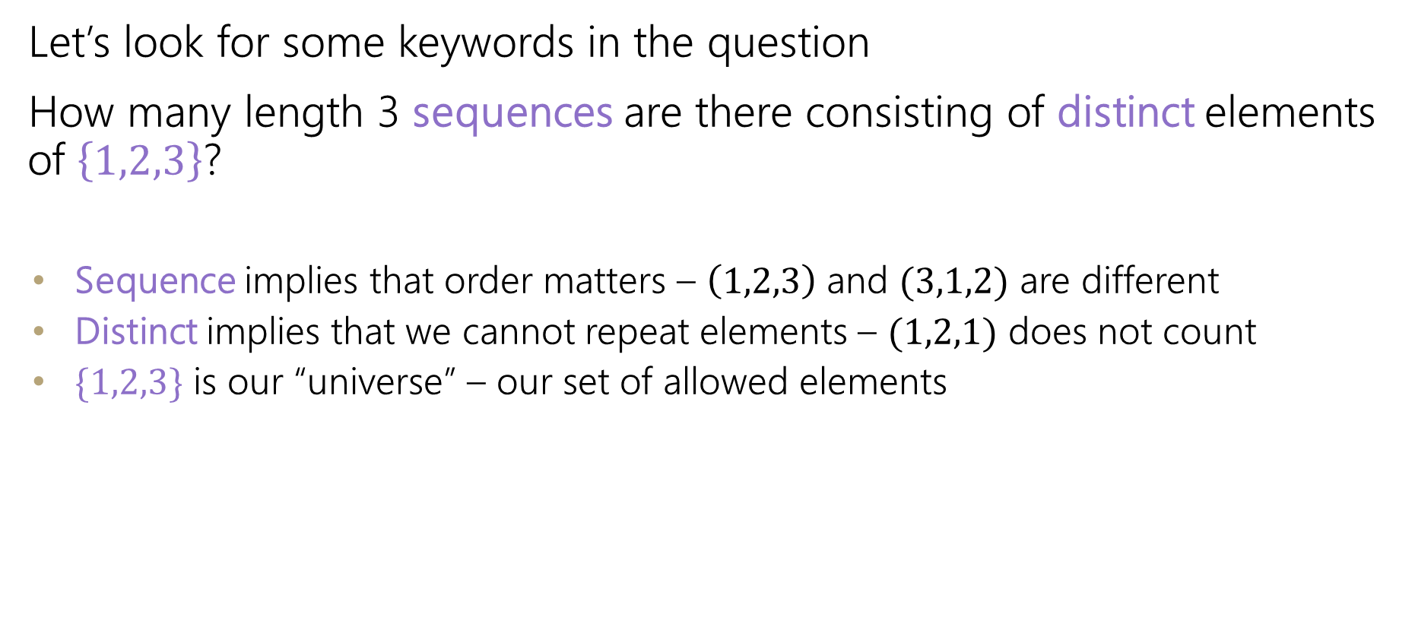
More sequential process practice
Let’s look for some keywords in the question
How many length 3 sequences are there consisting of distinct elements of $\left\{1,2,3\right\}$?
  Sequence implies that order matters – $\left(1,2,3\right)$ and $(3,1,2)$ are different
  Distinct implies that we cannot repeat elements – $(1,2,1)$ does not count
  $\{1,2,3\}$ is our “universe” – our set of allowed elements

Slide 7
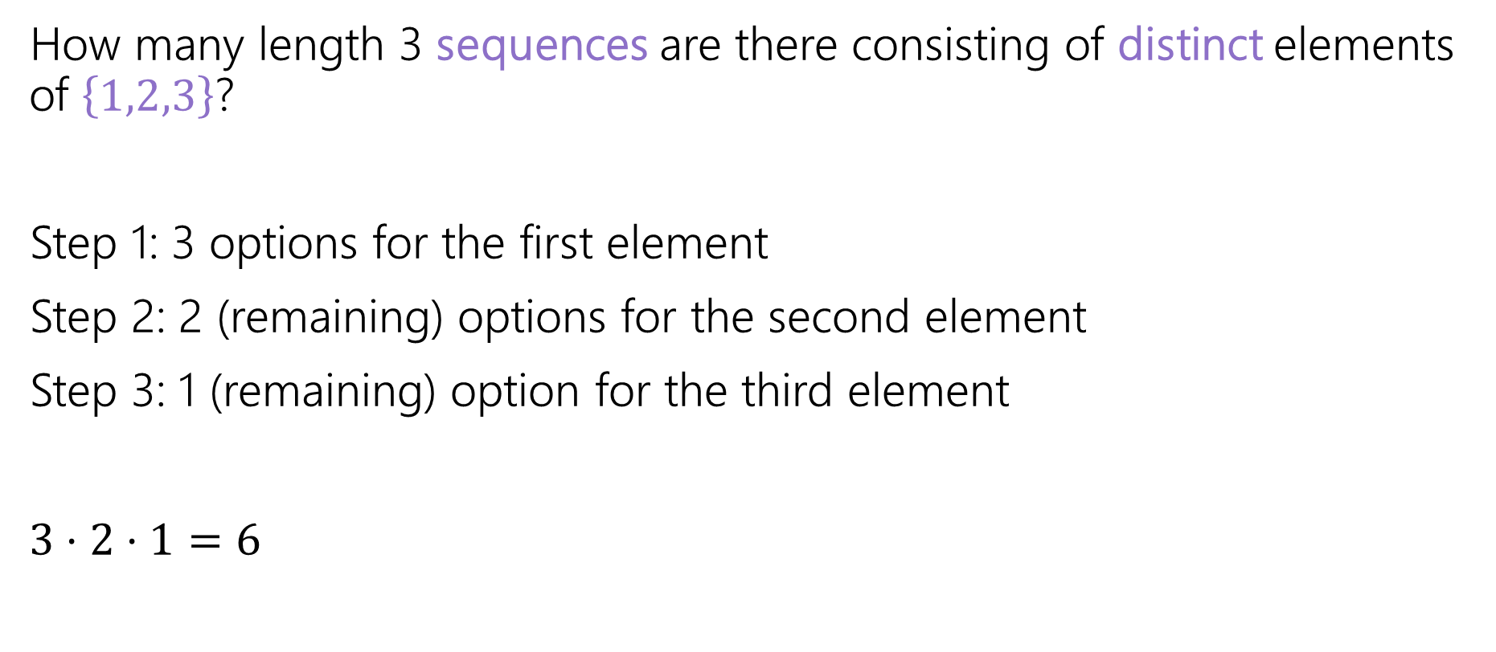
More sequential process practice
How many length 3 sequences are there consisting of distinct elements of $\left\{1,2,3\right\}$?
Step 1: 3 options for the first element
Step 2: 2 (remaining) options for the second element
Step 3: 1 (remaining) option for the third element
$3⋅2⋅1=6$

Slide 8

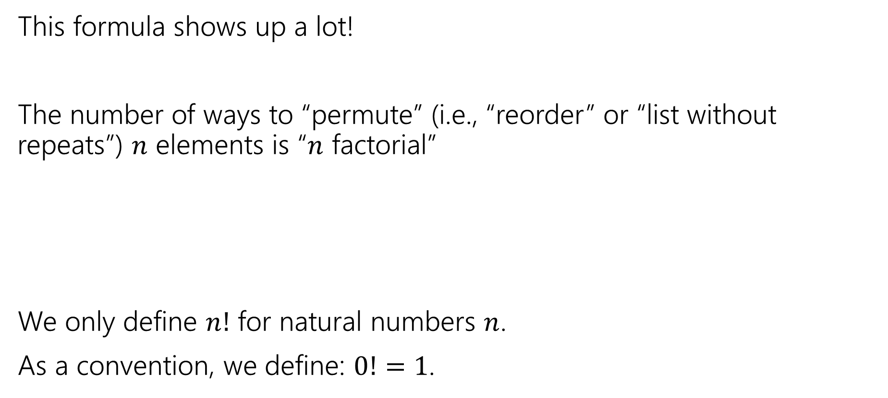
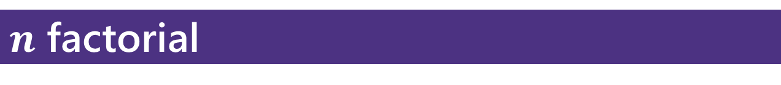
Factorial
This formula shows up a lot!
The number of ways to “permute” (i.e., “reorder” or “list without repeats”) $n$ elements is “$n$ factorial”
We only define $n!$ for natural numbers $n$.
As a convention, we define: $0!=1$.
$$n!=n⋅\left(n−1\right)⋅\left(n−2\right)⋯1$$
$n$ factorial

Slide 9

Distinct Letters
How many strings of length $5$ are there over the alphabet $\{A,B,C,…,Z\}$ where each string does not repeat a letter?
E.g., SWING is allowed but SALSA is not

Slide 10
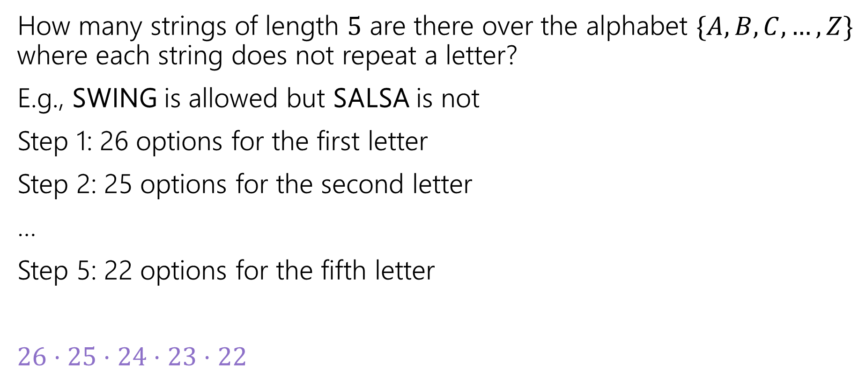
Distinct Letters
How many strings of length $5$ are there over the alphabet $\{A,B,C,…,Z\}$ where each string does not repeat a letter?
E.g., SWING is allowed but SALSA is not
Step 1: 26 options for the first letter
Step 2: 25 options for the second letter
…
Step 5: 22 options for the fifth letter
$26⋅25⋅24⋅23⋅22$

Slide 11
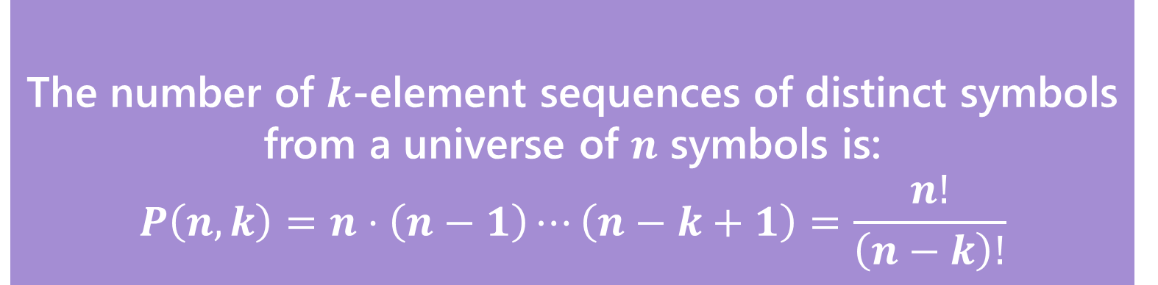
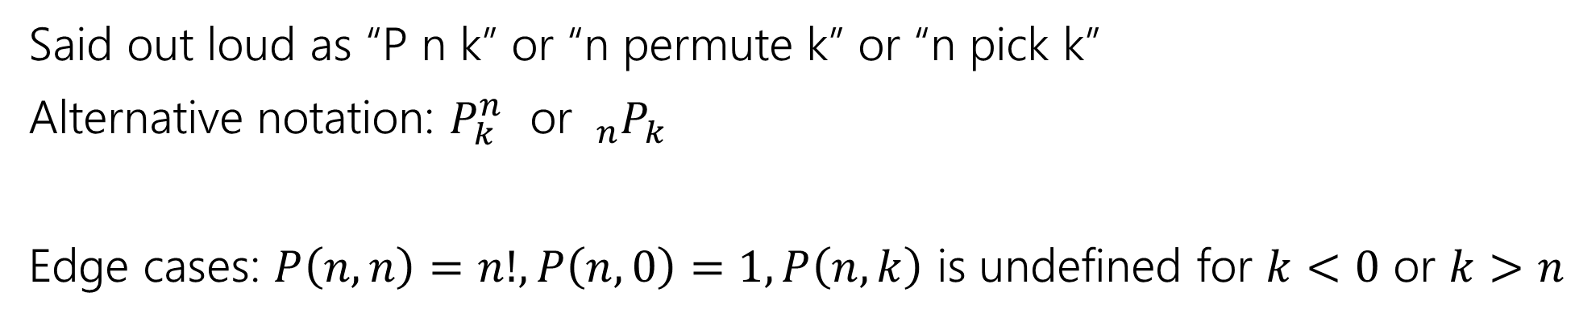
In General
The number of $k$-element sequences of distinct symbols from a universe of $n$ symbols is:
$$P\left(n,k\right)=n⋅\left(n−1\right)⋯\left(n−k+1\right)=\frac{n!}{\left(n−k\right)!}$$
$k$-permutation
Said out loud as “P n k” or “n permute k” or “n pick k”
Alternative notation: $P_{k}^{n}$ or $_{n}P_{k}$
Edge cases: $P\left(n,n\right)=n!, P\left(n,0\right)=1, P\left(n,k\right)$ is undefined for $k<0$ or $k>n$

Slide 12
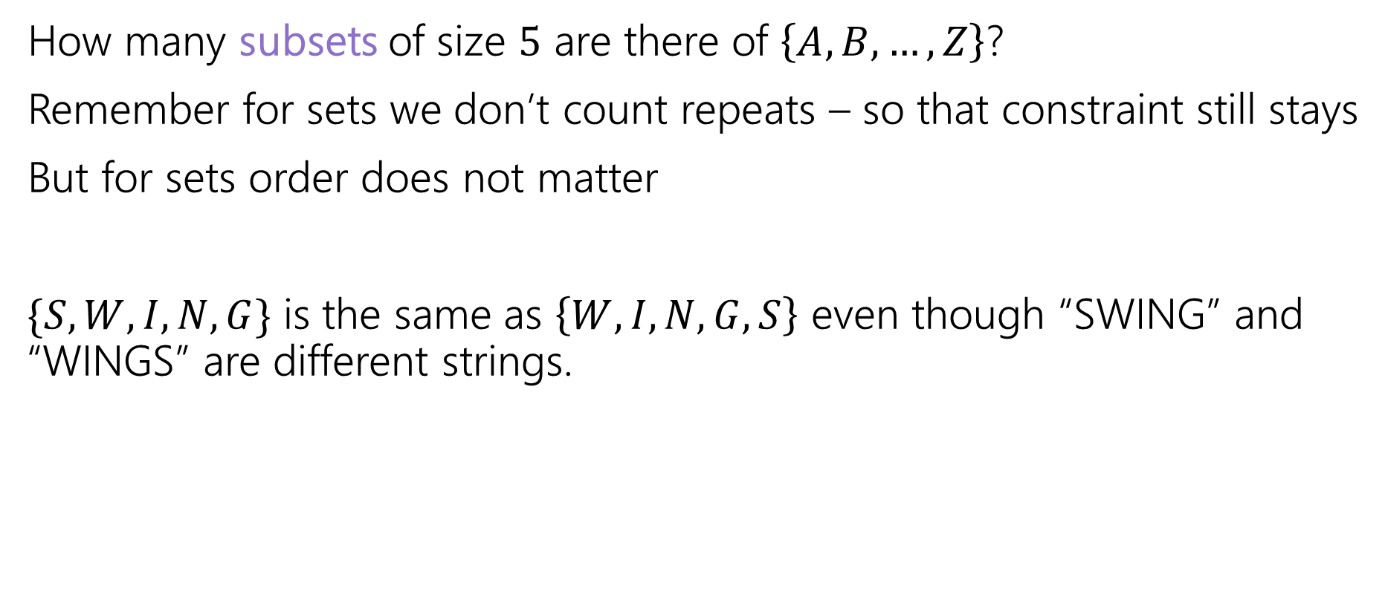
Change it slightly
How many subsets of size $5$ are there of $\left\{A,B,…, Z\right\}$?
Remember for sets we don’t count repeats – so that constraint still stays
But for sets order does not matter
$\{S,W,I,N,G\}$ is the same as $\left\{W,I,N,G,S\right\}$ even though “SWING” and “WINGS” are different strings.

Slide 13
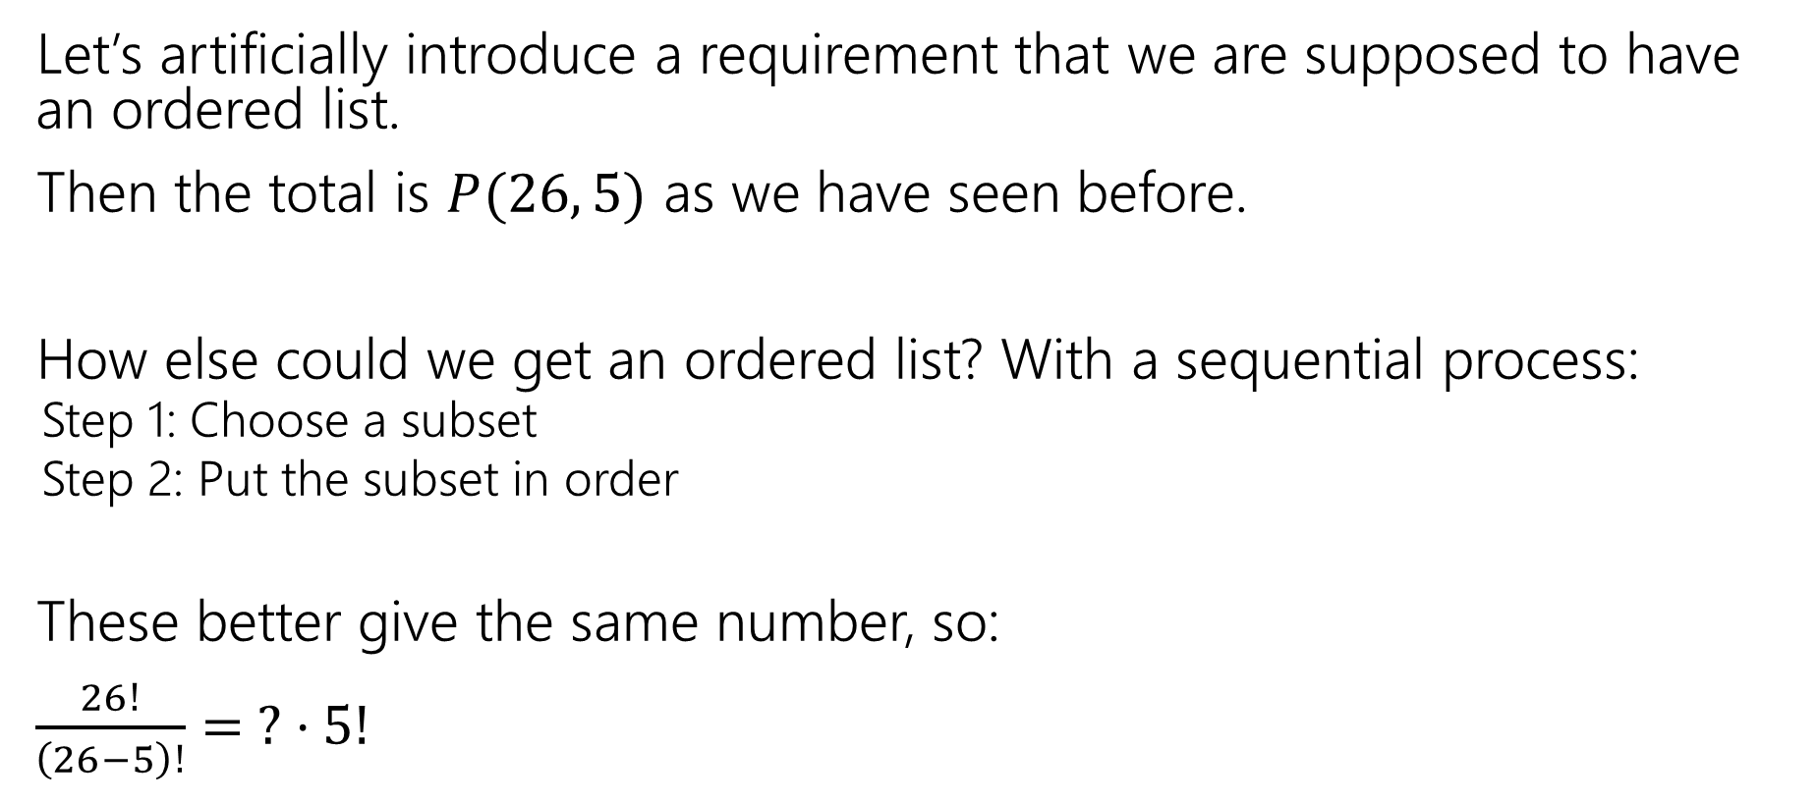
Count two ways
Let’s artificially introduce a requirement that we are supposed to have an ordered list.
Then the total is $P(26, 5)$ as we have seen before.
How else could we get an ordered list? With a sequential process:
  Step 1: Choose a subset
  Step 2: Put the subset in order
These better give the same number, so:
$\frac{26!}{\left(26−5\right)!}= ? ⋅5!$

Slide 14
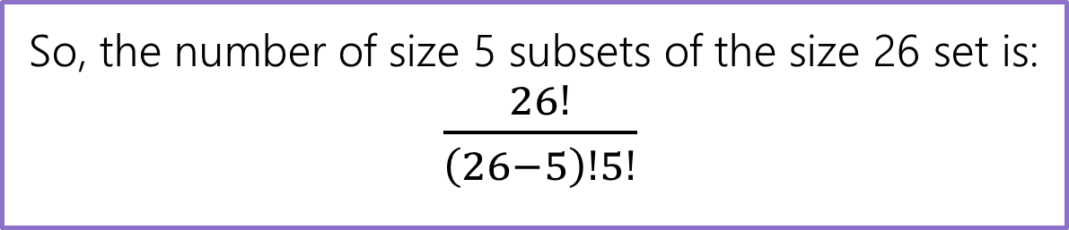
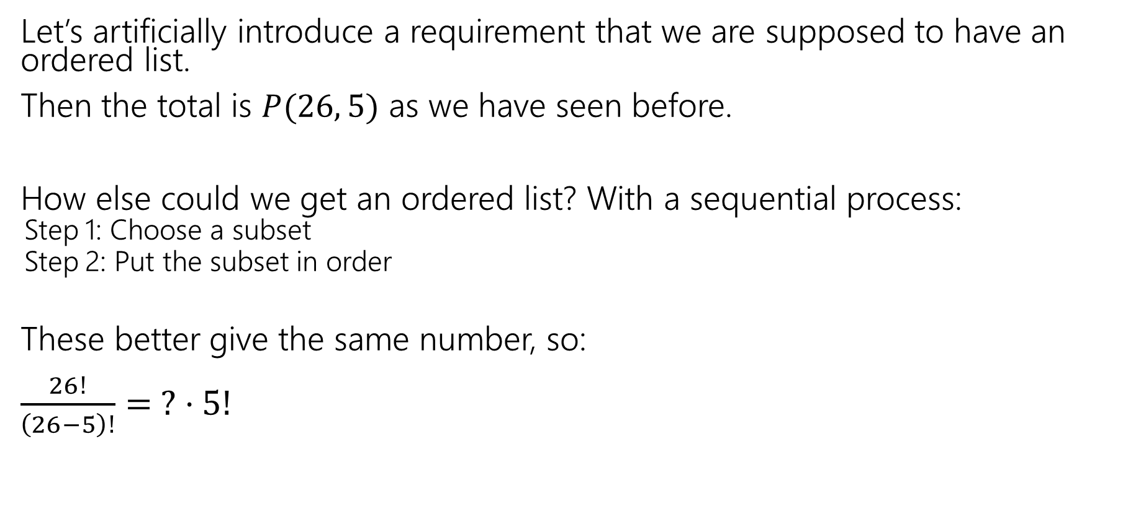
Count two ways
Let’s artificially introduce a requirement that we are supposed to have an ordered list.
Then the total is $P(26, 5)$ as we have seen before.
How else could we get an ordered list? With a sequential process:
  Step 1: Choose a subset
  Step 2: Put the subset in order
These better give the same number, so:
$\frac{26!}{\left(26−5\right)!}= ? ⋅5!$
So, the number of size 5 subsets of the size 26 set is:
$\frac{26!}{\left(26−5\right)!5!}$

Slide 15
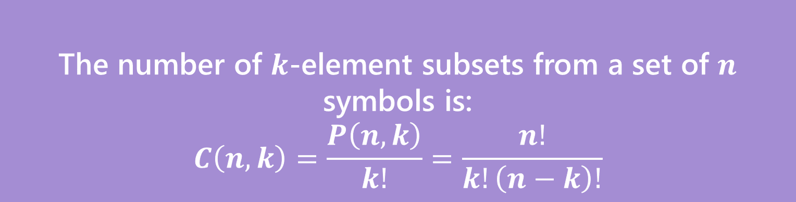
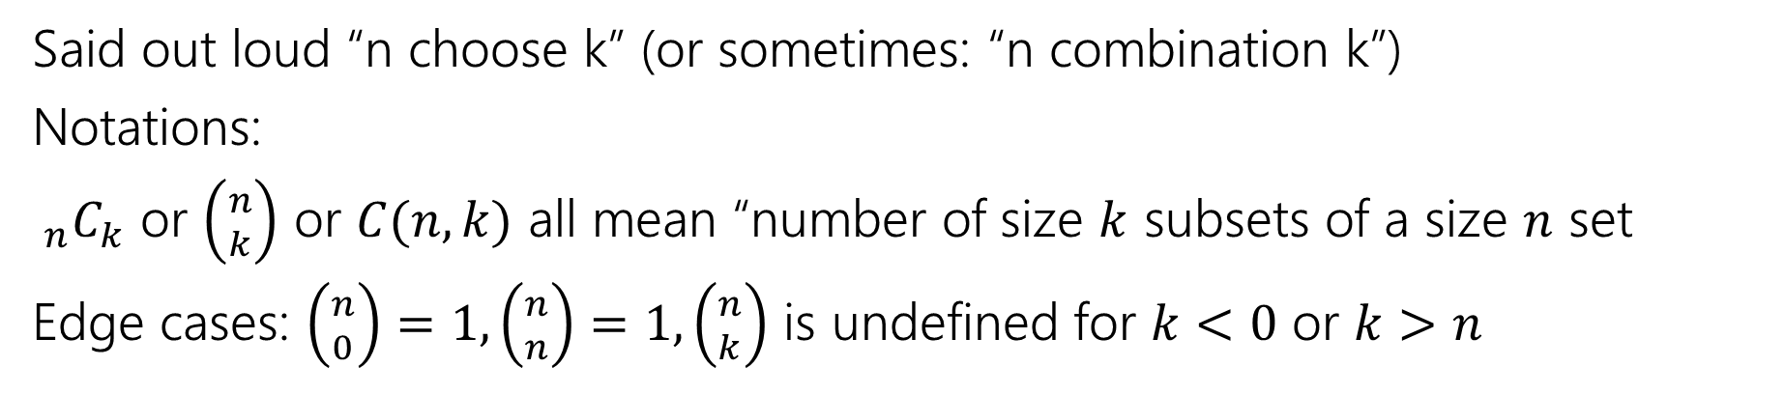
Number of subsets
The number of $k$-element subsets from a set of $n$ symbols is:
$$C\left(n,k\right)=\frac{P\left(n,k\right)}{k!}=\frac{n!}{k!\left(n−k\right)!}$$
$k$-combination
Said out loud “n choose k” (or sometimes: “n combination k”)
Notations:
$_{n}C_{k}$ or $\left({n \atop k}\right)$ or $C(n,k)$ all mean “number of size $k$ subsets of a size $n$ set
Edge cases: $\left({n \atop 0}\right)=1,\left({n \atop n}\right)=1,\left({n \atop k}\right)$ is undefined for $k<0$ or $k>n$

Slide 16
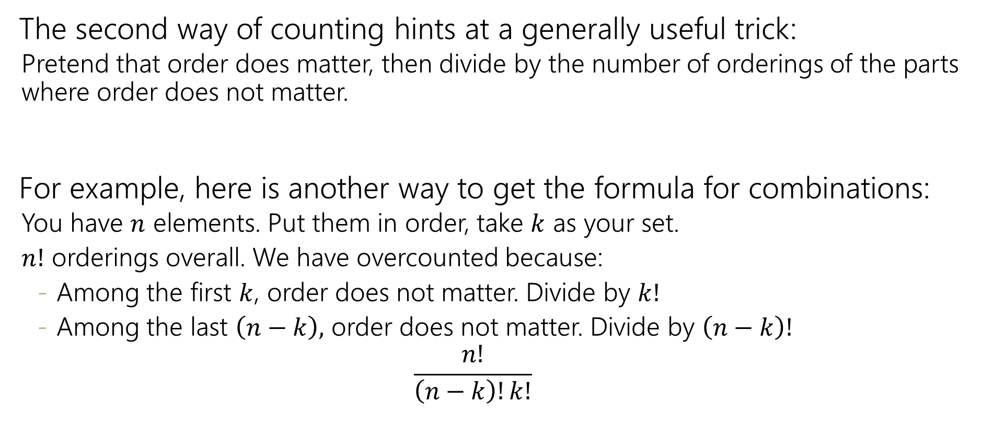
Takeaway
The second way of counting hints at a generally useful trick:
  Pretend that order does matter, then divide by the number of orderings of the parts where order does not matter.
For example, here is another way to get the formula for combinations:
  You have $n$ elements. Put them in order, take $k$ as your set.
  $n!$ orderings overall. We have overcounted because:
    Among the first $k$, order does not matter. Divide by $k!$
    Among the last $\left(n−k\right),$ order does not matter. Divide by $\left(n−k\right)!$
    $$\frac{n!}{\left(n−k\right)!k!}$$

Slide 17
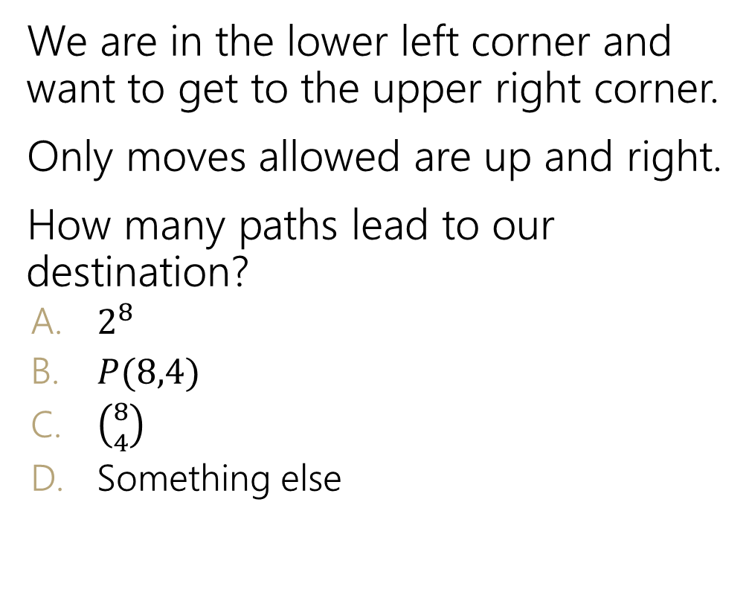
Path Counting
We are in the lower left corner and want to get to the upper right corner.
Only moves allowed are up and right.
How many paths lead to our destination?
  $2^{8}$
  $P(8,4)$
  $\left({8 \atop 4}\right)$
  Something else
Fill out the Poll Everywhere for Kushal to adjust his explanation
Go to pollev.com/cse312su21

Slide 18
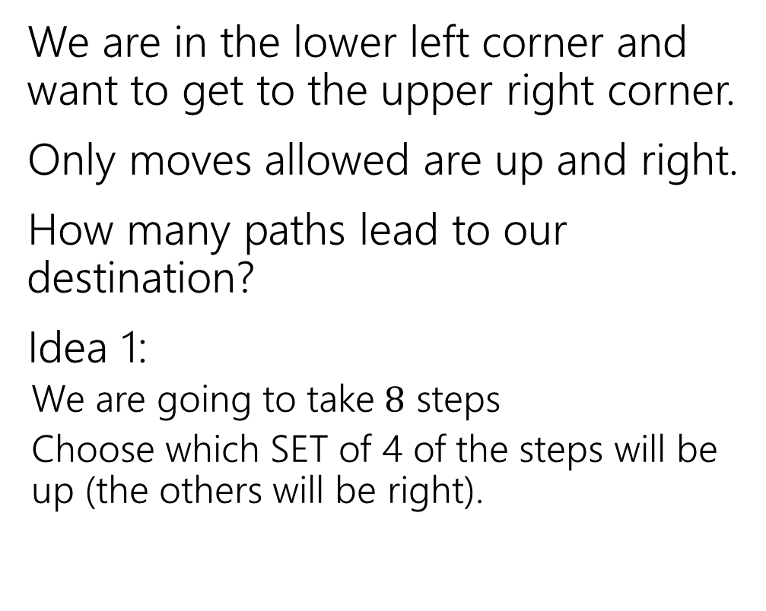
Path Counting
We are in the lower left corner and want to get to the upper right corner.
Only moves allowed are up and right.
How many paths lead to our destination?
Idea 1:
  We are going to take $8$ steps
  Choose which SET of 4 of the steps will be up (the others will be right).

Slide 19
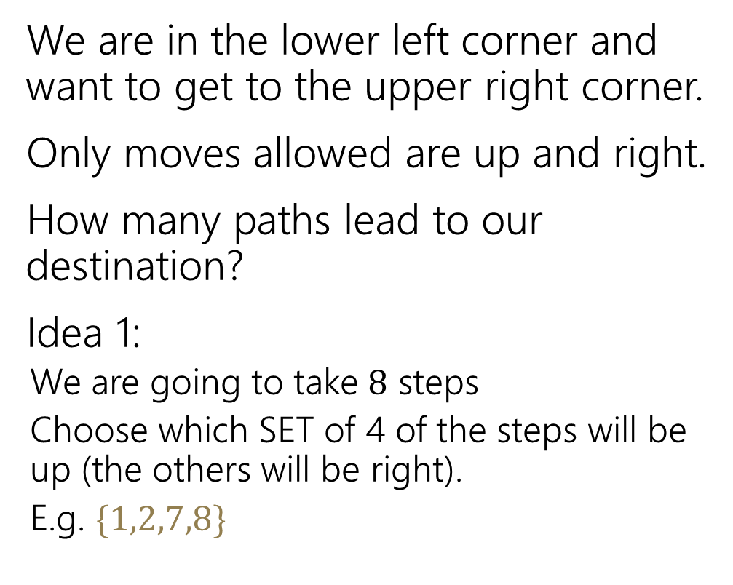
Path Counting
We are in the lower left corner and want to get to the upper right corner.
Only moves allowed are up and right.
How many paths lead to our destination?
Idea 1:
  We are going to take $8$ steps
  Choose which SET of 4 of the steps will be up (the others will be right).
  E.g. $\{1,2,7,8\}$

Slide 20
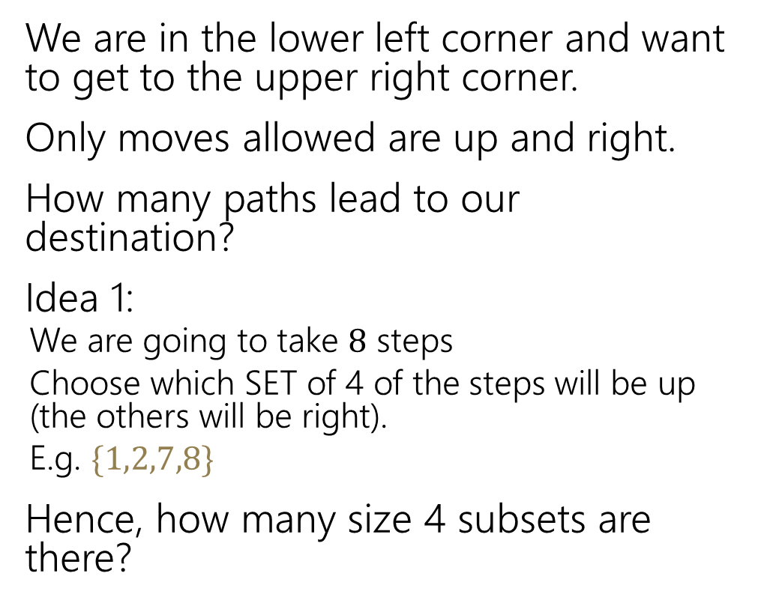
Path Counting
We are in the lower left corner and want to get to the upper right corner.
Only moves allowed are up and right.
How many paths lead to our destination?
Idea 1:
  We are going to take $8$ steps
  Choose which SET of 4 of the steps will be up (the others will be right).
  E.g. $\{1,2,7,8\}$
Hence, how many size 4 subsets are there?

Slide 21
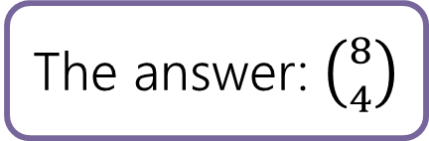
Path Counting
We are in the lower left corner and want to get to the upper right corner.
Only moves allowed are up and right.
How many paths lead to our destination?
Idea 1:
  We are going to take $8$ steps
  Choose which SET of 4 of the steps will be up (the others will be right).
  E.g. $\{1,2,7,8\}$
Hence, how many size 4 subsets are there?
The answer: $\left({8 \atop 4}\right)$

Slide 22
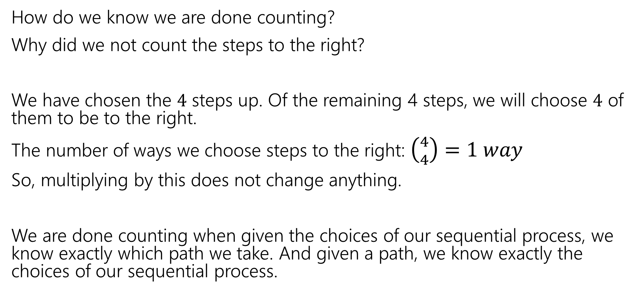
Path Counting
How do we know we are done counting?
Why did we not count the steps to the right?
We have chosen the $4$ steps up. Of the remaining 4 steps, we will choose $4$ of them to be to the right.
The number of ways we choose steps to the right: $\left({4 \atop 4}\right)=1 way$
So, multiplying by this does not change anything.
We are done counting when given the choices of our sequential process, we know exactly which path we take. And given a path, we know exactly the choices of our sequential process.

Slide 23
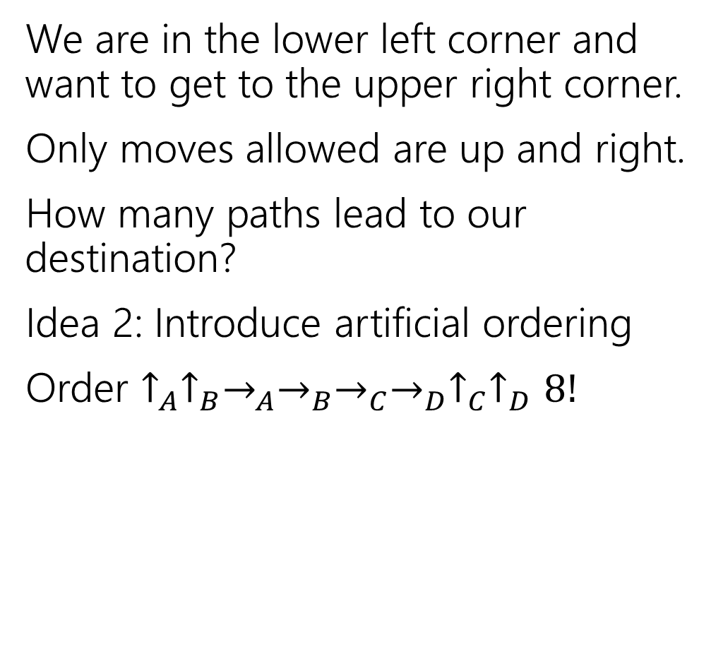
Path Counting
We are in the lower left corner and want to get to the upper right corner.
Only moves allowed are up and right.
How many paths lead to our destination?
Idea 2: Introduce artificial ordering
Order $↑_{A}↑_{B}→_{A}→_{B}→_{C}→_{D}↑_{C}↑_{D}8!$

Slide 24
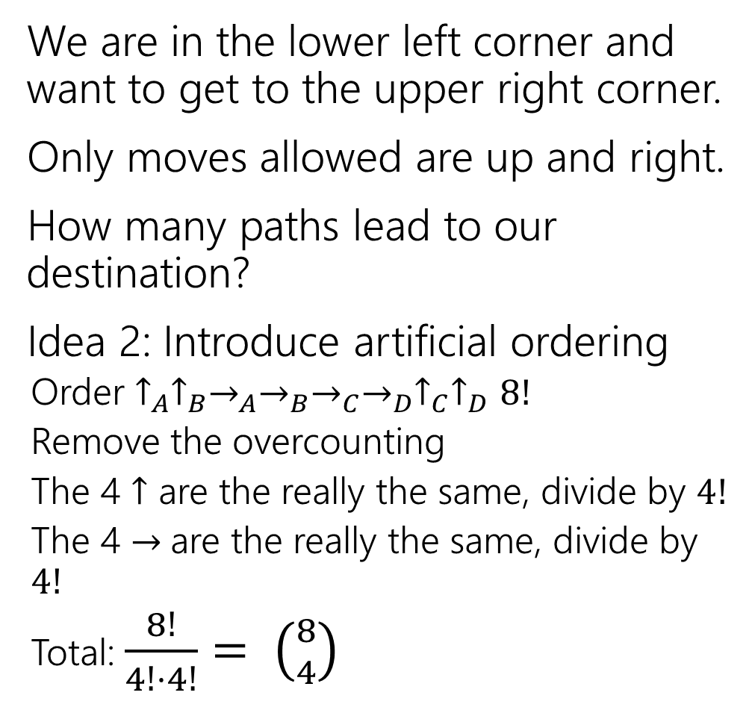
Path Counting
We are in the lower left corner and want to get to the upper right corner.
Only moves allowed are up and right.
How many paths lead to our destination?
Idea 2: Introduce artificial ordering
  Order $↑_{A}↑_{B}→_{A}→_{B}→_{C}→_{D}↑_{C}↑_{D}8!$
  Remove the overcounting
  The 4 $↑$ are the really the same, divide by $4!$
  The 4 $→$are the really the same, divide by $4!$
  Total: $\frac{8!}{4!⋅4!}= \left({8 \atop 4}\right)$

Slide 25
Overcounting
How many anagrams are there of SEATTLE?
Anagram – a rearrangement of letters

Slide 26

Overcounting
How many anagrams are there of SEATTLE?
Anagram – a rearrangement of letters
It is not $7!$
$7!$ counts SEATTLE and SEATTLE (where the Es are switched) as different words.

Slide 27
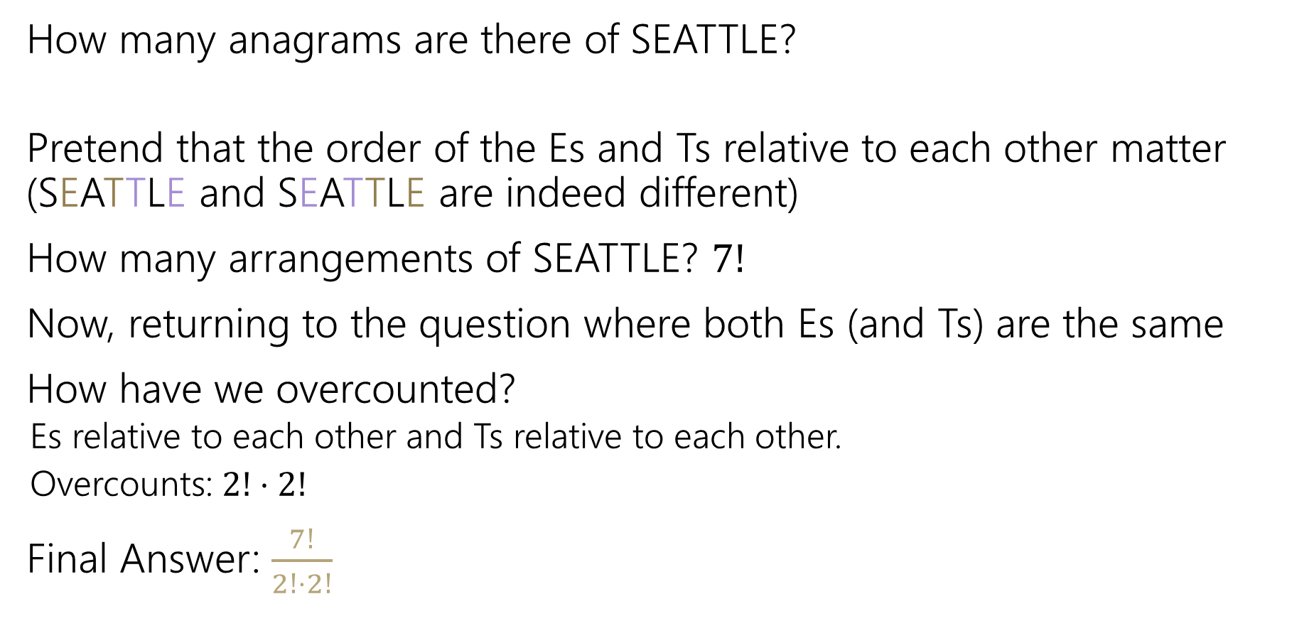
Overcounting
How many anagrams are there of SEATTLE?
Pretend that the order of the Es and Ts relative to each other matter (SEATTLE and SEATTLE are indeed different)
How many arrangements of SEATTLE? $7!$
Now, returning to the question where both Es (and Ts) are the same
How have we overcounted?
  Es relative to each other and Ts relative to each other.
  Overcounts: $2!⋅2!$
Final Answer: $\frac{7!}{2!⋅2!}$

Slide 28
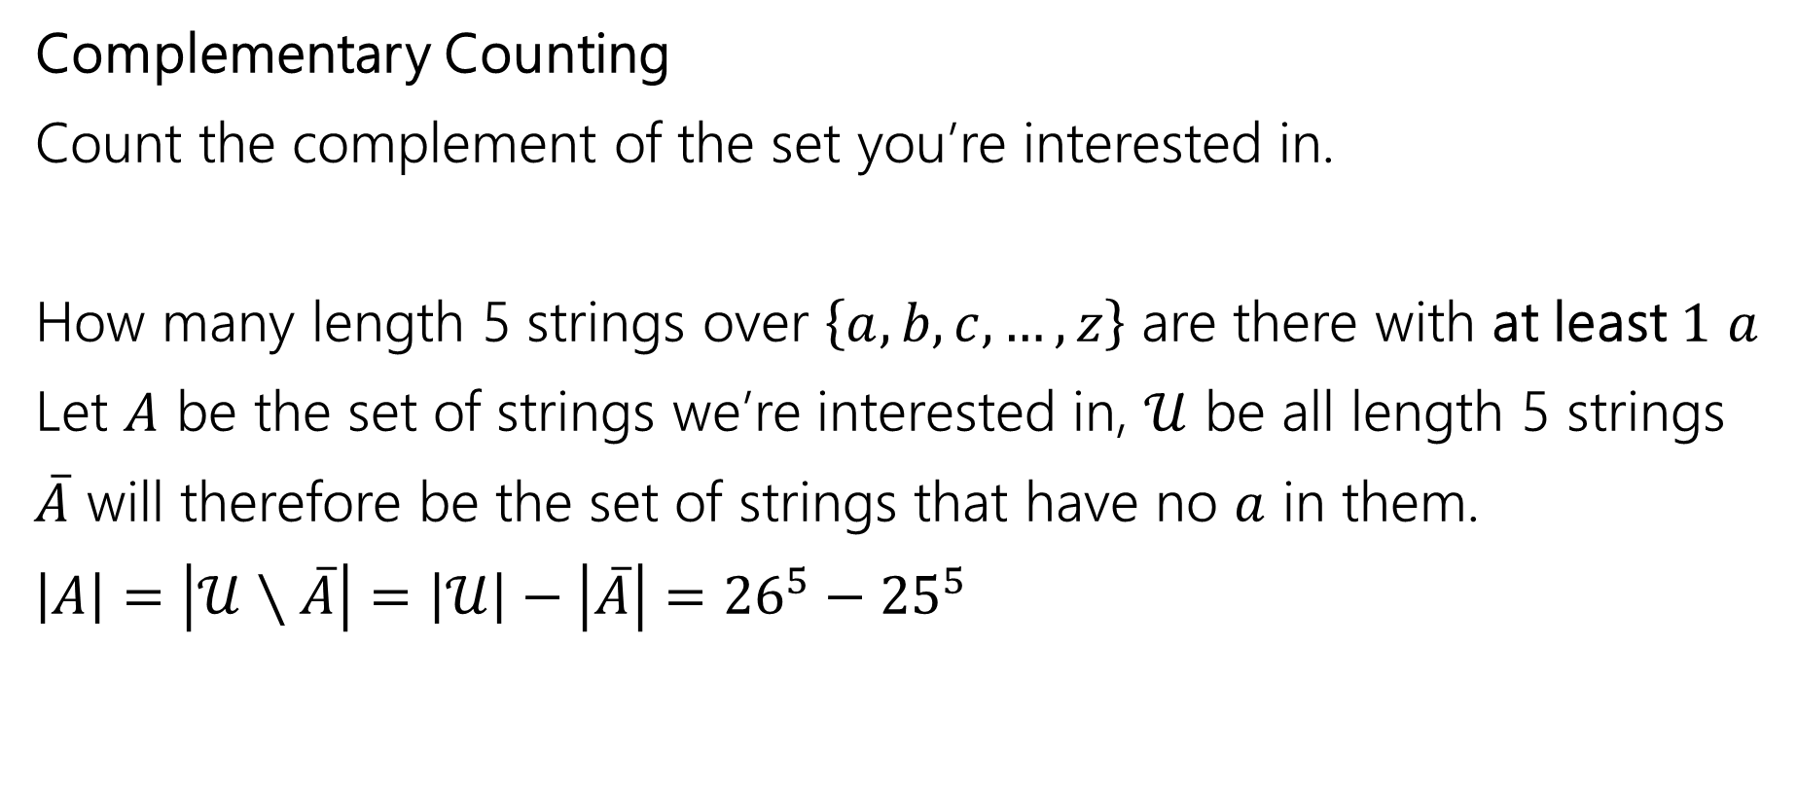
One More Counting Technique
Complementary Counting
Count the complement of the set you’re interested in.
How many length 5 strings over $\left\{a,b,c,…,z\right\}$ are there with at least $1$ $a$
Let $A$ be the set of strings we’re interested in, $𝒰$ be all length 5 strings
$\overline{A}$ will therefore be the set of strings that have no $a$ in them.
$\left|A\right|=\left|𝒰∖\overline{A}\right|=\left|𝒰\right|−\left|\overline{A}\right|={26}^{5}−{25}^{5}$

Slide 29
Takeaways
Formulas for factorial, permutations, and combinations.
A useful trick for counting is to pretend that order matters, then account for the overcounting at the end – dividing the repetitions.
When you are trying to prove facts about counting (more in the appendix), try to have each side of the equation count the same thing.
  It will be much more intuitive and fun than churning through complex algebra.

Slide 30
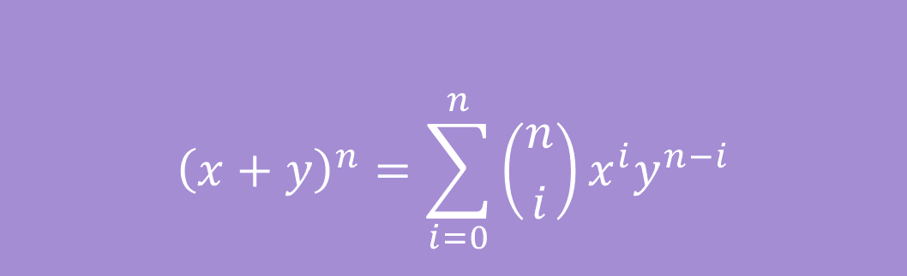

Binomial Theorem
In high school you probably memorized
${\left(x+y\right)}^{2}=x^{2}+2xy+y^{2}$
And ${\left(x+y\right)}^{3}=x^{3}+3x^{2}y+3xy^{2}+y^{3}$
The Binomial Theorem gives us the equation for every power $n$:
$${\left(x+y\right)}^{n}=\sum_{i=0}^{n}{\left({n \atop i}\right)x^{i}y^{n−i}}$$
The Binomial Theorem

Slide 31

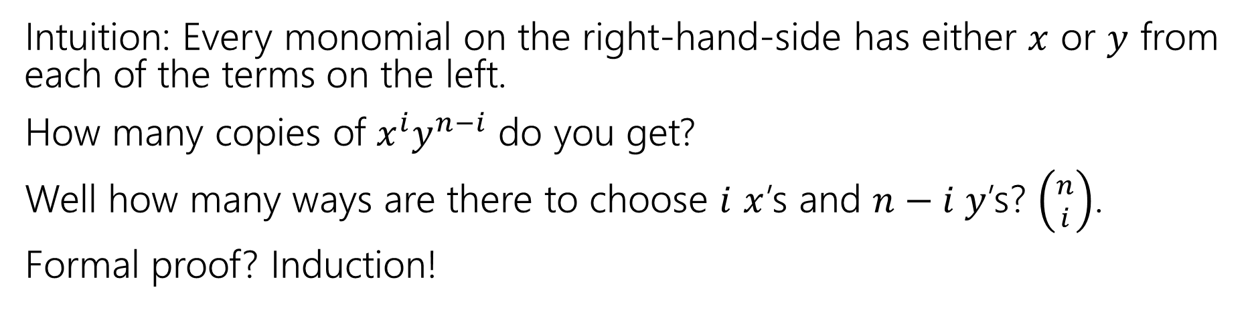
Some intuition
$${\left(x+y\right)}^{n}=\sum_{i=0}^{n}{\left({n \atop i}\right)x^{i}y^{n−i}}$$
The Binomial Theorem
Intuition: Every monomial on the right-hand-side has either $x$ or $y$ from each of the terms on the left.
How many copies of $x^{i}y^{n−i}$ do you get?
Well how many ways are there to choose $i$ $x$’s and $n−i y$’s? $\left({n \atop i}\right)$.
Formal proof? Induction!

Slide 32
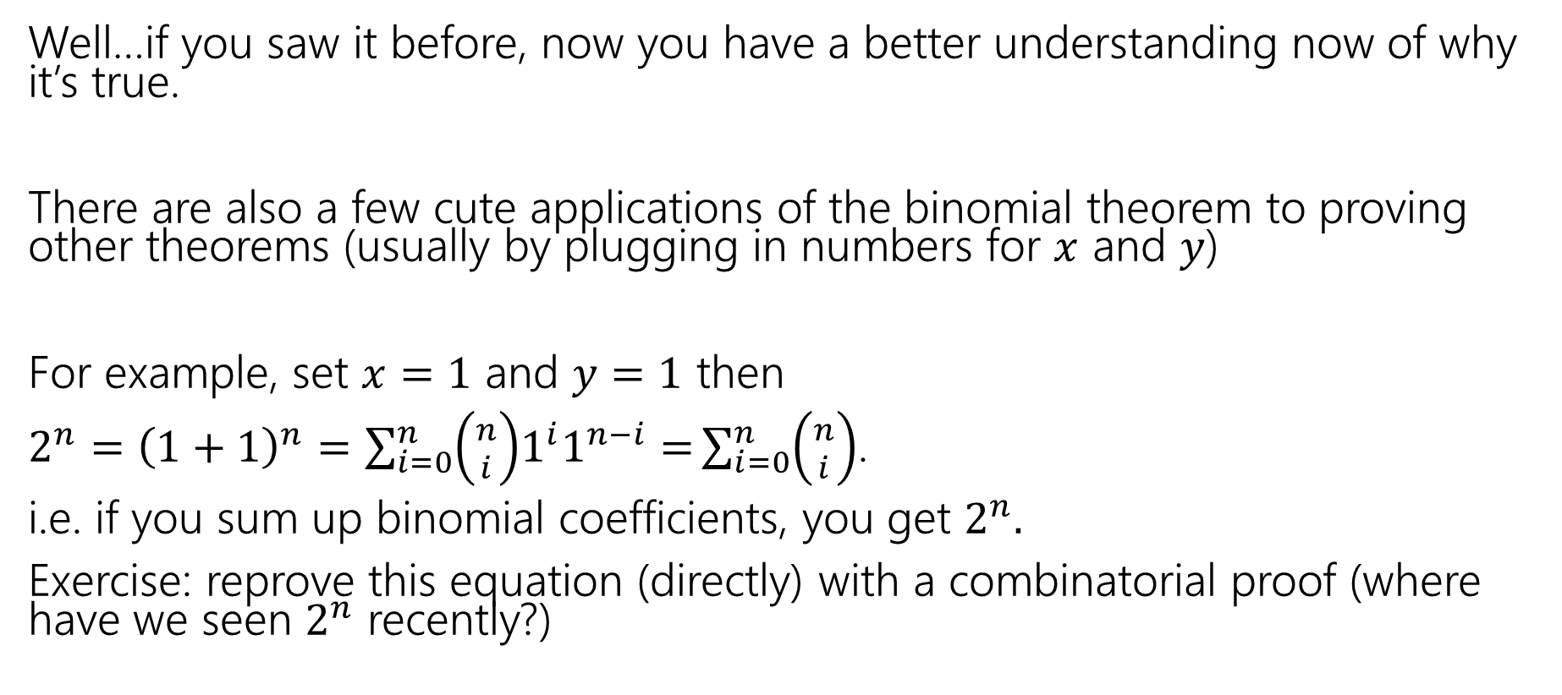
So What?
Well…if you saw it before, now you have a better understanding now of why it’s true.
There are also a few cute applications of the binomial theorem to proving other theorems (usually by plugging in numbers for $x$ and $y$)
For example, set $x=1$ and $y=1$ then
$2^{n}={\left(1+1\right)}^{n}=\sum_{i=0}^{n}{\left({n \atop i}\right)1^{i}1^{n−i}=}\sum_{i=0}^{n}{\left({n \atop i}\right)}$.
i.e. if you sum up binomial coefficients, you get $2^{n}.$
Exercise: reprove this equation (directly) with a combinatorial proof (where have we seen $2^{n}$ recently?)

Slide 33
Appendix: Combination Facts

Slide 34

Some Facts about combinations
Symmetry of combinations: $\left({n \atop k}\right)=\left({n \atop n−k}\right)$
Pascal’s Rule: $\left({n \atop k}\right)=\left({n−1 \atop k−1}\right)+\left({n−1 \atop k}\right)$

Slide 35

Two Proofs of Symmetry
Proof 1: By algebra
$\left({n \atop k}\right)=\frac{n!}{k!\left(n−k\right)!}$
$=\frac{n!}{\left(n−k\right)!k!}$
$=\left({n \atop n−k}\right)$
Definition of Combination
Algebra (commutativity of multiplication)
Definition of Combination

Slide 36
Two Proofs of Symmetry
Wasn’t that a great proof.
Airtight. No disputing it.
Got to say “commutativity of multiplication.”
But…do you know why? Can you feel why it’s true?

Slide 37
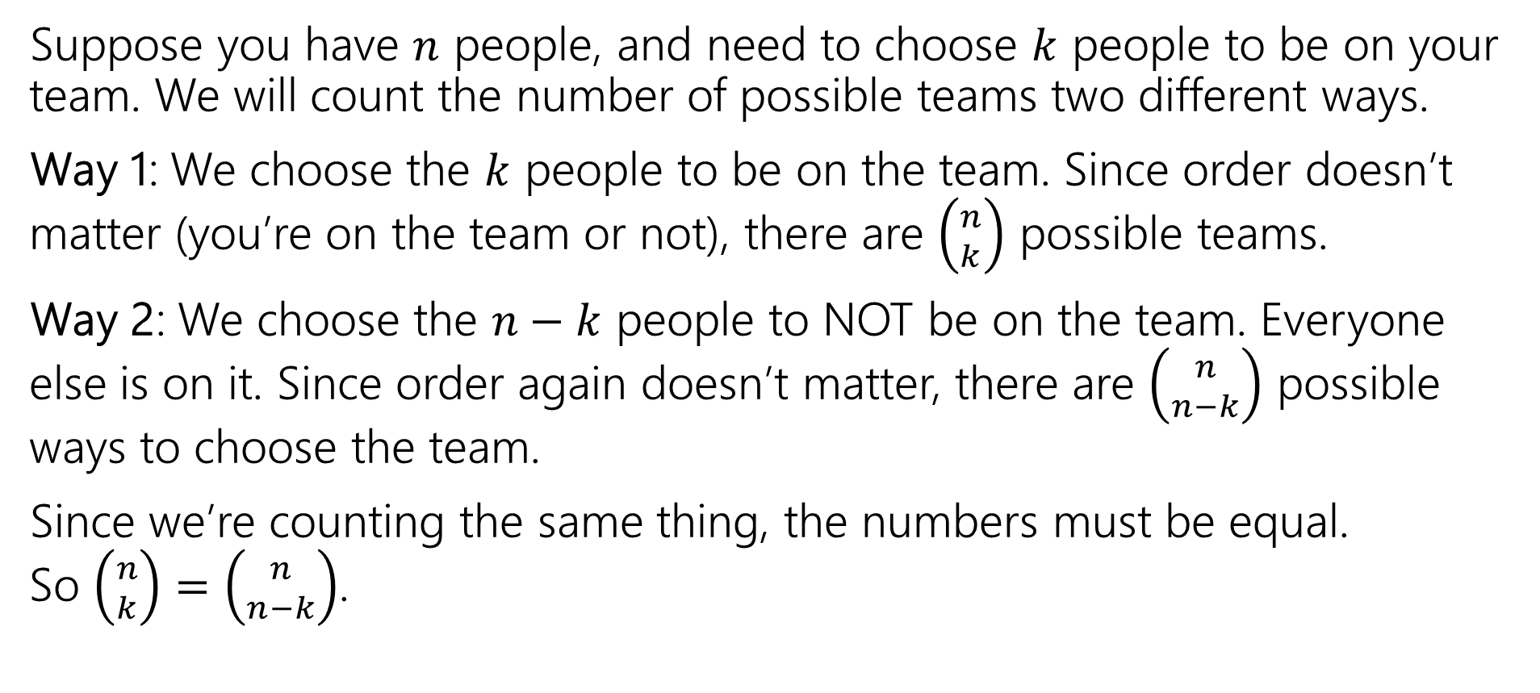
Two Proofs of Symmetry
Suppose you have $n$ people, and need to choose $k$ people to be on your team. We will count the number of possible teams two different ways.
Way 1: We choose the $k$ people to be on the team. Since order doesn’t matter (you’re on the team or not), there are $\left({n \atop k}\right)$ possible teams.
Way 2: We choose the $n−k$ people to NOT be on the team. Everyone else is on it. Since order again doesn’t matter, there are $\left({n \atop n−k}\right)$ possible ways to choose the team.
Since we’re counting the same thing, the numbers must be equal.
So $\left({n \atop k}\right)=\left({n \atop n−k}\right)$.

Slide 38
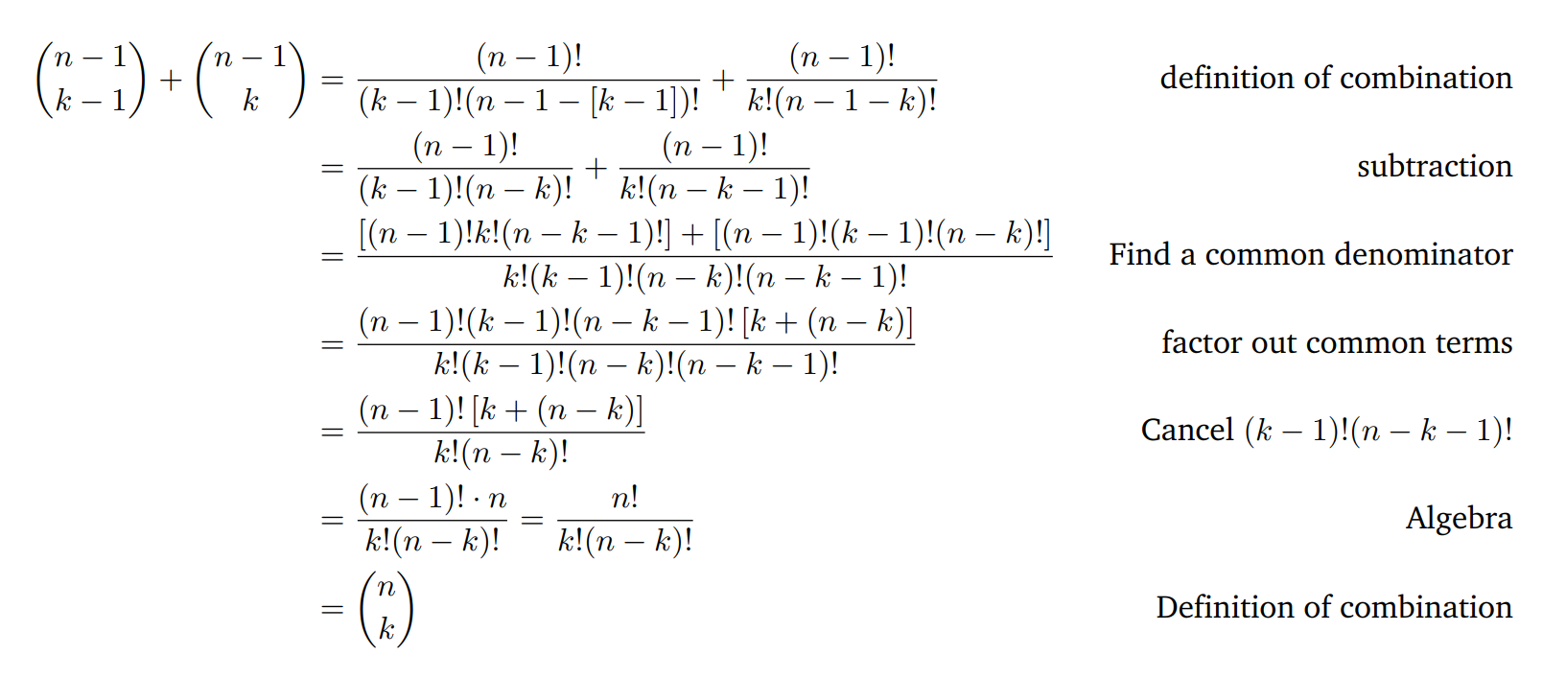

Pascal’s Rule: $\left({n \atop k}\right)=\left({n−1 \atop k−1}\right)+\left({n−1 \atop k}\right)$

Slide 39

Pascal’s Rule: $\left({n \atop k}\right)=\left({n−1 \atop k−1}\right)+\left({n−1 \atop k}\right)$
You and $n−1$ other people are trying out for a $k$ person team. How many possible teams are there?

Slide 40
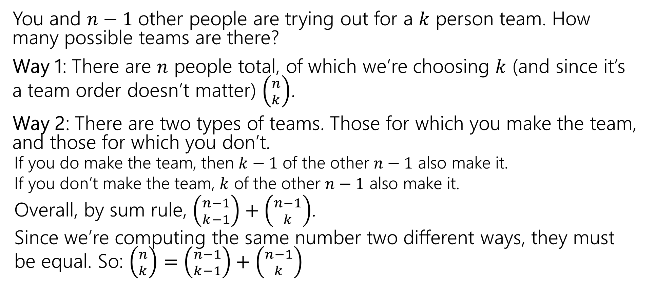
Pascal’s Rule: $\left({n \atop k}\right)=\left({n−1 \atop k−1}\right)+\left({n−1 \atop k}\right)$
You and $n−1$ other people are trying out for a $k$ person team. How many possible teams are there?
Way 1: There are $n$ people total, of which we’re choosing $k$ (and since it’s a team order doesn’t matter) $\left({n \atop k}\right)$.
Way 2: There are two types of teams. Those for which you make the team, and those for which you don’t.
  If you do make the team, then $k−1$ of the other $n−1$ also make it.
  If you don’t make the team, $k$ of the other $n−1$ also make it.
  Overall, by sum rule, $\left({n−1 \atop k−1}\right)+\left({n−1 \atop k}\right)$.
  Since we’re computing the same number two different ways, they must be equal. So: $\left({n \atop k}\right)=\left({n−1 \atop k−1}\right)+\left({n−1 \atop k}\right)$

Slide 41
More Practice

Slide 42
Books, revisited
Remember the books problem from lecture 1? Books 1,2,3,4,5 need to be assigned to Alice, Claris, and Pascal (each book to exactly one person).
Now that we know combinations, try a sequential process approach. It won’t be as nice as the change of perspective, but we can make it work.
Break into cases based on how many books Alice gets, use the sum rule to combine.

Slide 43
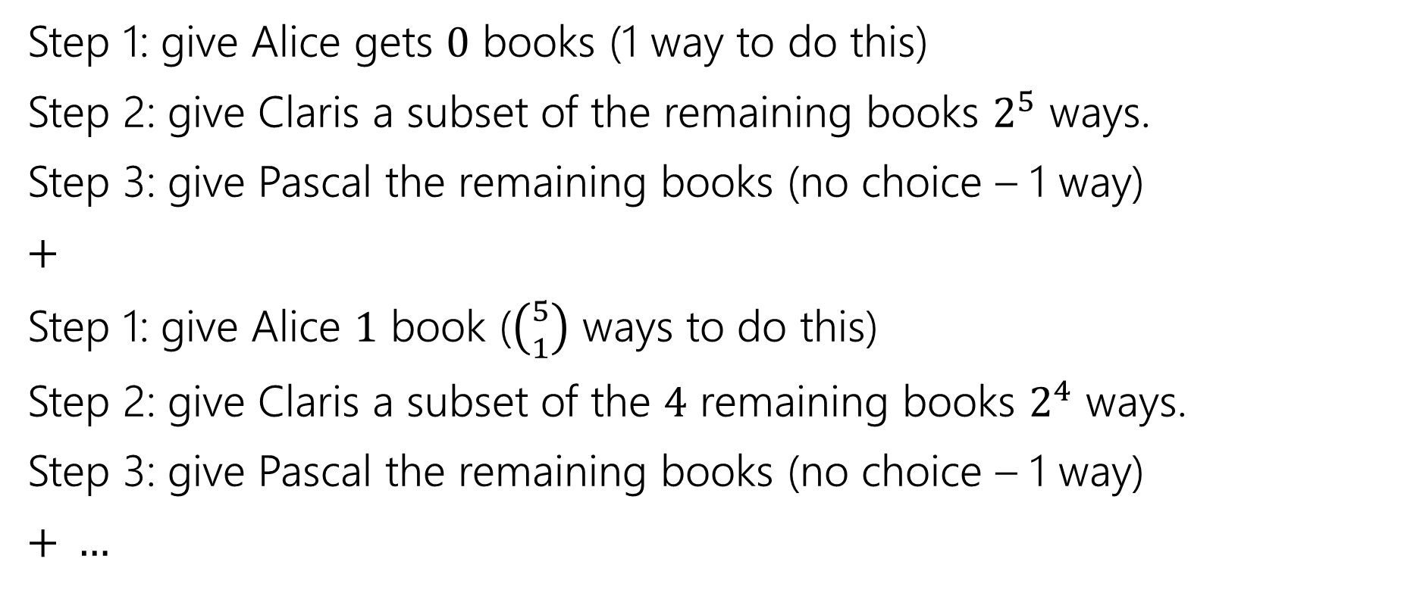
Books, revisited
Step 1: give Alice gets $0$ books (1 way to do this)
Step 2: give Claris a subset of the remaining books $2^{5}$ ways.
Step 3: give Pascal the remaining books (no choice – 1 way)
$+$
Step 1: give Alice $1$ book ($\left({5 \atop 1}\right)$ ways to do this)
Step 2: give Claris a subset of the $4$ remaining books $2^{4}$ ways.
Step 3: give Pascal the remaining books (no choice – 1 way)
$+ …$

Slide 44

Books, revisited
Add all the options together
$1⋅2^{5}⋅1+\left({5 \atop 1}\right)⋅2^{4}⋅1+\left({5 \atop 2}\right)⋅2^{3}⋅1+\left({5 \atop 3}\right)⋅2^{2}⋅1+\left({5 \atop 4}\right)⋅2^{1}⋅1+\left({5 \atop 5}\right)⋅2^{0}⋅1$
If you plug and chug, you’ll get the number we got last time. It took quite a bit of work, but we got there!

