Slide 1
Maximum Likelihood Estimation
CSE 312 Summer 21
Lecture 21

Slide 2
Important Dates!
Real World 2 – Wednesday, Aug 11
Review Summary 3 – Friday, Aug 13
Problem Set 7 – Monday, Aug 16
Final Released – Friday, Aug 13
Final Due & Key Released – Tuesday, Aug 17

Slide 3
Asking The Opposite Question
So far:
Give you rules for an experiment.
Give you the event/outcome we’re interested in.
You calculate/estimate/bound what the probability is.
Today:
Give you some of the rules of the experiment.
Tell you what happened.
You estimate what the rest of the rules of the experiment were.

Slide 4
Example
Suppose you flip a coin independently 10 times, and you see
HTTTHHTHHH
What is your estimate of the probability the coin comes up heads?
$2/5$
$1/2$
$3/5$
$55/100$
Fill out the poll everywhere so Kushal knows how long to explain
Go to pollev.com/cse312su21

Slide 5
Maximum Likelihood Estimation
Idea: we got the results we got.
High probability events happen more often than low probability events.
So, guess the rules that maximize the probability of the events we saw (relative to other choices of the rules).
Since that event happened, might as well guess the set of rules for which that event was most likely.

Slide 6
Maximum Likelihood Estimation
Formally, we are trying to estimate a parameter of the experiment (here: the probability of a coin flip being heads).
The likelihood of an event $E$ given a parameter $θ$ is
$ℒ(E;θ)$ is $ℙ(E)$ when the experiment is run with $θ$
We’ll use the notation $ℙ(E;θ)$ for probability when run with parameter $θ$ where the semicolon means “extra rules” rather than conditioning
We will choose $\hat{θ}={argmax}_{θ} ℒ(E;θ)$
$argmax$is the argument that produces the maximum so the $θ$ that causes $ℒ(E;θ)$ to be maximized.

Slide 7
Notation comparison
$ℙ(X|Y)$ probability of $X,$ conditioned on the event $Y$having happened ($Y$ is a subset of the sample space)
$ℙ(X;θ)$ probability of $X$, where to properly define our probability space we need to know the extra piece of information $θ.$ Since $θ$ isn’t an event, this is not conditioning
$ℒ(X;θ)$ the likelihood of event $X,$given that an experiment was run with parameter $θ$. Likelihoods don’t have all the properties we associate with probabilities (e.g. they don’t all sum up to 1) and this isn’t conditioning on an event ($θ$ is a parameter/rule of how the event could be generated).

Slide 8
MLE
The maximum likelihood estimator of the parameter $θ$is:
$$\hat{θ}={argmax}_{θ} ℒ(E;θ)$$
Maximum Likelihood Estimator
$θ$ is a variable, $\hat{θ}$is a number (or formula given the event).
We’ll also use the notation ${\hat{θ}}_{MLE}$ if we want to emphasize how we found this estimator.

Slide 9
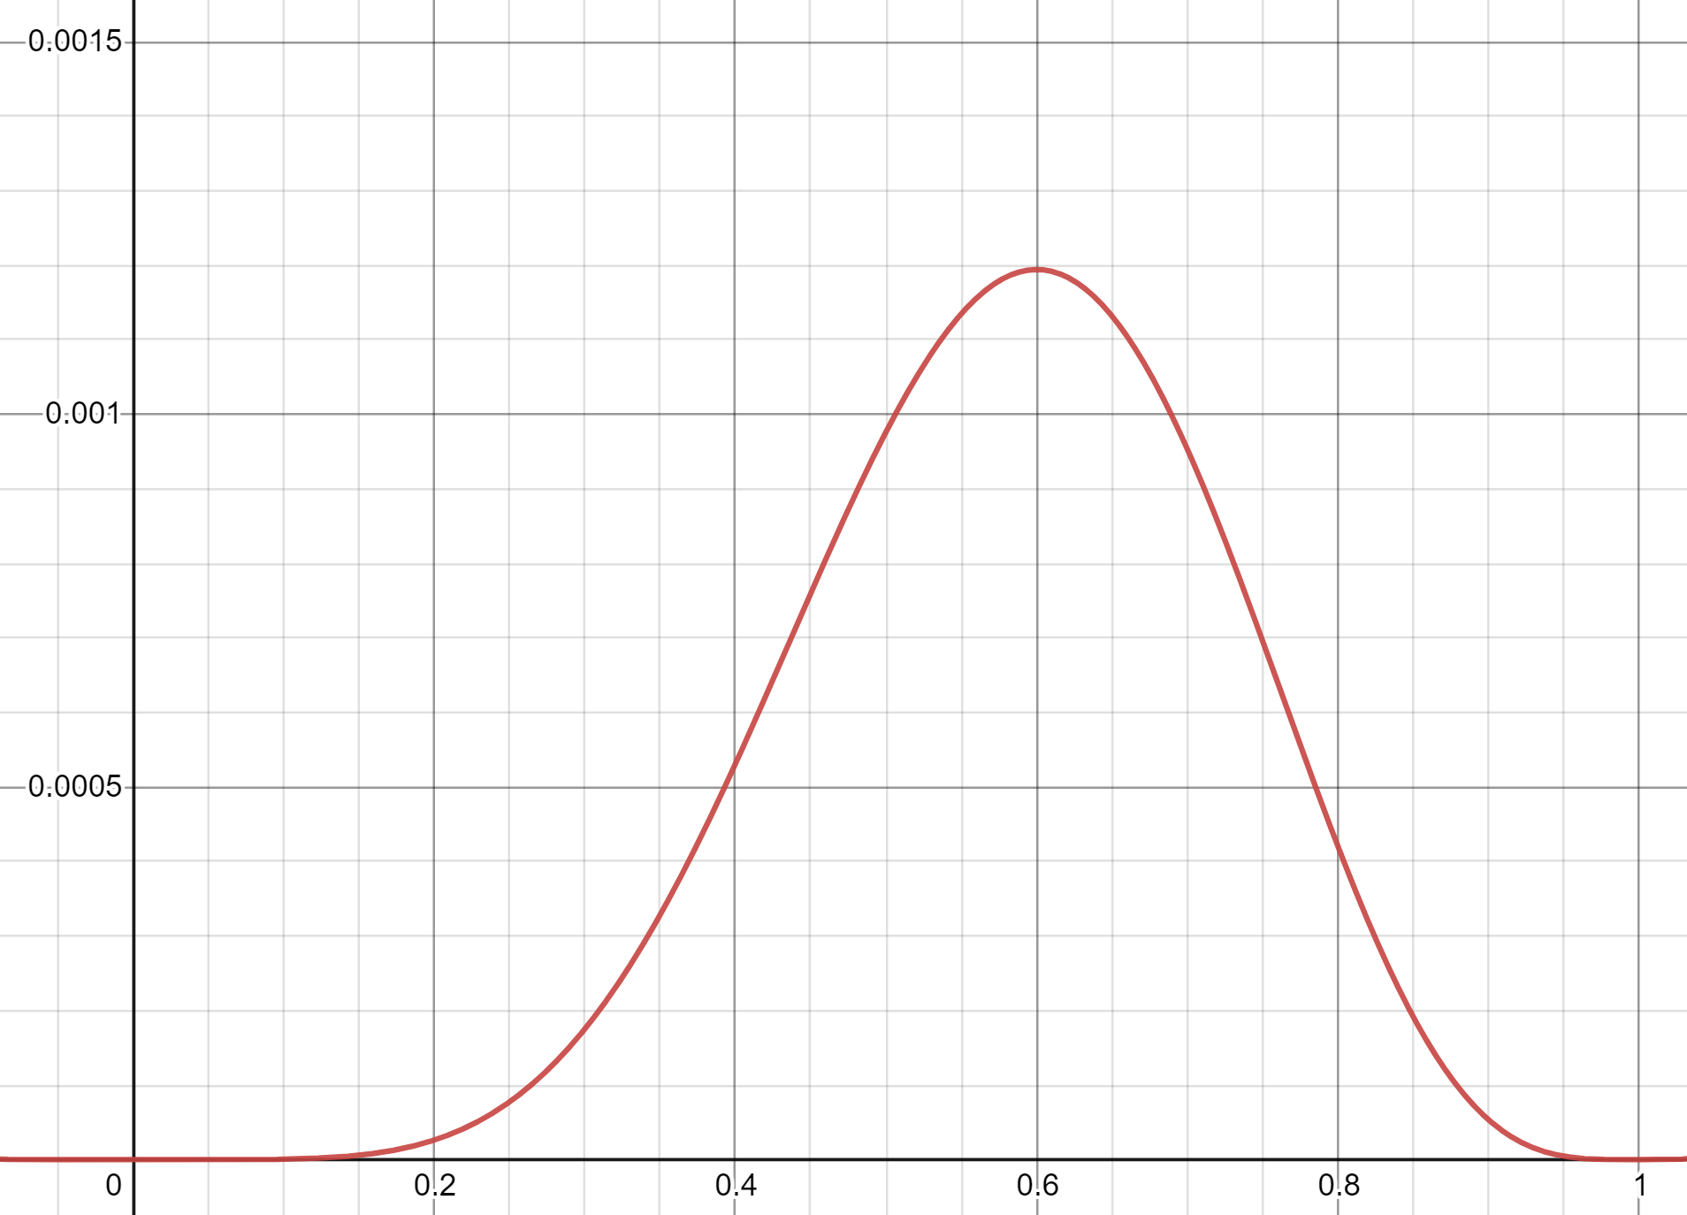
The Coin Example
$$ℒ(E;θ)$$
$ℒ(\text{HTTTHHTHHH}$ ; $θ)=θ^{6}{\left(1−θ\right)}^{4}$
Where is $θ$ maximized?
How do we usually find a maximum?
Calculus!!
$\frac{d}{dθ}θ^{6}{\left(1−θ\right)}^{4}=6θ^{5}{\left(1−θ\right)}^{4}−{4θ}^{6}{\left(1−θ\right)}^{3}$
Set equal to $0$ and solve
$6{\hat{θ}}^{5}{\left(1−\hat{θ}\right)}^{4}−{4\hat{θ}}^{6}{\left(1−\hat{θ}\right)}^{3}=0⇒6\left(1−\hat{θ}\right)−4\hat{θ}=0⇒−10\hat{θ}=−6⇒\hat{θ}=\frac{3}{5}$
$$θ$$

Slide 10
The Coin Example
For this problem, $θ$ must be in the closed interval $[0,1]$. Since $ℒ()$ is a continuous function, the maximum must occur at and endpoint or where the derivative is $0$.
Evaluate $ℒ(⋅;0)=0, ℒ(⋅;1)=0$
at $θ=0.6$ we get a positive value,
so$θ=0.6$ is the maximizer on the interval $[0,1]$.

Slide 11
Maximizing a Function
Closed intervals
Second derivative test
Set derivative equal to 0 and solve.
Evaluate likelihood at endpoints and any critical points.
Maximum value must be maximum on that interval.
Set derivative equal to 0 and solve.
Take the second derivative. If negative everywhere, then the critical point is the maximizer.

Slide 12
A Math Trick
We’re going to be taking the derivative of products a lot.
The product rule is not fun. There has to be a better way!
Take the log!
$\ln\left(a⋅b\right)=\ln\left(a\right)+\ln{(b)}$
We don’t need the product rule if our expression is a sum!
Can we still take the max? $\ln{()}$is an increasing function, so
$argmax_{θ} ln\left(ℒ(E;θ)\right)=argmax_{θ} ℒ(E;θ)$

Slide 13
Coin flips is easier
$ℒ($HTTTHHTHHH$;θ)=θ^{6}{\left(1−θ\right)}^{4}$
$\ln{(ℒ(\text{HTTTHHTHHH};θ)}=6\ln\left(θ\right)+4\ln{(1−θ)}$
$\frac{d}{dθ}\ln\left(ℒ\left(⋅\right)\right)=\frac{6}{θ}−\frac{4}{1−θ}$
Set to $0$ and solve:
$\frac{6}{\hat{θ}}−\frac{4}{1−\hat{θ}}=0$ $⇒$ $\frac{6}{\hat{θ}}=\frac{4}{1−\hat{θ}}$ $⇒$ $6−6\hat{θ}=4\hat{θ}⇒\hat{θ}=\frac{3}{5}$
$\frac{d^{2}}{dθ^{2}}=\frac{−6}{θ^{2}}−\frac{4}{{\left(1−θ\right)}^{2}}<0$ everywhere, so any critical point must be a maximum.

Slide 14
What about continuous random variables?
Can’t use probability, since the probability is going to be $0$.
Can use the density!
It’s supposed to show relative chances, that’s all we’re trying to find anyway.
$$ℒ(x_{1},x_{2},…,x_{n};θ)=∏_{i=1}^{n}f_{X}(x_{i};θ)$$

Slide 15
Continuous Example
Suppose you get values $x_{1},x_{2},…x_{n}$ from independent draws of a normal random variable $𝒩(μ,1)$ (for $μ$ unkown)
We’ll also call these “realizations” of the random variable.
$ℒ(x_{i};μ)=\prod_{i=1}^{n}{\frac{1}{\sqrt{2π}}\exp\left(−\frac{1}{2}{\left(x_{i}−μ\right)}^{2}\right)}$
$\ln{(ℒ(x_{i};μ))=\sum_{i=1}^{n}{\ln\left(\frac{1}{\sqrt{2π}}\right)−\frac{1}{2}{\left(x_{i}−μ\right)}^{2}}}$

Slide 16
Finding $\hat{μ}$
$\ln\left(ℒ\right)=\sum_{i=1}^{n}{\ln\left(\frac{1}{\sqrt{2π}}\right)−\frac{1}{2}{\left(x_{i}−μ\right)}^{2}}$
$\frac{d}{dμ}\ln\left(ℒ\right)=\sum_{i=1}^{n}{x_{i}−μ}$
Setting $μ=0$ and solving:
$\sum_{i=1}^{n}{x_{i}−\hat{μ}}=0⇒\sum_{i=1}^{n}{x_{i}}=\hat{μ}⋅n⇒\hat{μ}=\frac{\sum_{i=1}^{n}{x_{i}}}{n}$
Check using the second derivative test:
$\frac{d^{2}}{dμ^{2}}\ln{(ℒ)}=−n$
Second derivative is negative everywhere, so log-likelihood is concave down and average of the $x_{i}$ is a maximizer.

Slide 17
Summary
Given: an event $E$ (usually $n$ i.i.d. samples from a distribution with unknown parameter $θ$).
1. Find likelihood $ℒ(E;θ)$
Usually $∏ℙ (x_{i};θ)$ for discrete and $∏f(x_{i};θ)$ for continuous
2. Maximize the likelihood. Usually:
Take the log (if it will make the math easier)
Take the derivative
Set the derivative to 0 and solve
3. Use the second derivative test to confirm you have a maximizer

Slide 18
Two Parameter Estimation

Slide 19
Two Parameter Estimation Setup
We just saw that to estimate $μ$ for $𝒩(μ,1)$ we get:
$\hat{μ}=\frac{\sum_{i=1}^{n}{x_{i}}}{n}$
Now what happens if we know our data is $𝒩()$ but nothing else. Both the mean and the variance are unknown.

Slide 20
Log-likelihood
Let $θ_{μ}$ and $θ_{σ^{2}}$ be the unknown mean and standard deviation of a normal distribution. Suppose we get independent draws $x_{1},x_{2},…, x_{n}.$
$ℒ\left(x_{1},…,x_{n};θ_{μ},θ_{σ^{2}}\right)=\prod_{i=1}^{n}{\frac{1}{\sqrt{θ_{σ^{2}}2π}}\exp\left(−\frac{1}{2}⋅\frac{{\left(x_{i}−θ_{μ}\right)}^{2}}{θ_{σ^{2} }}\right)}$
$\ln\left(ℒ\left(x_{i};θ_{μ},θ_{σ^{2}}\right)\right)=\sum_{i=1}^{n}{\ln\left(\frac{1}{\sqrt{θ_{σ^{2}}2π}}\right)−\frac{1}{2}⋅\frac{{\left(x_{i}−θ_{μ}\right)}^{2}}{θ_{σ^{2}}} }$

Slide 21
Expectation
Arithmetic is nearly identical to known variance case.
$\ln\left(ℒ\left(x_{i};θ_{μ},θ_{σ^{2}}\right)\right)=\sum_{i=1}^{n}{\ln\left(\frac{1}{\sqrt{θ_{σ^{2}}2π}}\right)−\frac{1}{2}⋅\frac{{\left(x_{i}−θ_{μ}\right)}^{2}}{θ_{σ^{2}}} }$
$\frac{∂}{∂θ_{μ}}\ln\left(ℒ\right)=\sum_{i=1}^{n}{\frac{\left(x_{i}−θ_{μ}\right)}{θ_{σ^{2}}}}$
Setting equal to $0$ and solving
$\sum_{i=1}^{n}{\frac{\left(x_{i}−\hat{θ_{μ}}\right)}{θ_{σ^{2}}}}=0⇒\sum_{i=1}^{n}{\left(x_{i}−\hat{θ_{μ}}\right)=0⇒}\sum_{i=1}^{n}{x_{i}=n⋅\hat{θ_{μ}}⇒}\hat{θ_{μ}}=\frac{\sum_{i=1}^{n}{x_{i}}}{n}$
$\frac{∂^{2}}{∂θ_{μ}^{2}}=−\frac{n}{θ_{σ^{2}}}$
$θ_{σ^{2}}$is an estimate of a variance. It’ll never be negative (and as long as the draws aren’t identical it won’t be 0). So, the second derivative is negative, and we really have a maximizer.

Slide 22
Variance
$\ln\left(ℒ\left(x_{i};θ_{μ},θ_{σ^{2}}\right)\right)=\sum_{i=1}^{n}{\ln\left(\frac{1}{\sqrt{θ_{σ^{2}}2π}}\right)−\frac{1}{2}⋅\frac{{\left(x_{i}−θ_{μ}\right)}^{2}}{θ_{σ^{2}}} }$
$=\sum_{i=1}^{n}{−\frac{1}{2}\ln\left(θ_{σ^{2}}\right)−\frac{1}{2}\ln{(2π)}}−\frac{1}{2}⋅\frac{{\left(x_{i}−θ_{μ}\right)}^{2}}{θ_{σ^{2}}}$
$=−\frac{n}{2}\ln\left(θ_{σ^{2}}\right)−\frac{n⋅\ln\left(2π\right)}{2}−\frac{1}{2θ_{σ^{2}}}\sum_{i=1}^{n}{{\left(x_{i}−θ_{μ}\right)}^{2}}$
$\frac{∂}{∂θ_{σ^{2}}}\ln\left(ℒ\right)=−\frac{n}{2θ_{σ^{2}}}+\frac{1}{2{\left(θ_{σ^{2}}\right)}^{2}}\sum_{i=1}^{n}{{\left(x_{i}−θ_{μ}\right)}^{2}}$

Slide 23
Variance
$\frac{∂}{∂θ_{σ^{2}}}\ln\left(ℒ\right)=−\frac{n}{2θ_{σ^{2}}}+\frac{1}{2{\left(θ_{σ^{2}}\right)}^{2}}\sum_{i=1}^{n}{{\left(x_{i}−θ_{μ}\right)}^{2}}$
$−\frac{n}{2\hat{θ_{σ^{2}}}}+\frac{1}{2{\left(\hat{θ_{σ^{2}}}\right)}^{2}}\sum_{i=1}^{n}{{\left(x_{i}−θ_{μ}\right)}^{2}}=0$
$⇒−\frac{n}{2}\hat{θ_{σ^{2}}}+\frac{1}{2}\sum_{i=1}^{n}{{\left(x_{i}−θ_{μ}\right)}^{2}}=0$ (multiply by ${\left(\hat{θ_{σ^{2}}}\right)}^{2}$)
$⇒\hat{θ_{σ^{2}}}=\frac{1}{n}\sum_{i=1}^{n}{{\left(x_{i}−θ_{μ}\right)}^{2}}$
To get the overall max
We’ll plug in $\hat{θ_{μ}}$

Slide 24
Summary
If you get independent samples $x_{1},x_{2},…,x_{n}$ from a $𝒩(μ,σ^{2})$ where $μ$ and $σ^{2}$are unknown, the maximum likelihood estimates of the normal is:
$\hat{θ_{μ}}=\frac{\sum_{i=1}^{n}{x_{i}}}{n}$ and $\hat{θ_{σ^{2}}}=\frac{1}{n}\sum_{i=1}^{n}{{\left(x_{i}−\hat{θ_{μ}}\right)}^{2}}$
The maximum likelihood estimator of the mean is the sample mean that is the estimate of $μ$ is the average value of all the data points.
The MLE for the variance is: the variance of the experiment “choose one of the $x_{i}$ at random”

