Slide 1
How to Lie with Statistics
CSE 312 Summer 21
Lecture 23

Slide 2
Announcements
Upcoming Deadlines :
Review Summary 3 – Friday, Aug 13 (TONIGHT!)
Final Released – Friday, Aug 13 (TONIGHT!)
Problem Set 7 – Monday, Aug 16
Final Key Released – Tuesday, Aug 17
Final Interviews – Wednesday - Friday, Aug 18 - 20
Office Hours will go until Wednesday
Use Ed for finals discussions exclusively! No discussion in Office Hours.
More logistics posted on Ed as a pinned post later today.

Slide 3
How to Lie with Statistics – Darrell Huff
Published in 1954, over 500000 copies sold
Doesn’t teach how to lie with statistics, but how we are/can be lied to using statistics
In the current age, we are lied to by the media, by politicians, and marketers.
Often make decisions due to it: “4 out of 5 dentists recommend….”
Today’s lecture is heavily inspired by the book and similar examples available on the internet.
If you like this lecture, please check out INFO 270 (https://www.callingbullshit.org/)

Slide 4
What is Statistics?
A way to make sense of information from data
Framework for thinking, for reaching insights, and solving problems.
Numbers alone mean very little without context
Statistics is a marriage of:
Math
Science
Art

Slide 5
“Facts are stubborn things, but statistics are pliable.”
― Mark Twain
This Photo by Unknown Author is licensed under CC BY-SA

Slide 6
Friday the 13th!

Slide 7
Sampling gone wrong (bias)

Slide 8
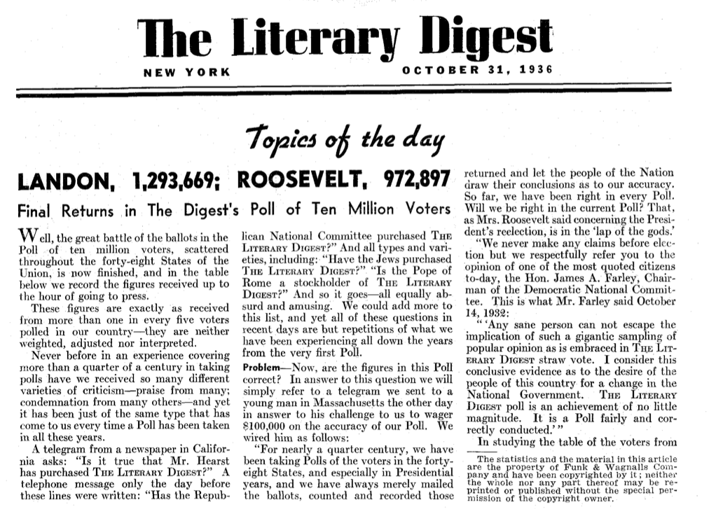
Sampling Gone Wrong (Bias)
“The Literary Digest” Magazine wanted to predict the 1936 election.
Alfred Landon vs Franklin D Roosevelt
Sent 10 million surveys and received 2.4 million responses
The people contacted were:
Subscribers of the “Literary Digest”
Owners of cars and telephones
Electoral Votes | Prediction | Actual
Landon | 370
Roosevelt | 161

Slide 9
Sampling Gone Wrong (Bias)
“The Literary Digest” Magazine wanted to predict the 1936 election.
Alfred Landon vs Franklin D Roosevelt
Sent 10 million surveys and received 2.4 million responses
The people contacted were:
Subscribers of the “Literary Digest”
Owners of cars and telephones
What went wrong?
Electoral Votes | Prediction | Actual
Landon | 370 | 8
Roosevelt | 161 | 523

Slide 10
Sampling Gone Wrong (Bias)
Not Representative
Voluntary Response Bias
Only 24% of respondents answered the poll
Not the Right Populations
Was biased towards people with more money, education, information, alertness than the average American
Not Random
Convenience Sampling
Only people whose contact information was available
Standing outside a church and asking, “Do you believe in God?”, and then using the result of this sample to represent the beliefs of the entire US population.
More samples is NOT a solution for a bad sampling technique

Slide 11
The “Well-Chosen” Average

Slide 12
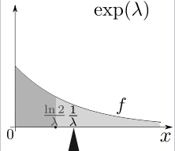
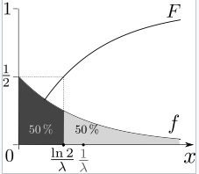
The “Well-Chosen” Average
Mean: Average of all values weighted by probability or density
Median: The point m where ½ values are larger and ½ are smaller
Mode: The point with the highest probability or density
Let $X\sim Exp(λ)$.
$𝔼[X]=\frac{1}{λ}$ $median(X)=\frac{\ln{2}}{λ}$ $mode\left(X\right)=0$

Slide 13
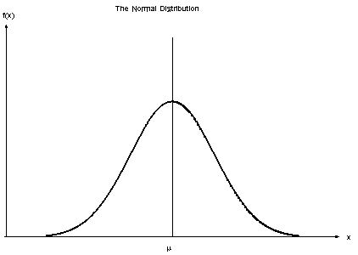
The “Well-Chosen” Average
Mean: Average of all values weighted by probability or density
Median: The point m where ½ values are larger and ½ are smaller
Mode: The point with the highest probability or density
Let $X\sim 𝒩(μ, σ^{2})$.
$𝔼[X]=μ$ $median(X)=μ$ $mode\left(X\right)=μ$

Slide 14
Are haircuts more expensive in Vancouver or Toronto?
Vancouver | Toronto
$20 | $15
$20 | $25
$22 | $25
$24 | $29
$25 | $35
$28 | $45
$400 | $65
Saloon | Vancouver | Toronto
1 | $20 | $15
2 | $20 | $25
3 | $22 | $25
4 | $24 | $29
5 | $25 | $35
6 | $28 | $45
7 | $400 | $65
What do you think?

Slide 15
Are haircuts more expensive in Vancouver or Toronto?
Saloon | Vancouver | Toronto
1 | $20 | $15
2 | $20 | $25
3 | $22 | $25
4 | $24 | $29
5 | $25 | $35
6 | $28 | $45
7 | $400 | $65
Mean | $77 | $36
Median | $24 | $29
Mode | $20 | $25
What do you think now?

Slide 16
The “Well-Chosen” Average
Mean: Heavily affected/influenced by outliers. Any extreme value(s) may make this measure terrible
Median: About half the values are higher than this, and half are lower than this
Mode: Most frequently occurring value
Which one is the best?
It depends, and it is good to know all of them for a better idea of the distribution.
It is good to know all - mean, median, and, mode - for a better idea of the distribution.

Slide 17
Small Sample Size

Slide 18
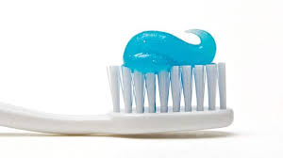
Sample Size Too Small
Senserdime (toothpaste company) claims 86% of dentists recommend their product.
Sounds very impressive.
Would you buy a Senserdime toothpaste?

Slide 19
Sample Size Too Small
Senserdime (toothpaste company) claims 86% of dentists recommend their product.
Sounds very impressive.
86% out of how many dentists?
$\frac{6}{7} =86\%$
$\frac{30}{35} =86\%$
$\frac{600}{700}=86\%$

Slide 20
Sample Size Too Small
Senserdime (toothpaste company) claims 86% of dentists recommend their product.
Sounds very impressive.
86% out of how many dentists?
$\frac{6}{7} =86\%→[0.7664, 0.9479]$
$\frac{30}{35} =86\%→[0.8166, 0.8977]$
$\frac{600}{700}=86\%→\left[0.8481, 0.8662\right]$
These are the 95% confidence intervals for the above

Slide 21
Misleading results

Slide 22
Colgate 2007 Ad Campaign
In 2007, Colgate advertised that more than 80% of dentists recommended their toothpaste.
How would you read this Ad Campaign?
More than 80% dentists recommend Colgate over other toothpaste brands
OR
More than 80% of dentists recommend Colgate among other toothpaste brands

Slide 23
Colgate 2007 Ad Campaign
More than 80% dentists recommend Colgate over other toothpaste brands
This may imply that only 20% of dentists recommend toothpaste that are from brands other than Colgate
More than 80% of dentists recommend Colgate among other toothpaste brands
This means that more than 20% of dentists recommend toothpaste that are from brands other than Colgate where a dentist can recommend more than 2 brands

Slide 24
Correlation $→$ Causation?

Slide 25
Correlation $→$ Causation?
People who use Senserdime generally have less cavities than those who use generic brands
Can we say “Senserdime prevents cavities”?

Slide 26
Correlation $→$ Causation?
People who use Senserdime generally have less cavities than those who use generic brands
Can we say “Senserdime prevents cavities”?
Turns out that a tube of Senserdime costs $1000.
This means that only wealthy people can afford it.
Wealthy people have access to good healthcare and hygiene
They are less likely to get cavities.
Therefore, Senserdime did not do anything!

Slide 27
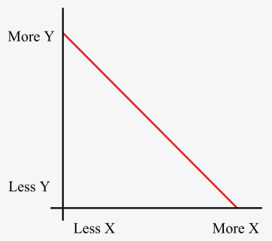
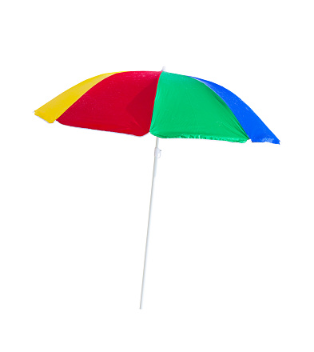
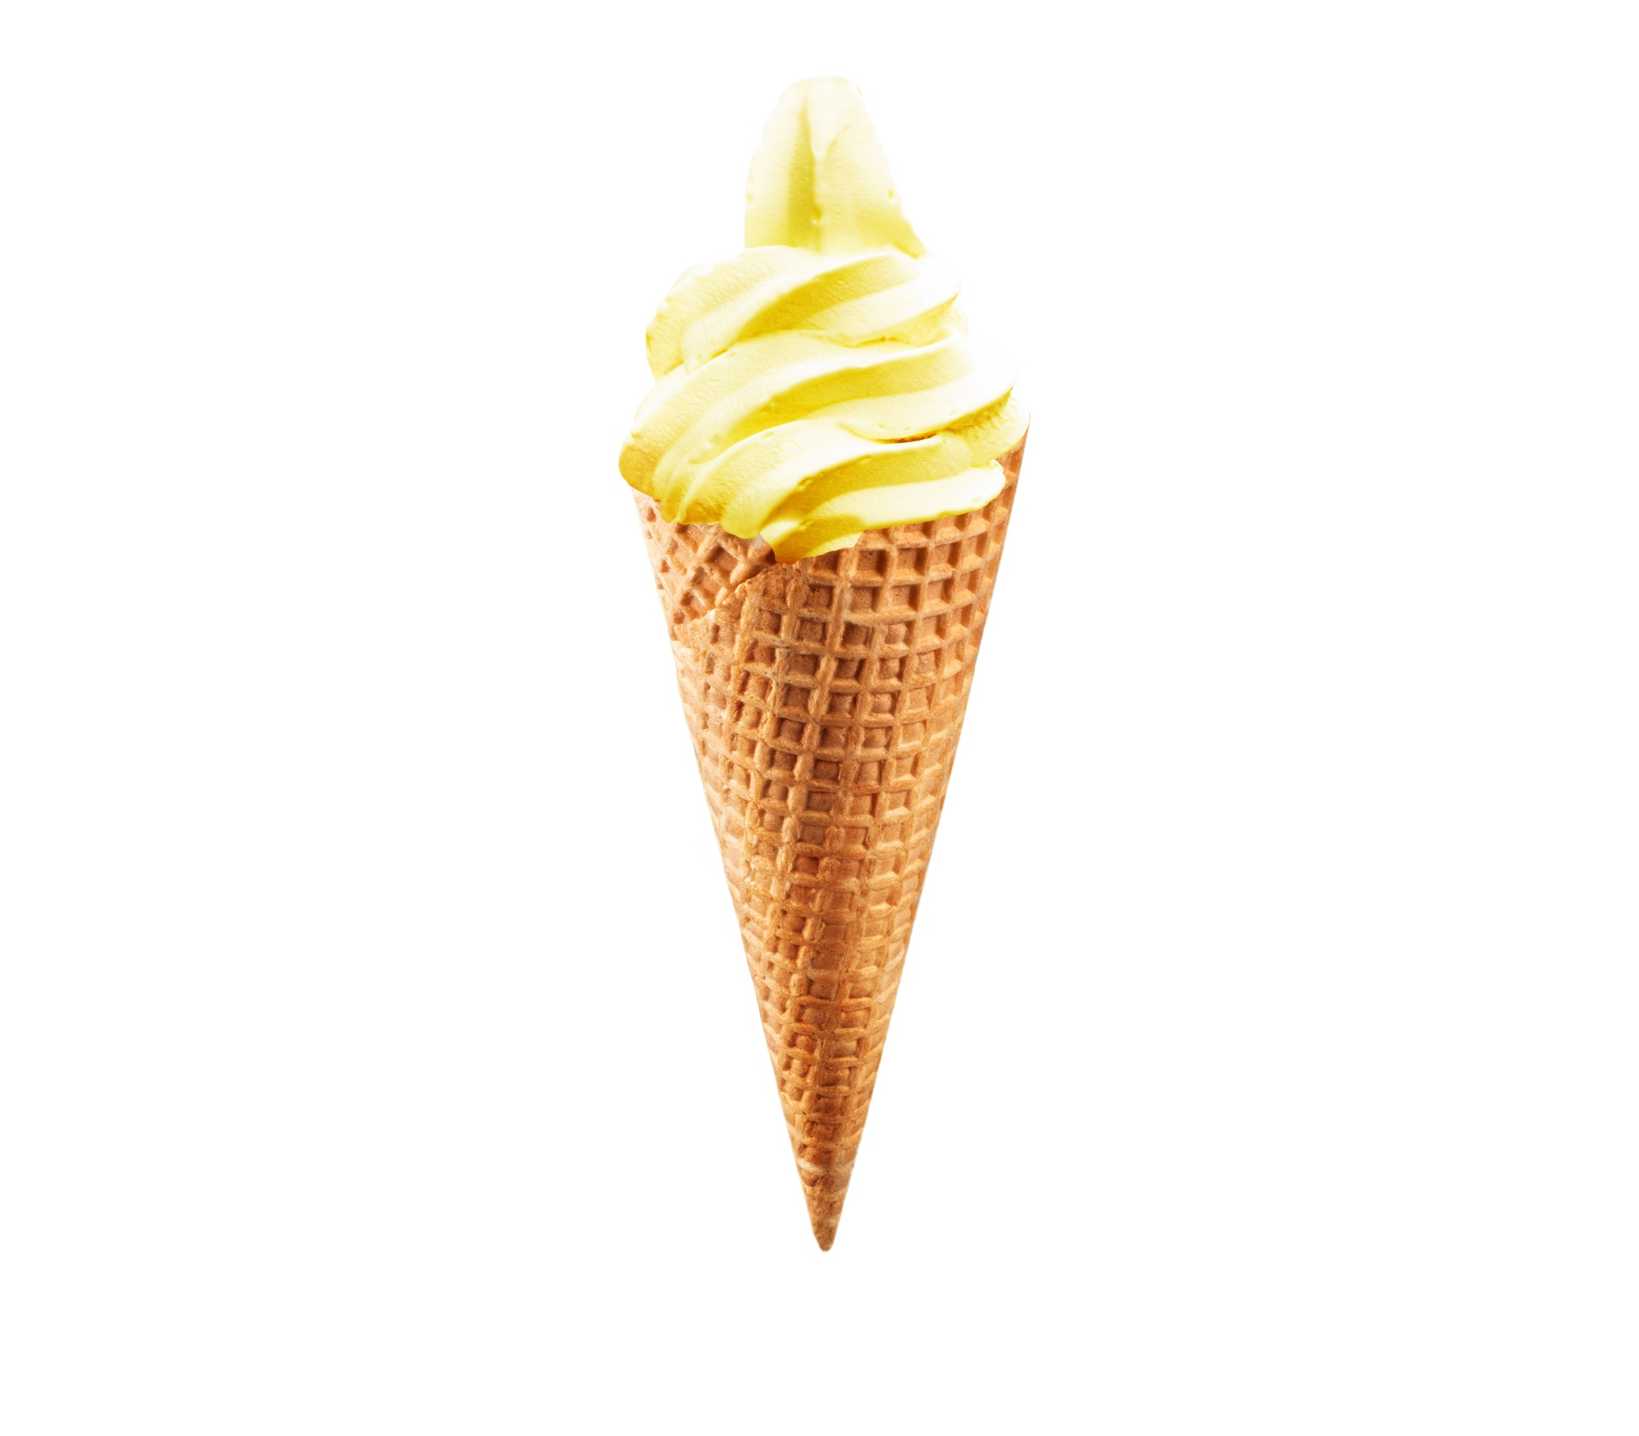
Correlation $→$ Causation?
“When ice cream sales go up, umbrella sales go down”

Slide 28
Correlation $→$ Causation?
“When ice cream sales go up, umbrella sales go down”
Both generally happen in the summer
An increase in ice cream sales did not CAUSE umbrella sales to go down.
The weather CAUSED both of these things to happen
Correlation DOES NOT imply Causation!

Slide 29
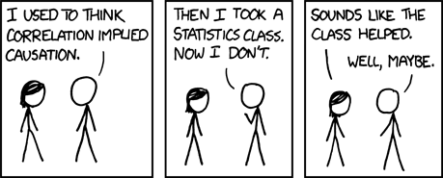

Slide 30
Conditional Probability

Slide 31
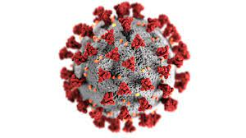
Medical Tests
Abbott’s test for COVID-19 is 99% accurate, and we know that 0.005% of the population has the disease. If you test positive, the probability you have the disease is?

Slide 32
Medical Tests
Abbott’s test for COVID-19 is 99% accurate, and we know that 0.005% of the population has the disease. If you test positive, the probability you have the disease is?
$ℙ\left(D | +\right)=\frac{ℙ(+|D)ℙ(D)}{ℙ(+|D)ℙ\left(D\right)+ℙ(+|D^{C})ℙ(D^{C})}$
$=\frac{0.99⋅0.00005}{0.99⋅0.00005+0.01⋅0.9995}≈0.49\%$
Much lower than it seems at first glance!

Slide 33
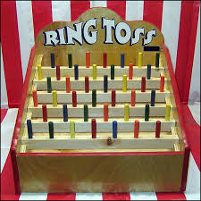
Biased Carnival?
Suppose there is a carnival game which gives out prizes, and three types of players: children, teenagers, and adults.
Justin thinks the carnival unfairly gives more prizes to children over the other types of players. Is this true?
Player Type | % Prizes Won
Child | 70%
Teenager | 5%
Adult | 25%

Slide 34
Biased Carnival?
Suppose there is a carnival game which gives out prizes, and three types of players: children, teenagers, and adults.
Justin thinks the carnival unfairly gives more prizes to children over the other types of players. Is this true?
Player Type | % Prizes Won
Child | 70%
Teenager | 5%
Adult | 25%

Slide 35
Biased Carnival?
Suppose there is a carnival game which gives out prizes, and three types of players: children, teenagers, and adults.
Justin thinks the carnival unfairly gives more prizes to children over the other types of players.
How about now?
Player Type | % Prizes Won | % Global Population
Child | 70% | 25%
Teenager | 5% | 15%
Adult | 25% | 60%

Slide 36
Biased Carnival?
Suppose there is a carnival game which gives out prizes, and three types of players: children, teenagers, and adults.
Justin thinks the carnival unfairly gives more prizes to children over the other types of players.
This looks very fair now!
Player Type | % Prizes Won | % Global Population | % Carnival Population
Child | 70% | 25% | 71%
Teenager | 5% | 15% | 4.5%
Adult | 25% | 60% | 24.5%

Slide 37
Biased Carnival?
This looks very fair now!
Player Type and Prize won are (almost independent)
$ℙ\left(child \right| prize won)=0.7$ $ℙ(child)=0.71$
$ℙ\left(teenager \right| prize won)=0.05$ $ℙ\left(teenager\right)=0.045$
$ℙ\left(adult \right| prize won)=0.25$ $ℙ(adult)=0.245$
Player Type | % Prizes Won | % Global Population | % Carnival Population
Child | 70% | 25% | 71%
Teenager | 5% | 15% | 4.5%
Adult | 25% | 60% | 24.5%

Slide 38
Simpson’s Paradox

Slide 39
Simpson’s Paradox
An analysis of the admission rates for the UC Berkeley grad school in 1973 is a great example of Simpson’s Paradox.
Was the office of admissions unfair?
 | Applicants | Admitted
Men | 8442 | 44%
Women | 4321 | 35%
Total | 12763 | 41%

Slide 40
Simpson’s Paradox
How about now?
Department | Men |  | Women |  | Total
 | Applicants | Admitted | Applicants | Admitted | Applicants | Admitted
A | 825 | 62% | 108 | 82% | 933 | 64%
B | 560 | 63% | 25 | 68% | 585 | 63%
C | 325 | 37% | 593 | 34% | 918 | 35%
D | 417 | 33% | 375 | 35% | 792 | 34%
E | 191 | 28% | 393 | 24% | 584 | 25%
F | 373 | 6% | 341 | 7% | 714 | 6%

Slide 41
Simpson’s Paradox
Simpson's paradox is a phenomenon in probability and statistics in which a trend appears in several groups of data but disappears or reverses when the groups are combined.

Slide 42
Gambler’s Fallacy

Slide 43
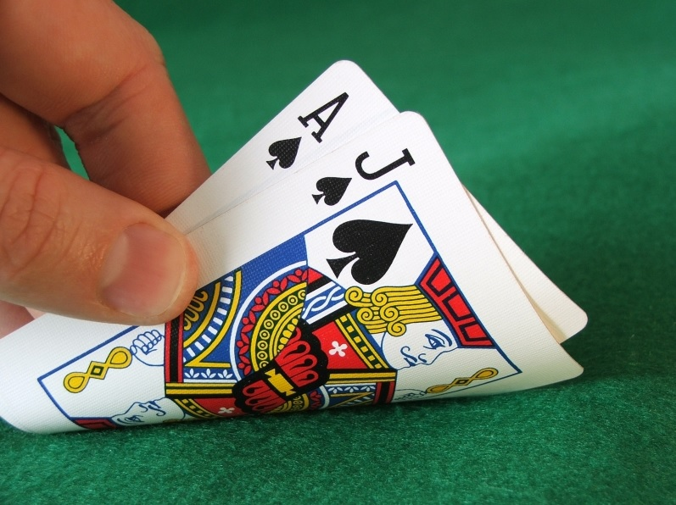
Gambler’s Fallacy
“Play another round of blackjack – you have to win soon! You have been losing too much!”
Each game is independent, and so even if you already lost 10 times, the probability of you winning the next game is the same as any other
Remember “Memorylessness” property for Geometric RV!
$ℙ\left(win \right| 1000 losses)= ℙ\left(win \right| 10 losses)= ℙ(win)$

Slide 44
How to better understand Statistics?
Who says so?
How do they know this is true?
What’s missing?
Did somebody change the subject?
Does it make sense?

Slide 45
Conclusions
Determine if the samples are random and representative.
Ask if the statistic represents the mean, median, or mode.
Inquire about the size of the sample relative to the population, and/or ask for a confidence interval.
Correlation does not imply causation.
Check the distribution of the samples (are they uniform, or not)?
Interpret conditional probabilities properly. Intuition sometimes doesn’t work here!
Does the data give you the full picture? If there are subcategories, enquire into them!
Independent events! Don’t gamble, ever.

Slide 46
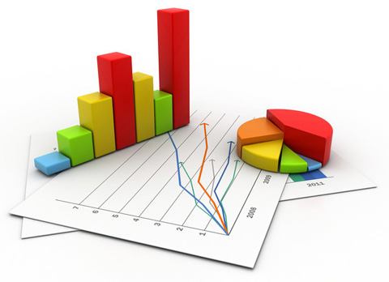
“95.73% of all statistics are made up!”
- Kushal Jhunjhunwalla
This Photo by Unknown Author is licensed under CC BY-SA-NC

