Slide 1
Applications in Computational Biology and Explainable AI
CSE 312 Summer 21
Lecture 24

Slide 2
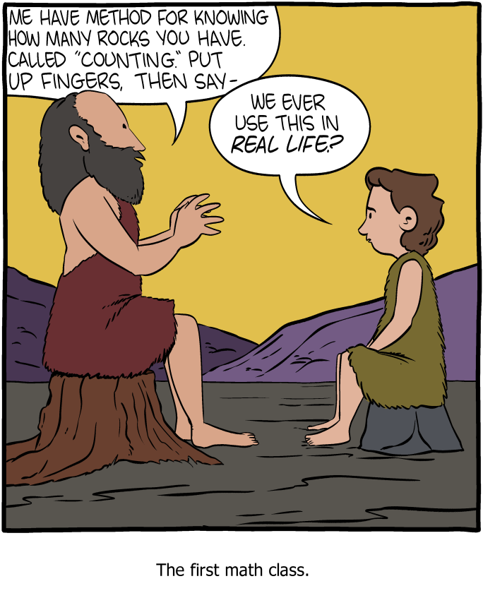
“Real Life”
The usual attitude towards math/theory is: “why should I care?”
This lecture is going to try and motivate an answer, at least from a research perspective
https://www.smbc-comics.com/comic/a-new-method

Slide 3
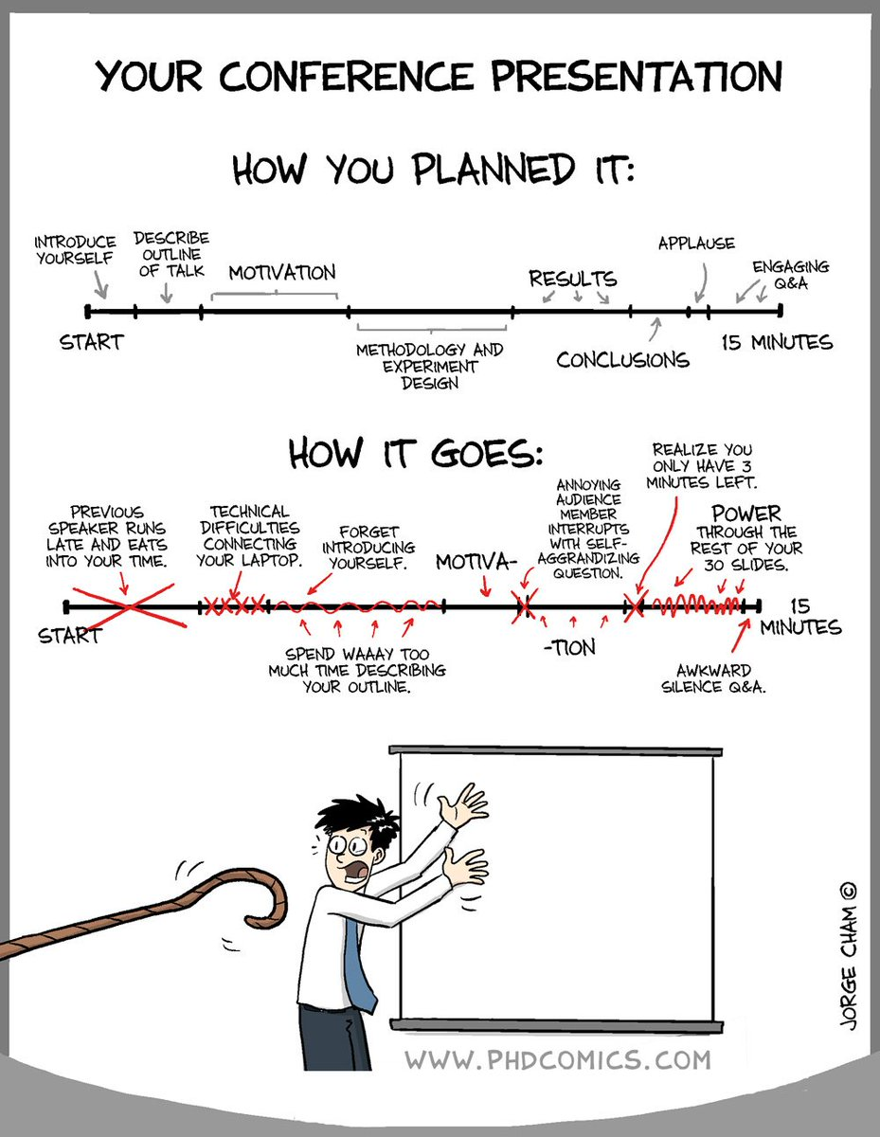
Caveats
This talk will be *very* high level - I will skip many details
It is mainly an attempt to motivate you to think about how these concepts apply to real life situations

Slide 4
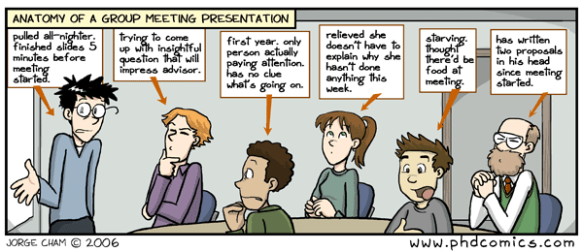
Engagement
This talk will be much more fun if you engage and ask questions
Remember: if you aren’t asking questions for me, I will be asking questions to you

Slide 5
An Application in Computational Biology: Protein Sequence Statistics
Karlin, Samuel, and Stephen F. Altschul. "Methods for assessing the statistical significance of molecular sequence features by using general scoring schemes." Proceedings of the National Academy of Sciences 87.6 (1990): 2264-2268.

Slide 6
A Coin Flip Problem
Consider the following problem: I flip a coin n times with probability p of heads. What is the expected length of the longest sequence of heads?
We will consider this problem shortly, but first, some warm up

Slide 7
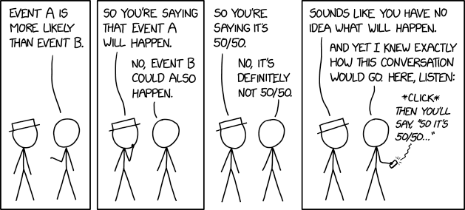
Coin Flip Warm Up
I flip a coin n times with probability p of heads. What is…
...the distribution of the number of heads?
...the probability that we see a sequence of only heads?
...the expected number of runs of heads with length k?

Slide 8
Coin Flip Recursion
What is the probability that we see a sequence of k consecutive heads?

Slide 9
Coin Flip Recursion
What is the probability that we see a sequence of k consecutive heads?
f(j, m) be the probability of seeing such a sequence having already observed j consecutive heads with m flips remaining

Slide 10
Coin Flip Recursion
What is the probability that we see a sequence of k consecutive heads?
f(j, m) be the probability of seeing such a sequence having already observed j consecutive heads with m flips remaining
Initial conditions:
f(j, m) = 0 if k - j > m
f(j, m) = 1 if j >= k

Slide 11
Coin Flip Recursion
What is the probability that we see a sequence of k consecutive heads?
f(j, m) be the probability of seeing such a sequence having already observed j consecutive heads with m flips remaining
Initial conditions:
f(j, m) = 0 if k - j > m
f(j, m) = 1 if j >= k
Recursion:
f(j, m) = p * f(j + 1, m - 1) + (1 - p) * f(0, m - 1)

Slide 12
A Coin Flip Problem
Consider the following problem: I flip a coin n times with probability p of heads. What is the expected length of the longest sequence of heads?
TTTTTHHTHTTHHHHTHTHHHTTTHHHHHHTHTTT
Before we answer this - how might we go about beginning this problem? What distributions may be involved?

Slide 13
A Coin Flip Problem
Consider the following problem: I flip a coin n times with probability p of heads. What is the expected length of the longest sequence of heads?
A very loose answer:
Expected # of a sequence of heads of length k is roughly n(1 - p) * p^k
There is usually 1 sequence that is the longest, so solve for k:
n(1 - p) * p^k = 1
k = -log_p(n * (1-p))

Slide 14
A Coin Flip Problem
Consider the following problem: I flip a coin n times with probability p of heads. What is the expected length of the longest sequence of heads?
A tighter bound is *much* harder to find

Slide 15
So “Why Do We Care?”
So why am I asking you all these weird questions about sequences of coin flips?

Slide 16
So “Why Do We Care?”
So why am I asking you all these weird questions about sequences of coin flips?
They are a good model of a biological phenomenon: the sequences of amino acids that make up proteins in our body

Slide 17
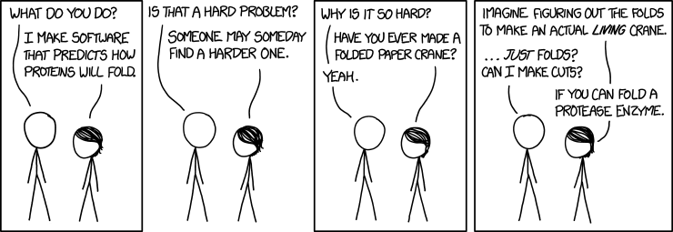
High School Biology Refresher
Proteins are a key organic macromolecule - they do almost everything in our bodies, from supporting muscle tissue to carrying oxygen in our blood
As a computer scientist, all you need to know is that proteins are strings from a roughly ~20 amino acid alphabet

Slide 18
The Sequence Distribution
Protein sequences aren’t random - they have evolved over millions of years to accomplish specific functions using amino acids as a code
Often, we have a particular subsequence that we observe multiple times throughout different sequences. The question becomes: what was the probability of observing that specific subsequence at random?

Slide 19
Amino Acid Modeling
Usually, we define a reference distribution: we assume the ith amino acid occurs with probability p_i independently
We then define a scoring system: s_i is the score of the ith amino acid
We can then ask questions about the probability of seeing subsequences with particular scores. Usually, we are interested in finding the Maximal Scoring Subsequence (MSS)

Slide 20
Amino Acid Modeling
The score of a subsequence is the sum of the scores of each individual amino acid in the subsequence
For example, maybe we care about amino acids with a particular property, like hydrophobicity - so we might give all the hydrophobic amino acids a positive score and all others a negative score

Slide 21
An Example
Suppose my scoring system is:
A = 1
B = 0
C = -1
and my sequence is:
ABBCCABAACACBAAAABACCCAACACCACBBCABCAB
What is my MSS? What is its score?

Slide 22
An Example
Suppose my scoring system is:
A = 1
B = 0
C = -1
and my sequence is:
ABBCCABAACACBAAAABACCCAACACCACBBCABCAB
What is my MSS? What is its score?

Slide 23
An Exercise
Suppose I wanted to find the longest consecutive sequence of ‘A’s - what should my scoring system be?

Slide 24
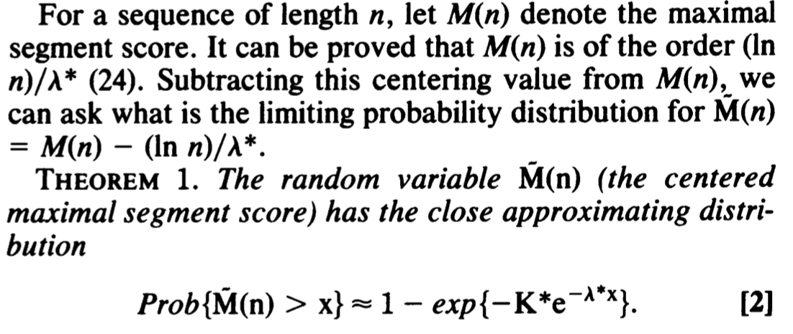
The Distribution
In general, Karlin and Altschul (1990) proved a formula for the distribution of the MSS:

Slide 25
Math Details
The math behind the proof is *complicated*
The intuition is not! We assume that in the limit of some very large sequence n, the maximal scoring sequence is a very *rare* event in an infinite process
This is modeled by a poisson distribution, and we ask the question: what is the probability that this distribution exceeds 0?

Slide 26
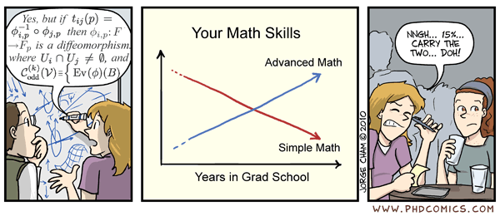
A Comedic Interlude

Slide 27
But Wait, There’s More!
One of the most important problems in computational biology is called sequence searching: given a sequence and a database of other sequences, which sequences are most “similar” to mine?
Many algorithms for doing this (which you can learn in 527), but suppose an algorithm spits out a similar looking sequence. How do you know if it is a significant match?

Slide 28
Pairwise Scoring Extensions
We can analyze this model in a very similar way: simply use a pairwise scoring system! Let s_{i,j} be the score of matching i and j, and then ask: what is the probability/expected value/bound of seeing a particular pair of matched subsequences?

Slide 29
Double Trouble
An example: suppose a match is worth 1 point, and a mismatch is worth -1 points. Consider picture at the bottom. What is the associated score? What is the probability of getting such a score at random?

Slide 30
BLAST
This insight - the ability to estimate the probability of high scoring pairwise matches - is the foundation of much of modern computational protein biology!
It is a key component of the BLAST algorithm, a tool used by essentially every computational biology researcher.

Slide 31
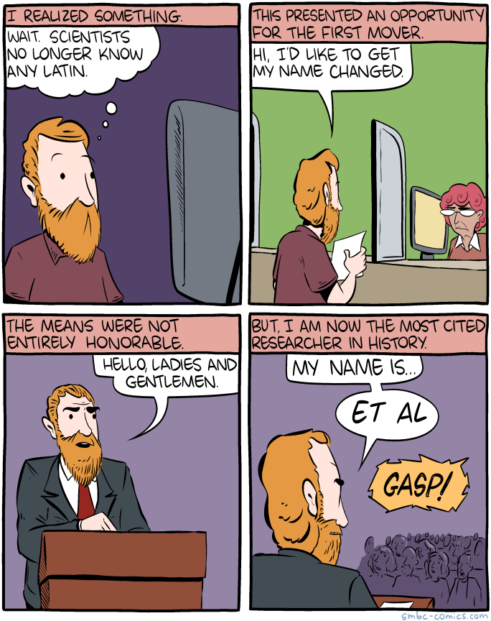
Citations...
90,000 citations is more than citations than most researchers get over their LIFETIMES…
...so yeah, the paper is pretty important

Slide 32
The Point
...is that you have learned many of the basic tools used to analyze these kinds of problems! All you need to do is apply them creatively.
What other kinds of questions could you ask and answer about the statistics of sequences and sequence matching?

Slide 33
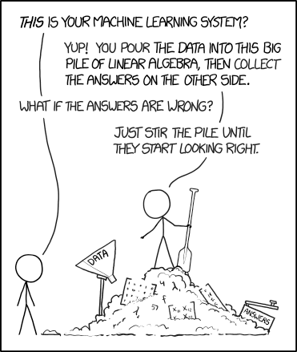
I was cheated...
...where’s the AI/research part of the talk??
Most of the AI methods we use go beyond this course. If you are interested, take 545! But a preview...

Slide 34
Mix in a Neural Net
Most research has gone beyond basic sequence statistics. The community is largely interested in training large, deep neural networks to predict things about protein sequences!

Slide 35
Mix in a Neural Net
Most research has gone beyond basic sequence statistics. The community is largely interested in training large, deep neural networks to predict things about protein sequences!

Slide 36
Mix in a Neural Net
Most research has gone beyond basic sequence statistics. The community is largely interested in training large, deep neural networks to predict things about protein sequences!

Slide 37
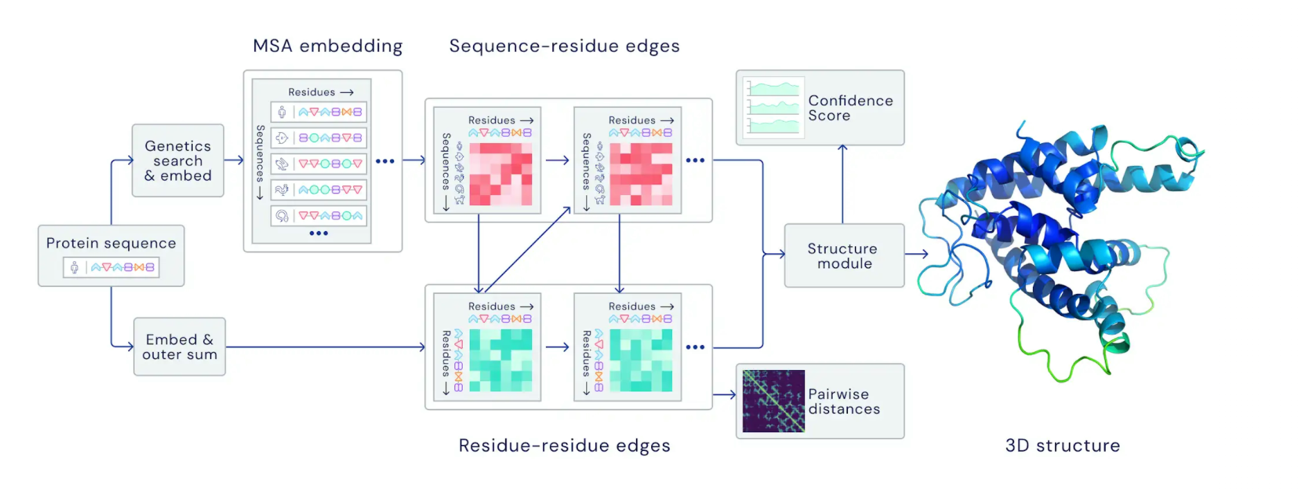
Mix in a Neural Net
For example, the biggest news in the protein world was AlphaFold 2: a system to predict how proteins fold from their individual sequences

Slide 38
Closer to Home...
One of my upcoming research ideas is about using neural networks to learn the significance of matches
Instead of using computational/discrete approximations, can we train a model to predict the probability of seeing two sequences being matched?

Slide 39
Closer to Home...
For example, certain coin flip sequence problems we’ve seen in this class have messy, recursive answers. Sometimes they have no closed formulas and we can only approximate them!
Wouldn’t it be nice to have a machine learning algorithm to do all the heavy theoretical work for us?

Slide 40
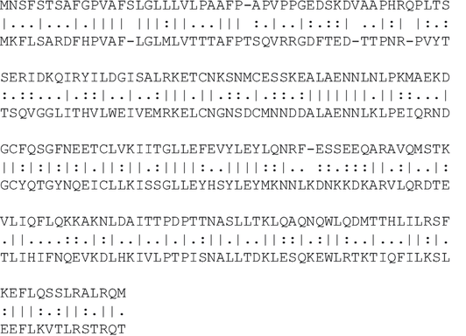
Closer to Home...
Neural Network
Significant with probability >0.99

Slide 41
Remember Your Basics
But in order to train such a model, we need DATA about the existing statistics of protein sequences…
...and in order to get DATA, we need to understand the underlying statistics ourselves! So don’t worry, understanding what we’ve learned in class is still very important!

Slide 42
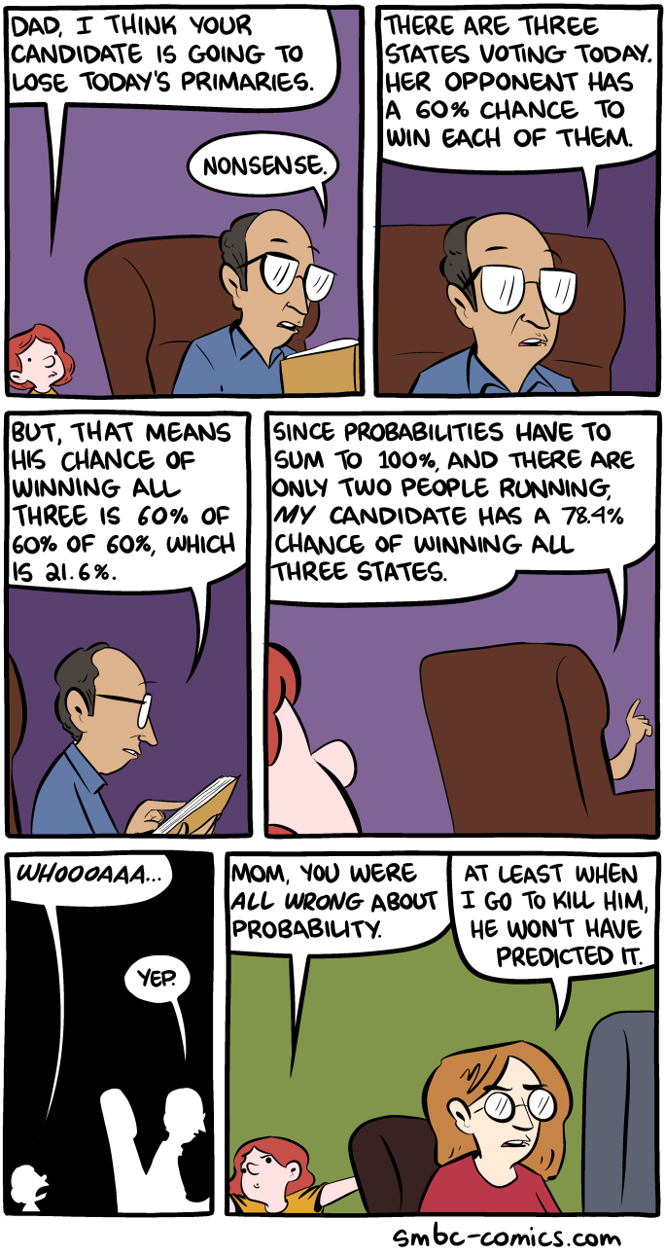
A Recap
Discrete math shows up everywhere in research - especially in computational biology, because our genomes and our proteomes are fundamentally discrete objects!
Understanding the statistics of these sequences is a foundational area of research, and one that has led to many important computational and biological discoveries!

Slide 43
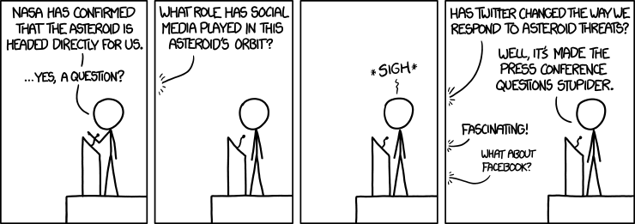
Any Questions?

