Slide 1
Victory Lap
CSE 312 Summer 21
Lecture 25

Slide 2
Content
Combinatorics (fancy counting)
Permutations, combinations, inclusion-exclusion, pigeonhole principle
Formal definitions of Probability
Probability space, events, conditional probability, independence, expectation, variance
Common patterns in probability
Equations and inequalities, common random variables, tail bounds
Continuous Probability
Density, sample distributions, Central Limit Theorem, Estimating probabilities
Applications
Across CS

Slide 3
Themes
Precise mathematical communication
Both reading and writing dense statements.
Probability in the “real world”
A mix of CS applications
And some actual “real life” ones.
Refine your intuition
Most people have some base level feeling of what the chances of some event are.
We’re going to train you to have better gut feelings.

Slide 4
Combinatorics
Sum and Product Rule
Permutations and Combinations
Complementary Counting
Binomial Coefficients
Principle of Inclusion-Exclusion
Pigeonhole Principle
Stars and Bars
Combinatorial Proofs

Slide 5
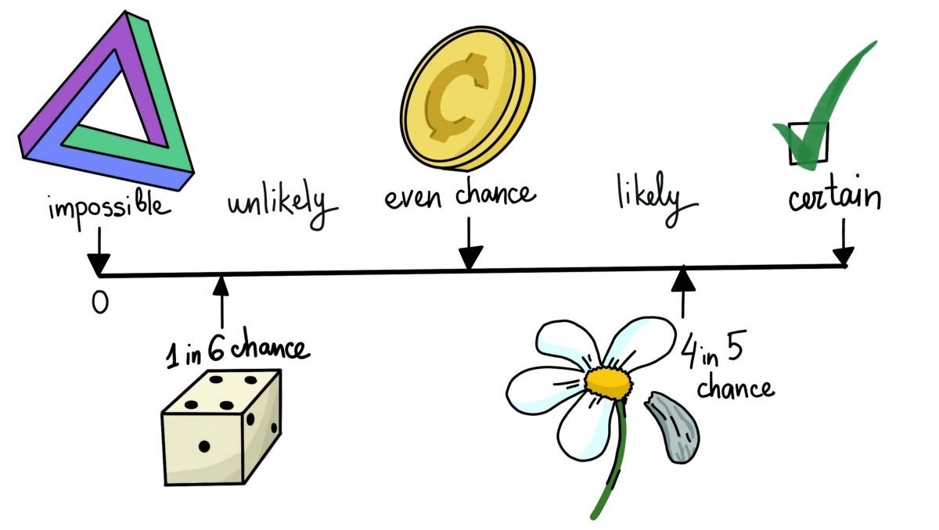
Discrete Probability
Axioms of Probability
Equally Likely Outcomes
Conditional Probability
Bayes Theorem
Law of Total Probability
Chain Rule
Independence
Conditional Independence

Slide 6
Discrete Distributions
Probability Mass Function
Expectation
Indicator Random Variables
Linearity of Expectation
Variance and Standard Deviation
LOTUS (Expectation of a function $g(X)$)
Independence of RVs
Zoo of Distributions

Slide 7
Continuous Distributions
Probability Density Function
Cumulative Distribution Function
Zoo of Continuous RVs
Normal Distribution
Standardizing
Linear Transformation
Sum of Normals -> Normal

Slide 8
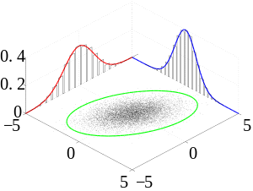
Multiple Random Variables
Joint PMFs / PDFs
Marginal PMFs / PDFs
Conditional PMFs / PDFs
Law of Total Expectation
Covariance
Central Limit Theorem

Slide 9
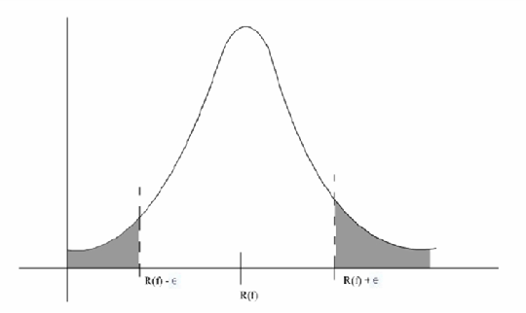
Tail Bounds or Concentration Inequalities
Markov’s Inequality
Chebyshev’s Inequality
Chernoff Bound
Union Bound

Slide 10
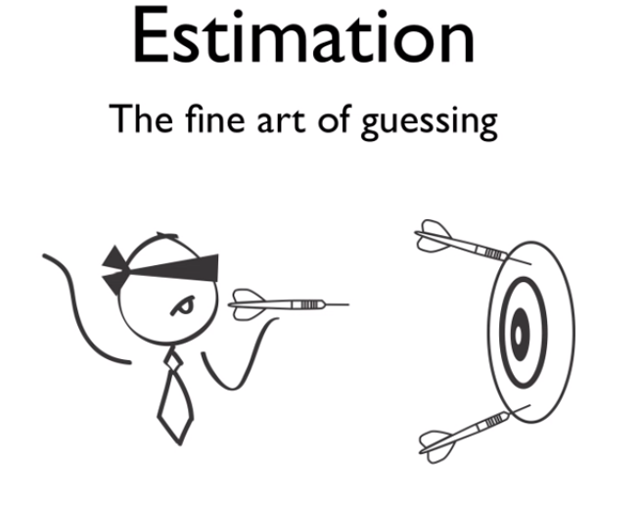
Estimation
Likelihood
Log-likelihood
Maximum Likelihood Estimation
Two Parameter Estimation
Bias

Slide 11
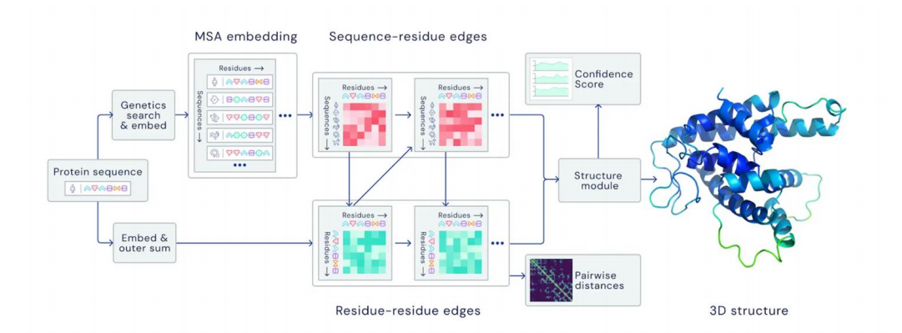
Applications
In Lecture
Polling
How to Lie with Statistics
Protein Synthesis
Assignments
Spam Filtering
Vaccine Efficacy
Distinct Elements

Slide 12
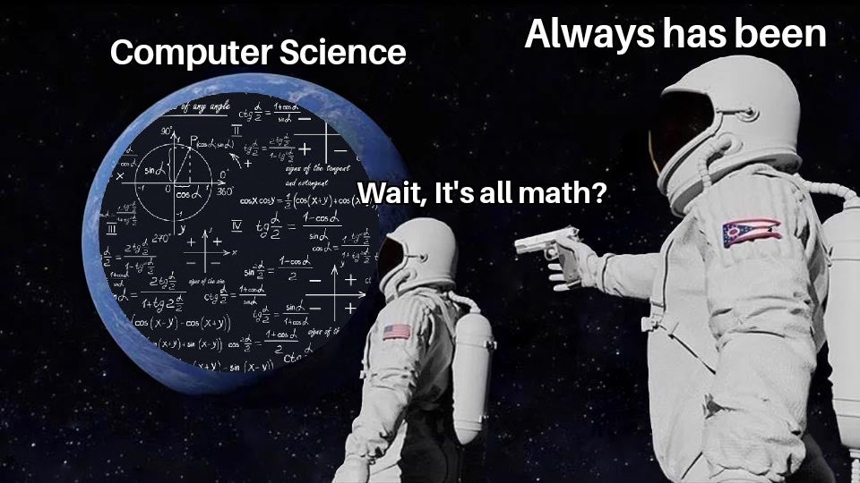

Slide 13
Technical Skills Learned
LaTeX
Difficult to start with
Very useful for Computer Scientists
Needed for Technical Writing and research papers
Python
Understanding some libraries like numpy
Less wordy than Java
Most Data Science courses use Python

Slide 14
Use Your Powers Wisely
We’ve seen probability can be used in the real world!
But also, that:
It can be counter-intuitive / hard to explain (Bayes Rule/Real World 1)
Probability estimates can depend on the model you’re using (Real World 2)

Slide 15
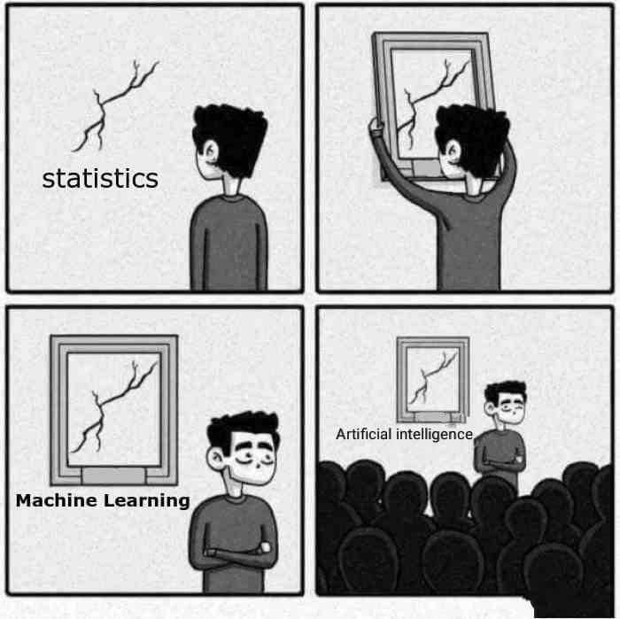
What to take next?
CSE 446 ML – using probability, linear algebra, and other techniques to extract patterns from data and make predictions.
CSE 421 designing algorithms – very little direct probability, but the combinatorics we did at the beginning will be useful.
We also have a graduate level course in randomized algorithms which will utilize more of the content covered in 312, but it has a few more prereqs
CSE 447 Natural Language Processing
CSE 490C Cryptography
Other things!

Slide 16
Parting Thoughts
This course is always a grind in the way we move from topic to topic.
You made it through over a year into a pandemic
Over zoom
Completing
7 Problem Sets
3 Review Summaries
2 Real World mini-projects
27 Concept Checks
And a Final!!!

Slide 17
Parting Thoughts
This course is always a grind in the way we move from topic to topic.
You made it through over a year into a pandemic
Over zoom
Completing
7 Problem Sets
3 Review Summaries
2 Real World mini-projects
27 Concept Checks
And a Final!!!

Slide 18
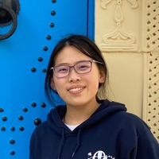
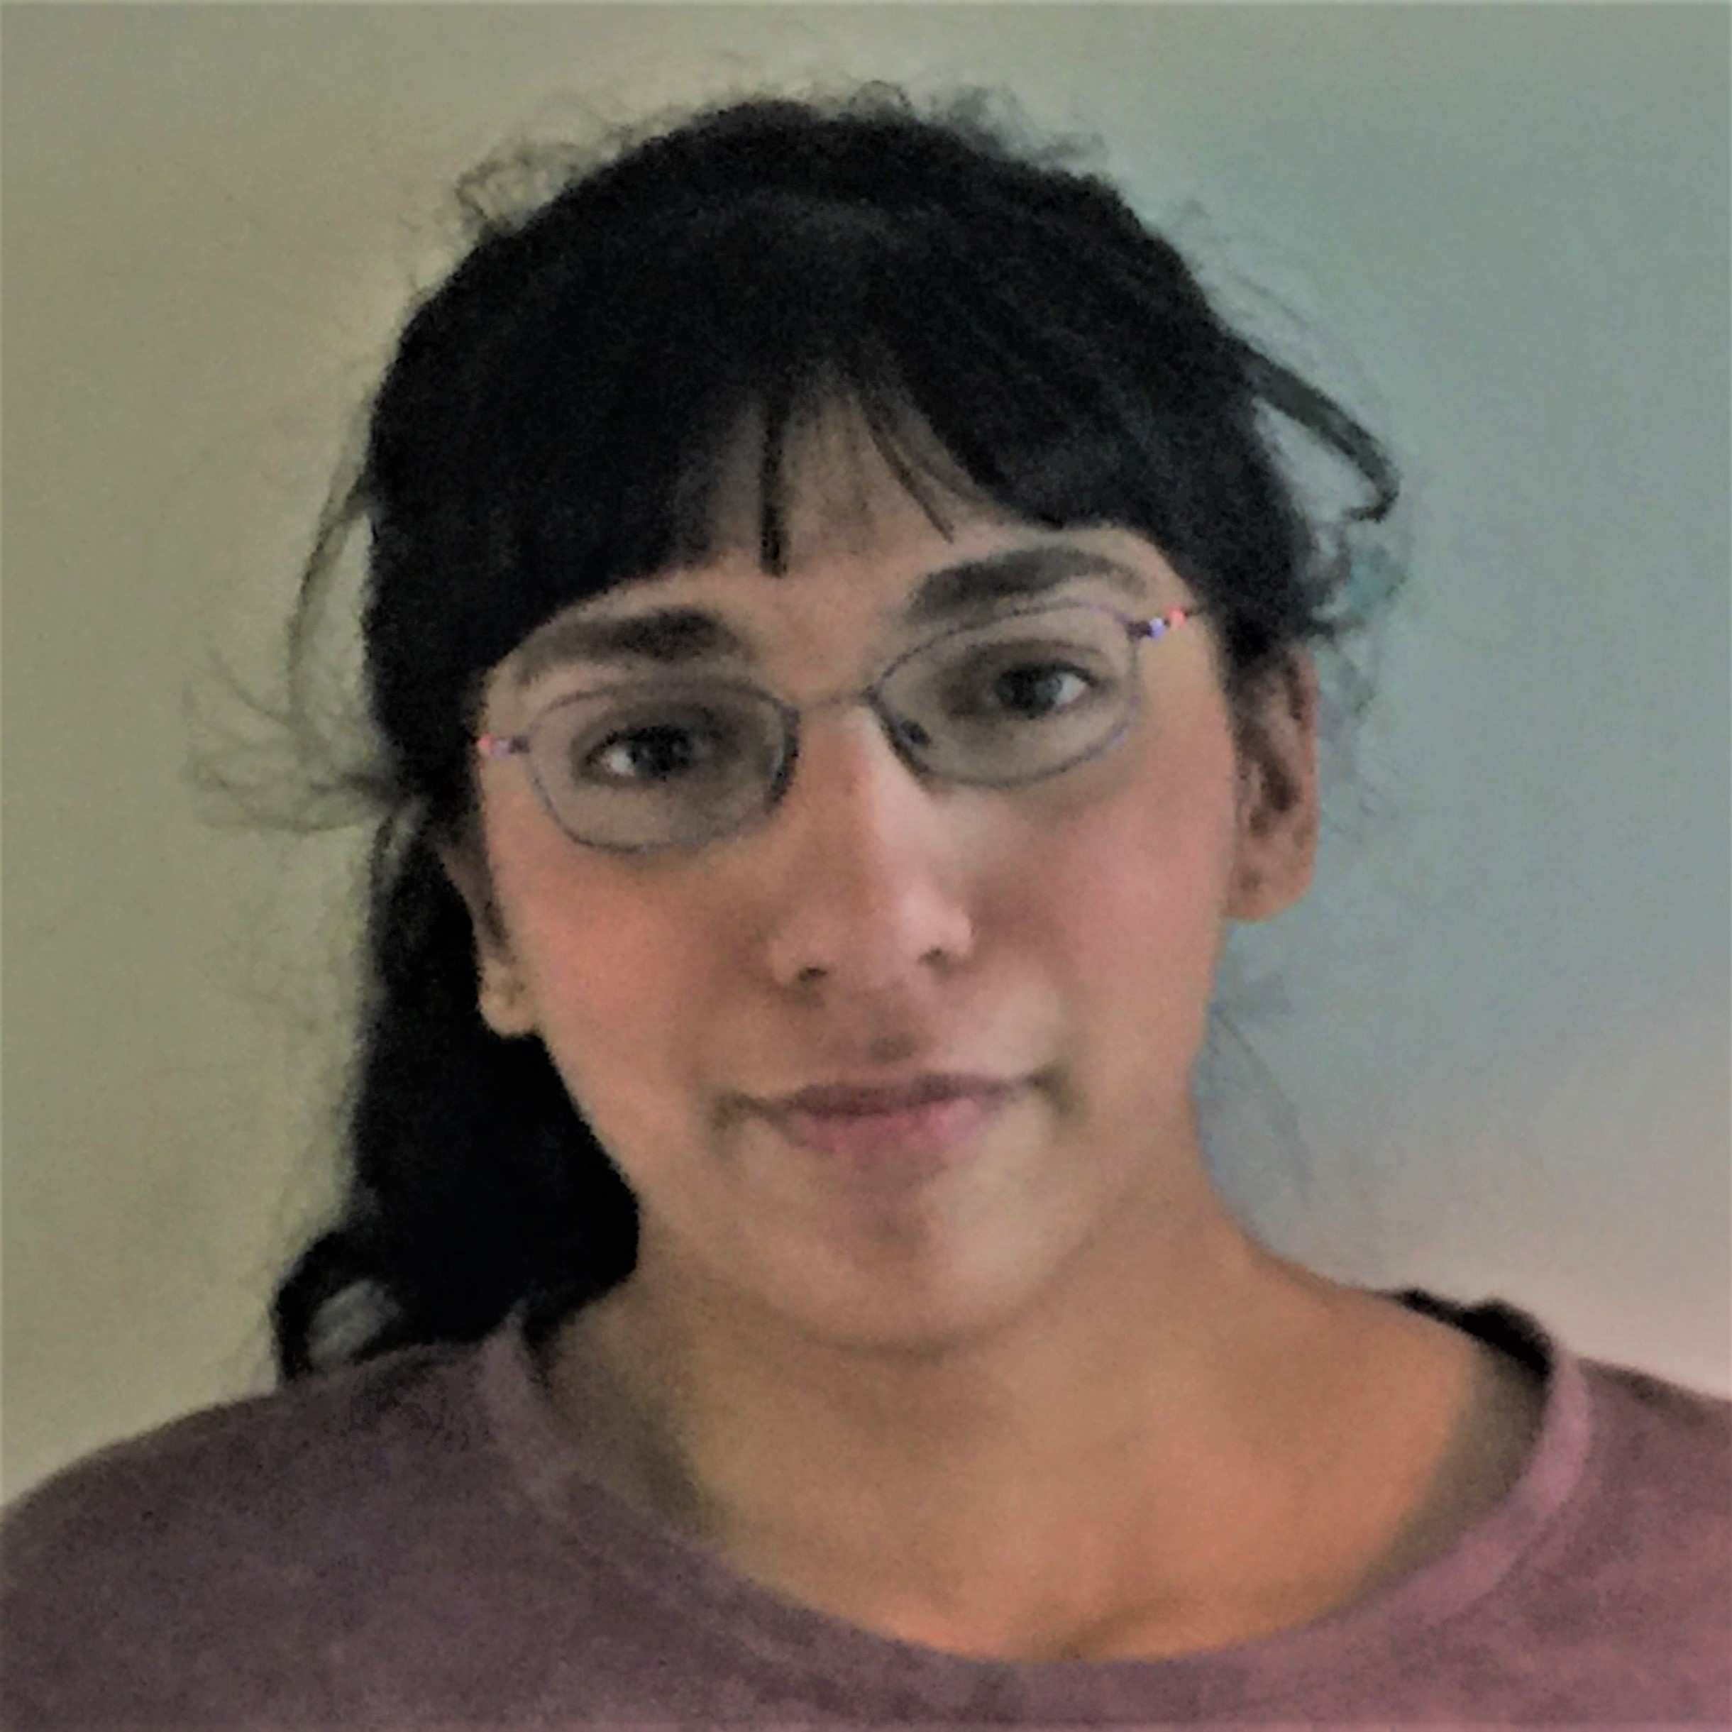
Thank you!
Thank you all for a great quarter!
This course would not have been possible without our amazing TAs!!

