Slide 1
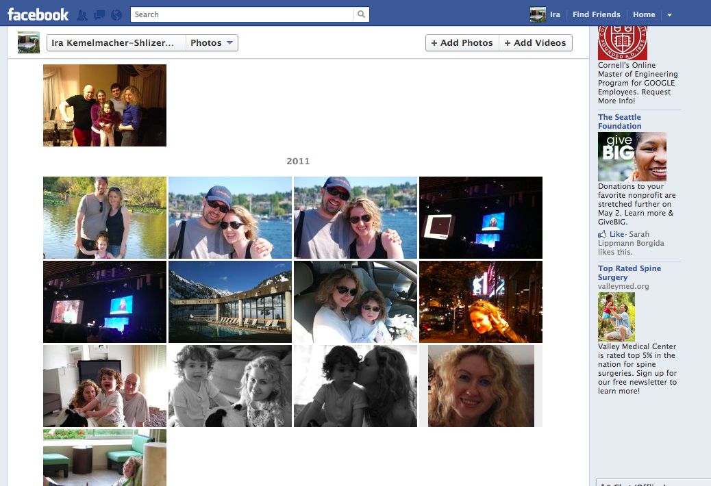

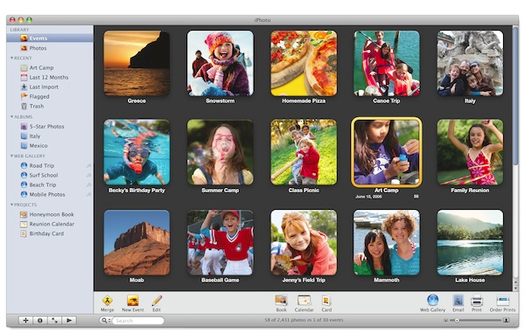

Computer Vision and Graphics
In the Wild
Personal collections:
Online collections:
Videos:
48 hours/minute
250 Billion
250 million/day
> Trillion

Slide 2
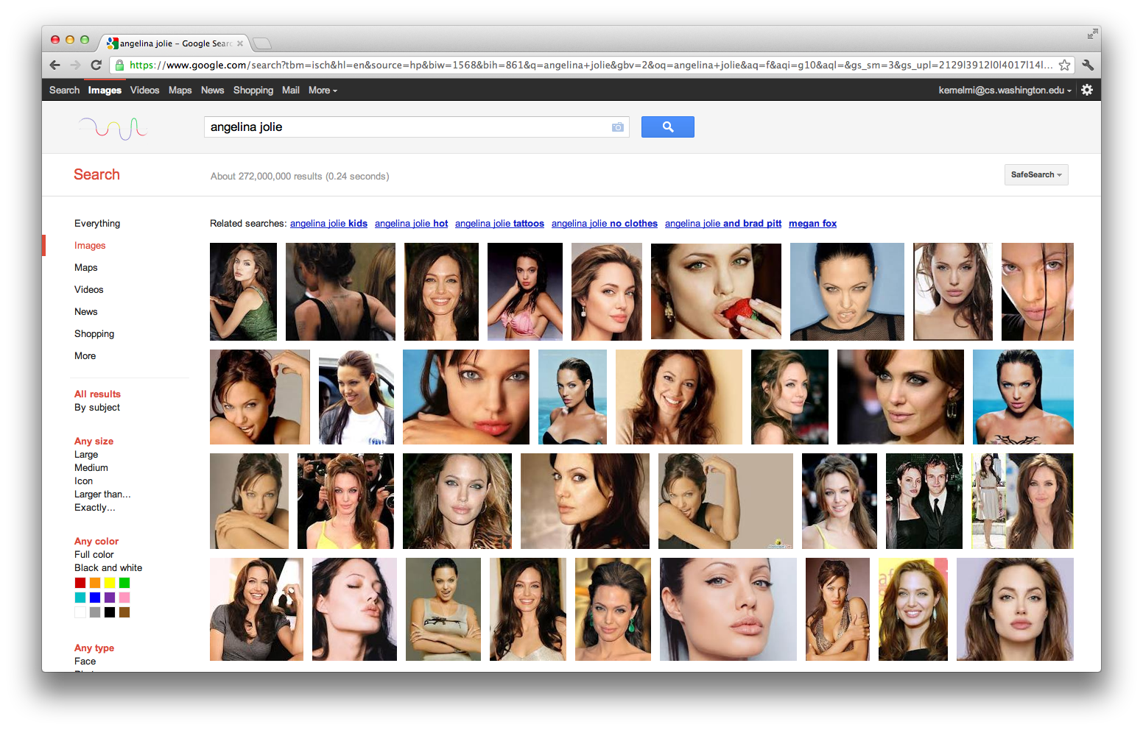

Variation in faces captured in Internet photos

Slide 3
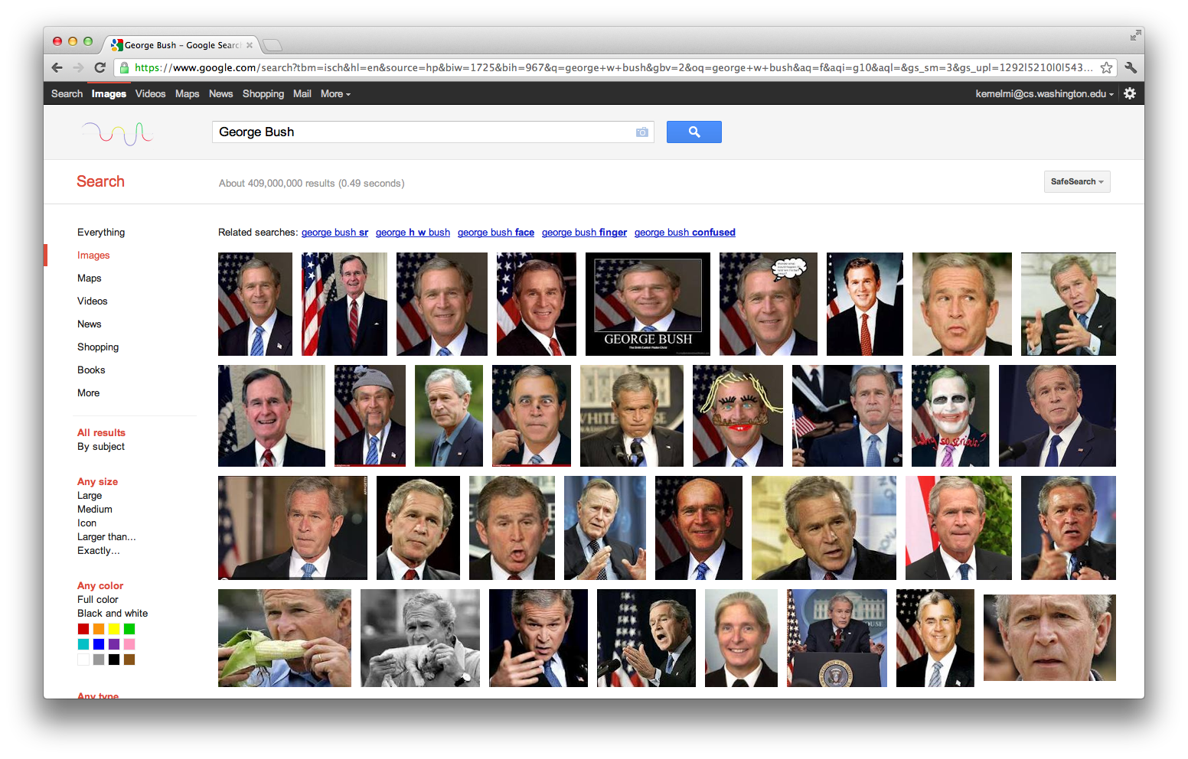
Variation in faces captured in Internet photos

Slide 4
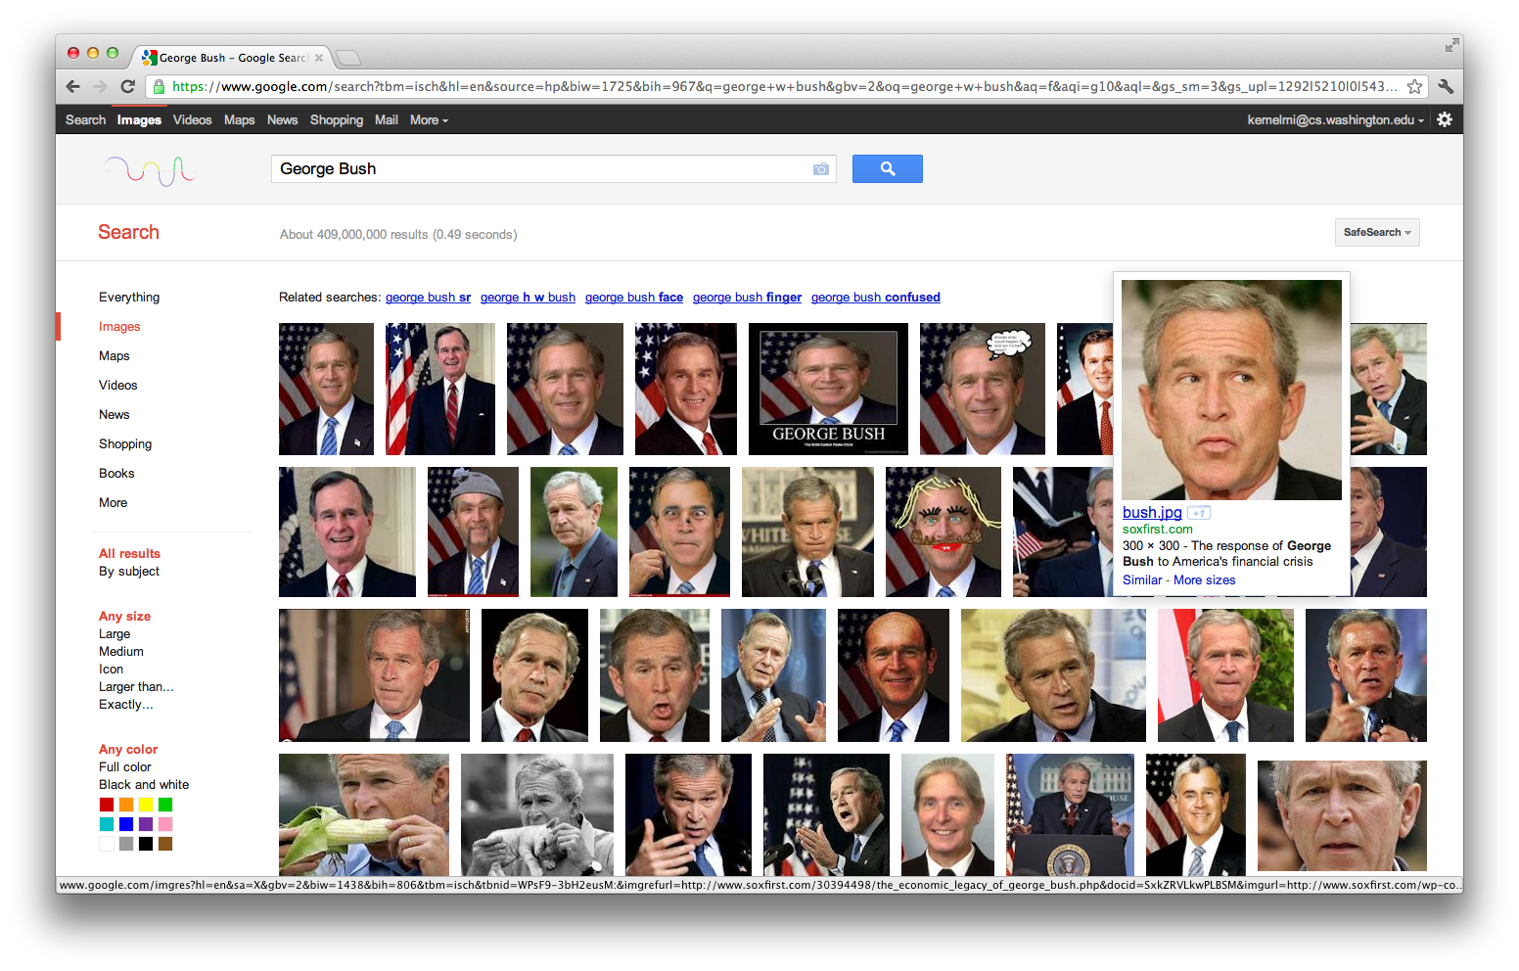
Variation in faces captured in Internet photos

Slide 5
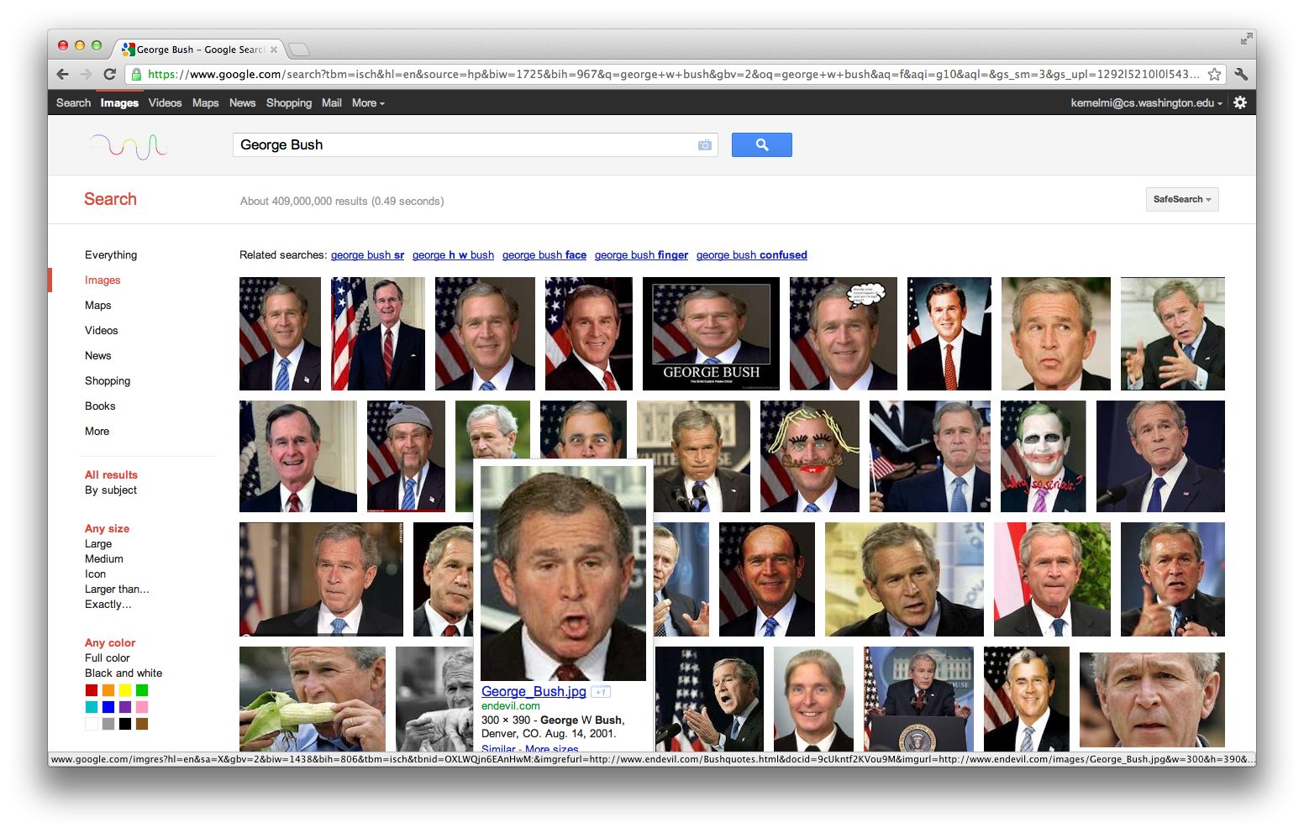
Variation in faces captured in Internet photos

Slide 6
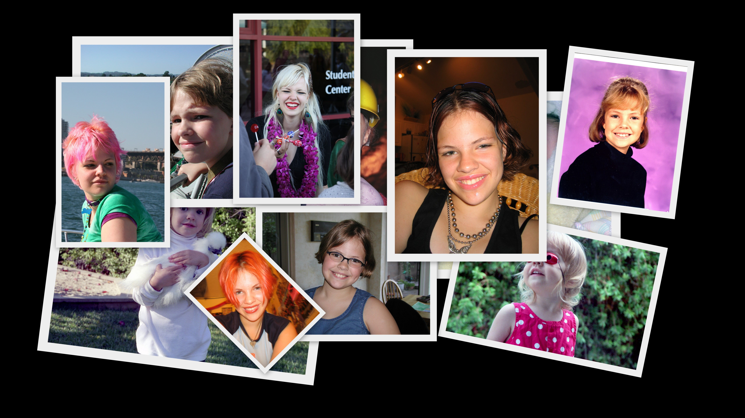
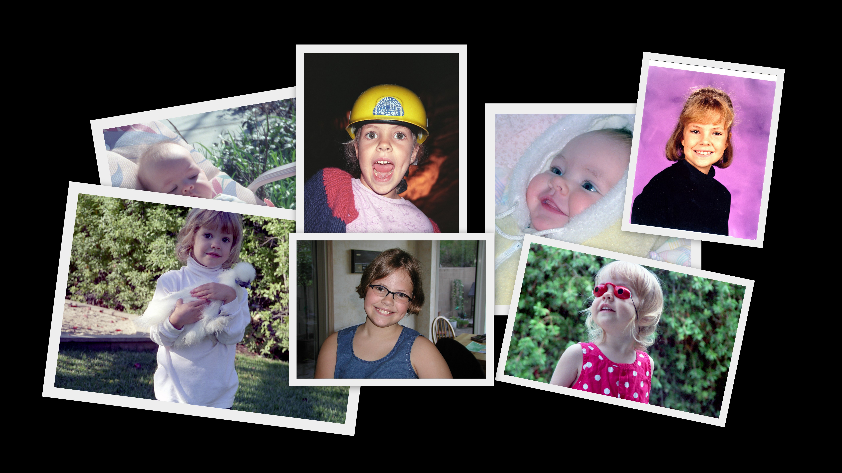
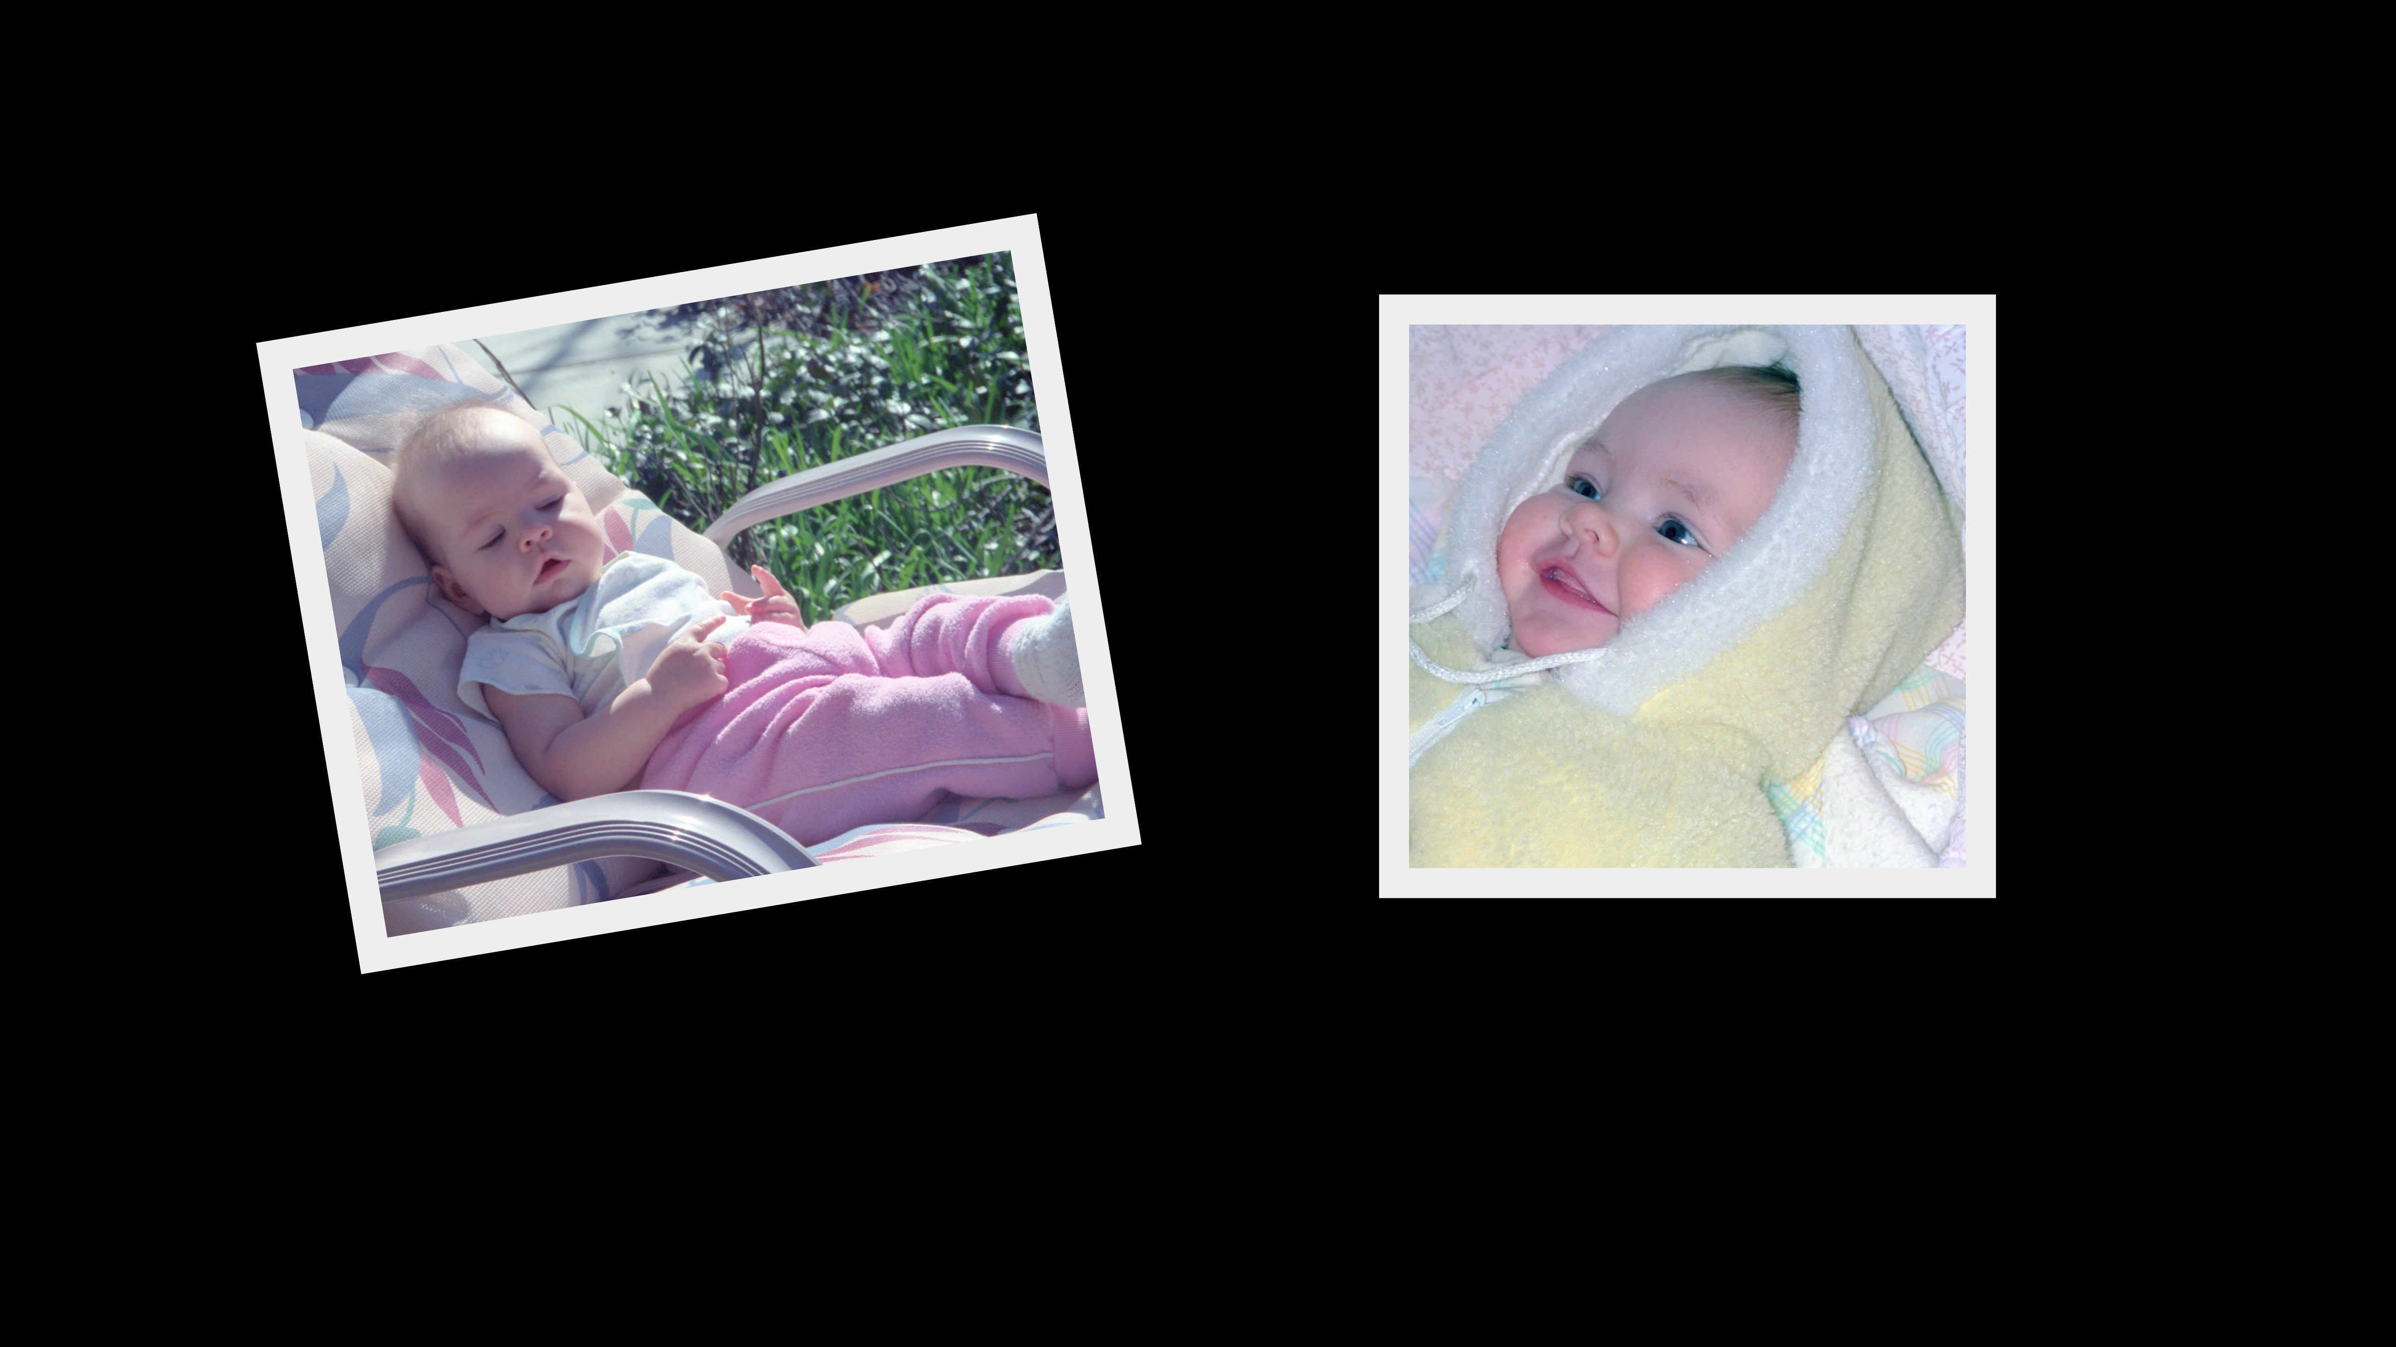
© Photos: Ariel McClendon
Notes:
Most of us are photographed thousands of times over our lives, and our photo collections are usually very big spanning many years and events.

Slide 7
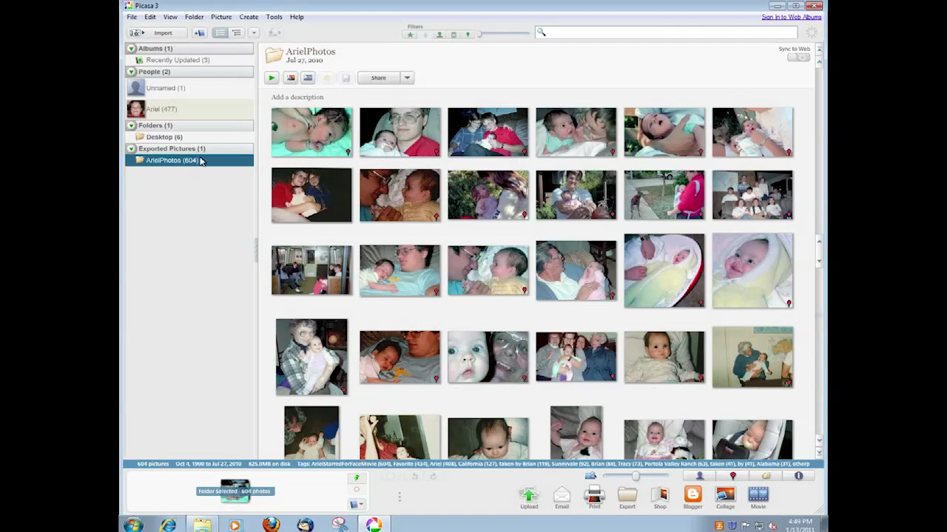
Notes:
Thanks to face tagging and face recognition advancement all of us can now easily process them and extract collection of a person. That collection is pretty amazing but it’s huge and very difficult to browse, so what one can do is to

Slide 8
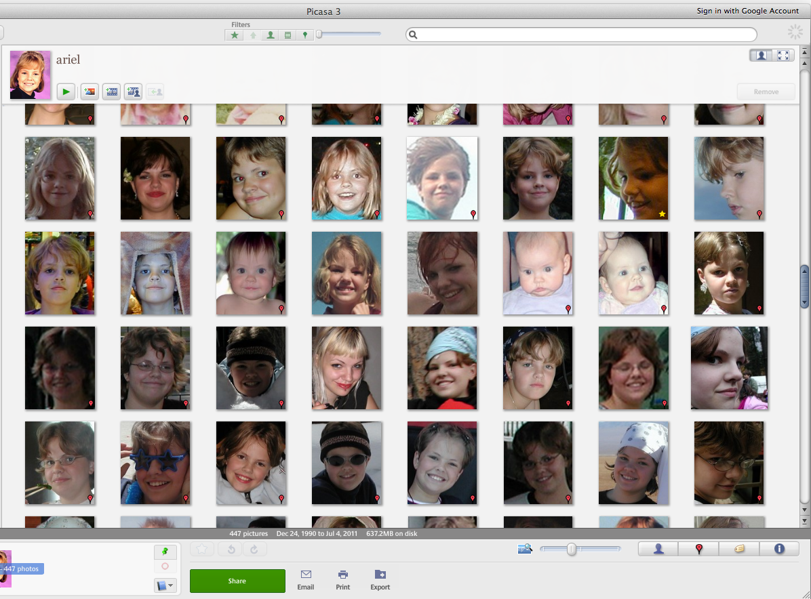
Challenges
Non-rigid (facial expressions, age…)
Occlusions (hair, glasses …)
Arbitrary lighting, pose
Different cameras, exposure, focus …
But: there are many photos!

Slide 9

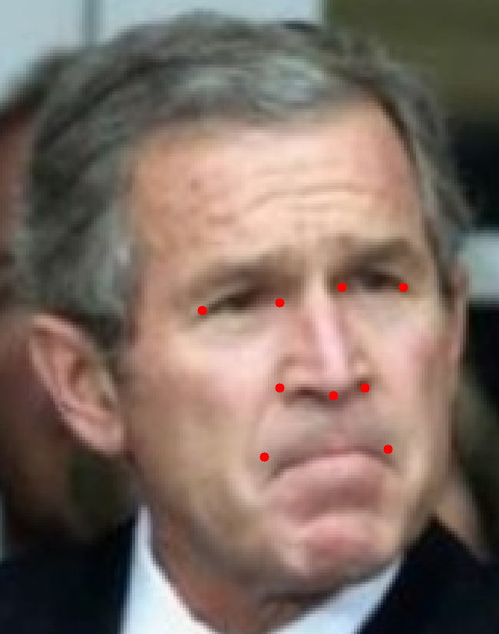

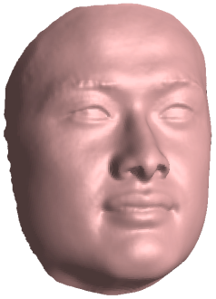
Image registration
Estimate 3D pose
Fiducial points
detection
Everingham et al. ‘06
2D registration
Face detection
Bourdev and Brandt ‘05
Template 3D model
Kemelmacher, Shechtman, Garg, Seitz, Exploring Photobios, SIGGRAPH’11
Notes:
Given such an unstructured colleciton the first thing we would like to do is to register the photos. We first detect the face in each photo and the fiducial points (corners of the mouth, eyes, nose ) . These two components we just use existing methods, we then

Slide 10

Image registration
Estimate 3D pose
Fiducial points
detection
Everingham et al. ‘06
3D
registration
Face detection
Bourdev and Brandt ‘05
Template 3D model
Kemelmacher, Shechtman, Garg, Seitz, Exploring Photobios, SIGGRAPH’11

Slide 11
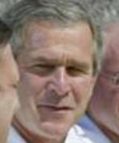
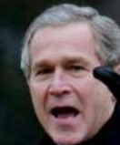
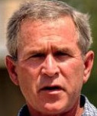
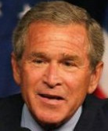
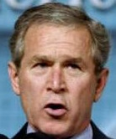
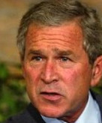

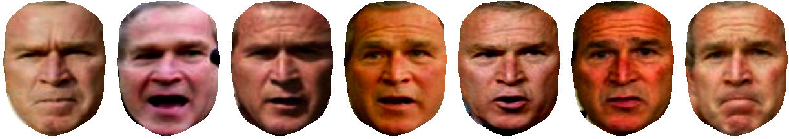
3D transformed photos
before
…
after
…
Notes:
Let say we can fix or apporoximately fix for the pose , and I will skip the details here but we do it automatically.
and correct the face to be in an approximately frontal position.
So we still have the expression change and the lighting.

Slide 12

Facial expression similarity
We use Local Binary Patterns – LBP (Ahonen et al. ‘06)
110
100
90
87
120
140
120
171
156
200
Notes:
We use descriptors that are called local binary patterns or LBP which in recent years shown to be very effective for face recognition, by themselves or in combination with HoG (histograms of gradients). I will describe the basic idea here and we have more details in the paper how we actually do it.
So, for each pixel in the image we look at a neighborhood around it, and the pixels intensity acts as a threshold, so in that case it is 120 so everything above that number will become 1 and below will become 0

Slide 13
Facial expression similarity
We use Local Binary Patterns – LBP (Ahonen et al. ‘06)
0
0
0
0
120
1
1
1
1
0 1 1 1 1 0 0 0
30
Binary code
Integer
Notes:
That produces a binary code that is then converted to an integer.

Slide 14
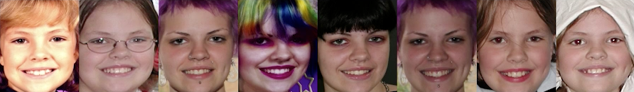
Facial expression similarity
Eyes
Mouth
Hair
Facial expression similarity
Eyes
Mouth
Hair
λ₁
+
λ₂
+
λ₃
Notes:
We decided to use those descriptors in the following way. We divide the face to areas of interest and consider each area separately.
Each area is divided to cells, for each pixel in each cell we calculate that integer descriptor, then a cell is represented by an histogram and all the histograms are concatenated together and then compared using chi-square distance.
The total similarity in facial expression is then weighted combination of the eyes, mouth and hair areas.

Slide 15
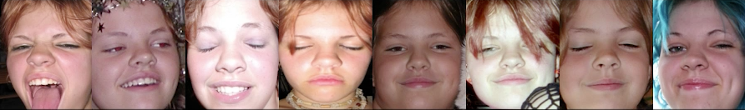
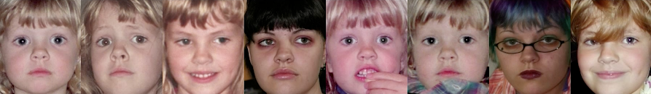
Facial expression similarity
Input
Nearest Neighbors
Eyes
Mouth
Hair
Notes:
And here is an example, for that input image, comparison of the eyes area yields those nearest neighbors. You can see how the eyes are more or less similar.
The next example is for mouth, and the final one for hair.
Stabilize the hair shape . not the color

Slide 16
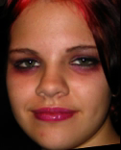
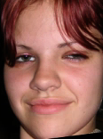



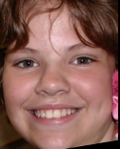



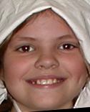



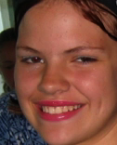

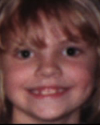
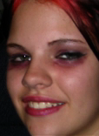

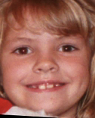
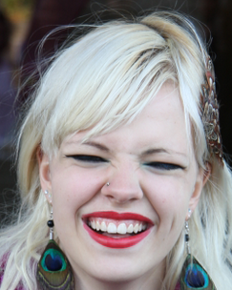
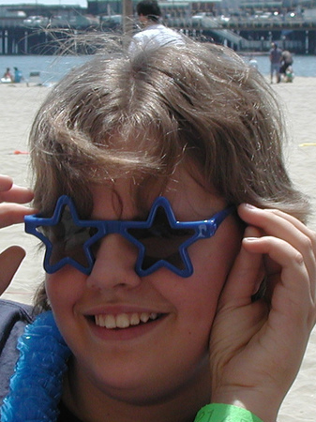
Represent the photo collection as a graph
Similarity between
2 photos
3D Head
Pose
similarity
Facial Expression
similarity
Time similarity

Slide 17
Represent the photo collection as a graph
Similarity between
2 photos
3D Head
Pose
similarity
Facial Expression
similarity
Time similarity

Slide 18
Represent the photo collection as a graph
Similarity between
2 photos
3D Head
Pose
similarity
Facial Expression
similarity
Time similarity

Slide 19
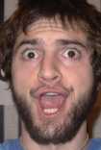
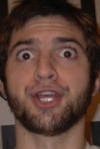
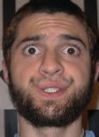
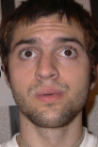
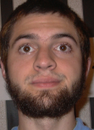
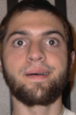
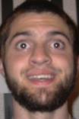
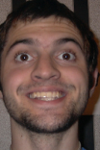
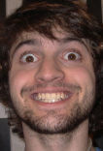
Automatically generated transition
Source
Target
© Photos: Jason Fletcher
Notes:
here an example of a transition that we generated from this guys collection. we chose those two pictures as endpoints and found the optimal path between them
note the continious changes in the forehead as well as mouth expression and stable eyes.

Slide 20
Analyze low dimensional space of Internet images (after pose correction)
M =
# Pixels
# Images
Notes:
Now new slide --- show stack of images of Geoge images.
My goal is still to solve optical flow for these two images.
Now we have tons of photos of george bush to help with that problem.
X – axis caption
Y – axis caption
Stack all the rows to one column.
Go back and forth between that and the neutralized version. Do an animation (not manual)
Why does this happen

Slide 21
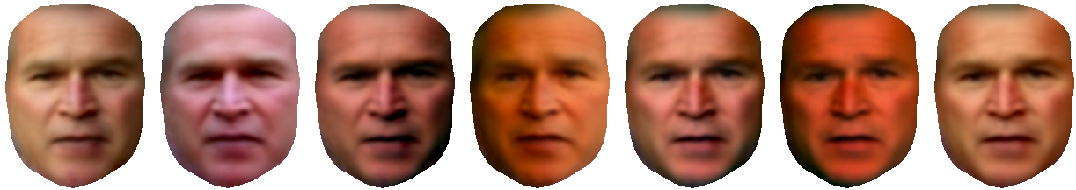
Analyze low dimensional space of Internet images (after pose correction)
M₄=
# Pixels
# Images
Notes:
Look for example on the second image when I switch between the two representations.

Slide 22
Expression gets normalized
Shading captured
Warped to frontal
Expression normalized
Rank = 4

Slide 23
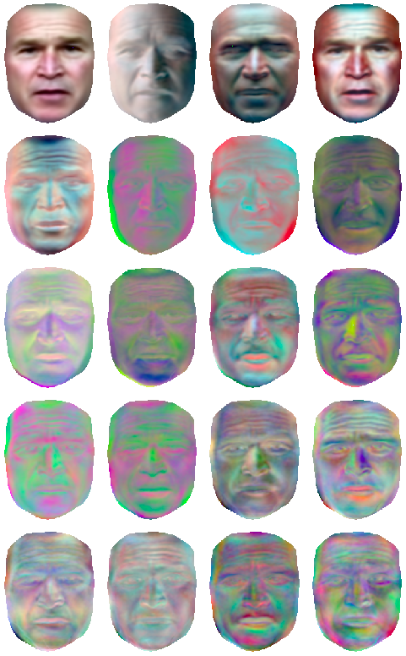
Why expression normalized by rank=4?
Lighting dominates facial expression
1) Rank 4 for rigid has >90% energy
Ramamoorthi & Hanrahan’01, Basri & Jacobs’01
Lighting affects all pixels (dense)
Expression (non-rigid) affects mostly edge pixels (sparse)
& captured by rank=5,6,…
Kemelmacher and Seitz, Collection Flow, CVPR’12
…

Slide 24
This is actually a photometric stereo setup
M₄=
# Pixels
  rigid object, fixed pose, varying lighting
Notes:
But let me take you back to my slide with the phenomena that expression can be normalized. It is like we brought Bush to a lab. Made him rigid and now we can actually use perhaps photometric stereo ? How ? Let me elaborate a bit about photometric stereo

Slide 25

Photometric Stereo with Constrained Light
T
Shape
Light
Coeff.
=
#images x #pixels
Factorization using SVD
Ikeuchi,81 , Nayar, 90, Hayakawa JOSA’94, Barsky and Petro, 03, Hertzmann and Seitz, 05
Woodham, Optical Eng.’80, JOSA’94

Slide 26

Photometric Stereo with Arbitrary Light
T
Light
Coeff.
=
4 x #pixels
#images x #pixels
#images x 4
Using spherical harmonics representation for
shape (surface normals) and lighting
Basri, Jacobs and Kemelmacher, Photometric Stereo with General Unknown Lighting, IJCV’07

Slide 27



Photometric Stereo with Arbitrary Light
T
Light
Coeff.
=
4 x #pixels
#images x #pixels
#images x 4
Solving for 4x4 ambiguity
Up to Lorenz transformation (6dof)
Basri, Jacobs and Kemelmacher, Photometric Stereo with General Unknown Lighting, IJCV’07

Slide 28
Photometric Stereo with Arbitrary Light
T
Light
Coeff.
=
4 x #pixels
#images x #pixels
#images x 4
For faces use another person’s
face to solve the ambiguity
Kemelmacher and Seitz, Face Reconstruction in the Wild, ICCV’11
Notes:
End with “why am I describing that” … because this is a way to reconstruct the 3d shape.

Slide 29
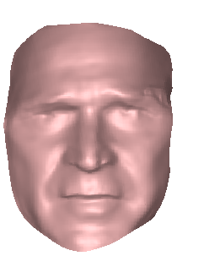
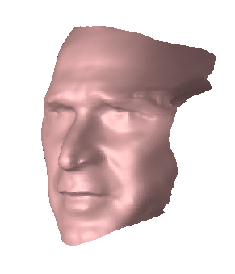
Shape Estimation Result
Kemelmacher and Seitz, Face Reconstruction in the Wild, ICCV’11
Notes:
Ok, and I really want you to appreciate that result

Slide 30
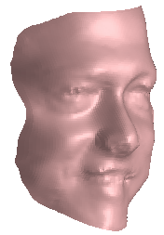
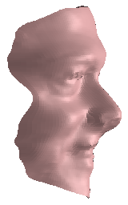
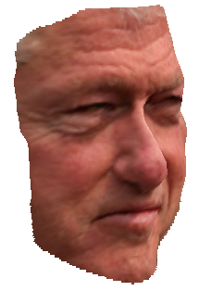

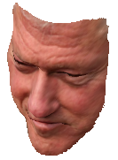
Shape Estimation Result
Notes:
And we can do it for anyone! Just from the photos.

Slide 31






Shape Estimation Result

Slide 32
Lighting invariant optical flow
?
input images
bright. const. doesn’t hold
b.c.
satisfied
b.c.
satisfied
k-rank projections
of warped images
flow=0
Key properties of projected images:
1) Very similar lighting/shading to their corresponding input
2) Deformation (facial expression) normalized!

Slide 33

Result of flow estimation applied to morphing
Accounts for lighting and shape changes
Notes:
Before that show… here what we get with cross dissolve…
And here what we get with
Show pair of images. Of bush. morpjed

Slide 34

Challenging for state of the art
Note the distortions due to violation of the brightness constancy
C. Liu. PhD thesis, MIT, 2009
Brox et al. ECCV’04
Bruhn et al. IJCV’05

Slide 35
State of the art flow on unstructured photos
TV-L₁
Chambolle & Pock, J. Mathematical Imaging and Vision 2011

Slide 36
State of the art flow on unstructured photos
SIFT Flow
C. Liu, J. Yuen, and A. Torralba. Sift ﬂow: Dense correspondence across scenes.. PAMI’11

Slide 37
Collection Flow (ours)
Accounts for lighting and shape changes
Kemelmacher and Seitz, Collection Flow, CVPR’12

Slide 38



Collection Flow
Automatically synthesized photos
TV-L₁
Brox et al. &
Bruhn et al.

Slide 39

Result of flow estimation applied to morphing
Accounts for lighting and shape changes

Slide 40


Automatically synthesized photos
I
J

Slide 41



Animation from Internet photos
Notes:
Final result that summarizes the whole method. Automatic selection of photos and transitions between them .

Slide 42


Face Movie feature in Google’s Picasa
Notes:
All invited to try…

Slide 43

Notes:
And here goes Google’s promo of Face Movies…

Slide 44


Slide 45

Being John Malkovich
Kemelmacher, Sankar, Shechtman, Seitz
Being John Malkovich, ECCV’10
Notes:
Adtiya is controlling a different person. Just by doing nearest neighbor …
A new way to SEARCH huge collection of photos…

Slide 46



How to animate the resulted photo sequence?
Linear interpolation (cross-dissolve)
between 2 images
can create physical motion
Notes:
Many transitions are possible. But we discovered that actually the simplest one produces physical motion.
What you saw in the previous examples (and google movie) it was linear interpolation

Slide 47

What is Cross-Dissolve?
FADE OUT
FADE IN
Notes:
Linear interpolation or in that context is known as the cross dissolve means the following.
It means that we simultaniously fade out one image while fading in the other image and adding them together.
Why would this produce motion?

Slide 48

Cross-Dissolve produces motion
Why?
Notes:
Note how the nose moves and the mouth . And it turns out the similar analysis applies to lighting as well. We have a proof in the paper

Slide 49
Lets represent an image as a collection of edges
Notes:
Show the dge map superimposed. Canny…
Essentially Image can be considered as a collection of edges. When the intensity goes between light to dark and back to light for example. And there are edges at different frequencies. There are edges at lower freq – meaning that it is more smooth and higher freq mean that sharper edges.
If we can figure out how the edges move we can understand how the face moves.
So lets take an edge, a zoomin on that edge will look like this

Slide 50
Lets represent an image as a collection of edges
Notes:
If we will horizontally translate the image we will get the following edge in the same location.

Slide 51
Can we move one edge to another?
Image 1
Image 2
Notes:
So here are the two edges

Slide 52



Let’s approximate with a sine
Notes:
And the key insight is that an edge can be approximated with a sine. And once you approximate that with a sine you can actually prove things. and that wasn’t realized that apporixmation and what can be derived from it.
Now, the derivation is trivial …

Slide 53
While doing cross-dissolve we see motion!
Cross dissolve
Notes:
A cross dissolve of a sine with a shifted sine will produce motion

Slide 54

It is actually a physical motion!
Cross dissolve
Notes:
“sine not a non linear…”
. Because it is another sine. And there are two parameters. C and k
C is the amplitude, or the contrast
K is the speed of motion
And there are expressions for them.
So lets ignore c and just consider k – the speed

Slide 55

Motion effect with larger phase shift
Cross dissolve
Notes:
And take a larger phase shift to see the effect of the speed
The edge moves faster.

Slide 56




The motion is non linear
There is slow-in slow-out
dynamics
Rule of Thumb in animation
Walt Disney Animation Principles, 1930
J. Lasseter, SIGGRAPH’87
Kemelmacher et al. SIGGRAPH’11
Notes:
Add rotation and lighting… but don’t explain
Same framework…
And it is easy to derive a parametric expression for the speed. And when we plot it for different phase shift we get this plot. Take a look on the red curve. The behavious that comes out naturally from cross dissolve is slow in in the beginning then go fast and then slow out again. This is actually a rule of thumb that is known to animators for more than a century, that this is the way animation should be since it will be more realistic, and they have the same curve. And we have shown why that happens and how to make it.

Slide 57
When motion is produced?
Approximately same frequency edges
The distance edges can move depends on the frequency
Notes:
Can move less →
Image of sharp edge. Smooth edge..
Ok when does it work? It works when edges are more or less the same frequency.
and the distance that an edge can move depends on the frequency of the edge.
Sharped edges can move less and smoother edge move a lot.
And lets see how it looks on images

Slide 58



Cross-dissolve produces edge rotation
Cross dissolve
= edge rotation (proof in the paper)
Image 1
Image 2
Notes:
Works for rotations..

Slide 59




Cross-dissolve produces light motion
Cross dissolve
= light motion (proof in the paper)
Image 1
Image 2
Notes:
Similar derivation… cosine…

