Slide 1
Image Stitching
Ali Farhadi
CSE 576
Several slides from Rick Szeliski, Steve Seitz, Derek Hoiem, and Ira Kemelmacher

Slide 2
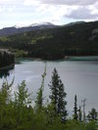
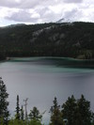
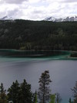
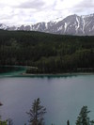
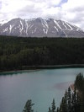
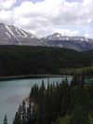
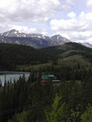
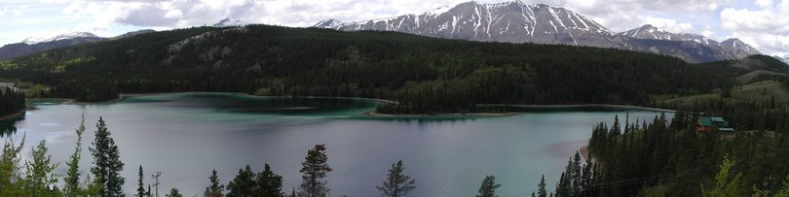
Combine two or more overlapping images to make one larger image
Add example
Slide credit: Vaibhav Vaish

Slide 3
How to do it?
Basic Procedure
  Take a sequence of images from the same position
    Rotate the camera about its optical center
  Compute transformation between second image and first
  Shift the second image to overlap with the first
  Blend the two together to create a mosaic
  If there are more images, repeat

Slide 4
  1. Take a sequence of images from the same position
    Rotate the camera about its optical center

Slide 5
  2. Compute transformation between images
Extract interest points
Find Matches
Compute transformation
?

Slide 6
  3. Shift the images to overlap

Slide 7
  4. Blend the two together to create a mosaic

Slide 8
5. Repeat for all images

Slide 9
How to do it?
Basic Procedure
  Take a sequence of images from the same position
    Rotate the camera about its optical center
  Compute transformation between second image and first
  Shift the second image to overlap with the first
  Blend the two together to create a mosaic
  If there are more images, repeat
✓

Slide 10
Compute Transformations
✓
Extract interest points
Find good matches
Compute transformation
✓
Let’s assume we are given a set of good matching interest points

Slide 11
Image reprojection
mosaic PP
The mosaic has a natural interpretation in 3D
  The images are reprojected onto a common plane
  The mosaic is formed on this plane

Slide 12


Example
Camera Center

Slide 13

Image reprojection
Observation
  Rather than thinking of this as a 3D reprojection, think of it as a 2D image warp from one image to another

Slide 14
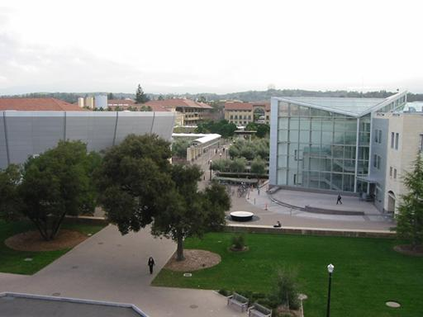
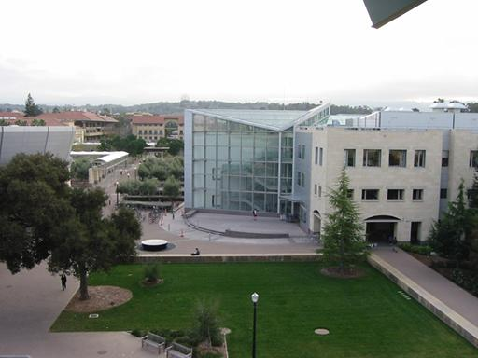
Motion models
What happens when we take two images with a camera and try to align them?
translation?
rotation?
scale?
affine?
Perspective?

Slide 15



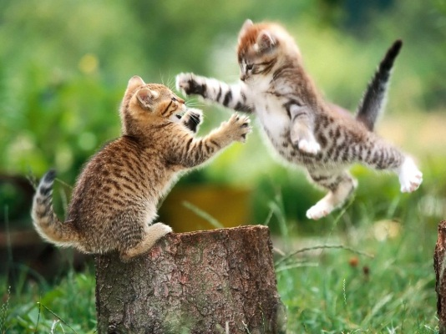


Recall: Projective transformations
(aka homographies)

Slide 16




Parametric (global) warping
Examples of parametric warps:
translation
rotation
aspect
perspective
affine

Slide 17
2D coordinate transformations
translation: x’ = x + t x = (x,y)
rotation: x’ = R x + t
similarity: x’ = s R x + t
affine: x’ = A x + t
perspective: x’ ≅ H x x = (x,y,1)
(x is a homogeneous coordinate)

Slide 18
Image Warping
Given a coordinate transform x’ = h(x) and a source image f(x), how do we compute a transformed image g(x’) = f(h(x))?
h(x)
x
x’
f(x)
g(x’)

Slide 19
Forward Warping
Send each pixel f(x) to its corresponding location x’ = h(x) in g(x’)
What if pixel lands “between” two pixels?
h(x)
x
x’
f(x)
g(x’)

Slide 20
Forward Warping
Send each pixel f(x) to its corresponding location x’ = h(x) in g(x’)
What if pixel lands “between” two pixels?
Answer: add “contribution” to several pixels, normalize later (splatting)
h(x)
x
x’
f(x)
g(x’)

Slide 21
Inverse Warping
Get each pixel g(x’) from its corresponding location x’ = h(x) in f(x)
What if pixel comes from “between” two pixels?
h⁻¹(x)
x
x’
f(x)
g(x’)

Slide 22
Inverse Warping
Get each pixel g(x’) from its corresponding location x’ = h(x) in f(x)
What if pixel comes from “between” two pixels?
Answer: resample color value from interpolated source image
h⁻¹(x)
x
x’
f(x)
g(x’)

Slide 23

Interpolation
Possible interpolation filters:
  nearest neighbor
  bilinear
  bicubic (interpolating)

Slide 24



Motion models
Translation
Affine
Perspective
2 unknowns
6 unknowns
8 unknowns

Slide 25
Finding the transformation
Translation = 2 degrees of freedom
Similarity = 4 degrees of freedom
Affine = 6 degrees of freedom
Homography = 8 degrees of freedom
How many corresponding points do we need to solve?

Slide 26
Plane perspective mosaics
  8-parameter generalization of affine motion
    works for pure rotation or planar surfaces
  Limitations:
    local minima
    slow convergence
    difficult to control interactively

Slide 27
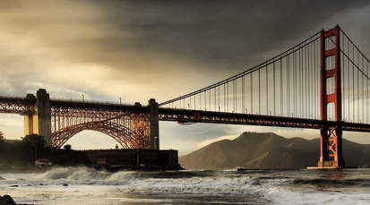
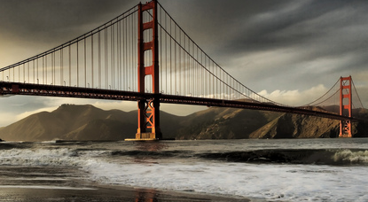

Simple case: translations
How do we solve for
?

Slide 28









Simple case: translations
Displacement of match i =
Mean displacement =

Slide 29

Simple case: translations
System of linear equations
  What are the knowns? Unknowns?
  How many unknowns? How many equations (per match)?

Slide 30
Simple case: translations
Problem: more equations than unknowns
  “Overdetermined” system of equations
  We will find the least squares solution

Slide 31


Least squares formulation
For each point
we define the residuals as

Slide 32

Least squares formulation
Goal: minimize sum of squared residuals
“Least squares” solution
For translations, is equal to mean displacement

Slide 33




Least squares
Find t that minimizes
To solve, form the normal equations

Slide 34





Solving for translations
Using least squares
2n x 2
2 x 1
2n x 1

Slide 35

Affine transformations
How many unknowns?
How many equations per match?
How many matches do we need?

Slide 36



Affine transformations
Residuals:
Cost function:

Slide 37

Affine transformations
Matrix form
2n x 6
6 x 1
2n x 1

Slide 38



Solving for homographies

Slide 39

Solving for homographies

Slide 40






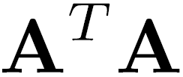
Direct Linear Transforms
2n × 9
9
2n
Defines a least squares problem:
  Since is only defined up to scale, solve for unit vector
  Solution: = eigenvector of with smallest eigenvalue
  Works with 4 or more points

Slide 41

Matching features
What do we do about the “bad” matches?

Slide 42
RAndom SAmple Consensus
Select one match, count inliers

Slide 43
RAndom SAmple Consensus
Select one match, count inliers

Slide 44
Least squares fit
Find “average” translation vector

Slide 45
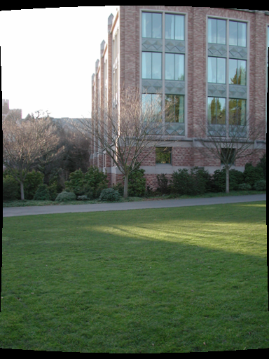
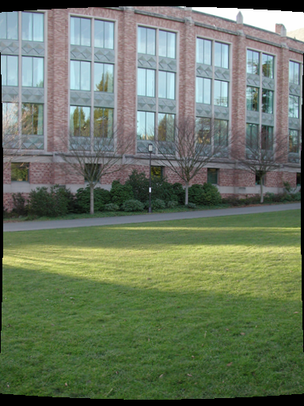

Slide 46
RANSAC for estimating homography
RANSAC loop:
Select four feature pairs (at random)
Compute homography H (exact)
Compute inliers where ||p_{i}’, H p_{i}|| < ε
Keep largest set of inliers
Re-compute least-squares H estimate using all of the inliers

Slide 47
Simple example: fit a line
Rather than homography H (8 numbers)
fit y=ax+b (2 numbers a, b) to 2D pairs
47

Slide 48
Simple example: fit a line
Pick 2 points
Fit line
Count inliers
3 inliers
48

Slide 49
Simple example: fit a line
Pick 2 points
Fit line
Count inliers
4 inliers
49

Slide 50
Simple example: fit a line
Pick 2 points
Fit line
Count inliers
9 inliers
50

Slide 51
Simple example: fit a line
Pick 2 points
Fit line
Count inliers
8 inliers
51

Slide 52
Simple example: fit a line
Use biggest set of inliers
Do least-square fit
52

Slide 53
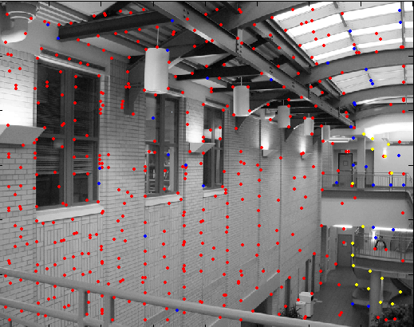
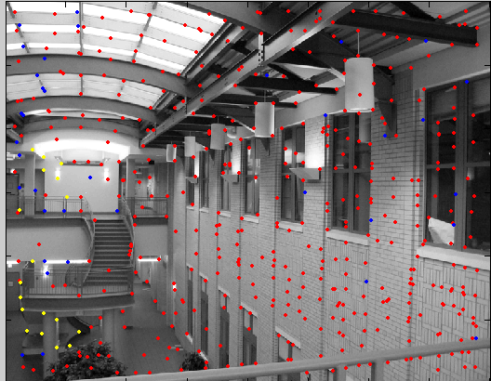
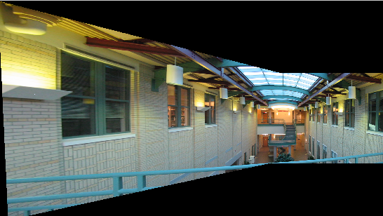
RANSAC
Red:
rejected by 2nd nearest neighbor criterion
Blue:
Ransac outliers
Yellow:
inliers

Slide 54
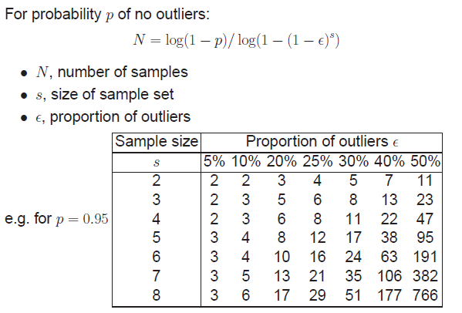
How many rounds?
If we have to choose s samples each time
  with an outlier ratio e
  and we want the right answer with probability p

Slide 55
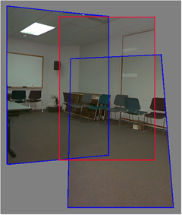
Rotational mosaics
  Directly optimize rotation and focal length
  Advantages:
    ability to build full-view
    panoramas
    easier to control interactively
    more stable and accurate
    estimates

Slide 56
Rotational mosaic
Projection equations
Project from image to 3D ray
(x₀,y₀,z₀) = (u₀-u_{c},v₀-v_{c},f)
Rotate the ray by camera motion
(x₁,y₁,z₁) = R₀₁ (x₀,y₀,z₀)
Project back into new (source) image
(u₁,v₁) = (fx₁/z₁+u_{c},fy₁/z₁+v_{c})

Slide 57
Computing homography
Assume we have four matched points: How do we compute homography H?
Normalized DLT
Normalize coordinates for each image
  Translate for zero mean
  Scale so that average distance to origin is ~sqrt(2)
  This makes problem better behaved numerically
Compute using DLT in normalized coordinates
Unnormalize:

Slide 58
Computing homography
Assume we have matched points with outliers: How do we compute homography H?
Automatic Homography Estimation with RANSAC
Choose number of samples N
Choose 4 random potential matches
Compute H using normalized DLT
Project points from x to x’ for each potentially matching pair:
Count points with projected distance < t
  E.g., t = 3 pixels
Repeat steps 2-5 N times
  Choose H with most inliers
HZ Tutorial ‘99

Slide 59
Automatic Image Stitching
Compute interest points on each image
Find candidate matches
Estimate homography H using matched points and RANSAC with normalized DLT
Project each image onto the same surface and blend

Slide 60




RANSAC for Homography
Initial Matched Points

Slide 61
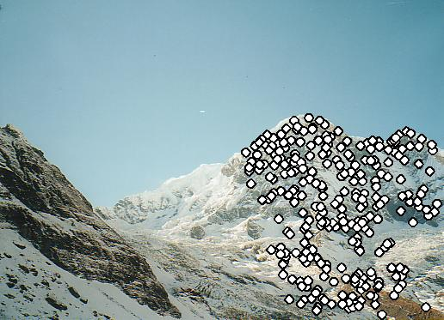
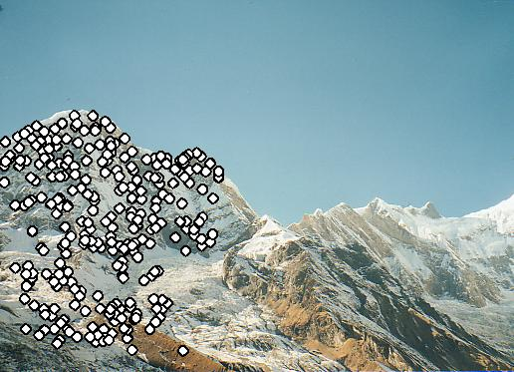
RANSAC for Homography
Final Matched Points

Slide 62

RANSAC for Homography

Slide 63
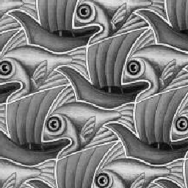
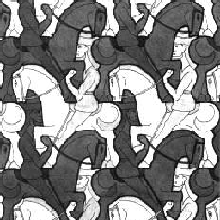
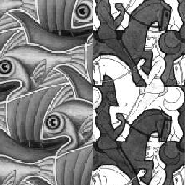
Image Blending

Slide 64
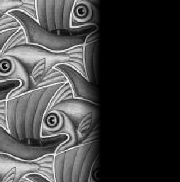
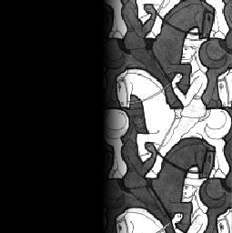

Feathering
+
1
1
0
0
=

Slide 65
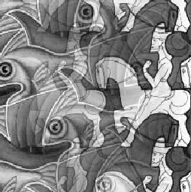
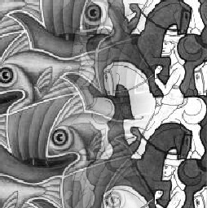
Effect of window (ramp-width) size
1
left
1
right
0
0

Slide 66


Effect of window size
1
1
0
0

Slide 67

Good window size
1
0
“Optimal” window: smooth but not ghosted
Doesn’t always work...

Slide 68
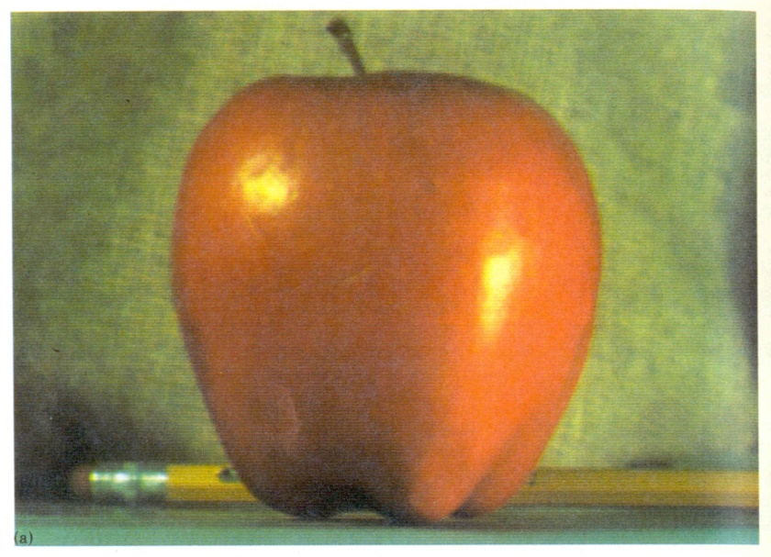
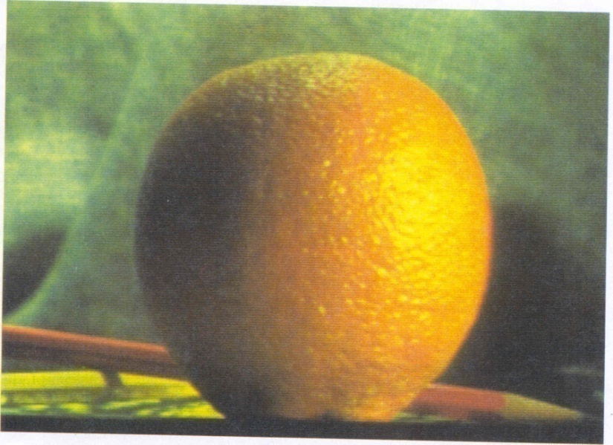
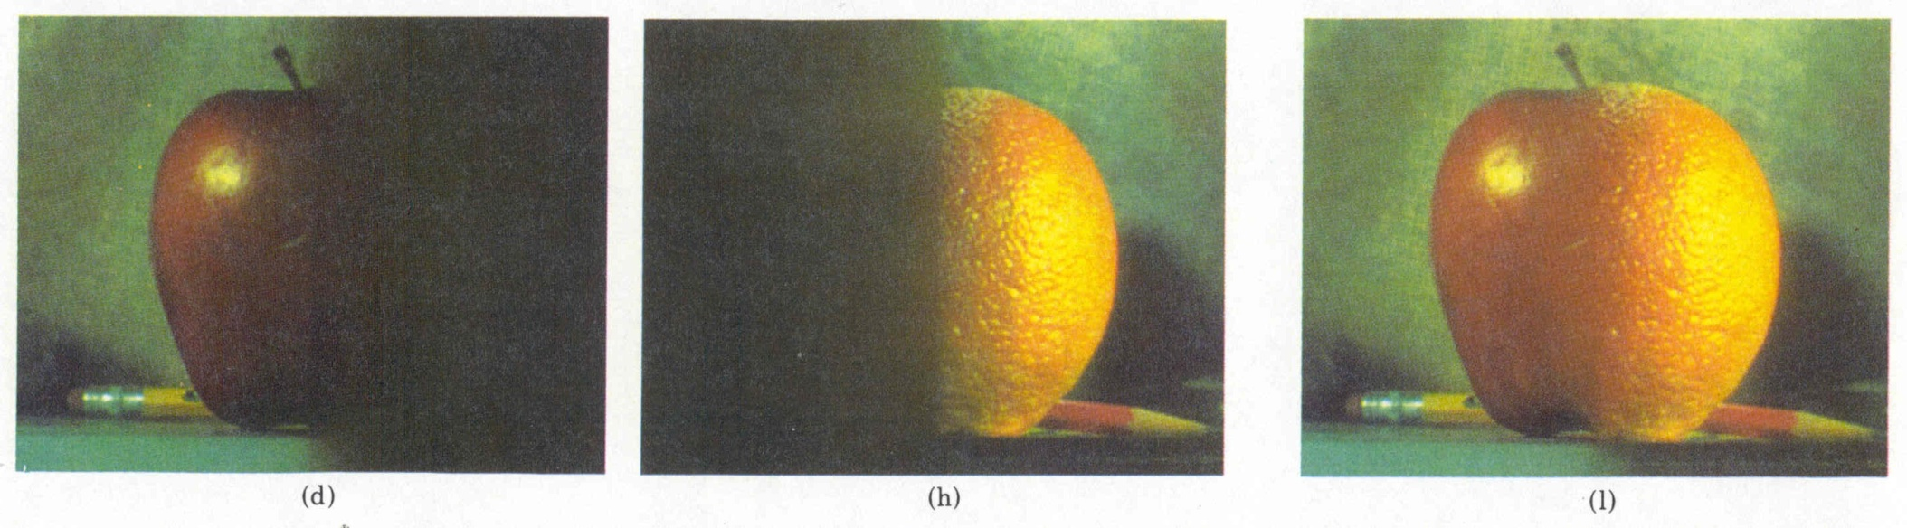
Pyramid blending
Create a Laplacian pyramid, blend each level
Burt, P. J. and Adelson, E. H., A multiresolution spline with applications to image mosaics, ACM Transactions on Graphics, 42(4), October 1983, 217-236.

Slide 69






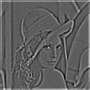
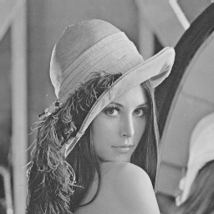

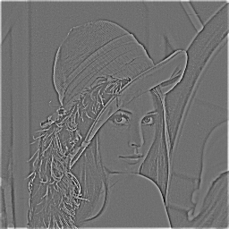
The Laplacian Pyramid
Gaussian Pyramid
Laplacian Pyramid
-
=
-
=
-
=

Slide 70
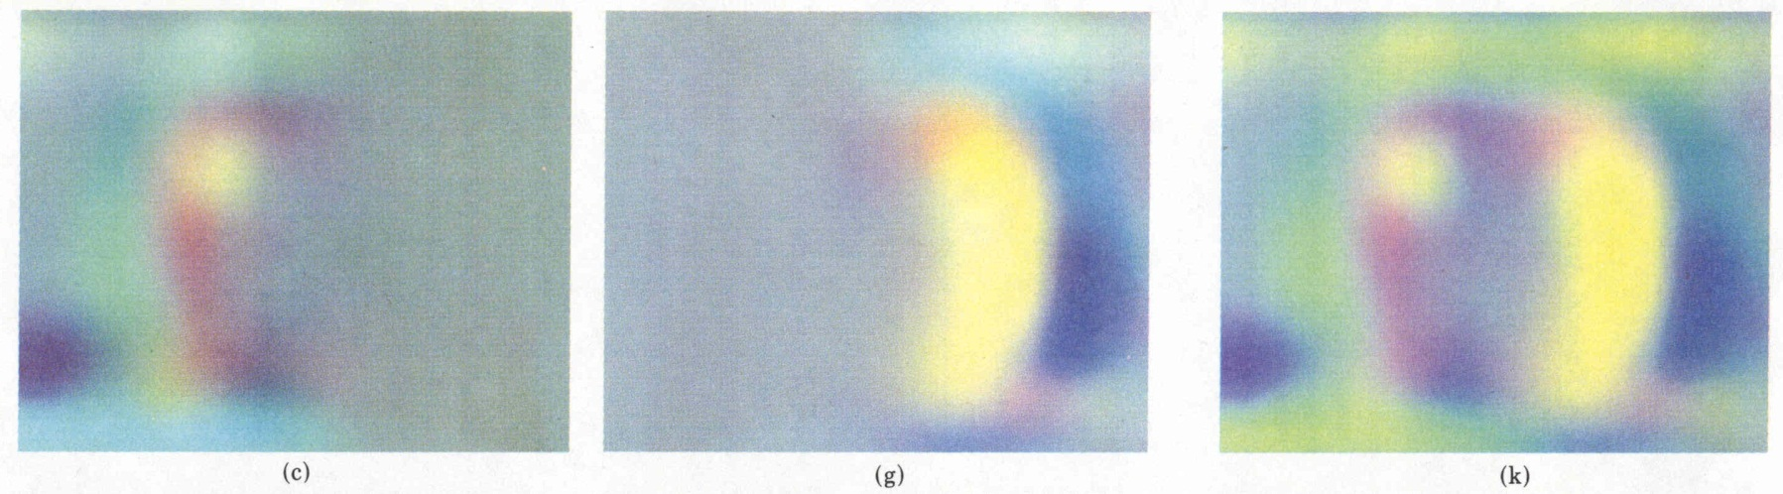
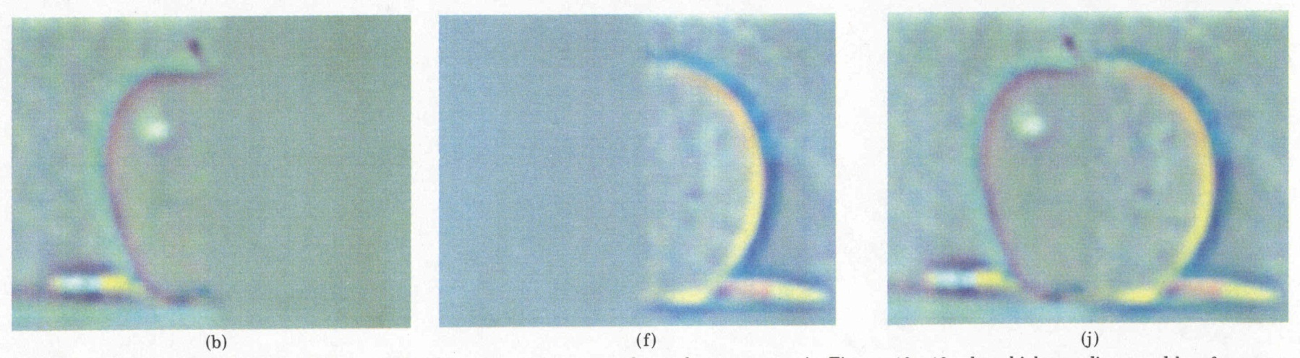
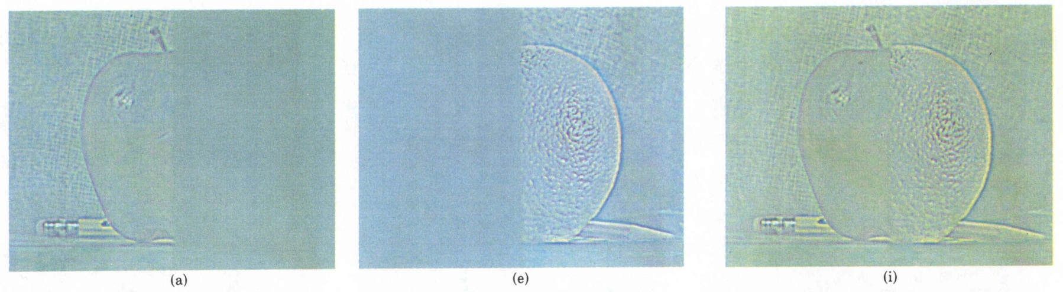
Laplacian
level
4
Laplacian
level
2
Laplacian
level
0
left pyramid
right pyramid
blended pyramid

Slide 71
Laplacian image blend
Compute Laplacian pyramid
Compute Gaussian pyramid on weight image
Blend Laplacians using Gaussian blurred weights
Reconstruct the final image

Slide 72
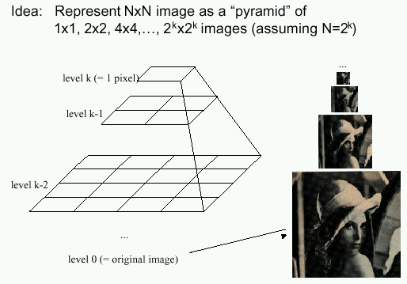
Multiband Blending with Laplacian Pyramid
At low frequencies, blend slowly
At high frequencies, blend quickly
1
0
1
0
1
0
Left pyramid
blend
Right pyramid

Slide 73
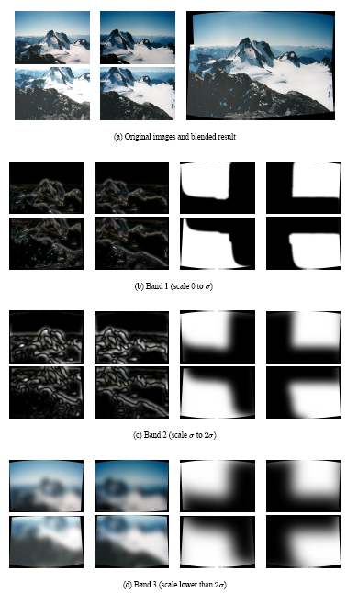
Multiband blending
Laplacian pyramids
Compute Laplacian pyramid of images and mask
Create blended image at each level of pyramid
Reconstruct complete image

Slide 74
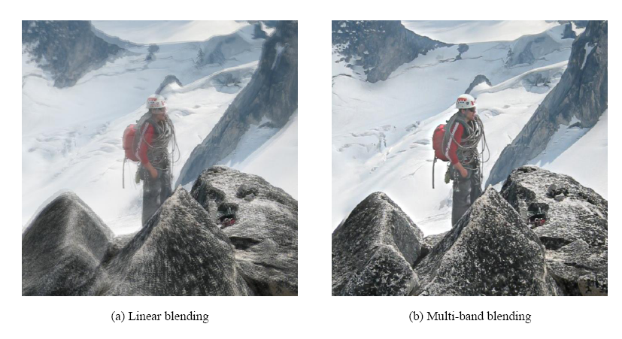
Blending comparison (IJCV 2007)

Slide 75
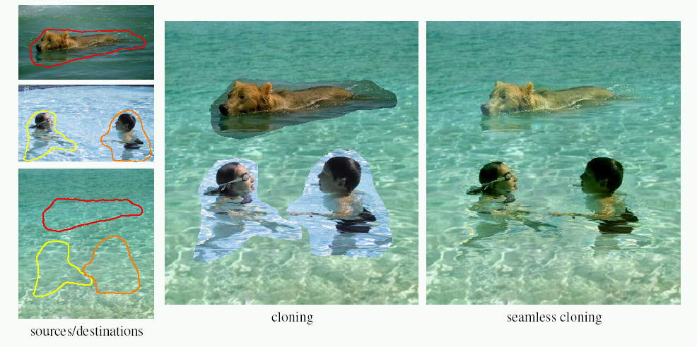
Poisson Image Editing
For more info: Perez et al, SIGGRAPH 2003
  http://research.microsoft.com/vision/cambridge/papers/perez_siggraph03.pdf

Slide 76
Alpha Blending
I₃
p
I₁
Optional: see Blinn (CGA, 1994) for details:
http://ieeexplore.ieee.org/iel1/38/7531/00310740.pdf?isNumber=7531&prod=JNL&arnumber=310740&arSt=83&ared=87&arAuthor=Blinn%2C+J.F.
I₂
Encoding blend weights: I(x,y) = (αR, αG, αB, α)
color at p =
Implement this in two steps:
1. accumulate: add up the (α premultiplied) RGBα values at each pixel
2. normalize: divide each pixel’s accumulated RGB by its α value
Notes:
A: render as black

Slide 77
Choosing seams
Easy method
  Assign each pixel to image with nearest center
im1
im2
x
x
Image 2
Image 1

Slide 78
Choosing seams
Easy method
  Assign each pixel to image with nearest center
  Create a mask:
  Smooth boundaries ( “feathering”):
  Composite
im1
im2
x
x
Image 2
Image 1

Slide 79
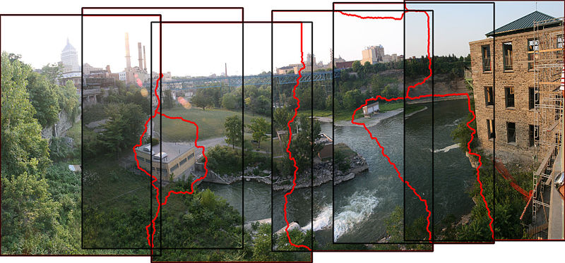
Choosing seams
Better method: dynamic program to find seam along well-matched regions
Illustration: http://en.wikipedia.org/wiki/File:Rochester_NY.jpg

Slide 80
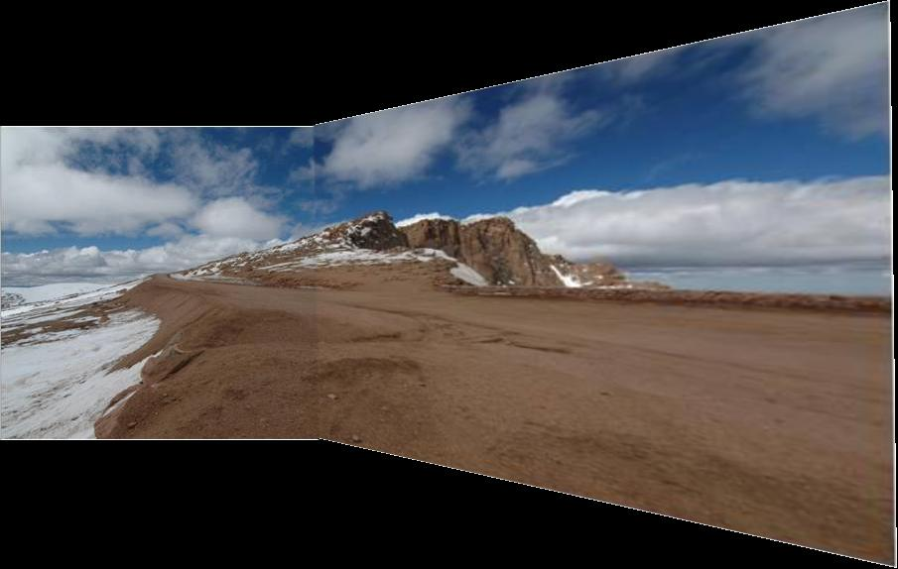
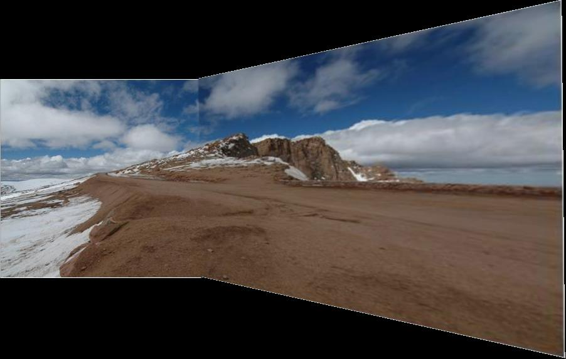
Gain compensation
Simple gain adjustment
  Compute average RGB intensity of each image in overlapping region
  Normalize intensities by ratio of averages

Slide 81
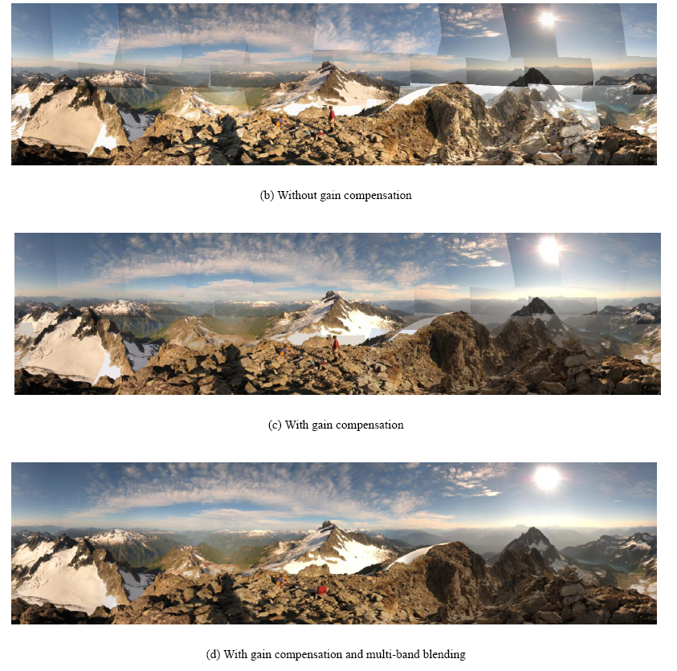
Blending Comparison

Slide 82
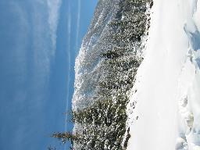
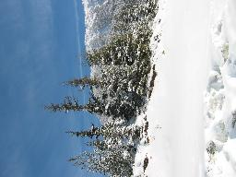
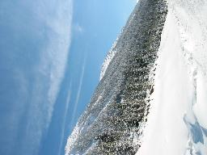

























Recognizing Panoramas
Some of following material from Brown and Lowe 2003 talk
Brown and Lowe 2003, 2007

Slide 83
Recognizing Panoramas
Input: N images
Extract SIFT points, descriptors from all images
Find K-nearest neighbors for each point (K=4)
For each image
  Select M candidate matching images by counting matched keypoints (m=6)
  Solve homography H_{ij} for each matched image

Slide 84
Recognizing Panoramas
Input: N images
Extract SIFT points, descriptors from all images
Find K-nearest neighbors for each point (K=4)
For each image
  Select M candidate matching images by counting matched keypoints (m=6)
  Solve homography H_{ij} for each matched image
  Decide if match is valid (n_{i} > 8 + 0.3 n_{f} )
# inliers
# keypoints in overlapping area

Slide 85
Recognizing Panoramas (cont.)
(now we have matched pairs of images)
Find connected components

Slide 86
Finding the panoramas

Slide 87
Finding the panoramas

Slide 88
Finding the panoramas

Slide 89
Recognizing Panoramas (cont.)
(now we have matched pairs of images)
Find connected components
For each connected component
  Solve for rotation and f
  Project to a surface (plane, cylinder, or sphere)
  Render with multiband blending

