Slide 1
CSE403 ● Software engineering ● sp12
Week 3
Monday | Tuesday | Wednesday | Thursday | Friday
Design Reading II due | Group meetings SRS due | Design | UML | Design Progress report due
Design is not just what it looks like and feels like. Design is how it works. –Steve Jobs
Apologies in advance: some slides with too much text (read off-line) and a really bad joke

Slide 2
What does this 1-line shell script do?
tr -cs A-Za-z '\n' | tr A-Z a-z | sort } uniq -c | sort -rn | sed ${1}q
1 tr -cs A-Za-z '\n' |
2 tr A-Z a-z |
3 sort |
4 uniq -c |
5 sort -rn |
6 sed ${1}q
Make one-word lines by transliterating the complement (-c) of the alphabet into newlines (note the quoted newline), and squeezing out (-s) multiple newlines.
Transliterate upper case to lower case.
Sort to bring identical words together.
Replace each run of duplicate words with a single representative and include a count (-c).
Sort in reverse (-r) numeric (-n) order.
Pass through a stream editor; quit (q) after printing the number of lines designated by the script’s first parameter (${1}).
Jon Bentley, Don Knuth, and Doug McIlroy. 1986. Programming pearls: a literate program.Commun. ACM 29, 6 (June 1986), 471-483. DOI=10.1145/5948.315654

Slide 3
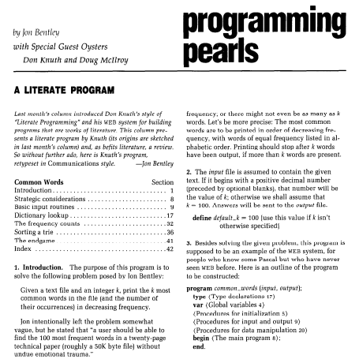
Given a text file and an integer k, print the k most common words in the file (and the number of their occurrences) in decreasing frequency.

Slide 4
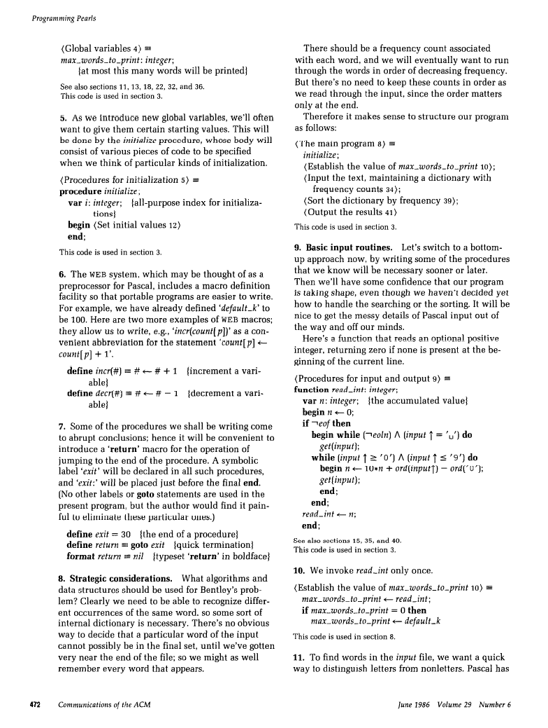
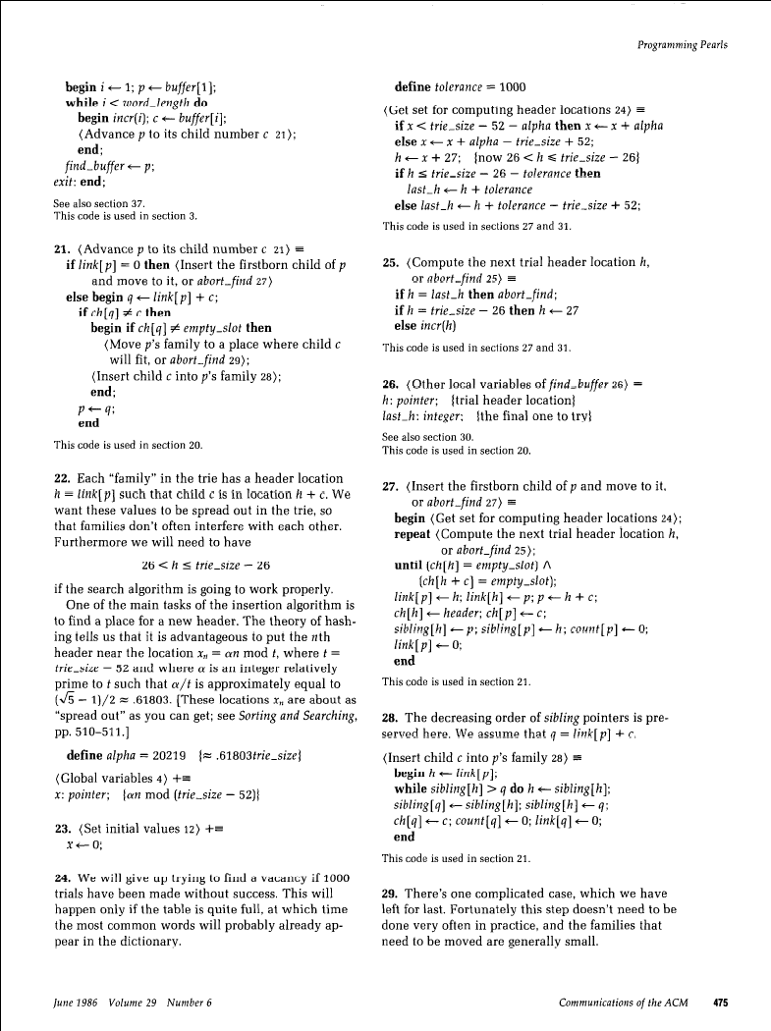
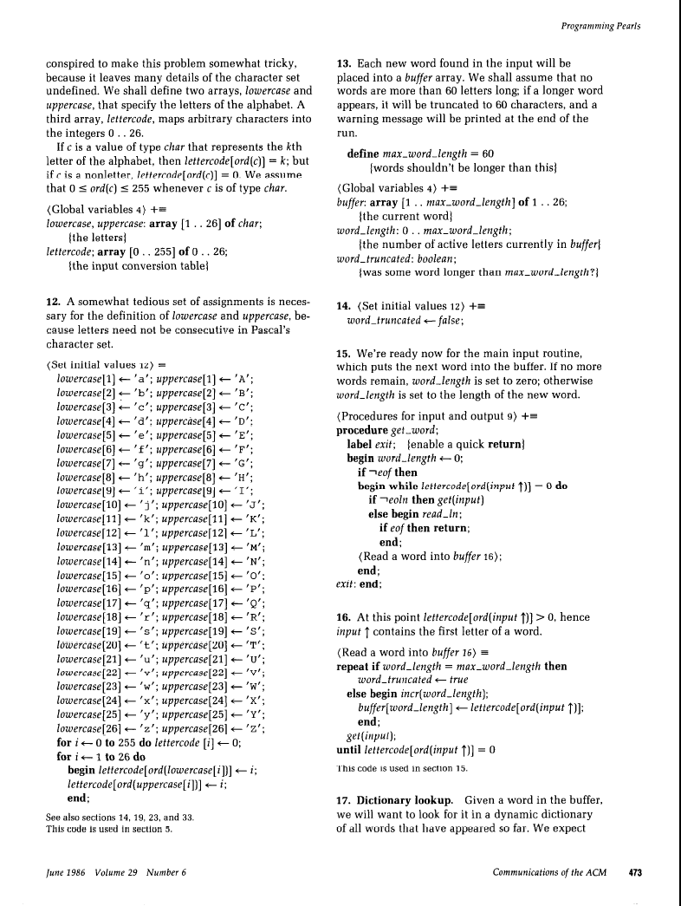
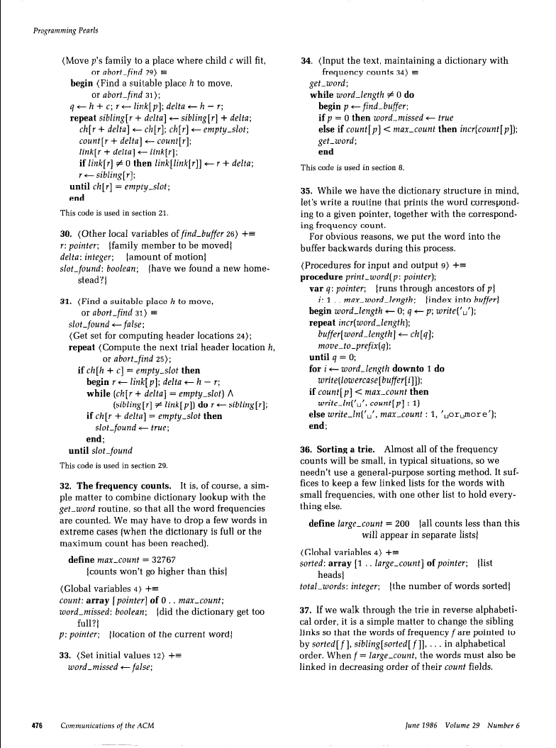
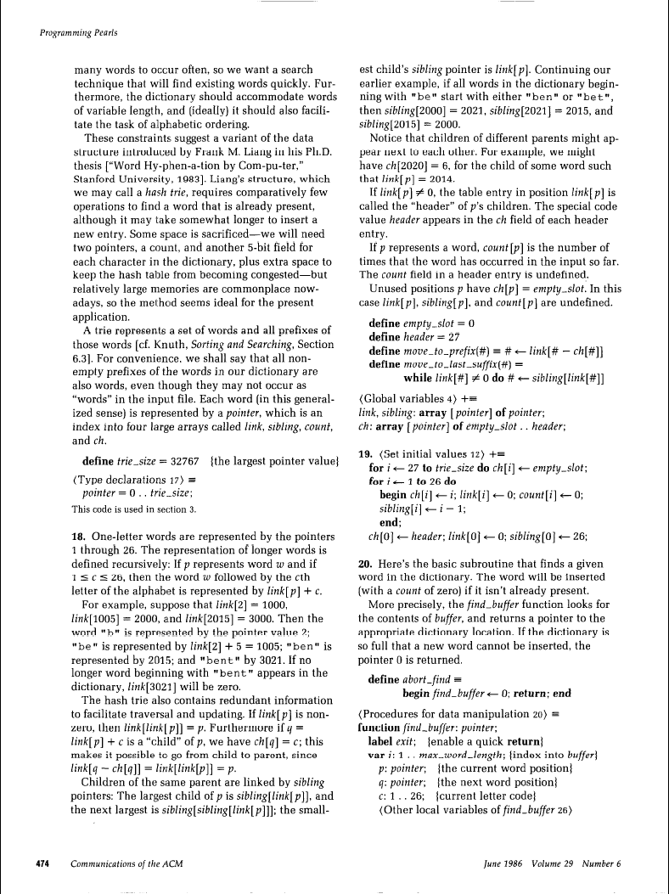
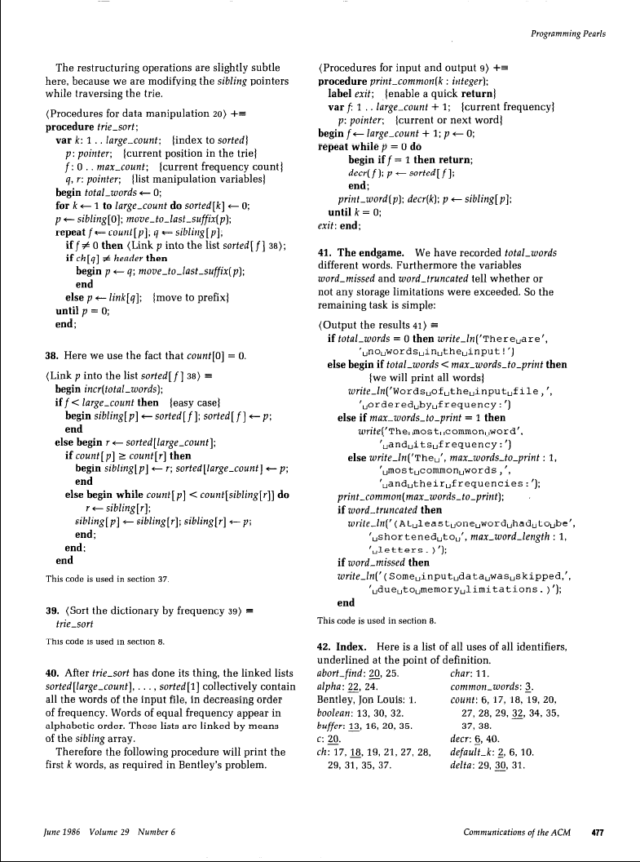
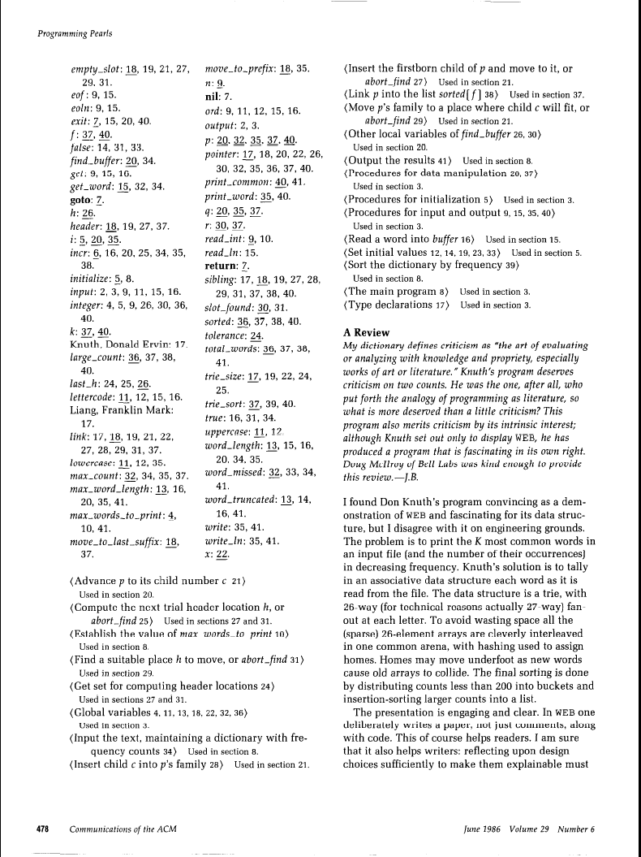
Knuth’s version: literate programming
8th page

Slide 5
McIroy’s exposition
Engineering: “Design under Constraints”
A wise engineering solution would produce—or better, exploit—reusable parts.
Very few people can obtain the virtuoso services of Knuth …but old UNIX hands know instinctively how to solve this one in a jiffy.
… Everything there—even input conversion and sorting—is programmed monolithically and from scratch. In particular the isolation of words, the handling of punctuation, and the treatment of case distinctions are built in. Even if data-filtering programs for these exact purposes were not at hand, these operations would well be implemented separately: for separation of concerns, for easier development, for piecewise debugging, and for potential reuse.
The simple pipeline given above will suffice to get answers right now, not next week or next month. It could well be enough to finish the job. But even for a production project, say for the Library of Congress, it would make a handsome down payment, useful for testing the value of the answers and for smoking out follow-on questions.
Reuse
Resources
Reuse++
Process

Slide 6
Challenger Disaster: Feynman
The usual way that such engines are designed … may be called the component system, or bottom-up design. First it is necessary to thoroughly understand the properties and limitations of the materials to be used (for turbine blades, for example), and tests are begun in experimental rigs to determine those. With this knowledge larger component parts … are designed and tested individually. As deficiencies and design errors are noted they are corrected and verified with further testing. … Finally one works up to the final design of the entire engine, to the necessary specifications. There is a good chance, by this time that the engine will generally succeed, or that any failures are easily isolated and analyzed because the failure modes, limitations of materials, etc., are so well understood. …
Roughly, build bottom-up with components with known properties

Slide 7
The Space Shuttle Main Engine was handled in a different manner, top down, we might say. The engine was designed and put together all at once with relatively little detailed preliminary study of the material and components. Then when troubles are found in the bearings, turbine blades, coolant pipes, etc., it is more expensive and difficult to discover the causes and make changes. For example, cracks have been found in the turbine blades of the high pressure oxygen turbopump. Are they caused by flaws in the material, the effect of the oxygen atmosphere on the properties of the material, the thermal stresses of startup or shutdown, … or mainly at some resonance at certain speeds, etc.? … Using the completed engine as a test bed to resolve such questions is extremely expensive. One does not wish to lose an entire engine in order to find out where and how failure occurs. Yet, an accurate knowledge of this information is essential to acquire a confidence in the engine reliability in use. …
A further disadvantage of the top-down method is that, if an understanding of a fault is obtained, a simple fix, such as a new shape for the turbine housing, may be impossible to implement without a redesign of the entire engine.

Slide 8
The point?
Software design – like all engineering design – has a set of dimensions and criteria to consider
Correctness, cost, performance, robustness, usability, understandability, modifiability, …
Some of these properties come directly from parts of the software system
Others are more properties of the overall system, sometimes called emergent properties
These are constraints that, in part, distinguish software engineering from the theoretical foundations of computation – that work is critical, and software engineering augments it with constraints
Underlying all effective software design – indeed, computational thinking – is the notion of abstraction

Slide 9
Continuous & iterative
Continuous•iterative
High-level (“architectural”) design
What pieces?
How connected?
Low-level design
Should I use a hash table or binary search tree?
Very low-level design
Variable naming, which language constructs, etc.
Boolean Zen
About 1000 design decisions at various levels are made in producing a single page of code

Slide 10
A few key criteria for software design
Accommodating change – taking advantage of software’s “soft”-ness
Agile Manifesto; “Software that does not change becomes useless over time” [Belady & Lehman]; …
Generality vs. performance
In math, a more general theorem is always better than a less general one
In software, a less general solution may consume enough fewer resources to dominate a more general solution – but don’t forget #1
Complexity – physical properties constrain physical design, but fewer constraints are imposed by software as a material

Slide 11
Abstraction Kramer, CACM 2007
“…[remove] detail to simplify and focus attention based on the definitions:
The act of withdrawing or removing something, and;
The act or process of leaving out of consideration one or more properties of a complex object so as to attend to others.
“…the process of generalization to identify the common core or essence based on the definitions:
The process of formulating general concepts by abstracting common properties of instances, and;
A general concept formed by extracting common features from specific examples.”

Slide 12
Computational thinking Wing, CACM 2006
“Computational thinking is using abstraction and decomposition when attacking a large complex task or designing a large complex system. It is separation of concerns. It is choosing an appropriate representation for a problem or modeling the relevant aspects of a problem to make it tractable. It is using invariants to describe a system's behavior succinctly and declaratively. It is having the confidence we can safely use, modify, and influence a large complex system without understanding its every detail. It is modularizing something in anticipation of multiple users or prefetching and caching in anticipation of future use.
“Thinking like a computer scientist means more than being able to program a computer. It requires thinking at multiple levels of abstraction…”

Slide 13
Mechanisms for abstraction?
Methods
Classes
In small groups list other software abstraction mechanisms
Two minutes

Slide 14
Decomposition and composition
The technique of mastering complexity has been known since ancient times: Divide et impera —Dijkstra, 1965
…strategy of gaining and maintaining power by breaking up larger concentrations of power into chunks that individually have less power than the one implementing the strategy. —Wikipedia, today
Divide and conquer. Separate your concerns. Yes. But sometimes the conquered tribes must be reunited under the conquering ruler, and the separated concerns must be combined to serve a single purpose.” —M. Jackson, 1995

Slide 15
Benefits of decomposition
Decrease size of tasks
Support independent testing and analysis
Separate work assignments
Ease understanding
In principle, can significantly reduce paths to consider by introducing an interface
Consider the Knuth and McIlory examples
Many more…

Slide 16
Alan Perlis quotations: abstraction
If you have a procedure with 10 parameters, you probably missed some.
One man's constant is another man's variable.
Simplicity does not precede complexity, but follows it.
Our designs are so complex there is no hope of getting them right first time by pure thought. To expect to is arrogant. —Brooks

Slide 17
Anticipating change & design
It is generally believed that to accommodate change one must anticipate possible changes
Counterpoint: Extreme Programming
By anticipating (and perhaps prioritizing) changes, one defines additional criteria for guiding the design activity – what abstractions one should choose
It is not possible to anticipate all changes
Anticipating vs. not anticipating: comments?
Extra credit

Slide 18
KWIC: “hello world” of module design
The KWIC index system accepts an ordered set of lines; each line is an ordered set of words, and each word is an ordered set of characters. Any line may be “circularly shifted” by repeatedly removing the first word and appending it at the end of the line. The KWIC index system outputs a list of all circular shifts of all lines in alphabetical order.

Slide 19
Another script…
awk '{print $0
for (i = length($0); i > 0; i--)
if (substr($0,i,1) == " ") print substr($0,i+1) "\t" substr($0,1,i-1)
}' $1 | sort -f | awk '
BEGIN {FS = "\t"; WID = 30}
{printf("%" WID "s %s\n",
substr($2,length($2)-WID+1),substr($1,1,WID))
}'
Why not always the best?
What might change?
More in lecture and in Reading III

Slide 20
CSE403 ● Software engineering ● sp12
Week 3
Monday | Tuesday | Wednesday | Thursday | Friday
Design Reading II due | Group meetings SRS due | Design | UML | Design Progress report due

