Slide 1
CSE403 ● Software engineering ● sp12
Week 3
Monday | Tuesday | Wednesday | Thursday | Friday
Design Reading II due | Group meetings SRS due | Design | UML | Design Progress report due
Today’s pre-apology: a couple of far too busy slides

Slide 2
(De)composition
Functional decomposition vs. information hiding
Architectural composition – pipes & filters, layers, etc.
Object-oriented – aggregation, inheritance, etc.

Slide 3
KWIC
The KWIC index system accepts an ordered set of lines; …Any line may be “circularly shifted” by repeatedly removing the first word and appending it at the end of the line. The KWIC index system outputs a list of all circular shifts of all lines in alphabetical order.
Jokes are silly! Mozart jokes are really silly. Notkin is not a comic.
a comic notkin is not are really silly mozart jokes are silly jokes comic notkin is not a is not a comic notkin jokes are really silly mozart jokes are silly mozart jokes are really silly not a comic notkin is notkin is not a comic really silly mozart jokes are silly jokes are silly mozart jokes are really | Notkin is not a comic! Mozart jokes are really silly. Jokes are silly! Notkin is not a comic! Notkin is not a comic! Mozart jokes are really silly. Jokes are silly! Mozart jokes are … Notkin is not a comic! Notkin is not a comic! Mozart jokes are really silly. Jokes are silly! … jokes are really silly!

Slide 4
KWIC script: (de)composition
Note: may not produce identical output to previous slide
awk '{print $0
for (i = length($0); i > 0; i--)
if (substr($0,i,1) == " ") print substr($0,i+1) "\t" substr($0,1,i-1)
}' $1 | sort -f | awk '
BEGIN {FS = "\t"; WID = 30}
{printf("%" WID "s %s\n",
substr($2,length($2)-WID+1),substr($1,1,WID))
}'
composition: Unix pipe
What can change easily? What can’t?
input
generate shifts
sort output
Generate k copies of each line of k words. Split each copy at a different word to produce all rotations of the line; mark the split word with a tab
Split each line at the tab, order the two pieces, truncate each piece to ≤30 characters, and output

Slide 5
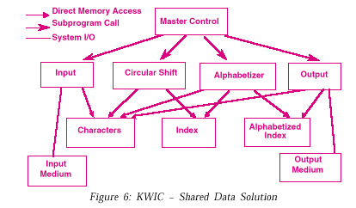
Parnas: functional decomposition
Partially obsolete design
Partial list of possible changes
Representation of lines, words, characters; storing on disk vs. in-memory – basically obsolete
Incremental vs. monolithic sorting algorithms
[shift; sort] vs. [for each shift insert into sorted list]
Eliminating noise words

Slide 6
Functional decomposition
Top-down design – breaking each high-level function into more manageable parts
Well-suited to program correctness, defining and proving pre- and post-conditions
What does this diagram actually show?
What would have to change?
Incremental vs. monolithic sorting algorithms
Eliminating noise words
Interactive UI
…
Main
Input
Shift
Sort
Output

Slide 7
Connecting design and change
The functional decomposition is based on breaking the computation down into more manageable parts
But the questions are about, “What will likely change?”
There is no a priori reason that a design based on functional decomposition will be suitable to support likely kinds of change
What if we decomposed with anticipated change in mind?
This is the core notion of Parnas’ information hiding – connecting design with anticipated change

Slide 8
Information hiding
Decide on likely changes
[Truth in advertising: this is hard and perhaps not doable well]
Design interfaces that protect clients from those changes – the interfaces define a contract that the clients can rely on
Implement the interface based on a best decision
If the decision later changes, re-implement the interface but continue to satisfy the contract

Slide 9
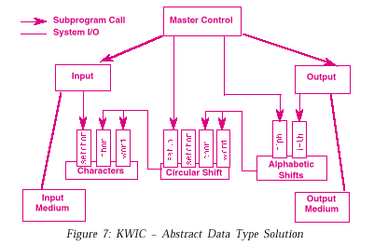
KWIC: information hiding
Partially obsolete design
Incremental vs. monolithic sorting? Eliminating noise words? Interactive UI? …?

Slide 10
Other examples of information hiding
Tax Credit of up to $8,000 for First-Time Homebuyers …
…Existing homebuyers are eligible to receive a tax credit of 10% of the purchase price up to $6,500 if they bought and closed on a replacement home by September 30, 2010. In order to be eligible for the credit, homeowners must have lived in the same principal residence for any five-consecutive-year period during the past eight years. They are not required to sell or dispose of their current home, but the new home must become their principal residence.
If you purchased and closed on a primary residence before September 30, 2010, and are a “first-time” homebuyer, you can qualify for a tax credit of 10% of the purchase price up to $8,000. To be eligible, you must not have owned a residence in the United States in the previous three years.
To qualify for either credit, you must have signed a binding contract to buy the house by April 30, 2010, and closed on it by September 30, 2010.
Members of the armed forces who were on official extended duty outside of the United States for at least 90 days between Jan .1, 2009, and May 1, 2010, may qualify for a one-year extension.
The credit is refundable to the extent it exceeds your regular tax liability, which means that if it more than offsets your tax liability, you’ll get a refund check. But it does not offset the Alternative Minimum Tax.
In addition, income limits were expanded from earlier versions of the credit. Homebuyers who file as single or head-of-household taxpayers can claim the full credit if their modified adjusted gross income (MAGI) is less than $125,000. For married couples filing a joint return, the combined income limit is $225,000.
Single or head-of-household taxpayers who earn between $125,000 and $145,000, and married couples who earn between $225,000 and $245,000 are eligible to receive a partial credit. The credit is not available for single taxpayers whose MAGI is greater than $145,000 and married couples with a MAGI over $245,000. Also, homes costing more than $800,000 are not eligible for the credit.
A software system based on a physical sensor – maybe an accelerometer on a mobile phone
Design to more easily accommodate improvements in the accuracy of the sensor in later versions of the phone?
Tax software (TurboTax, TaxCut, etc.)
Ever notice how Congress changes tax laws every year?
These companies can’t be late to market with their products
Allowing tax rates to change may be easy, but what about eligibility, etc.?

Slide 11
Some “last” things on information hiding
Encapsulation – defining an interface that may keep some elements of the corresponding implementation private – is not always information hiding
Encapsulation by itself does not focus on change as a design principle – separates public from private components
Abstract data types are a form of information hiding that focuses on hiding concrete data representations – that might change – and the implementation of the operations defined on the abstractions
What defines the “contract” by an information hiding interface? The documentation? Performance – promised or inferred? Is the client always right?
These are really complicated questions!… that led in part to the aspect-oriented design and programming paradigm

Slide 12
Software architecture
Mary Shaw and David Garlan … have been named co-recipients of the Outstanding Research Award for 2011 presented by the Association for Computing Machinery's Special Interest Group on Software Engineering (SIGSOFT). Shaw, the Alan J. Perlis Professor…, and Garlan, professor of computer science … in the [Carnegie Mellon] School of Computer Science, were recognized by SIGSOFT for their “significant and lasting software engineering research contributions through the development and promotion of software architecture.”
Capturing, cataloguing, and exploiting experience in software designs
Allowing reasoning on classes of designs
By adopting software architectures with known properties, one can increase confidence in the properties of your software system
[Think about Feynman’s observations]

Slide 13
Architecture: two parts
Components define the basic computations comprising a software system
Abstract data types, filters, etc.
Connectors define the interconnections between components
Procedure call, event announcement, etc.

Slide 14
Architectural style
Defines the vocabulary of components and connectors for a family (style) of software systems
Constraints on the components and connectors and on their combination
Topological constraints (no cycles, register/announce relationships, etc.)
Execution constraints (timing, etc.)
By choosing a style, one gets all the known properties of that style

Slide 15
Classic style example: pipes & filters
sort
print
shift
Filter
Pipe
Pipes must compute local transformations
Filters must not share state with other filters
There must be no cycles
If these constraints are satisfied, it is a pipe & filter system, and some properties are ensured – for example, lack of deadlock
But if they are not satisfied (even a “little” bit) no guarantees are provided
One can think of the constraints as obligations (pre-conditions of a sort) on the designer

Slide 16
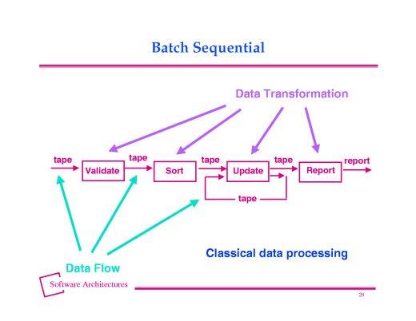
Pipe & filter?
Processing steps are independent
Each runs to completion before moving to next step
Data transmitted as a whole between steps
Pipes must compute local transformations
Filters must not share state with other filters
There must be no cycles

Slide 17
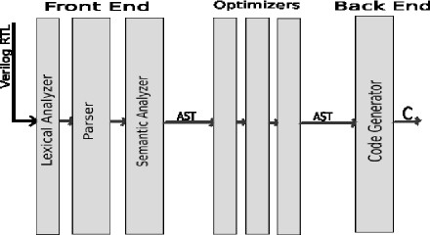

Slide 18
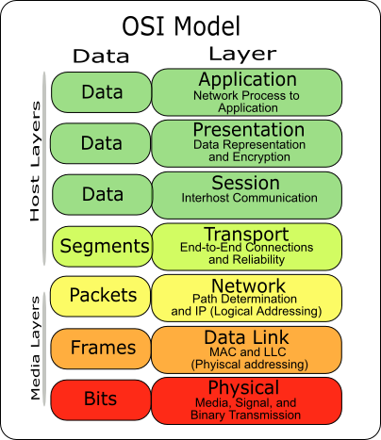
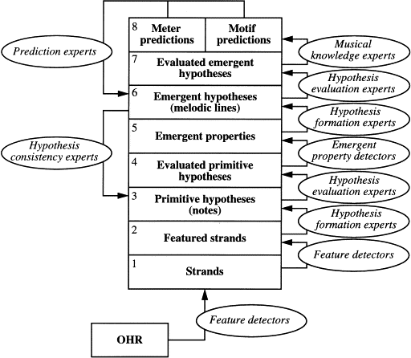
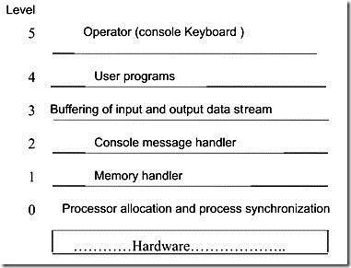
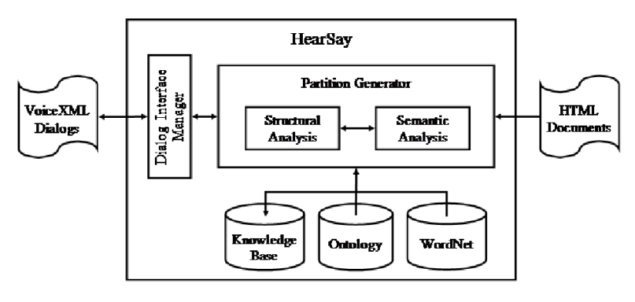
Other common styles
Layered systems
Blackboard systems
…many others
Key: by constraining your designs you can increase your confidence in the software’s properties

Slide 19
More to design? Of course
Pipe & filter from earlier slide
Now with more design information
Classes, interfaces, methods, …

Slide 20
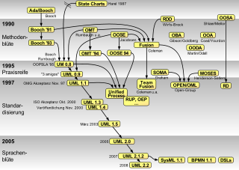
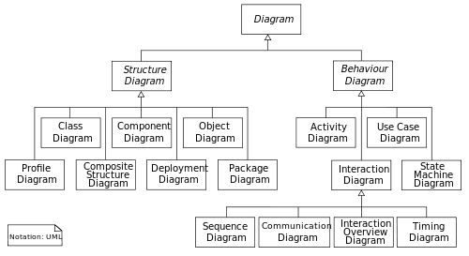
Object-oriented design notations
“Modeling” languages
UML is by far the most used (and misused), with 14 different kinds of diagrams
Very wide-spectrum use (and misuse)
Two most important diagrams are class diagrams (structure, attributes, and relationships) and sequence diagrams (how objects communicate via a sequence of messages)

Slide 21
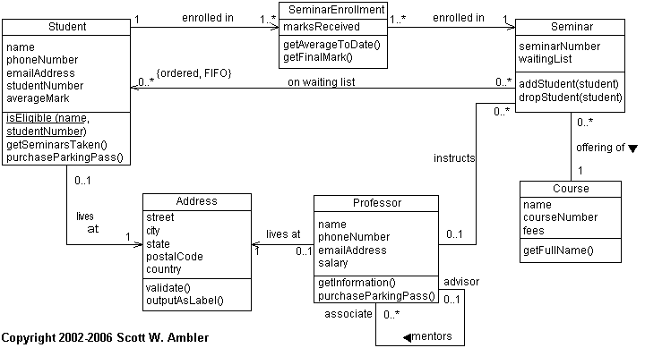
UML class diagrams
association (one- and two-way), aggregation, inheritance, multiplicity, interfaces, abstract, visibility, …

Slide 22
More in section tomorrow (Anton)
Class and sequence diagrams
Violet (free drawing package for UML)
Use UML to the degree it is a help for your team – if it’s getting in the way, think hard about what aspects you want to use

Slide 23
CSE403 ● Software engineering ● sp12
Week 3
Monday | Tuesday | Wednesday | Thursday | Friday
Design Reading II due | Group meetings SRS due | Design | UML | Design Progress report due

