Slide 1
CSE403 ● Software engineering ● sp12
Week 4
Monday | Tuesday | Wednesday | Thursday | Friday
Composition Reading III due | Group meetings | Phil Kimmey on using git @ rover.com | SDS++ due | Midterm review – content, format Progress report due

Slide 2
Today
Orthogonality in design: when, if ever, can we use multiple good design ideas simultaneously?
Ex: generic collections in Java
Abstraction over the details of the collection (array, list, hashtable, etc.)
Separate abstraction over the values – that is, the type of the elements
This kind of orthogonality is very powerful

Slide 3
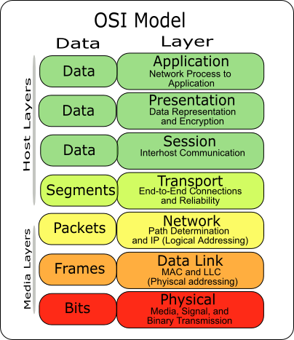
Layering in one slide
Used in part for program families, systems that have “so much in common that it pays to study their common aspects before looking at the aspects that differentiate them” [Parnas 1979]
For example, Microsoft operating systems, a number of the Mozilla systems, …
Another kind of dependence useful for families
A module A uses a module B if the correctness of A depends on the presence of a correct version of B
A non-hierarchical uses relation makes it difficult to produce useful subsets of a system
uses and invokes dependences often but do not always coincide
Invocation without use: name service with cached hints
Use without invocation: examples?
ipAddr := cache(hostName); if wrong(ipAddr,hostName) ipAddr := lookup(hostName) endif

Slide 4
ADTs and layering interact?
Information hiding modules (say, ADTs in this case) and layers are distinct concepts
How and where do they overlap in a system?
Are they orthogonal?
ADTs
What kinds of secrets (potential changes)? What kinds of families?
Layers
Extra credit

Slide 5
Composition: Michael Jackson
Jackson observes that we sometimes overvalue the notion of hierarchical decomposition
The world itself does not have strict typing and inheritance hierarchies
He argues that the CMYK printing is a better analogy for software composition at many levels

Slide 6
Design patterns
What are they?
Why are they?
Following slides from 331 au11
It’ll probably be a whirlwind

Slide 7
What is a design pattern?
A standard solution to a common programming problem
a design or implementation structure that achieves a particular purpose
a high-level programming idiom
A technique for making code more flexible
reduce coupling among program components
Shorthand for describing program design
a description of connections among program components (static structure)
the shape of a heap snapshot or object model (dynamic structure)
Notes:
the shape of a heap snapshot, object model, or MDD

Slide 8
Why design patterns?
Advanced programming languages like Java provide lots of powerful constructs – subtyping, interfaces, rich types and libraries, etc.
By the nature of programming languages, they can’t make everything easy to solve
To the first order, design patterns are intended to overcome common problems that arise in even advanced object-oriented programming languages
They increase your vocabulary and your intellectual toolset

Slide 9
From a colleague
No programming language is, or ever will be, perfect.
Extra-language solutions (tools, design patterns, etc.) are needed as well.
Perlis: “When someone says ‘I want a programming language in which I need only say what I wish done,’ give him a lollipop.”
FML. Today I got to write (in Java): import java.util.Set; import com.google.common.base.Function; import com.google.common.collect.DiscreteDomains; import com.google.common.collect.Iterables; import com.google.common.collect.Ranges; final int x = ...; Set<Integer> indices = Ranges.closed(0, size).asSet(DiscreteDomains.integers()); Iterable<Coord> coords = Iterables.transform(indices, new Function<Integer,Coord>(){ public Coord apply (Integer y) { return new Coord(x, y); } } ); when I wanted to write (in Scala): val x = ...; val coords = 0 to size map(Coord(x, _))

Slide 10
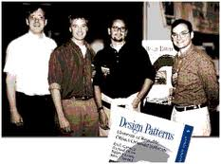
Whence design patterns?
The Gang of Four (GoF)  – Gamma, Helm, Johnson, Vlissides
Each an aggressive and thoughtful programmer
Empiricists, not theoreticians
Found they shared a number of “tricks” and decided to codify them – a key rule was that nothing could become a pattern unless they could identify at least three real examples
My first experience with patterns at Dagstuhl  with Helms and Vlissides

Slide 11
Patterns vs. patterns
The phrase “pattern” has been wildly overused since the GoF patterns have been introduced
“pattern” has become a synonym for “[somebody says] X is a good way to write programs.”
And “anti-pattern” has become a synonym for “[somebody says] Y is a bad way to write programs.”
A graduate student recently studied so-called “security patterns” and found that very few of them were really GoF-style patterns
GoF-style patterns have richness, history, language-independence, documentation and thus (most likely) far more staying power

Slide 12
An example of a GoF pattern
Given a class C, what if you want to guarantee that there is precisely one instance of C in your program? And you want that instance globally available?
First, why might you want this?
Second, how might you achieve this?

Slide 13
Possible reasons for Singleton
One RandomNumber generator
One Restaurant, one ShoppingCart
One KeyboardReader, etc…
Make it easier to ensure some key invariants
Make it easier to control when that single instance is created – can be important for large objects
…

Slide 14
Several solutions
public class Singleton { private static final Singleton instance = new Singleton(); // Private constructor prevents // instantiation from other classes private Singleton() { } public static Singleton getInstance() { return instance; } }
Eager allocation of instance
public class Singleton { private static Singleton _instance; private Singleton() { } public static synchronized Singleton getInstance() { if (null == _instance) { _instance = new Singleton(); } return _instance; } }
Lazy allocation of instance
And there are more (in EJ, for instance)

Slide 15
Abstract Factory Pattern
wikipedia
stackoverflow
…and who knows where?!

Slide 16
Points to make
Lots of different kinds of dependences
Composition of different design/abstraction mechanisms can be extraordinarily powerful
So increasing your understanding of powerful mechanisms and patterns will surely help simplify your design over time
This in turn may well increase some form of conceptual integrity

Slide 17
CSE403 ● Software engineering ● sp12
Week 3-4
Monday | Tuesday | Wednesday | Thursday | Friday
Composition Reading III due | Group meetings | Phil Kimmey on using git @ rover.com | SDS++ due | Midterm review – content, format Progress report due

