Slide 1

CSE403 ● Software engineering ● sp12
Week 1
Monday | Tuesday | Wednesday | Thursday | Friday
Overview Course plans & expectations | Tools & tool questions (section) | Lifecycle & project milestones KNOW project overview JB office hours 2-3PM Atrium | No section JB office hours 11:30AM-12:30 PM Atrium DN office hours 9:00-10:00AM & 11:30-noon | Proposal descriptions & slides by 9:30AM
 |  |  |  | Proposal presentations
 |  |  |  | Project & team preferences by 11PM
 |  |  |  | Teams announced by 11PM Saturday
Cycle
Life
Software
Software development lifecycle
the power of process

Slide 2
Two goals of software engineering
Barry Boehm
Building the right system
  Validation: Does the program meet the users’ needs?
Building the system right
  Verification: Does the program meet the specification?

Slide 3
The software lifecycle
These goals – software that works as specified and software that meets users’ needs – are hard to achieve for substantive systems
The lifecycle is a series of steps or phases through which software is produced – usually over months or years, from womb to tomb
It is a process by which teams of people can create complex software systems
The lifecycle helps teams deal with complexity by laying out a clear set of steps to perform and associate tangible artifacts that can be assessed to determine progress, quality, etc.
Notes:
What are some of the common phases?

Slide 4
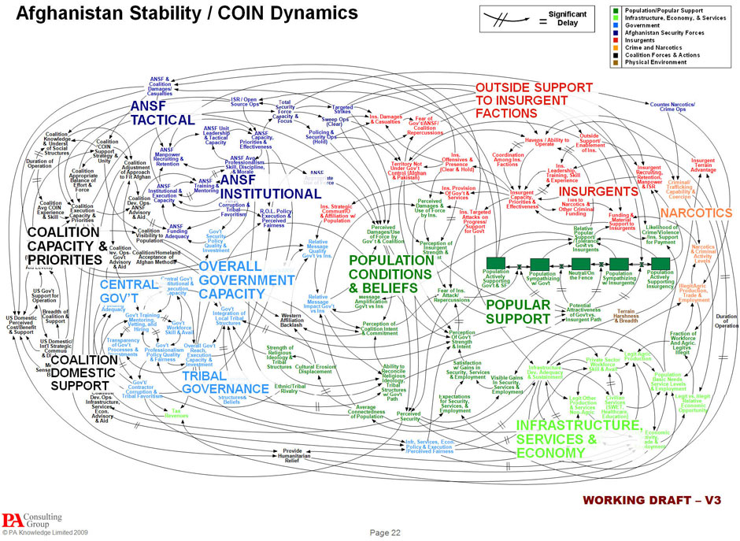
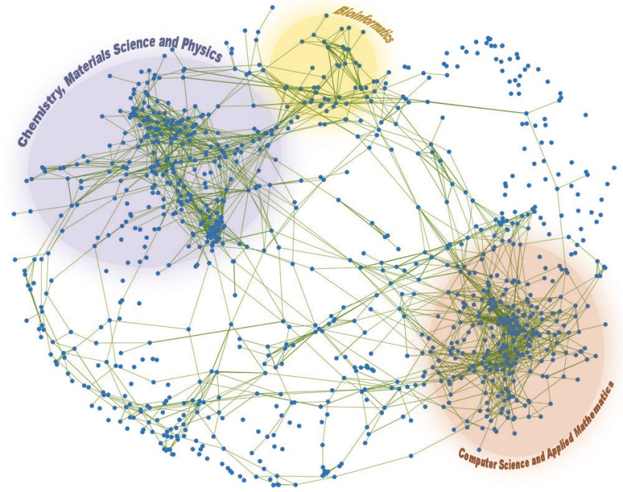
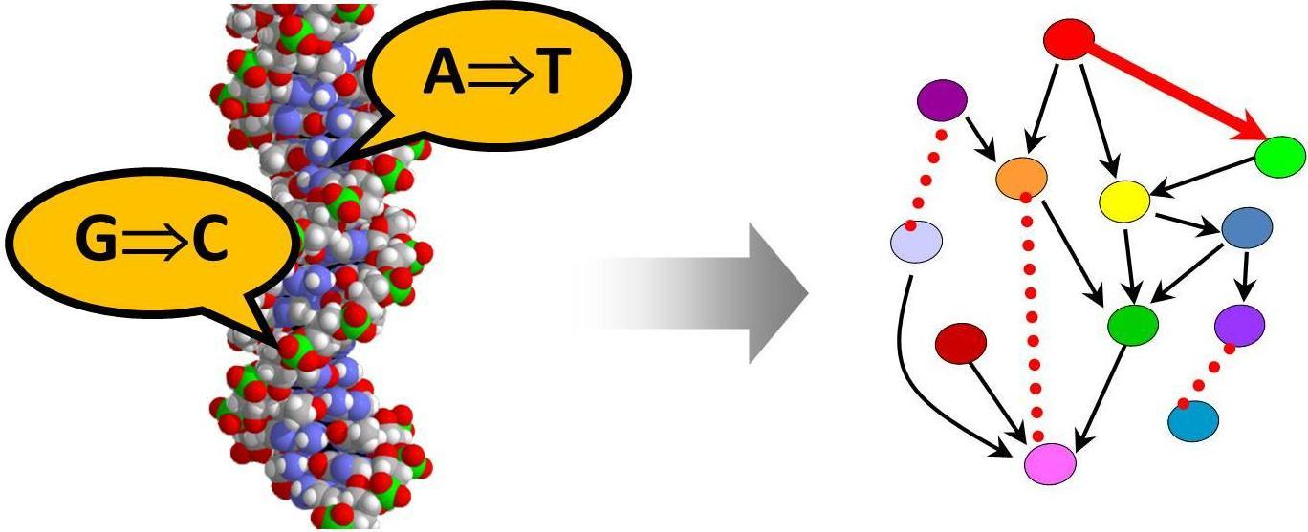
What is complexity?
“The state or quality of being intricate…”
Dictionary.com. Collins English Dictionary - Complete & Unabridged 10th Edition. HarperCollins (accessed: March 27, 2012).

Slide 5
Complexity in computation
How much resource – usually time or space – is needed, based on the size of the input, to solve a specific problem using a precise model?
  Lower bound: best possible
  Upper bound: best known
Kolmogorov complexity represents the shortest possible representation of a (often a program to compute) value
  2³¹⁵⁴² vs. 4522134566.3232335425256788888532212232342342346666193
Fred Brooks: Essential vs. incidental complexity

Slide 6
How complex is software?
Possible measures include
lines of code
# classes
# modules
# module interconnections and dependencies
# paths: cyclomatic complexity takes a control flow graph (roughly, a “flow chart”) of a program and computes E − N + 2P
  E = the number of edges of the graph
  N = the number of nodes of the graph
  P = the number of connected components (exit nodes)
time to understand
# of authors
… many more

Slide 7
Lines of Code
LOC (SLoC – source lines of code) are frequently used to characterize the size of a software system
  Often used for cost estimation
May be as good a proxy for complexity as anything else
MSLoC (MLOC) ≡ Million Lines of Source Code
Windows Server 2003 | 50 MSLoC
Debian 5.0 | 324 MSLoC
Downside
Paying people per LOC isn’t smart
If they refactor and make the code better but smaller, should they pay you?

Slide 8
How big is 324 MLOC?
Left side of the room: in small groups estimate how high 324 MLOC would be if you printed it
(assume 50 LOC/page, two-sided)
~13,000 inches ≈ 13x the height of the Allen Center
Ideas about how to think about this?
Two minutes
Right side of the room: in small groups estimate how long it would take you to type 324 MLOC
(assume 5 words/LOC @ 50 wpm )
~32,000,000 min ≈ 61 years
no thinking • no sleeping • no breaks

Slide 9
How to get to 324 MLOC?
…or even 1MLOC … or even 100KLOC …?
Especially adding in some expectations of what the program does, its correctness, etc.

Slide 10
Ad-hoc development
Creating software without any formal guidelines or process; ever done this for a project or assignment?
Advantages
  Easy to learn
  Easy to use
Disadvantages
  May ignore some important tasks like testing and design
  Unclear when to start or stop each task
  Scales poorly to teams
  Hard to review/evaluate work
  Code may not match users’ needs – no requirements!
  Code likely to be inflexible
  No way to assess progress, quality or risks
  Unlikely to accommodate changes without a major design overhaul
  Unclear delivery features (scope), timing, and support
  …
Notes:
Have you done any ad hoc projects? Assignments?

Slide 11
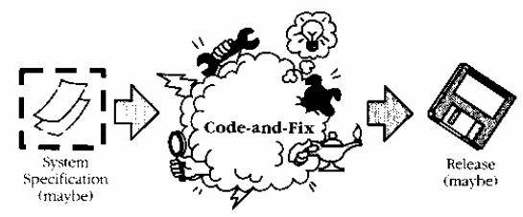
Also know as code-and-fix
It doesn’t manage or tame complexity
And the later a problem is found in software, the more costly it is to fix

Slide 12
Managing complexity: break it down
We identify different activities that we know – from experience – we will have to do (such as testing)
We identify different milestones that we know – from experience – we will have to produce (such as requirements)
We identify different roles – from experience – that people will perform in a project (such as designers)
We identify a process that increases our confidence that people in those roles will address all the activities effectively and produce a quality set of milestones
The specifics of these dimensions – people, activities, milestones – and the way they interact characterizes different lifecycles

Slide 13
Parts of speech
Milestones are also points in time – deadlines – but they are accompanied by deliverables
Subject Role | Verb Activity | Object Milestone
A designer | designs | a design
A programmer | implements | modules
A tester | plans and runs | tests
…
These are largely different sides of the same (three-sided) coin
It’s never 1:1:1
  An individual may be a programmer and a tester
  Multiple milestones will include designs
  …

Slide 14
Benefits of using a lifecycle
It provides a structure for organizing work
It forces us to think of the “big picture” and follow steps so that we reach it without glaring deficiencies
Without it you may make decisions that are individually on target but collectively misdirected
It is a management tool
Drawbacks?
Extra credit
“…I have always found that plans are useless, but planning is indispensable.” –D.D. Eisenhower
Notes:
#3 example: Developed a library interface suitable for one client but not another
#5 no example: Write a little tool for myself to filter mail to help me write my performance review. What’s the difference: small, I’m only customer, don’t have to maintain
Any drawbacks of using a model? Does every project need to use one?
Can lead to compromises and artificial constraints
Risk of overemphasizing process (not the end in itself)
Ways of evaluating models
risk management, quality/cost control, predictability, visibility of progress, customer involvement/feedback

Slide 15
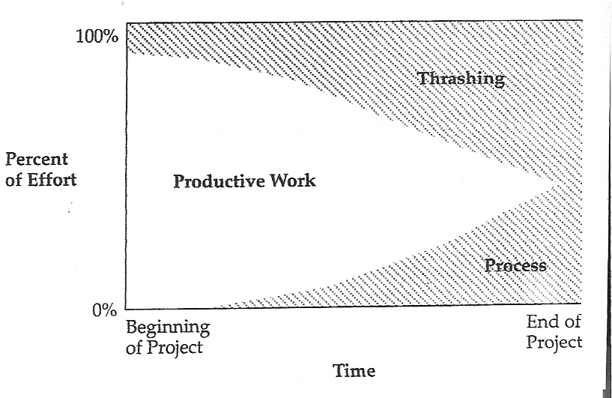
Project with little attention to process
Survival Guide: McConnell p. 24

Slide 16
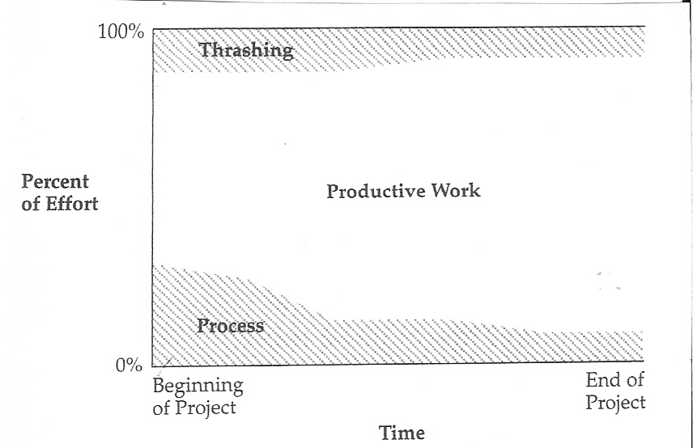
With early attention to process
Survival Guide: McConnell p. 25

Slide 17
Some lifecycle models (past code-and-fix)
waterfall: standard phases – requirements, design, code, test, … – in order
spiral: assess risks at each step; do most critical action first
staged delivery: build initial requirement specifications for several releases, then design-and-code each in sequence
evolutionary prototyping: build an initial small requirement specification, code it, then “evolve” the specification and code as needed
agile: very flexible, customer-oriented variations of evolutionary prototyping (more coming next week)

Slide 18
Waterfall model
Notes:
Phases don’t overlap, document/signoff driven, result not until end. No integration until end!
Linear, inflexible ** Refer to Computerworld Article **

Slide 19
Waterfall model tradeoffs
Can work well for well-understood but complex projects
  Tackles all planning upfront
Supports inexperienced teams
  Orderly, easy-to-follow sequential model
  Reviews at each stage determine if the product is ready to advance
Hard to specify requirements of a stage completely and correctly upfront
Rigid, linear, not adaptable to change in the product
  Costly to "swim upstream"
No sense of progress until end
  Nothing to show until almost done ("we're 90% done, I swear!")
Integration occurs at the very end
  Defies “integrate early and often” rule
  No feedback until end to customer
Notes:
In real life, overlap. Design finds a flaw in requirements. Coding finds problem with design.
Example use: critical software where spec needs to be complete
Example use: second generation of the software

Slide 20
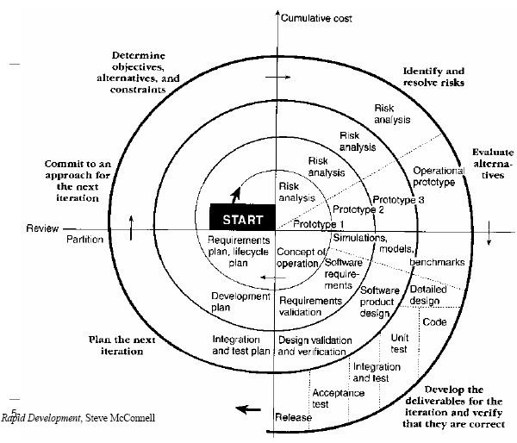
Spiral model – risk-oriented
Determine objectives and constraints
Identify and resolve risks
Evaluate options to resolve risks
Developer and verify deliverables
Plan next spiral
Commit (or not) to next spiral

Slide 21
Spiral model – tradeoffs
A lot of planning and management
Frequent changes of task
Requires customer and contract flexibility
Must be able to assess risk properly
Take on the big risks early, make decisions
  Right product?
  Can we implement?
Progresses carefully to a result – clearer tasks each spiral
As costs increase, risks decrease!
Notes:
early cancellation of bad projects is a major benefit
confidence that you're building the right product is a major benefit
Example: Linux on compute nodes

Slide 22
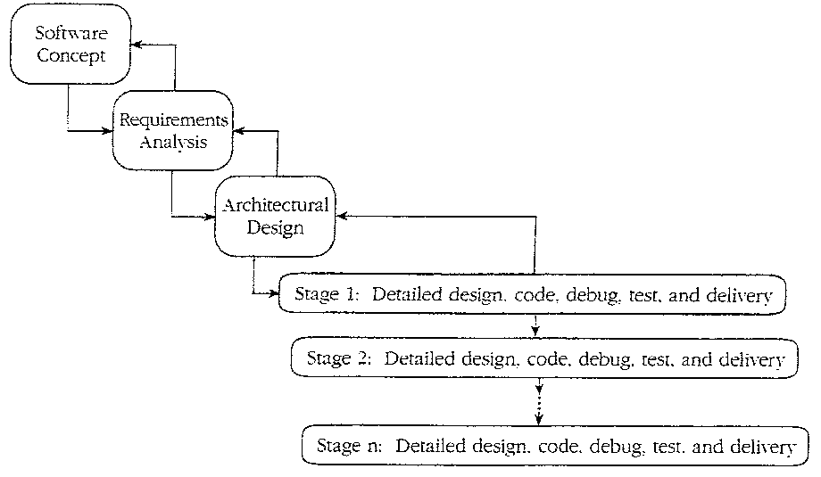
Staged delivery model
Waterfall-like beginnings
Then, short release cycles: plan, design, execute, test, release, with delivery possible at the end of any cycle
Notes:
Refer to pages in the text book SG: 54-59

Slide 23
Staged-delivery tradeoffs
Can ship at the end of any release cycle
Intermediate deliveries show progress, satisfy customers, and lead to feedback
Problems are visible early (e.g., integration)
Facilitates shorter, more predictable release cycles
Prioritize features
Requires tight coordination with documentation, management, marketing
Product must be decomposable
Extra releases cause overhead
Feature creep
Very practical, widely used and successful
Notes:
Most used model at Cray – makes sense
Prioritize features for delivery
Fun with themed releases/capabilities (marketing likes it too), ie. Move from Catamount to Linux
Another risk – feature creep

Slide 24
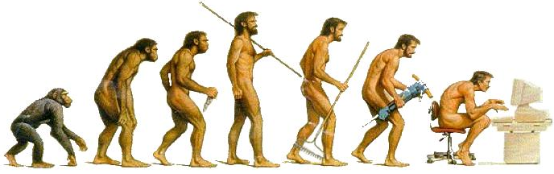
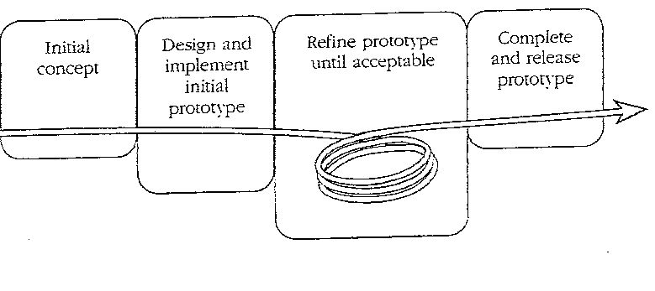
Evolutionary prototyping model
Develop a skeleton system and evolve it for delivery
Staged delivery: requirements are known ahead of time
Evolutionary: discovered by customer feedback on each release
Notes:
WHAT CLASS OF PROBS LENDS ITSELF TO THIS MODEL? Class: User interface
Example – our work for NSA … not quite sure what they want, added difficulty that do not have close involvement
Example – Urban Sim
Prototype actually becomes the product (is not thrown away)

Slide 25
Evolutionary process
Requires close customer involvement
Assumes user's initial specification is flexible
Problems with planning
  Feature creep, major design decisions, use of time, etc.
  Hard to estimate completion schedule or feature set
  Unclear how many iterations will be needed to finish
Integration problems
Temporary fixes become permanent constraints

Slide 26
Why are there so many models?
The choice of a model depends on the project circumstances and requirements
A good choice of a model can result in a vastly more productive environment than a bad choice
A cocktail of models is frequently used in practice to get the best of all worlds – models are often combined or tailored to environment
“Models” are as often descriptive as they are prescriptive
  Parnas and Clements. A rational design process: How and why to fake it. IEEE Trans. Software Eng. 12, 2 (Feb 1986), 251-257.

Slide 27
The “best” model depends on…
The task at hand
Risk management
Quality / cost control
Predictability
Visibility of progress
Customer involvement and feedback
Team experience
…
Notes:
1. Reasonable understanding of what to deliver.
Waterfall: Has been done before; requirements well understood. Staged delivery or Spiral are also appropriate for this software dev project.
2. More progressive models, showing intermediate progress, good for this situation are Staged delivery or Spiral.
Could also map Waterfall to this situation, as it's an overhaul of a current system.
3. Need interaction with the customers to see how well the system is working. All features needed
may not be known upfront. Evolutionary prototyping most appropriate to get that feedback.

Slide 28
Better question: best model for …
A system to control anti-lock braking in a car?
A hospital accounting system that replaces an existing system?
An interactive system that allows airline passengers to quickly find replacement flight times (for missed or bumped reservations) from terminals installed at airports?
A specific 403 project?
Notes:
1. Reasonable understanding of what to deliver.
Waterfall: Has been done before; requirements well understood. Staged delivery or Spiral are also appropriate for this software dev project.
2. More progressive models, showing intermediate progress, good for this situation are Staged delivery or Spiral.
Could also map Waterfall to this situation, as it's an overhaul of a current system.
3. Need interaction with the customers to see how well the system is working. All features needed
may not be known upfront. Evolutionary prototyping most appropriate to get that feedback.

Slide 29
Today | Tomorrow | Wednesday | Thursday | Friday
Overview Course plans & expectations | Tools & tool questions (section) | Lifecycle & project milestones KNOW project overview Form project proposal groups NOW (if you haven’t yet) KNOW++: JB office hours | No section Meet with your project proposal groups KNOW++: JB office hours DN office hours 9-10 & 11:30-12 | Proposal descriptions & slides by 9:30AM Posted on web ASAP
 |  |  |  | Proposal presentations
 |  |  |  | Project & team preferences by 11PM
 |  |  |  | Teams announced by 11PM Saturday
Any questions?

