Slide 1
CSE403 ● Software engineering ● sp12
Week 7-10
Monday | Tuesday | Wednesday | Thursday | Friday
Reading due | Groups Beta due |  | Section | Progress report due Readings out (see next slide)
Midterm review | Groups | Midterm II Reading covered [Notkin gone] | No section | Information on final presentations, etc. Course evals Progress report due
Memorial Day Holiday | Groups | Final release due Project Pres. I | Project Pres. II | Project Pres. III

Slide 2
Reading for Midterm II
Managing Technical Debt Eric Allman Communications of the ACM Vol. 55 No. 5, Pages 50-55 10.1145/2160718.2160733 http://cacm.acm.org/magazines/2012/5/148568-managing-technical-debt/fulltext

Slide 3
Refactoring
Belady and Lehman’s (1974) Law of Increasing Complexity
As a [software] system evolves its complexity increases unless work is done to maintain or reduce it
In other words, it is natural for a program’s structure to degrade over time
Work done “to maintain or reduce” the program’s complexity is not directly beneficial – it doesn’t make the program do more, do it more quickly, or such

Slide 4
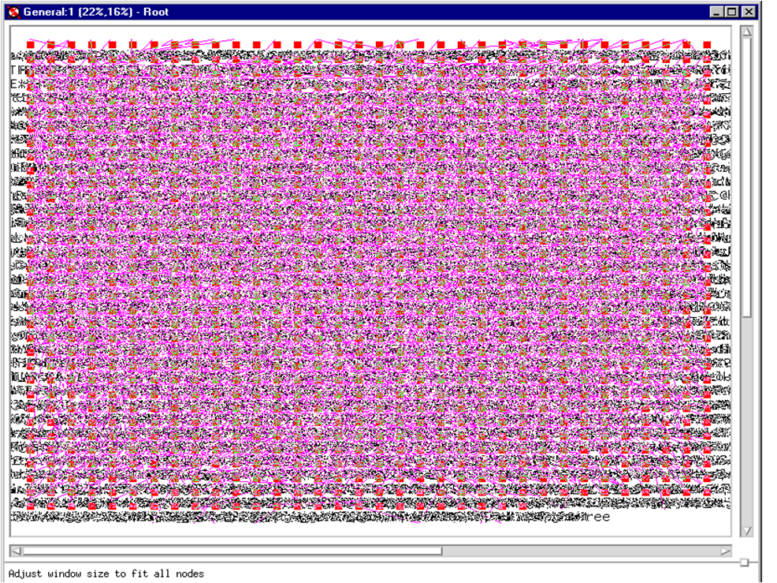
Hence…
Software system structures tend to degrade in practice
Not only are they complex, but they are highly likely to be incidentally complex more than essentially complex [Brooks]

Slide 5
Rewritten or abandoned
As months pass and new versions are developed, many codebases reach one of the following states
rewritten: Nothing remains from the original code.
abandoned: The original code is thrown out and rewritten from scratch.
…even if the code was initially reviewed and well-designed at the time of check-in, and even if check-ins are reviewed

Slide 6
“Bit rot”
Why does the code structure degrade?
Systems evolve to meet new needs and add new features
If the code's structure does not also evolve, it will “rot”
And the value-proposition for maintaining or improving the code structure is hard to see and evaluate
Notes:
Marius and 3 point cards
Life insurance

Slide 7
Maintenance
Modification of a software product after delivery
fix bugs
improve performance
improve design
add features
~80% of maintenance is for non-bug-fix-related activities such as adding functionality (Pigosky 1997)

Slide 8
Maintenance is hard
It's harder to maintain code than write new code
must understand code written by another developer, or code you wrote at a different time with a different mindset
danger of errors in fragile, poorly-understood code (don't touch it!)
Maintenance is how devs spend most of their time
Many developers hate code maintenance. Why?
With good design and advance planning, maintenance is less painful
Capacity for future change must be anticipated
Q: If maintenance is harder than writing new code, why is it assigned more frequently to newbies?

Slide 9
Refactoring
Improving a piece of software's internal structure without altering its external behavior
Incurs a short-term time/work cost to reap long-term benefits
A long-term investment in the overall quality of your system
refactoring is not the same thing as
rewriting code
adding features
debugging code

Slide 10
Why refactor?
Each part of your code has three purposes
to execute its functionality,
to allow change,
to communicate well to developers who read it
Code that is weak in any of these dimensions can be improved
Refactoring improves software's design
more extensible, flexible, understandable, faster, …
Every design improvement has costs (and risks)

Slide 11
Code “smells”: Signs you should refactor
Duplicated code
Poor abstraction (change one place → must change others)
Large loop, method, class, parameter list; deeply nested loop
Module has too little cohesion
Modules have too much coupling
Module has poor encapsulation
A “middle man” object doesn't do much (e.g., a “weak subclass” doesn’t use inherited functionality)
Dead code
Design is unnecessarily general
Design is too specific

Slide 12
Low-level refactoring
Names
Renaming (methods, variables)
Naming (extracting) “magic” constants
Procedures
Extracting code into a method
Extracting common functionality (including duplicate code) into a module/method/etc.
Inlining a method/procedure
Changing method signatures
Reordering:
Splitting one method into several to improve cohesion and readability (by reducing its size)
Putting statements that semantically belong together near each other

Slide 13
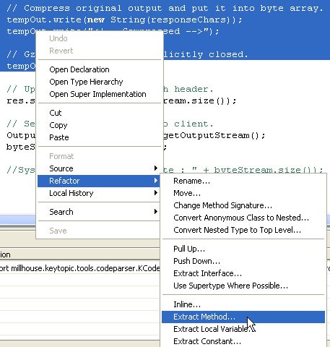
IDE support for refactoring
variable / method / class renaming
method or constant extraction
extraction of redundant code snippets
method signature change
extraction of an interface from a type
method inlining
providing warnings about method invocations with inconsistent parameters
help with self-documenting code through auto-completion

Slide 14
Higher-level refactoring
Refactoring to design patterns
Exchanging risky language idioms with safer alternatives
Performance optimization
Clarifying a statement that has evolved over time or is unclear
Compared to low-level refactoring, high-level is
Not as well-supported by tools
Much more important!

Slide 15
Recommended refactor plan
When you identify an area of your system that
is poorly designed
is poorly tested, but seems to work so far
now needs new features
What should you do?
Write unit tests that verify the code's external correctness
They should pass on the current, badly designed code
Refactor the code.
Some unit tests may break. Fix the bugs
Add the new features
As always, keep changes small, do code reviews, etc.

Slide 16
“I don't have time to refactor!”
Refactoring incurs an up-front cost.
some developers don't want to do it
most management don't like it, because they lose time and gain “nothing” (no new features)
However...
well-written code is much more conducive to rapid development (some estimates put ROI at 500% or more for well-done code)
finishing refactoring increases programmer morale
developers prefer working in a “clean house”
When to refactor?
best done continuously (like testing) as part of the SE process
hard to do well late in a project (like testing)
Why?

Slide 17
Should startups refactor?
Many small companies and startups skip refactoring
“We're too small to need it!”
“We can't afford it!”
Reality
Refactoring is an investment in quality of the company's product and code base, often their prime assets
Many web startups are using the most cutting-edge technologies, which evolve rapidly. So should the code
If a key team member leaves (common in startups), ...
If a new team member joins (also common), ...

Slide 18
Refactoring: reprise
“Improving a piece of software's internal structure without altering its external behavior”
What does “without altering its external behavior” mean?
How can we tell if a refactoring has left the behavior unchanged?
Do we care?

