Slide 1
CSE403 ● Software engineering ● sp12
Week 2
Monday | Tuesday | Wednesday | Thursday | Friday
Requirements Ambiguity Don’t write requirements in a bad mood Why requirements? Kinds of requirements Use cases | Group meetings – let your group TA know where you meet | Team work and structure | SRS information | Agile
A sign once outside the Blue Moon Tavern: “We are not allowed to advertise that we sell beer here.”

Slide 2
Ambiguity
Must I carry a dog?
What about the new shoes in my shopping bag?
Do dogs have to wear shoes?
What about an amputee? A single shoe? A double amputee?
What are shoes?
What are dogs?
On the street in front of a veterinarian’s office: “Please keep these parking spaces available for patients.”
Collect ‘em, Share ‘em with your friends!

Slide 3
Formalize
Must I carry a dog? No ● What about the new shoes in my shopping bag? No ● Do dogs have to wear shoes? Amputee? Double amputee? Yes ● What are shoes, dogs?
∀x(OnEscalator(x)→∃y(PairOfShoes(y)∧IsWearing(x,y)) ∀x((OnEscalator(x)∧IsDog(x))→IsCarried(x)
Formalization does not by itself ensure unambiguous requirements
The formalizations say “dogs are carried” and “shoes are worn” while the signs say “must be” – a difference in grammatical mood
Indicative mood: pertinent facts about the world ● “Each seat is located in one and only one theater.”
Optative mood: objectives of the system ● “Better seats should be allocated before worse seats at the same price.”
Principle of uniform mood: Indicative and optative properties should be entirely separated in documents (a) to reduce author and reader confusion and (b) to help identify problems
If the software works right, both sets of properties will hold as facts

Slide 4
Designations vs. definitions [M. Jackson]
Designations are atomic phenomena – asserted, not proven or provable, connecting the domain to the system
Mother(m,x) // m is x’s genetic mother
Definitions define terms using designations and other definitions
Child(x,m) ≡ Mother(m,x) Grandmother(m,x) ≡ ∃y(Mother(m,y)∧Mother(y,x))
Use as few designations as possible
Allows precision (even without formalism) and refutability
T/F? ∀m,x (Mother(m,x)→¬Mother(x,m))
T/F? ∀x,y,m (Mother(m,x)∧Mother(m,y))→x=y
May help understand if the designations/definitions make sense in the domain

Slide 5
Requirements documents should
avoid mood mixing
use precise language – make sure to designate or define common terms that you are using with a specific meaning

Slide 6
Abstractions are key to requirements
Y2K was (in a sense) a requirements problem
coders didn't consolidate date logic in one place
Another lesson from Y2K: “Premature optimization is the root of all evil.” – Donald Knuth
should have had a requirement such as: “The system must be easily modified to work in years ≥2000.”
DRY principle: Don't Repeat Yourself
Abstractions live longer than details
A good abstraction allows appropriate change
But don’t forget that ultimately your abstractions have to represent something useful in the domain
Notes:
The developers of that old code didn't want to handle dates the "right" way because of wasted time and efficiency. But they didn't have to handle them the right way; they just had to have a layer of abstraction that (currently) did it the wrong way, but allowed them to later swap in a new version that did it the right way, that all the other code would now use.

Slide 7
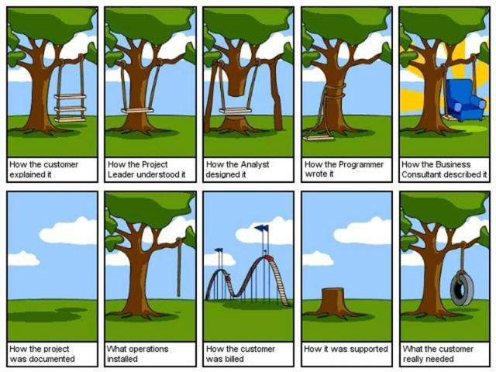
Why requirements?

Slide 8
Requirements: Goals and Roles
Understand precisely what is required
Communicate this understanding precisely to all parties
Control production to ensure that system satisfies the (final) requirements
Customers: show what should be delivered
Managers: a scheduling and progress indicator
Designers: provide a basis for design
QA/testers: a basis for testing, validation, verification
…

Slide 9
Good or bad requirements? Why?
Extra credit
The system will enforce 6.5% sales tax on Washington purchases
The system shall display the elapsed time for the car to make one circuit around the track within five seconds, in hh:mm:ss format
The product will never crash. It will also be secure against hacks
The system will support a large number of connections at once, and each user will not experience slowness or lag
The user can choose a document type from the drop-down list
Notes:
Answer: They are all bad!
- Shouldn't embed exact sales tax in the req.
- Compound sentence; really 3 reqs in one.
- Too vague and impossible to verify. Be quantitative. How many crashes per year? Etc.
-- Vague. How many connections? How much lag (seconds)?
- Over-specified. Don't describe the UI in English.

Slide 10
Classifying requirements
functional: identify inputs and outputs of computation
“A user search is with respect to one or more of the defined databases.”
“Every order is assigned a unique ID that the user can save.”
nonfunctional: other such as performance, dependability, reusability, safety, …
“Our deliverable documents shall conform to the XYZ process.”
“The system shall not disclose any personal user information.”
An alternative classification by Faulk in Reading II

Slide 11
“Digging” for requirements
Do
Don’t
Engage with the users to learn how they work
Ask questions throughout the process
Think about why users will do something in your system, not just what
Allow and expect requirements to change later
Describe complex business logic or rules
Be too specific or detailed
Describe the exact user interface
Try to think of everything ahead of time
Add unnecessary features the customers don’t want

Slide 12
Benefits of working with customers
Good relations improve actual and perceived development speed
Helps them figure out what they want
Helps them change what they want more smoothly over time
The #1 reason that projects succeed is user involvement [Standish Group]
Easy access to end users is a critical success factor in rapid-development projects [McConnell]

Slide 13
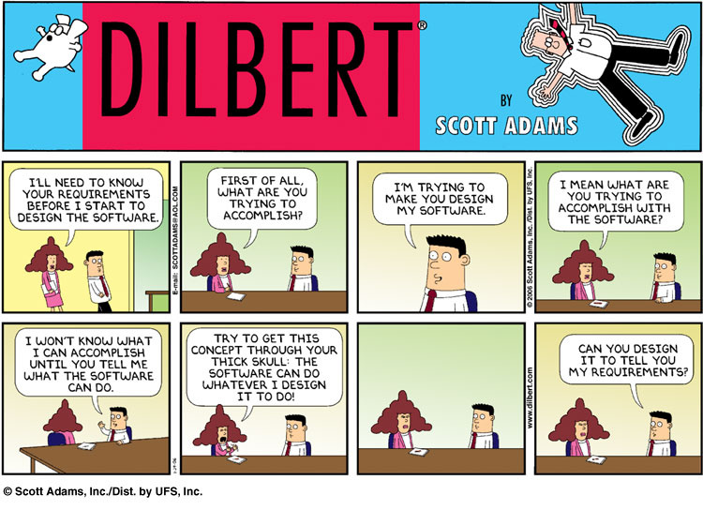

Slide 14
“What” vs. “How”
The conventional view is that requirements tell "what" to build and not "how“ to build
They reflect the problem, not the solution
One person’s what is another person’s how • “One person’s constant is another person’s variable.” [Perlis]
Input file processing is the what, parsing is the how
Parsing is the what, a stack is the how
A stack is the what, an array or a linked list is the how
A linked list is the what, a doubly linked list is the how
Notes:
Mention list of features and change to 15-20. Feature creep.

Slide 15
World and machine [Jackson] Alternative to what vs. how
The customer’s requirements are in the application domain (the world)
The program defines software (the machine) that has an effect in the world – for example, a database system dealing with books
There are things in the world not represented by a given machine – for examples, book sequels or trilogies, pseudonyms, anonymous books, …
Similarly, there are things in the machine that don’t represent anything in the world – for example, null pointers, deleting a record, back pointers, …
Notes:
Michael Jackson suggests a more fundamental distinction between requirements and program

Slide 16
How do we specify requirements?
It varies, but usually some combination of
Prototype
Use Cases
Feature List
Paper UI prototype
You will create a System Requirements Specification (SRS) document using structured natural language along with figures, use cases, etc.
I Although not ideal,
I.A structured natural language is almost always better
I.A.ii than unstructured natural language.
I.A.ii.3 Unless the structure is an
I.A.ii.3.q excuse to avoid content

Slide 17
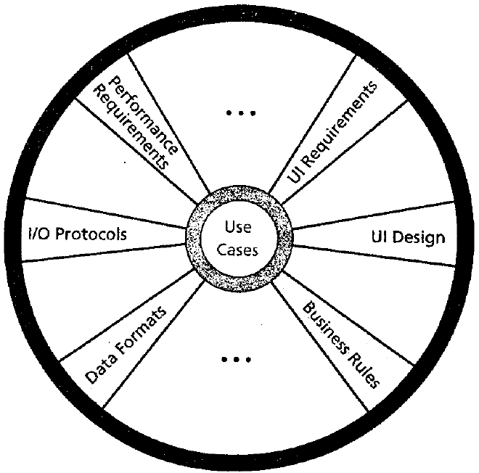
Cockburn's requirements template
purpose and scope
terms / glossary
use cases (the central artifact of requirements)
technology used
other
development process, participants, values (fast-good-cheap), visibility, competition, dependencies, business rules/constraints, performance demands, security, documentation, usability, portability, unresolved and deferred, human issues: legal, political, organizational, training

Slide 18
Use cases
A use case is an example behavior of the system, representing specific flows of events in the system
A use case characterizes a way of using a system
It represents a dialog between a user and the system, from the user’s point of view
It captures functional requirements
Ex: Robin has a meeting at 10AM; when Cameron tries to schedule another meeting for Robin at 10AM, Cameron is notified about the conflict
Similar to CRC (class responsibility collaborator) and eXtreme programming “stories”

Slide 19
Jacobson example: recycling
The course of events starts when the customer presses the “Start-Button” on the customer panel. The panel’s built-in sensors are thereby activated.
The customer can now return deposit items via the customer panel. The sensors inform the system that an object has been inserted, they also measure the deposit item and return the result to the system.
The system uses the measurement result to determine the type of deposit item: can, bottle or crate.
The day total for the received deposit item type is incremented as is the number of returned deposit items of the current type that this customer has returned...

Slide 20
Another example: Buy a product http://ontolog.cim3.net/cgi-bin/wiki.pl?UseCasesSimpleTextExample
Customer browses through catalog and selects items to buy
Customer goes to check out
Customer fills in shipping information
System presents full pricing information, including shipping
Customer fills in credit card information
System authorizes purchase
System confirms sale immediately
System sends confirming email to customer
Alternative: Authorization Failure
At step 6, system fails to authorize credit purchase
Allow customer to re-enter credit card information and re-try
Alternative: Regular Customer
3a. System displays current shipping information, pricing information, and last four digits of credit card information
3b. Customer may accept or override these defaults
Return to primary scenario at step 6

Slide 21
Qualities of a good use case
starts with a request from an actor to the system
ends with the production of all answers to the request
defines the interactions, between system and actors, related to the function
from the actor's point of view, not the system's
focuses on interaction
doesn't describe the GUI in detail
has 3-9 steps in the main success scenario
is easy to read, summary fits on a page

Slide 22
Benefits of use cases
Establish an understanding between the customer and the system developers of the requirements (success scenarios)
Alert developers to problematic situations (extension scenarios)
Capture a level of functionality to plan around (list of goals)

Slide 23
Terminology
Actor: someone/something who/that interacts with a use case; it could be a human, external hardware (like a timer), or another system
Primary actor: actor initiating the action
Goal: desired outcome of the primary actor
Level: top-level or implementation
summary goals
user goals
subfunctions

Slide 24
Use case summary diagrams
The overall list of your system's use cases can be drawn as high-level (UML-like) diagrams, with
actors as stick-figures with names (nouns)
use cases as ovals with names (verbs)
line associations that connect an actor to a use case in which that actor participates
use cases can be connected to other cases that they use
Check out book
Library patron

Slide 25
Library System
Check out
Search
Librarian
Reserve
Library Patron
Record new
Gen catalog
Notes:
Box can encapsulate the “system”

Slide 26
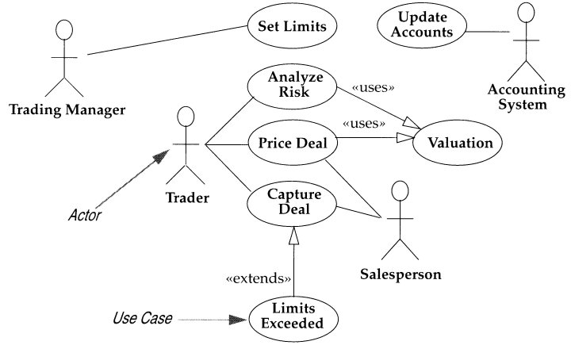
Investment System
Notes:
When you do your doc, should think about having an extension or a use

Slide 27
Are use cases good for these?
Which of these requirements should be represented directly in a use case?
Order cost = order item costs * 1.06 tax.
Promotions may not run longer than 6 months.
Customers only become Preferred after 1 year
A customer has one and only one sales contact
Response time is less than 2 seconds
Uptime requirement is 99.8%
Number of simultaneous users will be 200 max
None – many are non-functional requirements, others are core computation not based on interaction
Maybe the promotions, preferred, and sales contact would be handled in part with a use case
Notes:
Answer: NONE. Most of these requirements are non-functional, so the use cases wouldn't explicitly mention them. The user doesn't see them directly in the success scenario.

Slide 28
Use case summary diagrams
Actor | Goal
Library Patron | Search for a book
 | Check out a book
 | Return a book
Librarian | Search for a book
 | Check availability
 | Request a book from another library
It can be useful to list the primary actors and their “goals” – the use cases they start
Notes:
Check out book, search book, return book
Record book, search for book, generate catalog

Slide 29
Informal use case
An alternative, often combined with diagrams, is an informal use case written as a paragraph describing the interaction
Ex: Patron Loses a Book. The library patron reports to the librarian that she has lost a book. The librarian prints out the library record and asks patron to speak with the head librarian, who will arrange for the patron to pay a fee. The system will be updated to reflect lost book, and patron's record is updated as well. The head librarian may authorize purchase of a replacement book.

Slide 30
Formal use case: another approach
Goal | Patron wishes to reserve a book using the online catalog
Primary actor | Patron
Scope | Library system
Level | User
Precondition | Patron is at the login screen
Success end condition | Book is reserved
Failure end condition | Book is not reserved
Trigger | Patron logs into system

Slide 31
Main Success Scenario | Patron enters account and password System verifies and logs patron in System presents catalog with search screen Patron enters book title System finds match and presents location choices to patron Patron selects location and reserves book System confirms reservation and re-presents catalog
Extensions (error scenarios) | 2a. Password is incorrect 2a.1 System returns patron to login screen 2a.2 Patron backs out or tries again 5a. System cannot find book 5a.1 …
Variations (alternative scenarios) | 4. Patron enters author or subject

Slide 32
Creating a use case
Identify actors and their goals
What computers, subsystems and people will drive our system? (actors)
What does each actor need our system to do? (goals)
Consider software for a video store kiosk with no clerk
A customer with an account can use their membership and credit card to check out a video
The software can look up movies and actors by keywords
A customer can check out up to 3 movies, for 5 days each
Late fees can be paid at the time of return or at next checkout
Exercises: (1) Name four use cases, and draw a UML-like use case summary diagram of the cases and their actors; (2) Write a formal use case for the Customer Checks Out a Movie scenario

Slide 33
Creating a use case
Write the success scenario
This preferred “happy path” is easiest to read and understand, with everything else is a complication on this
Capture each actor's intent and responsibility, from trigger to goal delivery – say what information passes between them and number each line
List the variations
Label variations with step number and alternative
5’. Alternative 1 for step 5
5’’. Alternative 2 for step 5

Slide 34
What notation is good?
There are standard templates for requirements documents, diagrams, etc. with specific rules. Is this a good thing? Should we use these standards or make up our own?
Good: standards are helpful as a template or starting point; others are more likely to understand
But don't be a slave to formal rules or use a model/scheme that doesn't fit your project's needs

Slide 35
Pulling it all together
How much is enough?
You have to find a balance
comprehensible vs. detailed
graphics vs. explicit wording and tables
short and timely vs. complete and late
Your balance may differ with each customer depending on your relationship and flexibility
Notes:
Problems with underspecifiying?
Problems with overspecifying?

Slide 36
Feature creep: a warning!
Gradual accumulation of features over time
Often has a negative overall effect on a large software project
Why does feature creep happen? Why is it bad?
Because features are “fun”
developers like to code them
marketers like to brag about them
users want them
... but too many – “it’s OK, just one more” – means more bugs, more delays, less testing, ...

Slide 37
Week 2
Monday | Tuesday | Wednesday | Thursday | Friday
Requirements … | Group meetings – let your group TA know where you meet | Team work and structure | SRS information | Agile
Announcements now only on GoPost Announcements section Reading I: due tonight @ 11PM on DropBox https://catalyst.uw.edu/collectit/dropbox/notkin/20734 Weekly team summary: due Friday @ 11PM on DropBox by each PM SRS: due Tuesday April 10 @ 11PM on DropBox by each PM
Any questions?

