Slide 1
CSE403 ● Software engineering ● sp12
Week 7-10
Monday | Tuesday | Wednesday | Thursday | Friday
Joel test & interviewing No reading | Groups | Reviews | Section | Aspect-oriented design Progress report due Readings out
Reading due | Groups Beta due |  | Section | Progress report due Readings out
No reading due | Groups | Midterm II Reading covered [Notkin gone] | No section | Progress report due
Memorial Day Holiday | Groups | Final release due Project Pres. I | Project Pres. II | Project Pres. III

Slide 2
Collaborative programming
In some sense, all software developed by teams is collaboratively developed
We’ll look at two specific kinds of collaboration
Pair programming
Reviews

Slide 3
Pair programming
Technique from agile (XP)
2 people, 1 computer
take turns “driving” – tactics vs. strategy
rotate pairs often
pair people of different experience levels
all pairs
pros:
Can produce better code
An inexperienced coder can learn from an experienced one
cons:
Some people don’t like it
Multiple kids, multiple mice, one computer

Slide 4
What is known about PP?
Not entirely clear
“Laurie Williams … has shown that paired programmers are only 15% slower than two independent individual programmers, but produce 15% fewer bugs. Since testing and debugging are often many times more costly than initial programming, this is an impressive result.” [Economist, 2001]
A 5 year-old meta-analysis stated: "pair programming is not uniformly beneficial or effective because many other factors besides the choice of whether to use pair programming have large effects on the outcome of a programming task.”
And many other studies, with mixed outcome
Usually “less productive” but “better quality”
Some results showing benefits in introductory programming and in increasing diversity in computing

Slide 5
Possible “hard to measure” benefits
Knowledge passing
Practices
Knowledge of the specific system
Improved discipline and time management
Less likely to skip writing tests or cutting other corners
Less likely to spend time on personal stuff
Fewer interruptions of a pair than an individual
Increased morale
Greater confidence in the properties of the code

Slide 6
Reviews
Other team member(s) read an artifact (design, specification, code) and suggest improvements
Feedback leads to improvements, followed by additional reviews and eventually approval
Can occur before or after code is committed
Getting the right balance in when and how much is important
... everything is usually fair game
documentation
defects in program logic
program structure
coding standards & uniformity with codebase
enforce subjective rules

Slide 7
Analogy: writing a newspaper article
What is the effectiveness of…
Spell-check/grammar check?
Editing your own article?
Others editing your article?
Others walking through their comments with you?

Slide 8
Motivation for reviews
Can catch many bugs, design flaws early
> 1 person has seen every piece of code
Insurance against author’s disappearance
Accountability (both author and reviewers are accountable)
Forcing function for documentation and code improvements
Authors to articulate their decisions
Authors participate in the discovery of flaws
Prospect of someone reviewing your code raises quality threshold

Slide 9
More motivation
Inexperienced personnel get hands-on experience without hurting code quality
Pairing them up with experienced developers
Can learn by being a reviewer as well
Explicit non-purpose
Assessment of individuals for promotion, pay, ranking, etc.
Management is usually not permitted at reviews

Slide 10
Motivation by the numbers (From Steve McConnell’s Code Complete)
Average defect detection rates
Unit testing: 25%
Function testing: 35%
Integration testing: 45%
Design and code inspections: 55% and 60%
11 programs developed by the same group of people
First 5 without reviews: average 4.5 errors per 100 lines of code
Remaining 6 with reviews: average 0.82 errors per 100 lines of code
Errors reduced by > 80%
IBM's Orbit project: 500,000 lines, 11 levels of inspections. Delivered early with 1% of the predicted errors.
After AT&T introduced reviews, 14% increase in productivity and a 90% decrease in defects

Slide 11
Logistics of the code review
What is reviewed
A specification
A coherent module (sometimes called an “inspection”)
A single checkin or code commit (incremental review)
Who participates
One other developer
A group of developers
Where
In-person meeting
Best to prepare beforehand: artifact distributed in advance
Preparation usually identifies more defects than the meeting
Email/electronic

Slide 12
Review technique and goals
Specific focus?
Sometimes, a specific list of defects or code characteristics
Error-prone code
Previously-discovered problem types
Security
Checklist (coding standards)
Automated tools (type checkers, lint) can be better
Outcomes
Only identify defects, or also brainstorm fixes?

Slide 13
Code review variations
walkthrough: playing computer, trace values of sample data
group reading: as a group, read whole artifact line-by-line
presentation: author presents/explains artifact to the group
offline preparation: Reviewers look at artifact by themselves (possibly with no actual meeting)

Slide 14
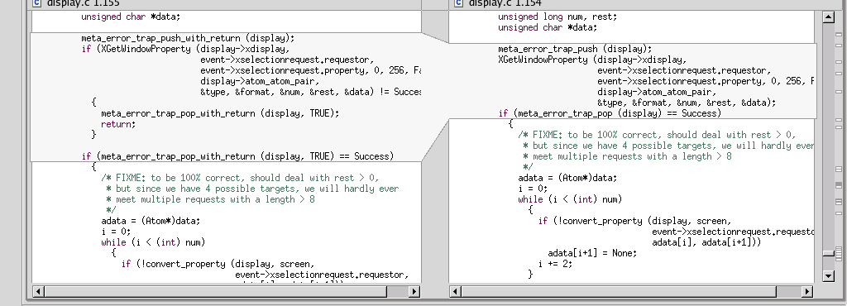
Code reviews in industry
Code reviews are a very common industry practice
Made easier by advanced tools that
integrate with configuration management systems
highlight changes (i.e., diff function)
allow traversing back into history

Slide 15
Common open source approach: incremental code review
Each small change is reviewed before it is committed
No change is accepted without signoff by a “committer”
Assumed to know the whole codebase well
Sometimes committers are excepted
Code review can (d)evolve into a design discussion

Slide 16
Ernst’s approach: holistic group code review
Distribute code (or other artifacts) ahead of time
Common pagination
Documentation is required (as is good style)
No extra overview from developer
Each reviewer focuses where he/she sees fit
Mark up with lots of comments
Identify 5 most important issues
At meeting, go around the table raising one issue at a time
Discuss the reasons for the current design, and possible improvements
Author takes all printouts and addresses all issues
Not just those raised in the meeting

Slide 17
Code Reviews at Google
"All code that gets submitted needs to be reviewed by at least one other person, and either the code writer or the reviewer needs to have readability in that language. Most people use Mondrian to do code reviews, and obviously, we spend a good chunk of our time reviewing code.“ --Amanda Camp, Software Engineer, Google

Slide 18
Code reviews at Yelp
“At Yelp we use review-board. An engineer works on a branch and commits the code to their own branch. The reviewer then goes through the diff, adds inline comments on review board and sends them back. The reviews are meant to be a dialogue, so typically comment threads result from the feedback. Once the reviewer's questions and concerns are all addressed they'll click ‘Ship It!’ and the author will merge it with the main branch for deployment the same day.” -- Alan Fineberg, Software Engineer, Yelp

Slide 19
Code reviews at WotC
“At Wizards we use Perforce for SCM. I work with stuff that manages rules and content, so we try to commit changes at the granularity of one bug at a time or one card at a time. Our team is small enough that you can designate one other person on team as a code reviewer. Usually you look at code sometime that week, but it depends on priority. It’s impossible to write sufficient test harnesses for the bulk of our game code, so code reviews are absolutely critical.” -- Jake Englund, Software Engineer, MtGO

Slide 20
Code reviews at Facebook
“At Facebook, we have an internally-developed web-based tool to aid the code review process. Once an engineer has prepared a change, she submits it to this tool, which will notify the person or people she has asked to review the change, along with others that may be interested in the change -- such as people who have worked on a function that got changed. “At this point, the reviewers can make comments, ask questions, request changes, or accept the changes. If changes are requested, the submitter must submit a new version of the change to be reviewed. All versions submitted are retained, so reviewers can compare the change to the original, or just changes from the last version they reviewed. Once a change has been submitted, the engineer can merge her change into the main source tree for deployment to the site during the next weekly push, or earlier if the change warrants quicker release.” --Ryan McElroy, Software Engineer, Facebook

Slide 21
Code review exercise
What feedback would you give the author? What changes would you request before checkin?
public class Account {
double principal,rate; int daysActive,accountType;
public static final int STANDARD=0, BUDGET=1,
PREMIUM=2, PREMIUM_PLUS=3;
}
...
public static double calculateFee(Account[] accounts)
{
double totalFee = 0.0;
Account account;
for (int i=0;i<accounts.length;i++) {
account=accounts[i];
if ( account.accountType == Account.PREMIUM ||
account.accountType == Account.PREMIUM_PLUS )
totalFee += .0125 * ( // 1.25% broker's fee
account.principal * Math.pow(account.rate,
(account.daysActive/365.25))
- account.principal); // interest-principal
}
return totalFee;
}

Slide 22
Improved code (page 1)
/** An individual account. Also see CorporateAccount. */
public class Account {
private double principal;
/** The yearly, compounded rate (at 365.25 days per year). */
private double rate;
/** Days since last interest payout. */
private int daysActive;
private Type type;
/** The varieties of account our bank offers. */
public enum Type {STANDARD, BUDGET, PREMIUM, PREMIUM_PLUS}
/** Compute interest. **/
public double interest() {
double years = daysActive / 365.25;
double compoundInterest = principal * Math.pow(rate, years);
return compoundInterest – principal;
}
/** Return true if this is a premium account. **/
public boolean isPremium() {
return accountType == Type.PREMIUM ||
accountType == Type.PREMIUM_PLUS;
}

Slide 23
Improved code (page 2)
/** The portion of the interest that goes to the broker. **/
public static final double BROKER_FEE_PERCENT = 0.0125;
/** Return the sum of the broker fees for all the given accounts. **/
public static double calculateFee(Account accounts[]) {
double totalFee = 0.0;
for (Account account : accounts) {
if (account.isPremium()) {
totalFee += BROKER_FEE_PERCENT * account.interest();
}
}
return totalFee; }
}

