Slide 1
CSE403 ● Software engineering ● sp12
Week 2
Monday | Tuesday | Wednesday | Thursday | Friday
Requirements … | Group meetings – let your group TA know where you meet | Team work and structure | SRS information | Agile
There is no “I” in ‘team’
(But there is a “me” in ‘team’)
My part wo_{r}
sk

Slide 2
Reprise: How big is 324 MLOC?
How long it would take you to type 324 MLOC
(assume 5 words/LOC @ 50 wpm )
~32,000,000 min ≈ 61 years
no thinking • no sleeping • no breaks
Teams of six people ≈ 10 years
Teams of 50 people ≈ 1¼ years
What’s right and what’s wrong
with this reasoning?

Slide 3
Team pros and cons
Benefits
  Attack bigger problems in a short period of time
  Utilize everyone’s collective experience and skills
Risks
  Communication and coordination issues
  Groupthink: diffusion of responsibility, going along
  Working by inertia, not planning ahead
  Conflict or mistrust between team members

Slide 4
An apparent aside: diversity
From Diversity in Engineering by Wm. Wulf
Every time an engineering problem is approached with a pale, male design team, it may be difficult to find the best solution, understand the design options, or know how to evaluate the constraints.
…it is that the range of design options considered in a team lacking diversity will be smaller. … It is that the most elegant solution may never be pursued. …There is a real economic cost to that. Unfortunately, it is an opportunity cost … and those kinds of costs are very hard to measure.

Slide 5
Team
Structure
Decision-making
Communication and coordination
Motivation
A team is a set of people with complementary skills who are committed to a common purpose, performance goals, and approach for which they hold themselves mutually accountable. – Katzenbach and Smith

Slide 6
Issues affecting team success
Presence of a shared mission and goals
Motivation and commitment of team members
Experience level – and presence of experienced members
Team size – and the need for bounded yet sufficient communication
Team organization – and results-driven structure
Reward structure within the team – incentives, enjoyment, empowerment (e.g., ownership, autonomy)

Slide 7
Team structures: tricky balance
Progress
Activity
Communication
Too much/little communication
Expertise
“It’s all about me”
Motivation
Artist’s rendition only

Slide 8
Communication: essence
Need a team to develop large projects
Progress towards this goal requires concurrent work to achieve a team’s multiplicative effect
Concurrent work must be coordinated across the team – or activity may by itself be mistaken for progress towards the goal
Communication is the foundation for team coordination – it there to allow progress towards the goal, but it isn’t progress in and of itself

Slide 9
Communication: challenges
Bigger teams ⇒ more communication
  ⇒ a smaller multiplier effect
  Everybody to everybody communication has quadratic cost (in team size)
  Maybe ¼ of each increase in team size goes to communication cost
  [on right: 75% ● 56% ● 42%]
Communication may introduce miscommunication
  Electronic communication may be more susceptible to miscommunication
1 | 2 |  |  | 1 | 2 | 3 | 4
3 |  |  |  | 5 |  | 6
 |  |  |  | 7 | 8
 |  |  |  | 9
1 | 2 | 3 | 4 | 5 | 6 | 7 | 8
9 |  | 10 |  | 11 |  | 12
13 | 14 |  |  | 15 | 16
17 |  |  |  | 18
19 | 20 | 21 | 22
23 |  | 24
25 | 26
27

Slide 10
Common SWE team responsibilities
Project management
Functional management
Designers/architects
Developers: programmers, testers, integrators
Lead developer (“tech lead”)
These could be all different team members, or some members could span multiple roles
Key: Identify and stress roles and responsibilities
  Responsibility should come with both authority and accountability

Slide 11
Organizing by functionality
Pragmatic Programmer tip: “Organize around [project] functionality, not job functions”
Not testers and developers and maintainers etc., but UI and backend and network etc.
Benefits and costs of this approach?
Extra credit

Slide 12
Who will do the ...
Scheduling? Development? Testing? Documentation (spec, design, write-ups, presentations)? Build/release preparation? Team communication? Customer communication? …

Slide 13
Team structure models
Dominion model
  clear chain of responsibility
  people are used to it
  single point of failure
  less shared sense of ownership
Communion model
  a community of leaders, each in his/her own domain
  inherent sense of ownership
  people aren't used to it (and this scares them)

Slide 14
Surgical/Chief Programmer Team
[Baker, Mills, Brooks]
Chief: all key decisions
Copilot: chief’s assistant
Administrator: manages people, hardware, resources
Editor: edits chief’s documentation
Secretaries (2): for administrator and for editor
Program clerk: keeps all project records
Toolsmith: builds programming tools for chief
Language lawyer: programming language expert, advises chief
Tester: develops and runs unit and system tests
A 40 year-old dominion model

Slide 15
Toshiba Software Factory [Y. Matsumoto]
Late 1970’s structure for 2,300 software developers producing real-time industrial application software systems (such as traffic control, factory automation, etc.)
Unit Workload Order Sheets (UWOS) precisely define a software component to be built
Assigned by project management to developers based on scope/size/skills needed
Completed UWOS fed back into management system
Highly measured to allow for process improvement

Slide 16
Microsoft’s team structure [microsoft.com]
Program Manager. Leads the technical side of a product development team, managing and defining the functional specifications and defining how the product will work.
Software Design Engineer. Codes and designs new software, often collaborating as a member of a software development team to create and build products.
Software Test Engineer. Tests and critiques software to assure quality and identify potential improvement opportunities and projects.

Slide 17
Other kinds/styles of teams
problem-resolution: a focused attack on specific bugs, problems, issues
creative: coming up with and exploring new ideas
tactical-execution: carries out a defined plan
Some other team models
  skunkworks: turn the developers loose
  SWAT: skilled with a particular advanced tool(s)
  Professional Athletic: carefully selected people w/ very specialized roles
  Theater: “director” assigns roles to others

Slide 18


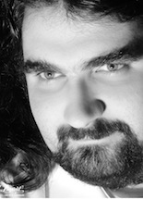

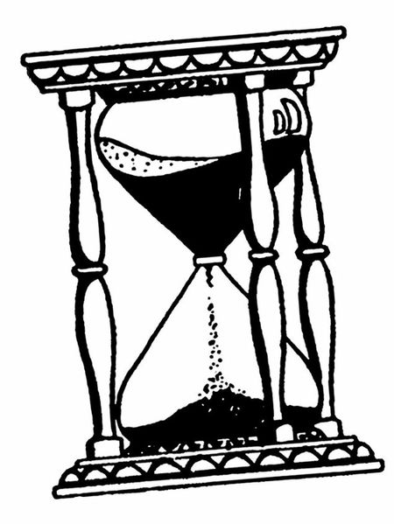
Enough from me – what do you want to know about teams and teamwork?

Slide 19
Team leadership
Who makes the important product-wide decisions in your team?
  One person?
  All, by unanimous consent?
  Consensus?
  Other options?...
Is this an unspoken or an explicit agreement among team members?

Slide 20
Making decisions: some guidelines
  Delegate when possible – and make sure every member has a significant role
Let everyone give their input – even if some of it appears to be off-track
Write down pros/cons of alternatives, evaluate cost/benefit/risks – how long will it take? is it needed? Plan B? …
Have a clear procedure for resolving disagreement – strive for consensus, but if it cannot be achieved …
Pareto analysis: find 20% of work that solves 80% of problem
Compromise, compromise, compromise

Slide 21
Once decisions are made
Write down decisions and responsibilities clearly
  Document electronically; post to a shared wiki or web page that can be retrieved easily
Determine how to accomplish the decision
  Specific dates for progress – usually in terms of several smaller milestones
  Agree to coordinate when milestones are met
Prioritize and order goals and TODOs
  List by urgency, by due date/milestone date
  List team member responsibility

Slide 22
Results-driven structure
Clear roles and responsibilities – each person knows and is accountable for their work
Monitor individual performance, hold people accountable – who is doing what, are we getting the work done?
Effective communication system – available, credible, tracking of issues and decisions
Fact based decisions – focus on the facts, not the politics, personalities, …

Slide 23
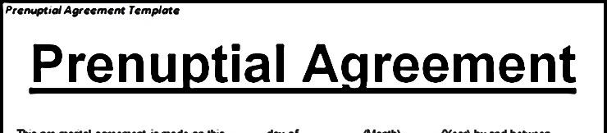
Motivation
How can you motivate all team members to do their share?
What happens if they don’t?
What happens if they can’t?

Slide 24
What motivates you? Others?

Slide 25
Incomplete and overlapping…
Achievement
Recognition
Advancement
Salary
Possibility for growth
Interpersonal relationships
  Subordinate
  Superior
  Peer
Status
Technical supervision opportunities
Company policies
Work itself
Work conditions
Personal life
Job security
Responsibility
Competition
Time pressure
Tangible goals
Social responsibility
Other?
What de-motivates you? Others?

Slide 26

De Mentoring and De management of DA students david notkin ● UW Computer science & engineering
Dementors are among the foulest creatures that walk this earth. They infest the darkest, filthiest places, they glory in decay and despair, they drain peace, hope, and happiness out of the air around them... Get too near a Dementor and every good feeling, every happy memory will be sucked out of you. If it can, the Dementor will feed on you long enough to reduce you to something like itself...soulless and evil. You will be left with nothing but the worst experiences of your life.
—Remus Lupin to Harry Potter
February 2012 ● CRA Career Mentoring Workshop

Slide 27
Incomplete and overlapping…
Micro-management or no management
Lack of ownership
Lack of effective reward structure – including lack of simple appreciation for job well done
Excessive pressure and resulting “burnout”
Allowing “broken windows” to persist
Lack of focus in the overall direction
Productivity barriers – asking too much, not allowing sufficient learning time, using the wrong tools, …
Too little challenge
Work not aligned with personal interests and goals
Poor communication inside the team

Slide 28
A productive team
Specific, small, attainable goals that can be visualized
Shared long-term vision
Frequent communication and updates
Meet in person to work as much as possible
Minimize work done “solo” – use small teams
Build good team camaraderie
…

Slide 29
Road blocks?
Technical confusion
How do I start implementing that feature?
Unclear responsibilities
Oh, am I supposed to do that?
Unclear due dates
When was I supposed to have that done?
Lack of milestones
But it's not due until next Friday!
Distraction
Time to work on 403 ... Ooh look, Men of Sieg Hall calendar!

Slide 30
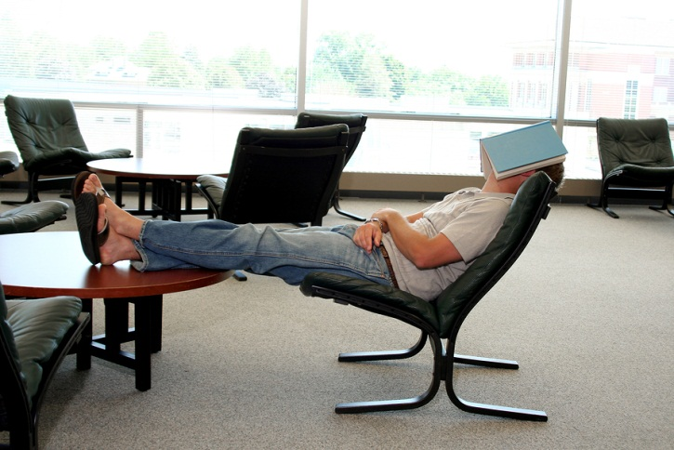
Slackers
If the problem persists…
  PM can send a kind but firm email with concerns
  In-person meeting with PM (and maybe a few members)
  Talk to us to let us know about the issue and see if we can help
What do you do if a group member is slacking off?
  Try to find out why
  Check in more frequently
  Team them up
  Meet more in person

Slide 31
Group relations: handle with care
Unnecessarily singling out individuals – by words or by actions, intentional or unintentional – is counterproductive
  There are (at least) two sides to every story
The goal is to maintain positive group relations and make progress on the project
  Problems must be dealt with, but criticism does not necessitate being harsh, rude, mean
Depersonalize when possible
  “We are concerned about XYZ.”
  "We are a little behind, so let's all meet in person in the lab today.”

Slide 32
Email
Hey Dana, I was wondering if you finished the XYZ feature you were assigned yet? You were late on the ABC feature from the last phase so I thought I better email you. When you have time, please tell me when XYZ is done. –Hunter
Hey Dana, how is your work on the XYZ going? It's due a week from Friday. Like we talked about at our last meeting, we are hoping to have the rough sketch of the first 2/3 of it by Sunday so we can go over it together. Please let me know by tomorrow night how much progress has been made. If you have any questions or need some help, let me know. We'll all meet Saturday in person and you can give us another update at that time. Thanks! –Hunter

Slide 33
Be quantitative and specific
Use specific, incremental goals, not just for things to be “done”
List particular dates that results are expected
Give an expected date/time to reply to a communication
Offer support, help, gratitude as appropriate – in contrast to being accusatory
Remind about upcoming deadlines, meetings, key points

Slide 34
Effective meetings
An agenda of topics to discuss (email ahead of time)
Each member/subgroup reports its progress
Get an update on every current work item
Take notes on decisions made and post them to wiki or such
Have whiteboard/paper handy for sketching out ideas
Keep everyone's attention (ban laptops/cell phones?)
Walk away with a clear plan of action, set of TODOs

Slide 35
Meeting gotchas
Don't “meet just to meet” – if you have nothing to discuss, cancel it or make it a work meeting in the lab
Use email, not meetings, for a one-way flow of information
Start on time, end on time – a team member (often the PM) should track the agenda and time
  Steer sidetracked discussion back to the agenda
  If time runs out, push specific items to the next meeting and/or email
Don't ignore a group member's input – even if you don't go forward with their idea, at least listen to it

Slide 36
Week 2
Monday | Tuesday | Wednesday | Thursday | Friday
Requirements … | Group meetings – let your group TA know where you meet | Team work and structure | SRS information | Agile
Weekly team summary: due Friday @ 11PM on DropBox by each PM SRS: due Tuesday April 10 @ 11PM on DropBox by each PM
Any questions?

