Slide 1
Software Requirement Specifications (SRS)
With an Emphasis on Use Cases
Most of the slides are adapted from the previous quarter’s recitation and an existing SRS document

Slide 2
Use Cases
A written description of the user's interaction with the software product to accomplish a goal
Accurately describes the what system must do
Documentation of functionality not design
Remember ‘what’ vs. ‘how’

Slide 3
A Few Use Case Clarifications…
Primary Actor: the person interacting in the use case
Level: granularity, big picture vs. small feature
Minimal/Success “Guarantee”
Guarantee == Post-condition
Minimal/Success == worst case/best case
Main Success Scenario
Describes how user uses system to successfully complete a task
Extensions
Alternate paths in success scenario (usually failure cases)
Should maintain minimal guarantee

Slide 4
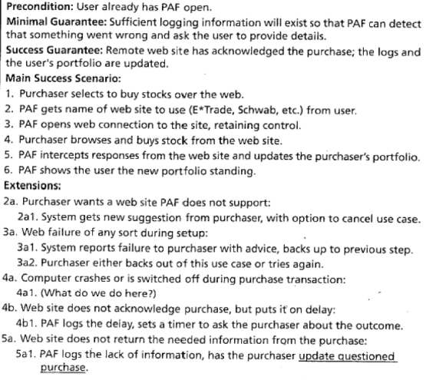
Personal Advisors Finance Package

Slide 5
SRS Definition
“A software requirements specification (SRS) is a complete description of the behavior of a system to be developed.”
Wikipedia

Slide 6
SRS Outline
Introduction: Purpose, scope and overview
Overall Description
System environment
Functional Reqs: “What” your software does
Use case scenarios
User Characteristics: How will different actors interact with your software
Non-functional Requirements: Imposed by the employer & users
Quality standards, performance requirements, etc

Slide 7
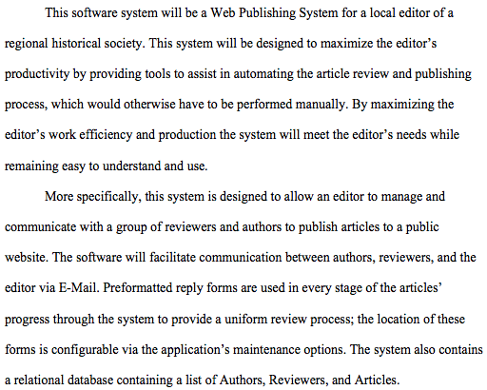
Example: Web Publishing System
Example from: www.courses.utep.edu/portals/870/S04-F04%20SRS%20v0.91.doc

Slide 8
Scope
Web publishing system for an editor
Goal: Maximize editor’s productivity
Automated article review and publishing
Facilitate communication between the editor, a group of reviewers and the author via email
Preformatted reply forms to provide uniform reviewing process

Slide 9
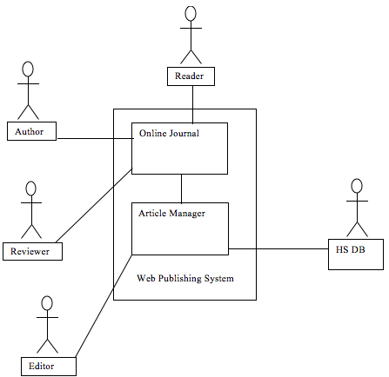
System Environment Diagram

Slide 10
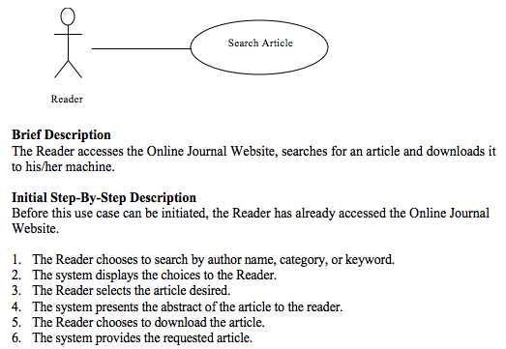
Use Case 01: Search Article

Slide 11
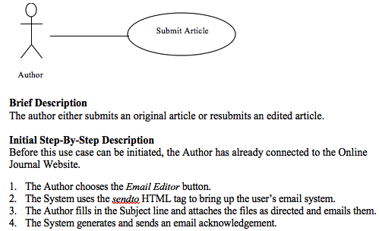
Use Case 02: Submit Article

Slide 12
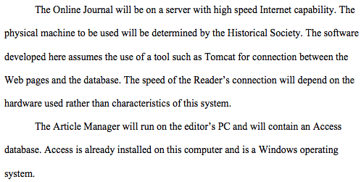
Non-functional Requirements

Slide 13
Your SRS Outline
Follow the information on the web
mostly straightforward, but answer questions thoroughly
Write in complete sentences and paragraphs
Explain your choices, describe your product as if we have not seen your presentation
Parts:
Product description, Use cases (also in SRS)
UI diagrams, process, customer meeting report

Slide 14
Reminders
Group Meetings
Name your team!
Select your Program Manager (PM)
Schedule your weekly group meetings and let your TAs know your meeting times
We won’t be able to meet with each group every week, but we will try our best and coordinate with your PMs
Also you can always setup appointments with us
SRS document due on April 10 (next Tue.) @11PM

