Slide 1
UML
CSE 403 Spring 2012
Class and Sequence Diagrams
Violet
Anton Osobov
Slides adapted from Marty Stepp, CSE 403, Winter 2012

Slide 2
Design Phase
design: Specifying the structure of how a software system will be written and function (without actually writing the code).
a transition from "what" the system must do, to "how" the system will do it
What classes will we need in order to implement a system that meets our requirements?
What fields and methods will each class have?
How will the classes interact with each other?

Slide 3
Introduction to UML
Unified Modeling Language (UML): depicts an OO system
programming languages are not abstract enough for OO design
UML is an open standard; lots of companies use it
many programmers either know UML or a "UML-like" variant

Slide 4
UML Class Diagrams
UML class diagram: A picture of the classes in an OO system, their fields and methods, and connections between the classes that interact or inherit from each other
What are some things not represented in a class diagram?
details of how the classes interact
algorithmic details; how particular behavior is implemented
trivial methods (get/set)
classes that come from libraries (ArrayList, etc.)

Slide 5
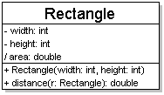
Diagram of a class
class name in top of box
write <<interface>> on top of interface’s names
use italics for an abstract class name
attributes
include all fields of the object
include properties “derived” properties
operations (constructors/methods)
may omit trivial methods – get/set
except from an interface
should not include inherited methods

Slide 6
Class attributes
syntax:
visibility name : type [count] = defaultValue
underline static attributes
Symbol | Visibility
+ | public
# | protected
- | private
~ | package (default)
/ | derived

Slide 7
Class operations/methods
syntax:
visibility name(parameters): returnType
underline static methods
parameter types listed as (name: type)
omit returnType on constructors and when return is void

Slide 8
Relationships between classes
generalization: an inheritance relationship
inheritance between classes
interface implementation
association: a usage relationship
dependency
aggregation
composition

Slide 9
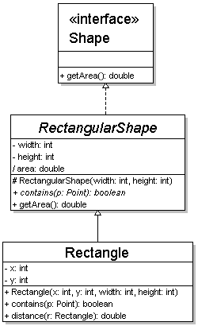
Generalization
hierarchies are drawn top down
arrow from child to parent
trivial/obvious relationships often not drawn
Java: Object
Parent | Line/Arrow Style
class | solid, black arrow
abstract class | solid, white arrow
interface | dashed, white arrow

Slide 10
Association
multiplicity
name
what relationship the objects have
navigability
direction
Symbol | How many are used?
* | 0, 1, or more
1 | exactly 1
2..4 | between 2 and 4
5..* | 5 or more

Slide 11
Association types
Car
1
aggregation
1
aggregation: “is part of”
clear, white diamond
composition: “is entirely made of”
stronger version of aggregation
the parts only exist while the whole exists
black diamond
dependency: “uses temporarily”
dotted arrow or line
Engine
Book
composition
1
*
Page
dependency
Lottery Ticket
Random

Slide 12
UML Sequence Diagrams
sequence diagram: an “interaction diagram” that models a single scenario executing in the system
UML representation of a use case

Slide 13
Sequence diagram key parts
participant: object or entity that acts in the diagram
message: communication between participants
axes in a sequence diagrams
horizontal: which participant/object is acting
vertical: time (down = forward in time)

Slide 14
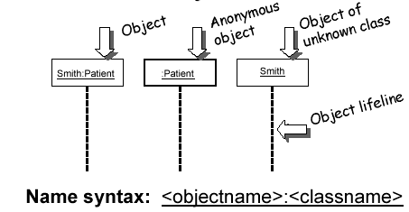
Representing objects
Rectangles with object type, optionally preceded by “name : ”
Write object’s name if it clarifies the diagram
Object’s “life line” represented by dashed vertical line

Slide 15
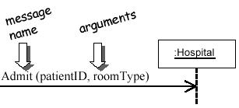
Messages between objects
messages (methods calls) represented by arrow to other object
method name and arguments written above the arrow

Slide 16
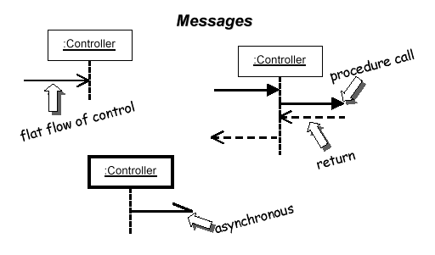
Messages continued
messages (methods calls) represented by arrow to other object
dashed arrow back indicates return
different arrows for normal and concurrent/asynchronous calls

Slide 17
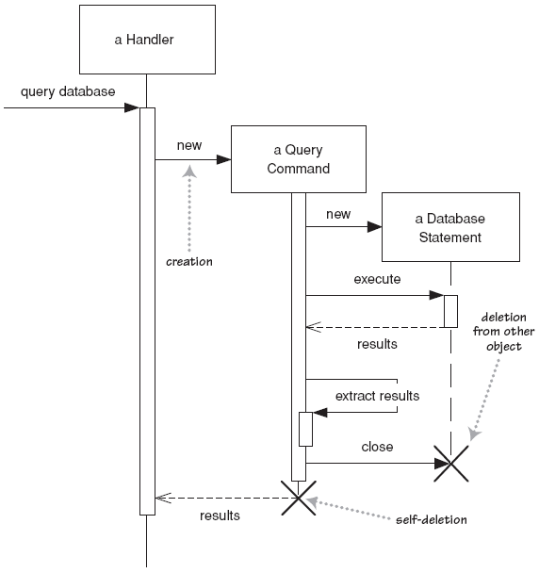
Object lifetime
creation: arrow with “new” written above it
object created after start of scenario appears lower than the others
deletion: an X at bottom of object’s lifeline
more applicable to languages with manual memory management (C, C++)

Slide 18
Method activiation
activation: thick box over object's life line; drawn when object's method is on the stack
either that object is running its code, or it is on the stack waiting for another object's method to finish
nest activations to indicate recursion
Activation
Nesting

Slide 19
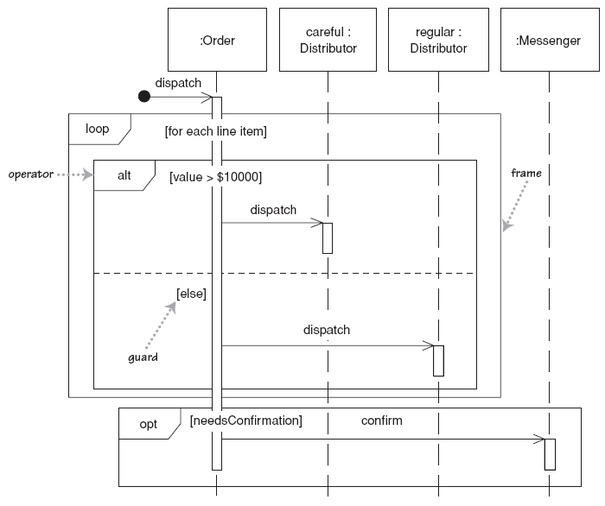
If statements and loops
frame: box around part of diagram to indicate if or loop
if -> (opt) [condition]
if/else -> (alt) [condition], separated by horizontal dashed line
loop -> (loop) [condition or items to loop over]

Slide 20
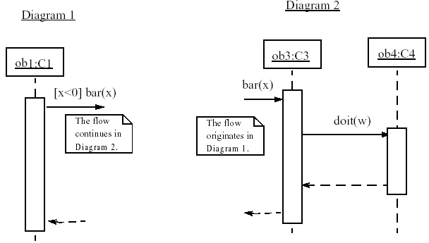
Linking sequence diagrams
If one diagram is too large or refers to another, indicate with:
a "ref" frame that names the other diagram
Or an unfinished arrow and comment,

Slide 21
Violet
Tool for creating UML diagrams
Free
Easy to learn/use
http://sourceforge.net/projects/violet/
Other software:
Rational Rose
Visual Paradigm UML Suite
Microsoft Visio

