Slide 1
Design Patterns
with an Emphasis on
Gang of Four

Slide 2
Design Patterns – WHY?
Good programming practice
They solve common problems
If you can recognize that you need them, they will make your life and coding easier
Resulting code is easy to manage & maintain
Any other reasons why you use them?

Slide 3
Design Patterns
Ones you have seen on Monday
Singleton
(Abstract)Factory
Ones we will focus today
Adapter
Observer
Tons of others available at:
http://sourcemaking.com/design_patterns

Slide 4
Adapter Pattern
“An “off the shelf” component offers compelling functionality that you would like to reuse, but its “view of the world” is not compatible with the philosophy and architecture of the system currently being developed.”
http://sourcemaking.com/design_patterns/adapter

Slide 5
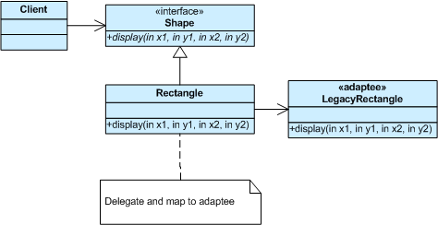
Adapter Example

Slide 6
Adapter (High Level)

Slide 7
Observer Pattern
A type ‘A’ produces (keeps) events/data
Type ‘B’ is interested in these events/data
Wants to observe ‘A’
‘A’ lets a special type ‘C’ to register itself and get notified as these events/data is being generated
‘B’ implements ‘C’ and registers itself to ‘A’ during creation

Slide 8
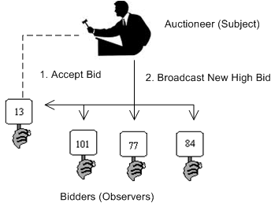
Observer Example

Slide 9
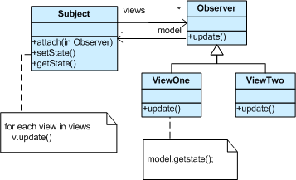
Observer (High Level)

Slide 10
Git Lecture
Any questions about Git?

Slide 11
Reminders
SDS is due today @11 PM
You should start coding soon! (If you have not already)
Your next assignment is ZFR
Progress report due Friday @11 PM (as usual)

