Slide 1
Reconstruction
CSE 576
Ali Farhadi
Several slides from Steve Seitz, Larry Zitnick, Lana Lazebnik, Carlos Hernández, George Vogiatzis,Yasutaka Furukawa

Slide 2
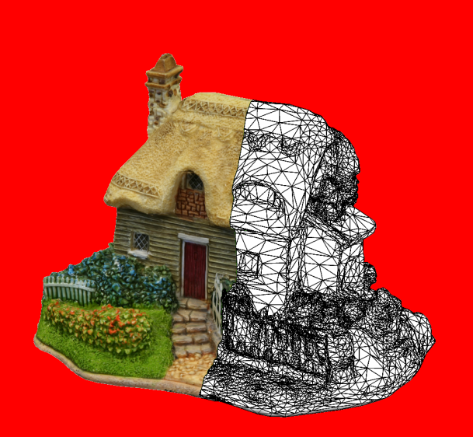
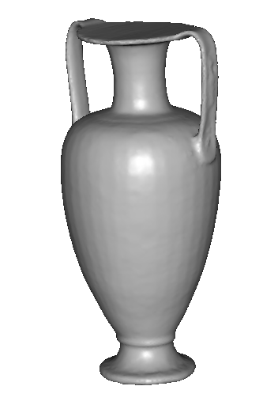
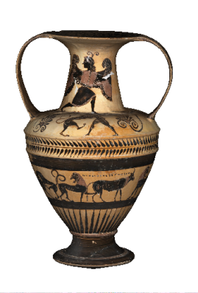
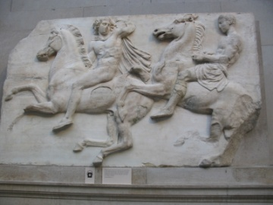
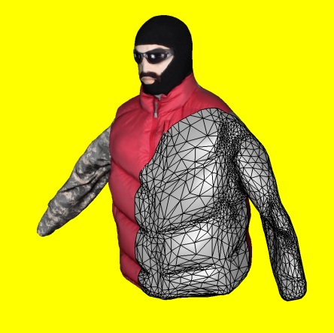
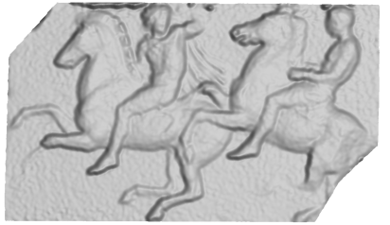
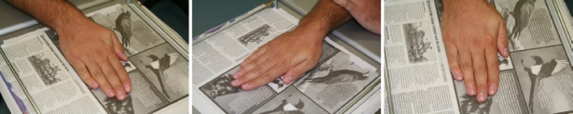
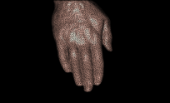
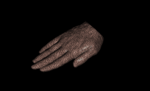
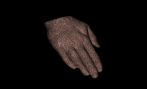
3d model
“Digital copy” of real object
Allows us to
  Inspect details of object
  Measure properties
  Reproduce in different material
Many applications
  Cultural heritage preservation
  Computer games and movies
  City modelling
  E-commerce

Slide 3
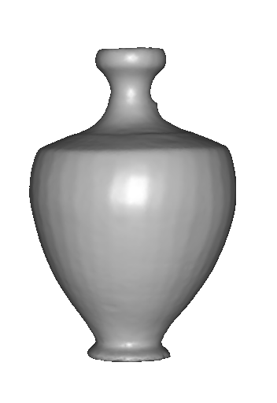
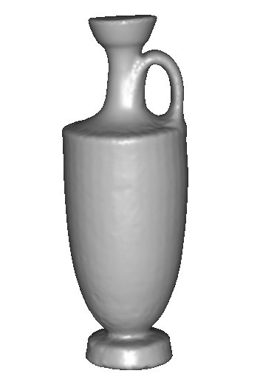
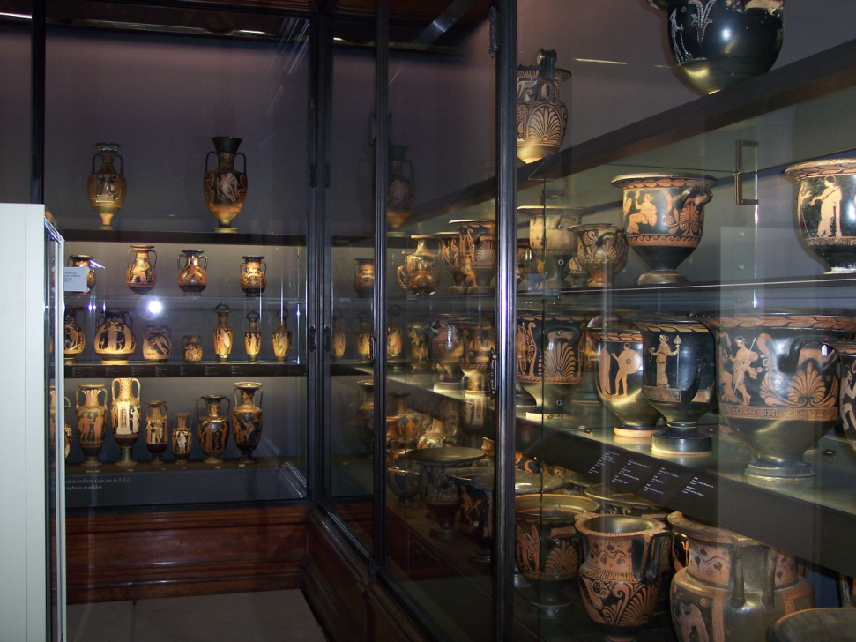
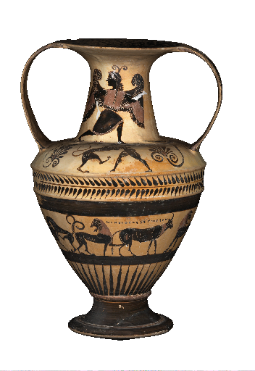
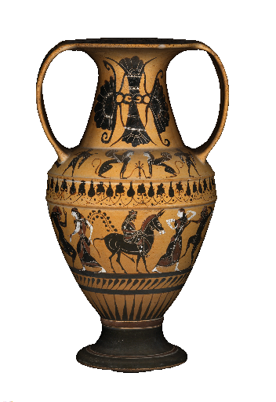
Applications: cultural heritage
SCULPTEUR European project
Notes:
To sum up,

Slide 4
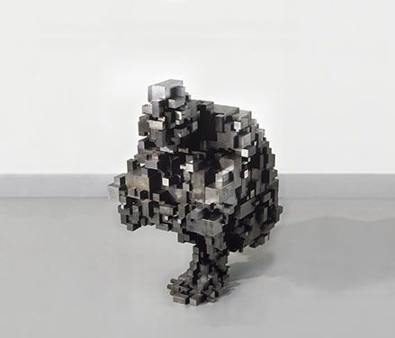
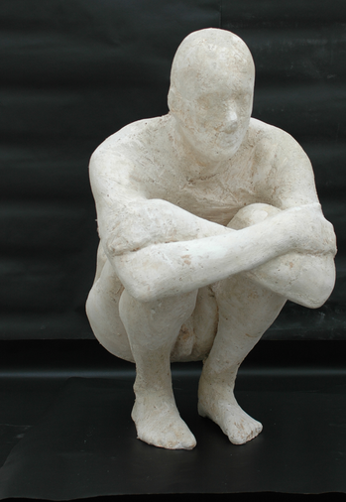
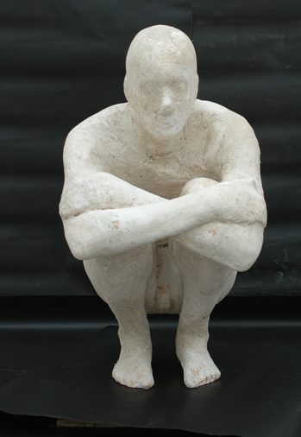
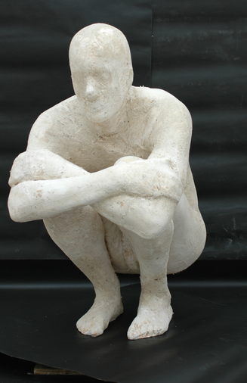
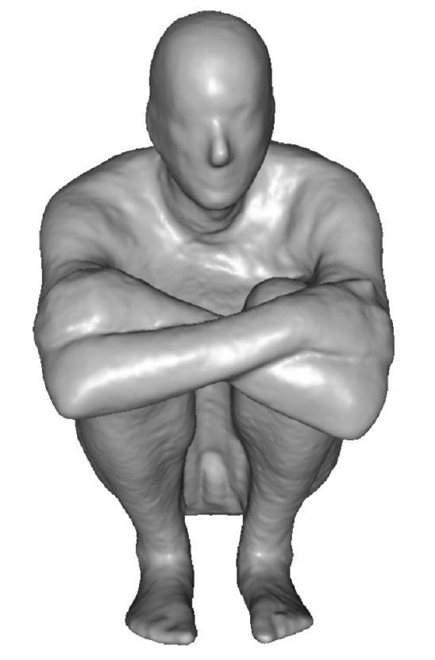
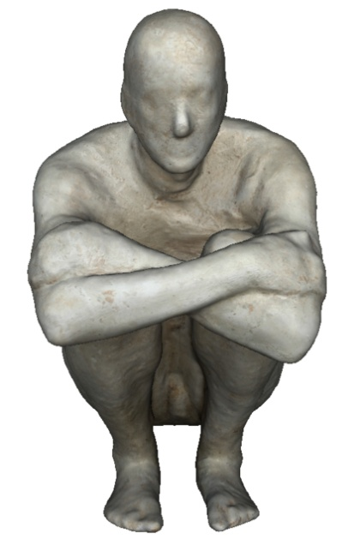
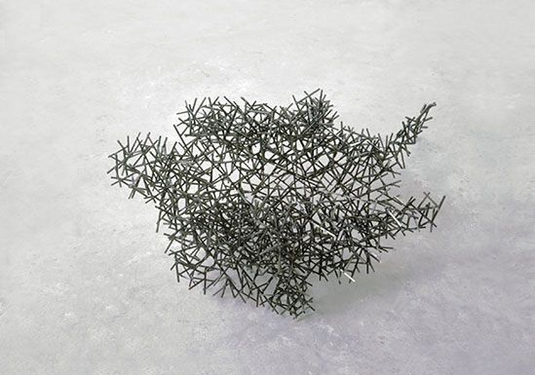
Applications: art
Block Works Precipitate III 2004
Mild steel blocks 80 x 46 x 66 cm
Domain Series Domain VIII Crouching
1999 Mild steel bar 81 x 59 x 63 cm

Slide 5
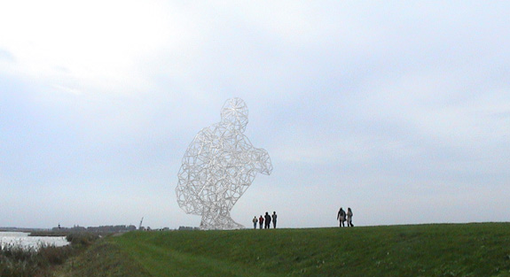
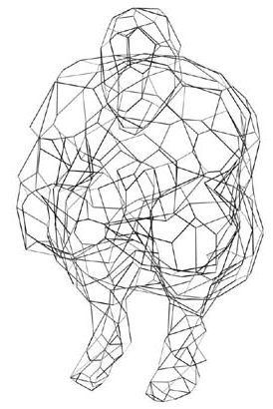
Applications: structure engineering
BODY / SPACE / FRAME, Antony Gormley, Lelystad, Holland
Notes:
To sum up,

Slide 6
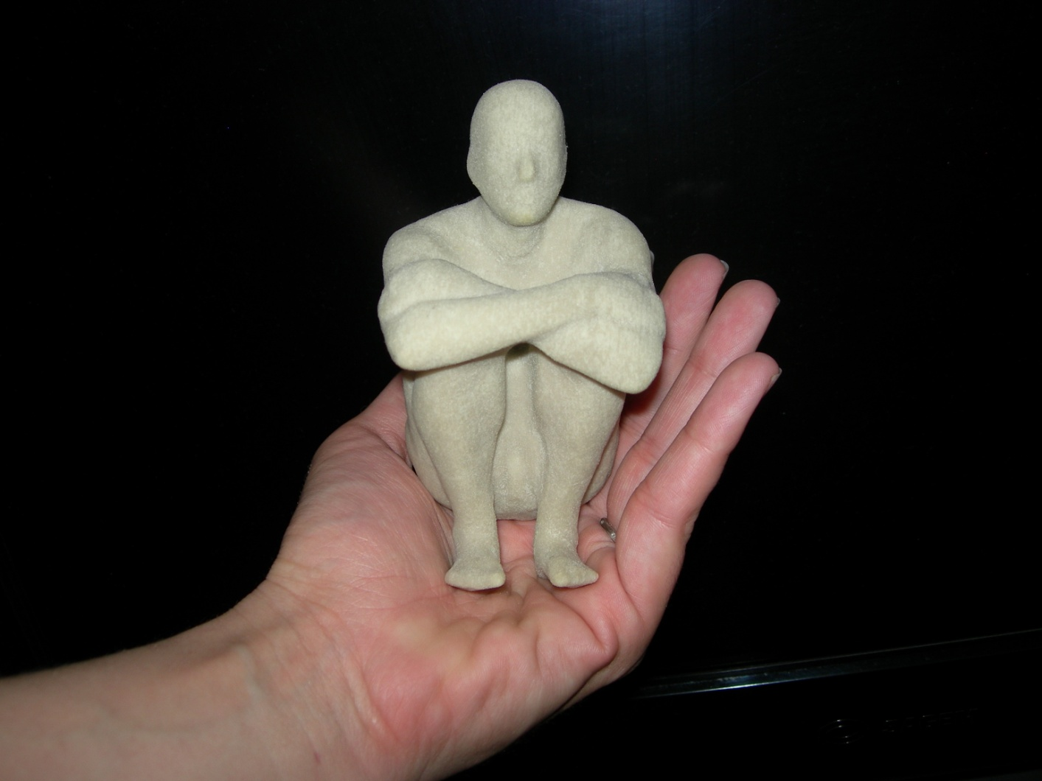
Applications: art
Notes:
To sum up,

Slide 7
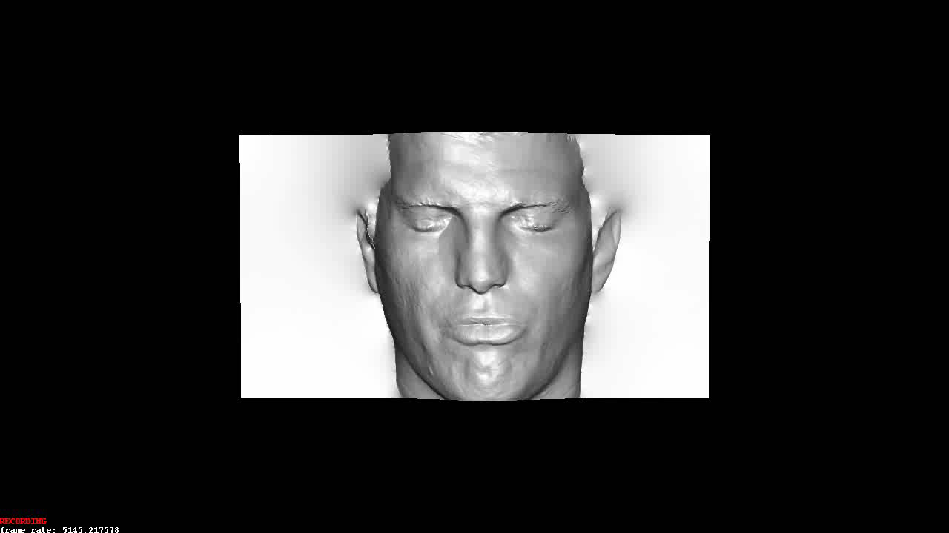
Applications: computer games
Notes:
To sum up,

Slide 8
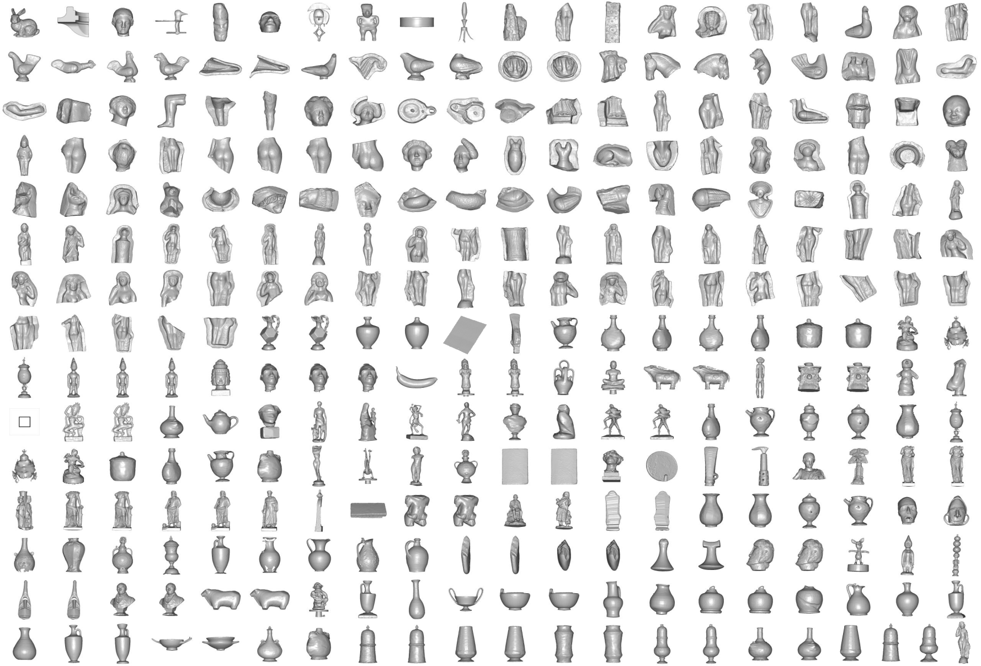
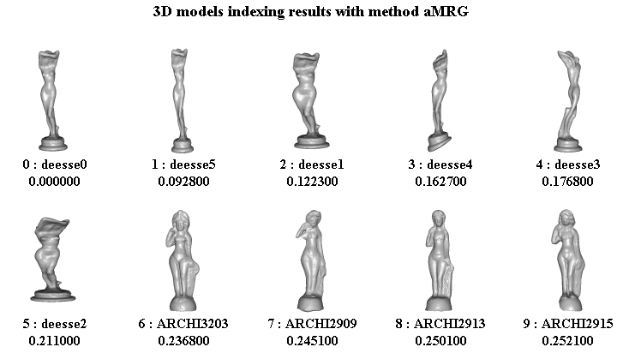
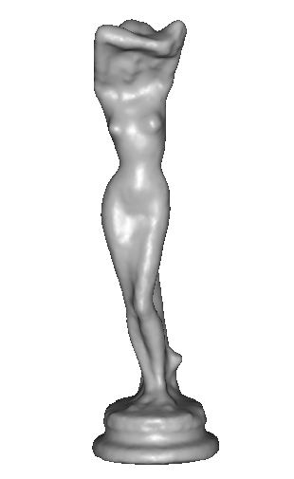
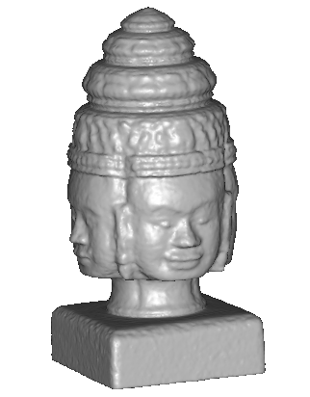
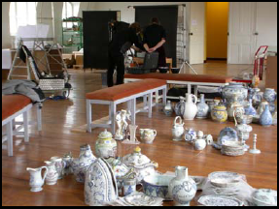
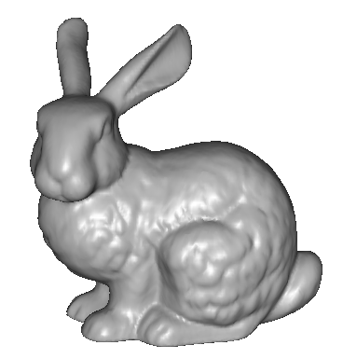
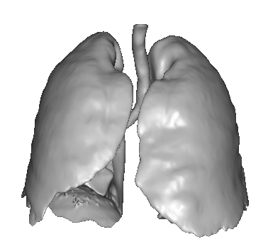
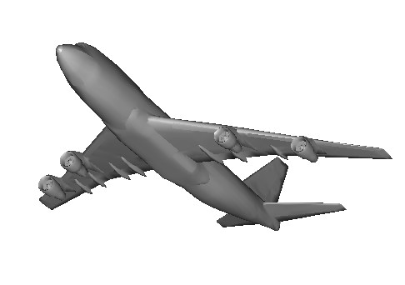
Applications: 3D indexation
? ?
? ? ?
?
? ?
?
SCULPTEUR European project
medical, industrial and cultural heritage indexation

Slide 9
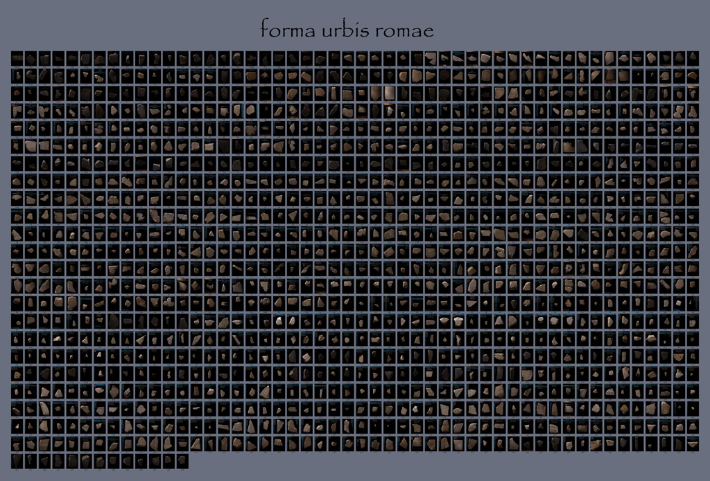
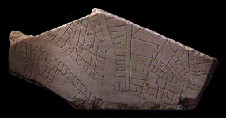
Applications: archaeology
“forma urbis romae” project
Fragments of the City: Stanford's Digital Forma Urbis Romae Project
David Koller, Jennifer Trimble, Tina Najbjerg, Natasha Gelfand, Marc Levoy
Proc. Third Williams Symposium
on Classical Architecture,
Journal of Roman Archaeology
supplement, 2006.
1186 fragments

Slide 10
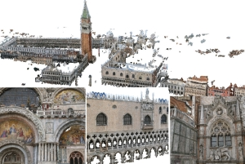
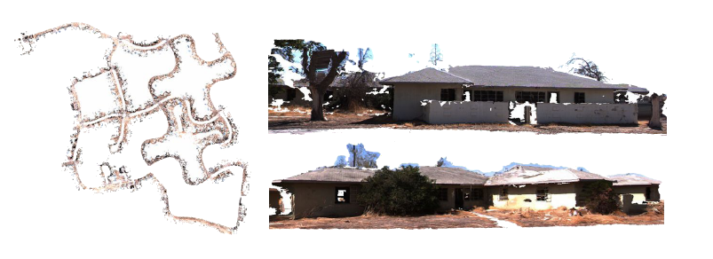
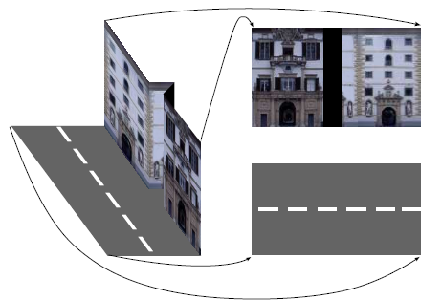

Applications: large scale modelling
[Furukawa10]
[Pollefeys08]
[Cornelis08]
[Goesele07]

Slide 11
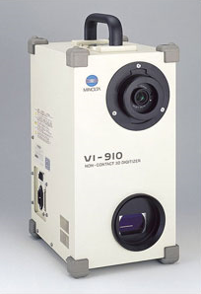
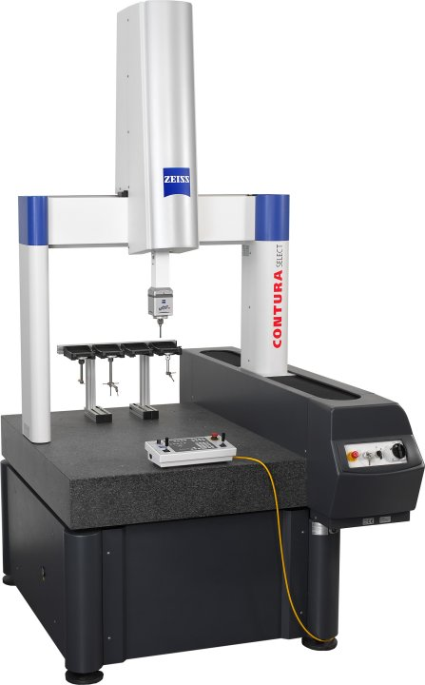

Scanning technologies
Laser scanner, coordinate measuring machine
  Very accurate
  Very Expensive
  Complicated to use
Minolta
“Michelangelo” project
Contura CMM

Slide 12
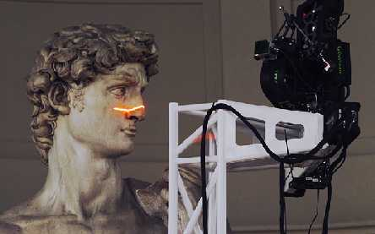
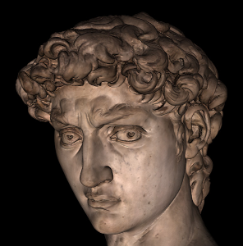
Applications: 3D Scanning
Scanning Michelangelo’s “The David”
  The Digital Michelangelo Project
    http://graphics.stanford.edu/projects/mich/
  2 BILLION polygons, accuracy to .29mm

Slide 13
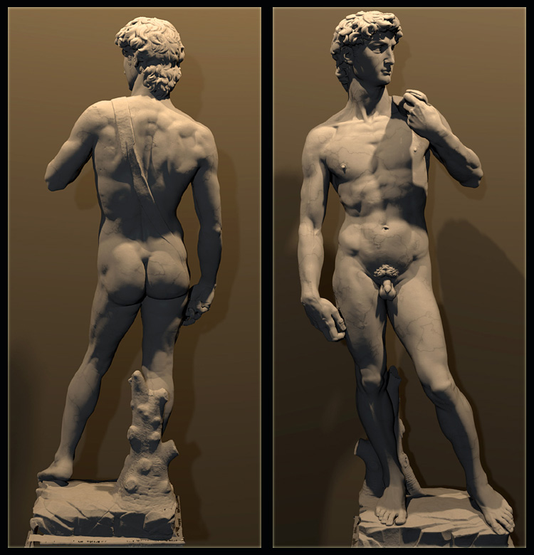
  The Digital Michelangelo Project, Levoy et al.

Slide 14
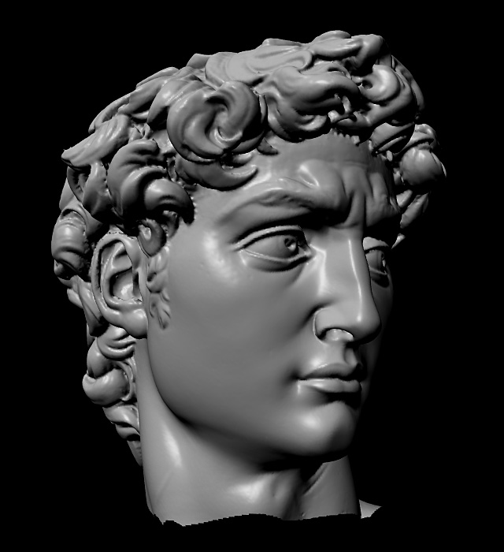

Slide 15
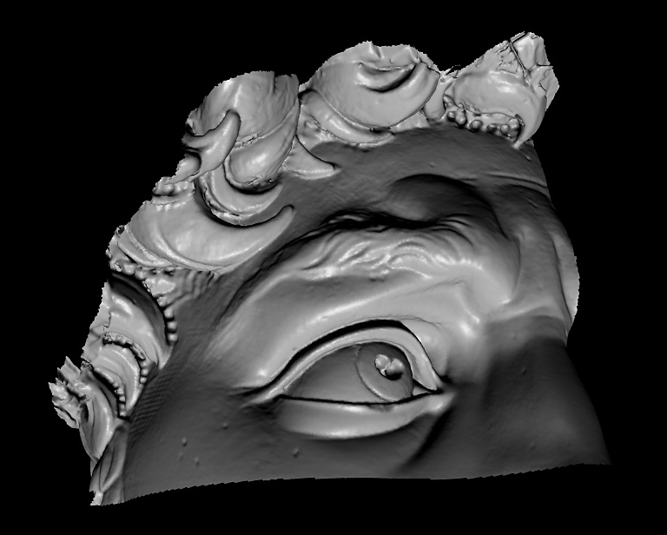

Slide 16
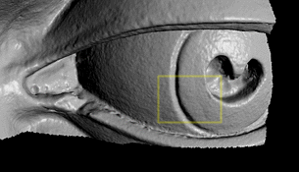

Slide 17
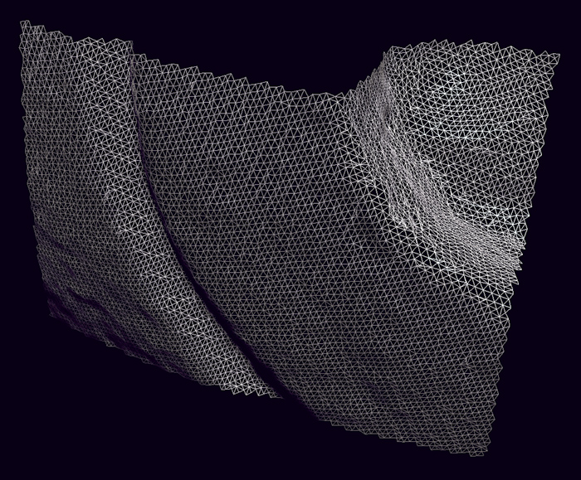

Slide 18
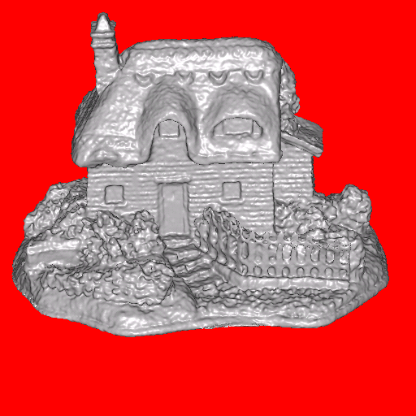
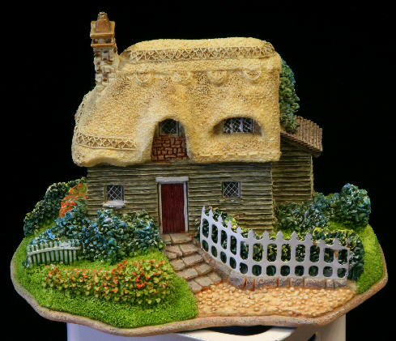
3d shape from photographs
“Estimate a 3d shape that would generate the input photographs given the same material, viewpoints and illumination”
viewpoint
?
geometry
material
illumination
image

Slide 19

3D shape from photographs
“Estimate a 3d shape that would generate the input photographs given the same material, viewpoints and illumination”
Real
Replica

Slide 20



3d shape from photographs
Appearance strongly depends on the material and lighting
textured
rigid
deforming
textureless

Slide 21


Slide 22



3d shape from photographs
Appearance strongly depends on the material and lighting
⇓
⇓
No single algorithm exists dealing with any type of scene
textured
rigid
deforming
textureless

Slide 23
3d shape from photographs
Photograph based 3d reconstruction is:
  practical
  fast
  non-intrusive
  low cost
  Easily deployable outdoors
  “low” accuracy
  Results depend on material properties

Slide 24

Reconstruction
Generic problem formulation: given several images of the same object or scene, compute a representation of its 3D shape

Slide 25
Reconstruction
Generic problem formulation: given several images of the same object or scene, compute a representation of its 3D shape
“Images of the same object or scene”
  Arbitrary number of images (from two to thousands)
  Arbitrary camera positions (camera network or video sequence)
  Calibration may be initially unknown
“Representation of 3D shape”
  Depth maps
  Meshes
  Point clouds
  Patch clouds
  Volumetric models
  Layered models

Slide 26




Multiple-baseline stereo
I1
I2
I10
M. Okutomi and T. Kanade, “A Multiple-Baseline Stereo System,” IEEE Trans. on Pattern Analysis and Machine Intelligence, 15(4):353-363 (1993).

Slide 27
Plane Sweep Stereo
Choose a reference view
Sweep family of planes at different depths with respect to the reference camera
input image
input image
reference camera
  Each plane defines a homography warping each input image into the reference view
R. Collins. A space-sweep approach to true multi-image matching. CVPR 1996.

Slide 28
Reconstruction from Silhouettes
The case of binary images: a voxel is photo-consistent if it lies inside the object’s silhouette in all views
Binary Images

Slide 29






Use silhouettes
Can be computed robustly
Can be computed efficiently
background
+
foreground
background
foreground
-
=

Slide 30
Reconstruction from Silhouettes
The case of binary images: a voxel is photo-consistent if it lies inside the object’s silhouette in all views
Binary Images
Finding the silhouette-consistent shape (visual hull):
  Backproject each silhouette
  Intersect backprojected volumes

Slide 31
Volume intersection
Reconstruction Contains the True Scene
  But is generally not the same
  In the limit (all views) get visual hull

Slide 32
Voxel algorithm for volume intersection
Color voxel black if on silhouette in every image

Slide 33
Volumetric Stereo / Voxel Coloring
Discretized
Scene Volume
Input Images
(Calibrated)
Goal: Assign RGB values to voxels in V
      photo-consistent with images

Slide 34


Photo-consistency of a 3d point
Photo-consistent point
≈

Slide 35
Photo-consistency of a 3d point
Non photo-consistent point
≠

Slide 36
Photo-consistency of a 3d patch

Slide 38



Challenges of photo-consistency
Camera visibility
Failure of comparison metric
  repeated texture
  lack of texture
  specularities

Slide 39
Voxel Coloring Approach
1. Choose voxel
Color if consistent
  (standard deviation of pixel
  colors below threshold)
2. Project and correlate
Visibility Problem: in which images is each voxel visible?

Slide 40
Depth Ordering: visit occluders first!
Layers
Scene
Traversal
Condition: depth order is the same for all input views

Slide 41
Panoramic Depth Ordering
  Cameras oriented in many different directions
  Planar depth ordering does not apply

Slide 42
Panoramic Depth Ordering
Layers radiate outwards from cameras

Slide 43
Panoramic Layering
Layers radiate outwards from cameras

Slide 44
Panoramic Layering
Layers radiate outwards from cameras

Slide 45


Compatible Camera Configurations
Depth-Order Constraint
  Scene outside convex hull of camera centers
Inward-Looking
cameras above scene
Outward-Looking
cameras inside scene

Slide 46





Calibrated Image Acquisition
Selected Dinosaur Images
Calibrated Turntable
360° rotation (21 images)
Selected Flower Images

Slide 47


Voxel Coloring Results (Video)
Dinosaur Reconstruction
72 K voxels colored
7.6 M voxels tested
7 min. to compute
on a 250MHz SGI
Flower Reconstruction
70 K voxels colored
7.6 M voxels tested
7 min. to compute
on a 250MHz SGI

Slide 48
Space Carving
Image 1
Image N
…...
Space Carving Algorithm
  Initialize to a volume V containing the true scene
  Choose a voxel on the outside of the volume
  Project to visible input images
  Carve if not photo-consistent
  Repeat until convergence
K. N. Kutulakos and S. M. Seitz, A Theory of Shape by Space Carving, ICCV 1999

Slide 49




Space Carving Results: African Violet
Input Image (1 of 45)
Reconstruction
Reconstruction
Reconstruction
Source: S. Seitz

Slide 50



Space Carving Results: Hand
Input Image
(1 of 100)
Views of Reconstruction

Slide 51
Carved visual hulls
The visual hull is a good starting point for optimizing
photo-consistency
  Easy to compute
  Tight outer boundary of the object
  Parts of the visual hull (rims) already lie on the surface and are already photo-consistent
Yasutaka Furukawa and Jean Ponce, Carved Visual Hulls for Image-Based Modeling, ECCV 2006.

Slide 52

Carved visual hulls
Compute visual hull
Use dynamic programming to find rims (photo-consistent parts of visual hull)
Carve the visual hull to optimize photo-consistency keeping the rims fixed
Yasutaka Furukawa and Jean Ponce, Carved Visual Hulls for Image-Based Modeling, ECCV 2006.

Slide 53


Stereo from community photo collections
Up to now, we’ve always assumed that camera calibration is known
For photos taken from the Internet, we need structure from motion techniques to reconstruct both camera positions and 3D points

Slide 54




Slide 55



Stereo from community photo collections
stereo
laser scan
Comparison: 90% of points within 0.128 m of laser scan (building height 51m)
M. Goesele, N. Snavely, B. Curless, H. Hoppe, S. Seitz, Multi-View Stereo for Community Photo Collections, ICCV 2007

Slide 56



Scanning technologies
Structured light
[Zhang02]

Slide 57


Kinect: Structured infrared light
http://bbzippo.wordpress.com/2010/11/28/kinect-in-infrared/

Slide 58

PrimeSense Patents

Slide 60


Kinect Fusion

