Slide 1
Wrap Up

Slide 2
We talked about
Filters
Edges
Corners
Interest Points
Descriptors
Image Stitching
Stereo
SFM

Slide 3
We talked about
Reconstruction
Flow
Face Detection
Face Recognition
Pedestrian Detection
Part-Based Recognition
…

Slide 4
What else ?
Several other interesting stuff that we wanted to talk about them

Slide 5
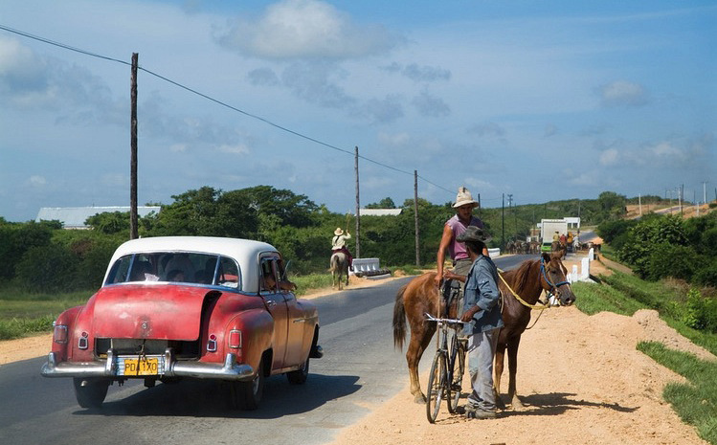
Image Segmentation
Sky
Tree
Car
Person

Slide 6
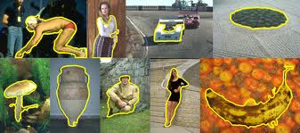

Slide 7
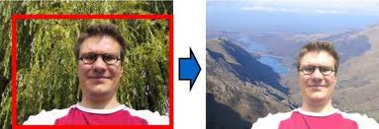

Slide 8
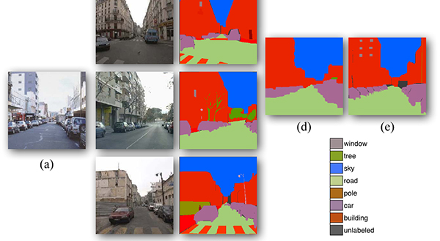
Scene Parsing

Slide 9
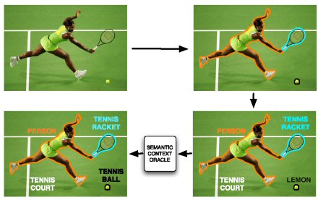
Context

Slide 10
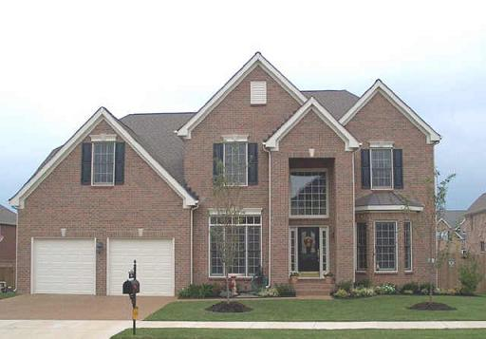
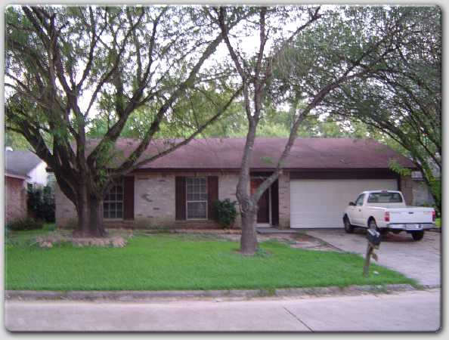
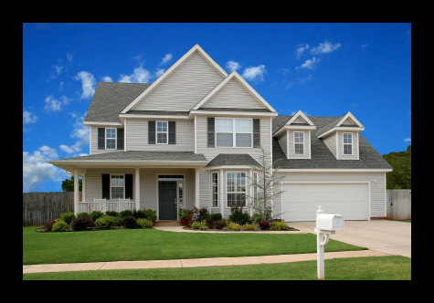

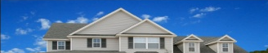


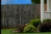






Context-aware visual discovery
?
?
?
sky
sky
sky
house
house
truck
fence
house
drive-way
drive-way
?
grass
grass
?
drive-way
grass
?
  Context in supervised recognition:
  [Torralba 2003], [Hoiem et al. 2006], [He et al. 2004], [Shotton et al. 2006], [Heitz & Koller 2008], [Rabinovich et al. 2007], [Galleguillos et al. 2008], [Tu 2008], [Parikh et al. 2008], [Gould et al. 2009], [Malisiewicz & Efros 2009], [Lazebnik 2009]

Slide 11
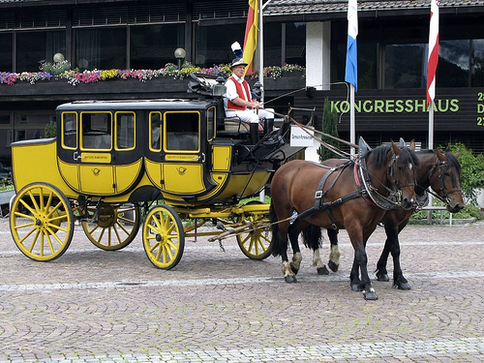
Attributes
Animal
Vehicle
Four-legged
Mammal
Head
Wheel
Leg
Can run
Can Jump
Is Herbivorous
Facing right
Moves on road
Facing right

Slide 12
3D Recognition

Slide 13
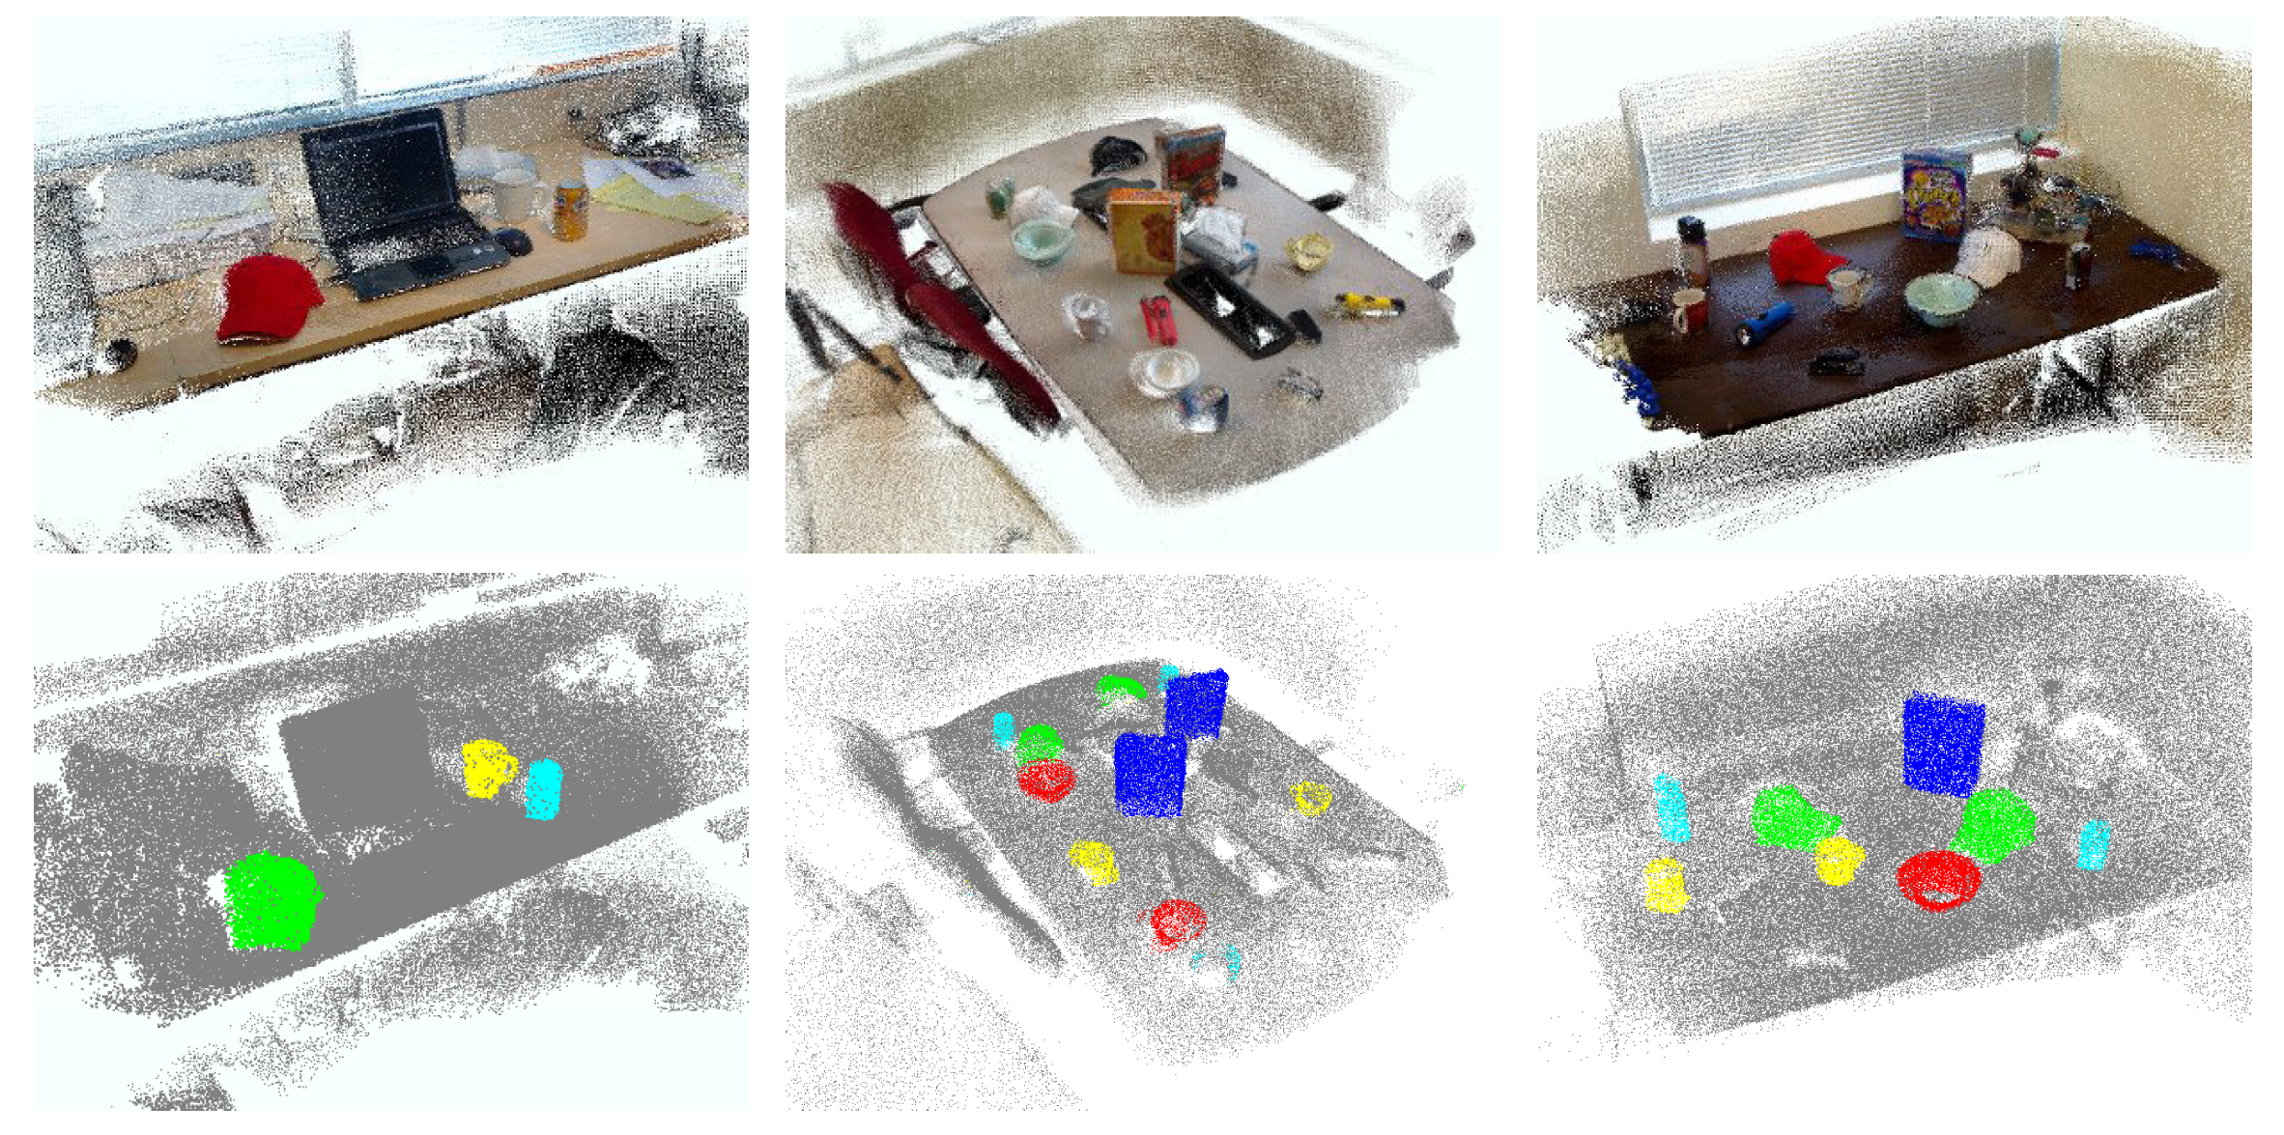
RGB-D

Slide 14
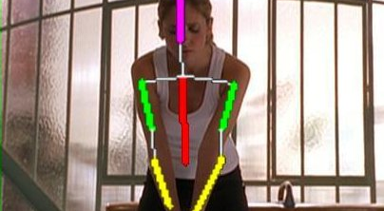
Pose Estimation

Slide 15
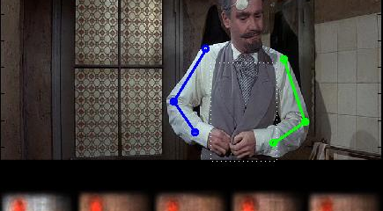

Slide 16
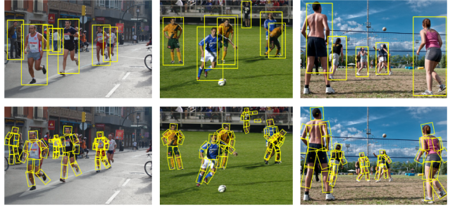

Slide 17
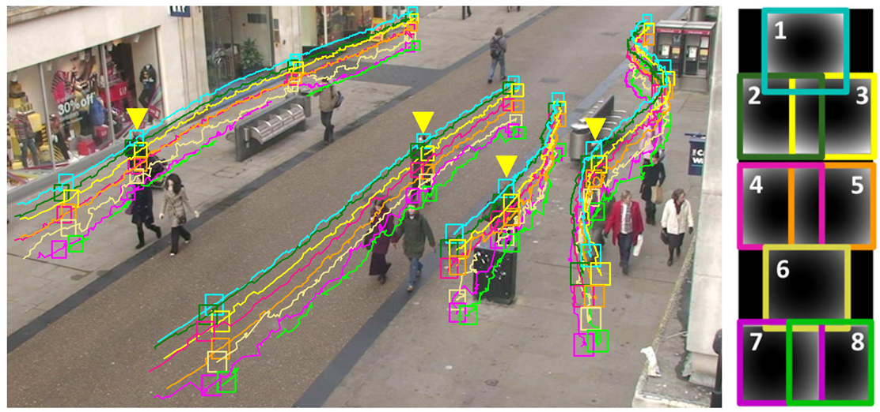
Tracking

Slide 18
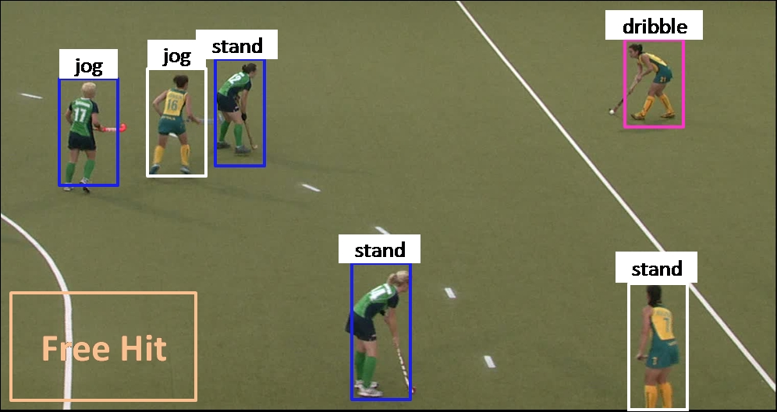
Action Recognition

Slide 19
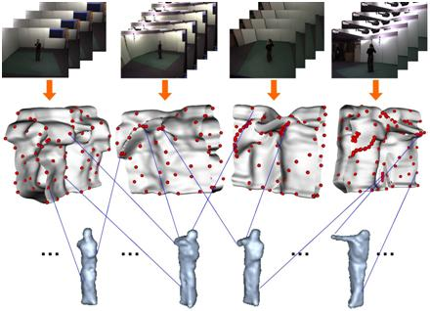
Action Recognition

Slide 20
Egocentric Vision

