Slide 1
Optimistic Concurrency Control by Melding Trees
Philip A. Bernstein
Colin Reid
Ming Wu
Xinhao Yuan
Microsoft Corporation
March 7, 2012
Published at VLDB 2011: http://www.vldb.org/pvldb/vol4/p944-bernstein.pdf

Slide 2
Introduction
A new algorithm for optimistic concurrency control (OCC) on tree-structured indices, called meld.
Scenario 1: A data-sharing system
The log is the database. All servers can access it.
Each transaction appends its after-images to the log.
Each server runs meld to do OCC and roll forward the log
Log
Server
Server
Server
App
App
App
DBMS
Meld
DBMS
Meld
DBMS
Meld
cache
cache
cache
2

Slide 3
Scenario 2
Core
Core
The log is the database.
All cores can access it.
Each transaction appends its after-images to the log.
One core runs meld to do OCC and roll forward the log
App
App
DBMS
Log
DBMS
Cache
Core
Roll Forward

Slide 4
Outline
Motivation
System architecture
Meld Algorithm
Performance
Conclusion
4

Slide 5
Database is a Binary Search Tree
G
B
H
Binary
Search
Tree
A
C
I
D
Tree is marshaled into the log
A
D
C
B
I
H
G
5
Notes:
Binary search trees give us better storage density than B-trees.

Slide 6
Binary Tree is Multi-versioned
Copy on write
To update a node, replace nodes up to the root
G
G′
B
H
B′
A
C
I
C′
D
D′
Update
D’s value
6
Notes:
So the state that’s referenced by a root is immutable.

Slide 7
Transaction Execution
Each server has a cache of the last committed DB state
DB cache
Transaction execution
Get pointer to snapshot
Generate updates locally
Append intention log record
G′
G
B′
B
H
C′
A
C
I
D′
D
last committed
A
D
C
B
I
H
G
D′
C′
B′
G′
Snapshot

Slide 8
Meld: Log Roll-forward
Each server processes intention records in sequence
To process transaction T’s intention record.
Check whether T experienced a conflict
If not, T committed, so the server merges the intention into its last committed state
All servers make the same commit/abort decisions
T’s conflict
zone
Did a committed transaction write into T’s readset or writeset here?
transaction T
A
D
C
B
I
H
G
D′
C′
B′
G′
Snapshot
Notes:
Supports all degrees of isolation, depending on definition of conflict

Slide 9
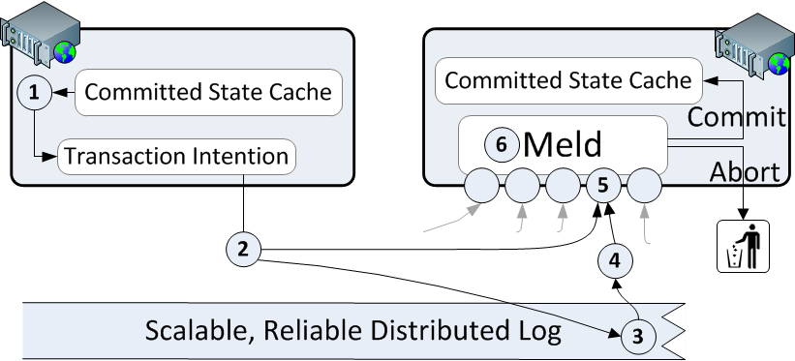
Transaction Flow
Run transaction
Broadcast intention
Append intention to log
4. Send log location
5. De-serialize intention
6. Meld
9

Slide 10
Bottlenecks
Broadcasting the intention
Appending intention to the log
Optimistic concurrency control (OCC)
Meld
Technology will improve 1 & 2
For 3, app behavior drives OCC performance
But 4 depends on single-threaded processor performance, which isn’t improving
Hence, it’s important to optimize Meld
10

Slide 11
Main Idea: Fast Conflict Check
Log
Compare transaction T’s after-image to the last committed state
which is annotated with version and dependency metadata
Traverse T’s intention, comparing versions to last-committed state
Stop traversing when you reach an unchanged subtree
If version(x)=version(x′) then simply replace x′ by x′′
x′′
x
x′
x′′[read: x]
state when T executed
Last-committed state
before T
Transaction T’s
intention
11

Slide 12
Outline
Motivation
System architecture
Meld Algorithm
Performance
Conclusion
12

Slide 13
Meld
Latest version of
database state
Meld
New version of
database state
Intention record
Must be computationally efficient
Must be deterministic
Must produce the same sequence of states on all servers

Slide 14
Running Example
T1
D
T1 creates keys B,C,D,E
B
E
T2 and T3 then execute concurrently, both based on the result of T1
T2 inserts A
T3 inserts F
C
T2
D
T3
D
B
E
B
E
A
C
C
F
T2 and T3 do not conflict, so the resulting melded state is A, B, C, D, E, F
D
B
E
A
C
F
14

Slide 15
Intention Metadata
Node Metadata
version of the subtree
dependency info
Every node n has a unique version number (VN)
VN(n) permanently identifies the exact content of n’s subtree
Each node n in an intention T stores metadata about T’s snapshot
Version of n in T’s snapshot
Dependency information
Each node’s metadata compresses to ~30 bytes
Root
metadata
D
…
…
B
E
C
…
15

Slide 16
Lazy VN Assignment
We need to avoid synchronization when assigning VNs
Stored as offsets from the base location of their intention
The base location is assigned when the intention is logged
Given: T0’s root subtree has VN 50
VN of each subtree S in T1= 50 + S’s offset
T1
D
VN=54
B
VN=52
E
VN=53
C
VN=51
T0
T1
∅
C
B
E
D
…
VN Offset +1 +2 +3 +4
Absolute VN: 50 51 52 53 54
16

Slide 17
Source Versions and Dependencies
Subtree metadata includes a source structure version (SSV).
Intutively, SSV(n) = version of n in transaction T’s snapshot
DependsOn(n) = Y if T depends on n not having changed while T executed
T1’s root subtree depends on the entire tree version 50.
Since SSV(D) = VN(∅), T1 becomes the last-committed state.
T0
T1
∅
C
B
E
D
…
VN Offset: +1 +2 +3 +4 SSV: 0 0 0 50
DependsOn: N N N Y
Absolute VN 50 51 52 53 54
17

Slide 18
Serial Intentions
A serial intention is one whose source version is the last committed state.
Meld is then trivial and needs to consider only the root node.
T1 was serial.
T2 is serial, so meld makes T2 the last committed state.
Thus, a meld of a serial intention executes in constant time.
T0
T1
T2
C
B
E
D
A
B
D
VN Offset: +1 +2 +3 +4
SSV: 0 0 0 50
DependsOn: N N N Y
+1 +2 +3
0 52 54
N N N
Absolute VN 51 52 53 54 55 56 57
18

Slide 19
Running Example
T1
D
B
E
C
T2
D
T3
D
B
E
B
E
A
C
C
F
D
B
E
A
C
F
19

Slide 20
Concurrent (= non-serial) Intentions
T3 is not serial because VN of D in T2 (= 57) ≠ SSV(D) in T3 (= 54).
Meld checks if T3 conflicts with a transaction in its conflict zone
Traverses T3, comparing T3’s nodes to the last-committed state
If there are no conflicts, then since T3 is concurrent, meld creates an ephemeral intention to merge T3’s state
T0
T1
T2
T3
C
B
E
D
A
B
D
F
E
D
VN Offset: +1 +2 +3 +4 SSV: 0 0 0 50
DependsOn: N N N Y
+1 +2 +3
0 52 54
N N N
+1 +2 +3
0 53 54
N N N
Absolute VN 51 52 53 54 55 56 57 58 59 60
20
Notes:
To do this, Meld traverses T3 top-down, comparing nodes to the last committed state (T2 in this case). If it hits a subtree S whose VN = SSV in T3, then it can stop, since that subtree hasn’t changed since T3’s snapshot.

Slide 21
Ephemeral Intentions
A committed concurrent intention produces an ephemeral intention (e.g. M3)
It’s created deterministically in memory on all servers.
T0
T1
T2
T3
M3
C
B
E
D
A
B
D
F
E
D
D
VN Offset: +1 +2 +3 +4
SSV: 0 0 0 50
DependsOn: N N N Y
+1 +2 +3
0 52 54
N N N
+1 +2 +3
0 53 54
N N N
+1 57
N
Absolute VN 51 52 53 54 55 56 57 58 59 60 61
It logically commits immediately after the intention it melds.
To meld the concurrent intention T3 above, we need to consider metadata only on the root node D.
21

Slide 22
Garbage Collecting Ephemeral Intentions
Most are automatically trimmed
Each committed intention I trims the previous ephemeral intention with either a persisted node (if I is serial) or an ephemeral node (if I is concurrent).
To track them use an ephemeral flag (or count) on each node that has ephemeral descendants
Periodically run a flush transaction
It copies a set of ephemeral nodes that have no reachable ephemeral nodes
It makes the original ephemeral nodes unreachable in the new committed state.
It has no dependencies, so it can’t conflict
22

Slide 23
Other Important Details
Phantom avoidance
Asymmetric meld operations
Necessary in common case when subtrees do not align
Uses a key-range as a parameter to the top-down recursion
Deletions
Use tombstones in the intention header
Checkpointing and recovery
23
Notes:
.

Slide 24
Performance
Focus here is on meld throughput only
For latency, see the paper
We count committed and aborted transactions
Experiment setup
128K keys, all in main memory. Keys and payloads are 8 bytes.
Serializable isolation, so intentions contain readsets
De-serialize intentions on separate threads before meld
Transaction size affects meld throughput
So does conflict zone size (“concurrency degree”)
As transaction size or concurrency degree increase ⇒ more concurrent transactions update keys with common ancestors ⇒ meld has to traverse deeper in the tree
24

Slide 25
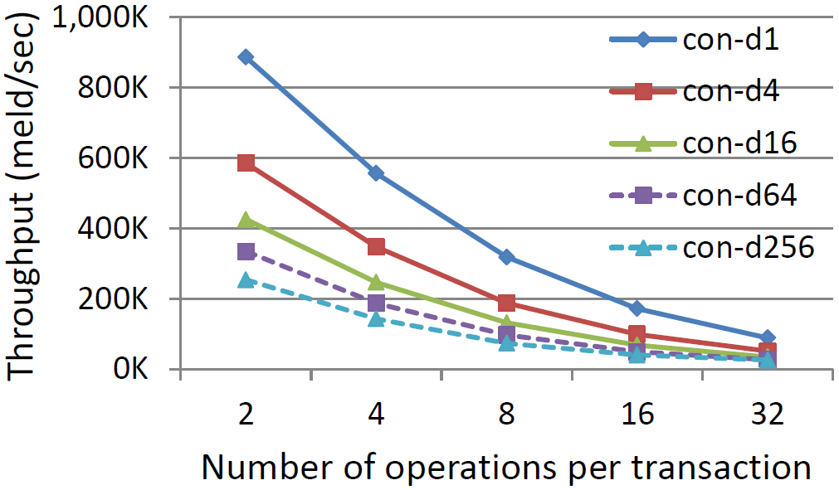
Throughput
r:w ratio is 1:1
con-di = concurrency degree i
25

Slide 26
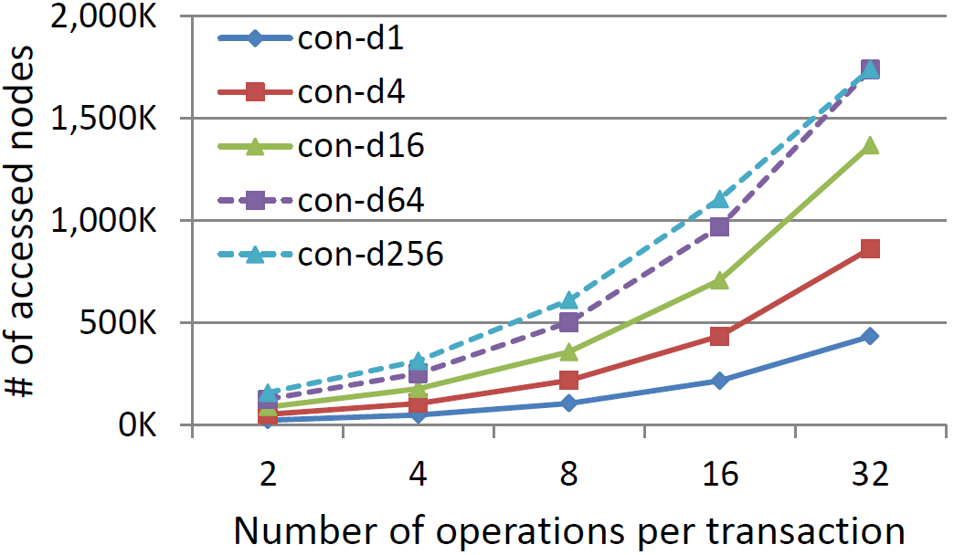
Number of Nodes Accessed
26

Slide 27
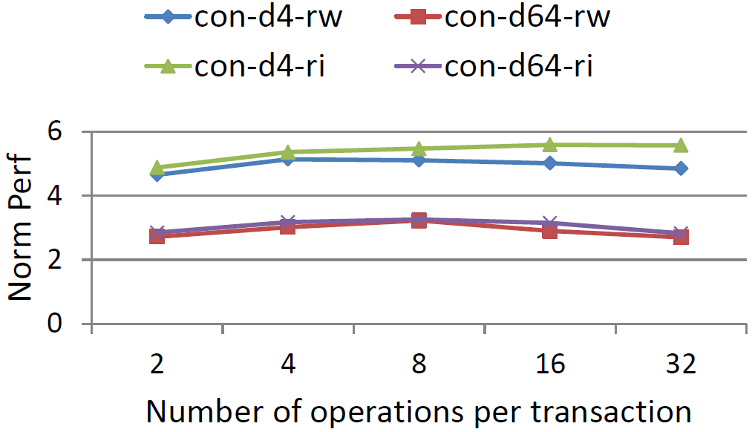
Meld Performance vs. Brute Force
Brute force = traverse the whole tree
27

Slide 28
Related Work
Lots of OCC papers but none that give details of efficient conflict-testing
By contrast, there’s a huge literature on conflict-testing for locking
Oxenstored [Gazagnairem & Hanquezis, ICFP 09]
Similar scenario: MV trees and OCC
However, very coarse-grain conflict-testing
Uses none of our optimizations
28

Slide 29
Summary
New algorithm for OCC
Developed many optimizations to truncate the conflict checking early in the tree traversal
Implemented and measure it
Future work:
Apply it to other tree structures
Measure it on various storage devices
Compare it with locking and other OCC methods on multiversion trees
Try to apply it to physiological logging
29

Slide 30
Backup Slides
© 2007 Microsoft Corporation. All rights reserved. Microsoft, Windows, Windows Vista and other product names are or may be registered trademarks and/or trademarks in the U.S. and/or other countries.
The information herein is for informational purposes only and represents the current view of Microsoft Corporation as of the date of this presentation. Because Microsoft must respond to changing market conditions, it should not be interpreted to be a commitment on the part of Microsoft, and Microsoft cannot guarantee the accuracy of any information provided after the date of this presentation. MICROSOFT MAKES NO WARRANTIES, EXPRESS, IMPLIED OR STATUTORY, AS TO THE INFORMATION IN THIS PRESENTATION.

Slide 31
Metadata for Conflict Testing
Consider node n in Intention I
SCV(n) = VN of the node that first generated the payload in n’s predecessor
Altered(n) = true if n‘s payload differs from its predecessor’s
DependsOn(n) = true if I depends on n’s predecessor’s content
NCV(n) = if Altered(n) then VN(n) else SCV(n)
n‘s content changed if SCV(n_{I}) ≠ NCV(n_{last committed state})
Implies a conflict
v₁
v₂
v₁₄
v₁₅
SCV
SCV
IsAltered=true
≠
DependsOn=true
⇒ NCV=self
31

Slide 32
Metadata for Detecting Phantoms
Again consider node n in Intention I
DependsOnTree(n) = true if I depends on n’s subtree not having changed
NSV(n) = oldest version of n whose subtree is exactly subtree(VN(n))
DependsOnTree(n) & NSV(n_{last committed state})≠SSV(n) ⇒ a conflict
Can extend DependsOnTree with DependencyRange of keys
in last committed state
v₁
v₈
v₁₄
v₁₅
Implies a conflict
NSV
SSV
≠
DependsOnTree=true
32

Slide 33
Computing NSV(n)
SubtreeIsOnlyReadDependent(n) = true iff none of n’s descendants are updated in I (i.e., have Altered = true).
Analogous to an intention-to-read lock
Avoids traversing entire tree when a descendent of n has DependsOnTree=true and NSV(n_{last committed state}) = SSV(n).
It also enables computing NSV
NSV(n) = (SubtreeIsOnlyReadDependent(n) = true) ⇒ SSV(n) else VN(n)
33

