Slide 1
P561: Network Systems
Week 4: Internetworking II
Tom Anderson
Ratul Mahajan
TA: Colin Dixon

Slide 2
Today
Internet routing (BGP)
Tunneling and MPLS
Wireless routing
Wireless handoffs

Slide 3
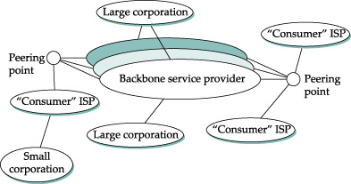
Internet today

Slide 4
Key goals for Internet routing
Scalability
Support arbitrary policies
  Finding “optimal” paths was less important
(Supporting arbitrary topologies)

Slide 5
Internet routing overview
Two-level hierarchy for scalability
  Intra-domain: within an ISP (OSPF, MPLS)
  Inter-domain: across ISPs (BGP)
Path vector protocol between Ases
  Can support many policies
  Fewer messages in response to small changes
    Only impacted routers are informed

Slide 6
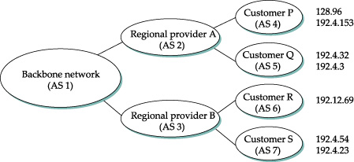
Path vector routing
Similar to distance vector routing info includes entire paths
192.4.23, [3, 7]
192.4.23, [7]

Slide 7
Policy knobs
1. Selecting one of the multiple offered paths
2. Deciding who to offer paths
192.168.1.3/24, [2, 4]
AS 2
AS 1
AS 4
192.168.1.3/24, [3, 4]
AS 3
AS 2
192.168.1.3/24, [4, 1]
AS 4
AS 1
AS 3
192.168.1.3/24, [4, 1]

Slide 8
Path vector vs. link state vis-à-vis policy
1
D
0
3
AS3 preferences
[31o]
[320]
[3210]
[3120]
2
With path vector, implementing the policy above requires only local knowledge at AS3
With link state, AS3 would need to know the policies of other ASes as well

Slide 9
Typical routing policies
Driven by business considerations
Two common types of relationships between ASes
  Customer-provider: customer pays provider
  Peering: no monetary exchange
When selecting routes: customer > peer > provider
When exporting routes: do not export provider or peer routes to other
providers and peers
Prefer routes with shorter AS paths
Peer or provider
Peer or provider
X
Customer
Customer

Slide 10
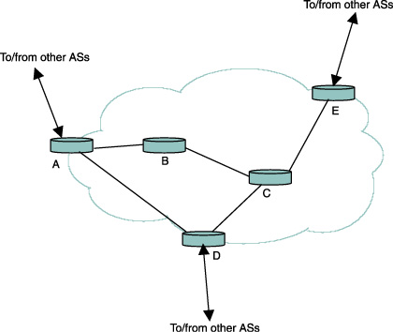
BGP at router level

Slide 11
BGP limitations
Path quality
Scale
Convergence
Security

Slide 12
Path quality with BGP
Combination of local policies may not be globally good
  Longer paths, asymmetric paths
  Shorter “detours” are often available
Example:
hot potato routing
A
B

Slide 13
Scaling pressures on BGP
Too many prefixes (currently ~280K)
Major factors behind growth: multi-homing and traffic engineering
192.168.0.0/16
192.168.0.0/17
192.168.0.0/16
Provider 1
Provider
Customer
Customer
Provider 2
192.168.0.0/16
192.168.128.0/17

Slide 14
BGP convergence (1/4)
1
D
0
3
2
Temporary loops during path exploration
Differentiating between failure and policy-based retraction can help but not completely

Slide 15
BGP convergence (2/4)
0
1
To get to D, X prefers
[X, (X+1) mod 3]
[X]
Others
D
2
Persistent loops can also form in BGP
Fundamentally, the combination of local policies may not have a unique global solution

Slide 16
BGP convergence (3/4)
Several other issues have been uncovered
  Interaction with intra-domain routing
  Interaction with traffic engineering extensions
  Interaction with scalability extensions

Slide 17
BGP convergence (4/4)
Q: What saves us in practice?
A: Policy! (No guarantees, however)
1
0
1
D
0
3
D
Policy reduces the number of valid paths
Policy makes some preferences rare
2
2

Slide 18
BGP security
Extreme vulnerability to attacks and misconfigurations
  An AS can announce reachability to any prefix
  An AS can announce connectivity to other Ases
Many known incidents
  AS7007 brought down the whole internet in 1997
  75% of new route adverts are due to misconfigs [SIGCOMM 2002]
  Commonly used for spamming
Technical solutions exist but none even close to deployment
  Incentives and deployability (Week 10)

Slide 19
Tunneling
Encapsulating one protocol within another
The blue sources, destinations, networks are oblivious to tunneling
The yellow network does not care if it carries blue (or green) packets
Src
Tun
Src
Tun
Dst
Dst

Slide 20
Tunneling is broadly useful technique
Used widely today
  Secure access to remote networks (VPNs)
    Your laptop to corporate networks
    Between different sites of a company
  MPLS
  6to4
  GRE
  SSH tunnels
  ….
Think of it as a generalization of traditional layering

Slide 21
MPLS
LER
LSR
LSR
LER
LER
LSR
LSR
LSR
LER

Slide 22
Benefits of MPLS (1/3)
LSRs do not understand or maintain state for IP
  Can yield higher performance
  Without n² pair-wise tunnels
LER
LSR
LSR
LER
LER
LSR
LSR
LSR
LER

Slide 23
Benefits of MPLS (2/3)
Traffic engineering (load balancing)
LER
LSR
LSR
LER
LER
LSR
LSR
LSR
LER

Slide 24
Benefits of MPLS (3/3)
Separation of traffic for security or for QoS
LER
LSR
LSR
LER
LER
LSR
LSR
LSR
LER

Slide 25
Downsides of MPLS
Unnecessary overhead
  If all you want is IP forwarding
  If link state routing can provide effective traffic engineering
Robustness to failures
  Setting up a complete virtual circuit takes time
  Fast reroute works only for a handful for failures
Opacity
  Traditional diagnosis tools do not work
Complexity
  Requires more configuration at routers

Slide 26
MPLS adoption
Pretty widespread
Almost all tier-1 ISPs have deployed MPLS
It offers tools that network admins badly need
Practical concerns trumped purist views

Slide 27
Why is wireless routing different?
Mobility and fast changing conditions
Packet losses
Interference

Slide 28
First generation of protocols
Focus on mobility and changing conditions
  Used hop count as the quality metric
  Reactive route computation was more popular
    To avoid unnecessary topology maintenance overhead
Examples: DSR, AODV

Slide 29
Hop count limitations
It minimizes the number of hops and thus prefers longer links
But longer links tend to have more loss
  Need more retransmissions for successful reception
Retransmissions can consume more spectrum resources than using shorter hops
  Need to balance hops and losses

Slide 30
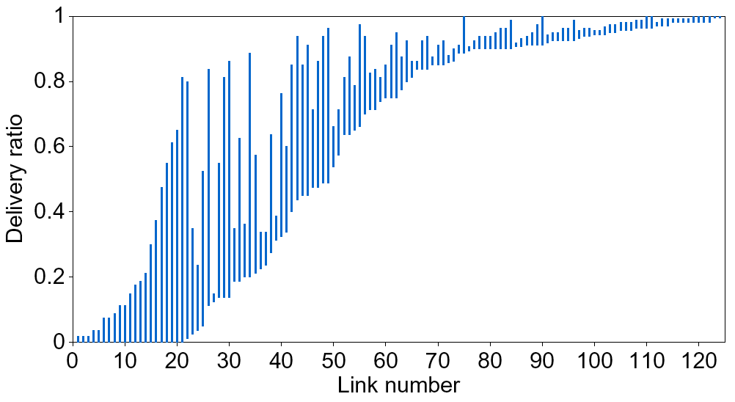
All links are not the same
MIT’s indoor testbed
Notes:
Graph shows broadcast delivery ratios in each direction for all non-zero links. Things to notice are:
Not only are many links lossy, many are asymmetric. Many of the good links are the good side of an asymmetric link.
Asymmetric links have long bars, they have very different delivery ratios in the two directions.
Asymmetric links complicate routing protocols.
Transition to next slide: so we’ve got these 3 problems (longer routes have less throughput; many links are lossy; many links are asymmetric). How can we use a route metric to find high-throughput paths in the face of these problems.

Slide 31
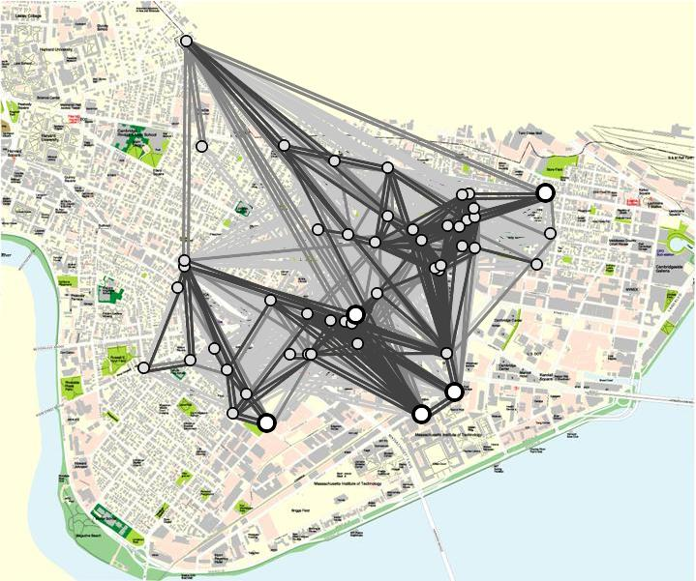
Link qualities in Roofnet
Broadcast packet
delivery probability
70-100%
30-70%
1-30%
1 kilometer
Notes:
Talk less
“what immediately jumps out at you” ->
Omit shades of grey explanation – use legend instead
Omit link-layer retransmission description
-- Mention freakishly long links?
-- shorten description of, “our routing protocol broke” – new slide?

Slide 32
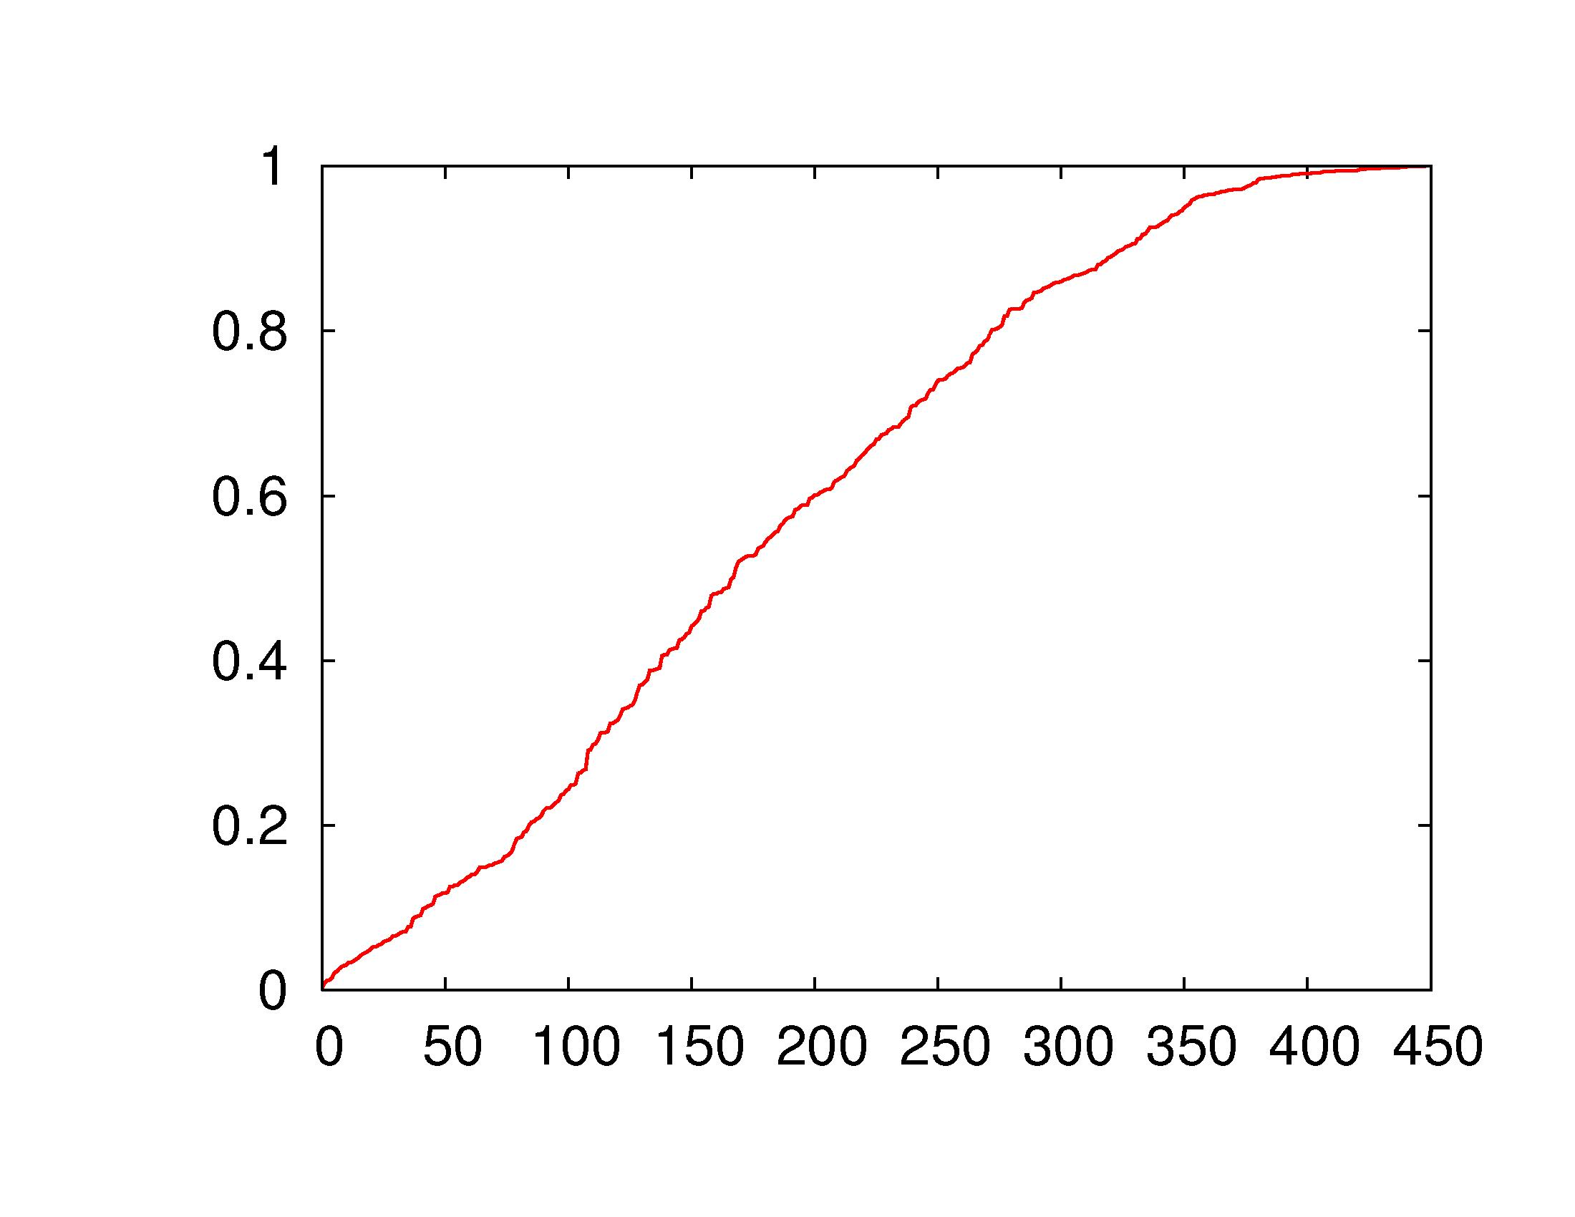
Delivery probabilities in Roofnet
Broadcast Packet
Delivery Probability
> two-thirds of links
deliver less than 90%
Node Pair
Notes:
Don’t make 85% sound important
Label the blue-dotted line or something, why is it up there?
Mention thresholds at the end of this slide, protocols on the next slide
Reflect over y=x?
Dotted line is confusing because it’s not a cdf
BROADCAST packet delivery probability
Mention only non-zero links

Slide 33
ETX: Expected transmissions
Estimate number of times a packet has to be retransmitted on each hop
Use probes to calculate forward and reverse loss rate to each neighbor
Select the path with least total ETX
Takes longer paths only when they are better

Slide 34
ETX avoids low-throughput paths
Results on MSR testbed (courtesy Jitu Padhye)

Slide 35
ETX paths are generally longer

Slide 36
ETX shortcomings
Assumes that all transmissions are equal
  In reality, different transmissions use different amount of spectrum
Assumes a simplistic interference model
  Cross-flow interference not directly accounted
  Worst-cast self-interference
Ignores the broadcast nature of wireless

Slide 37
ETT: Expected transmission time
Generalizes ETX to the case of multiple bit rates
Directly measures spectrum resources used
On a link with loss rate p, bitrate B, packet size S
12 Mbps
10% loss
48 Mbps
20% loss
[Routing in Multi-radio, Multi-hop Wireless Mesh Network, MOBICOM 2004]

Slide 38
ETT performance

Slide 39
Is one path better than the other?
Bad
Good
Source
Relay
Sink
Good
Bad
Source
Relay
Sink
Hint: ETT (or ETX) of both is same

Slide 40
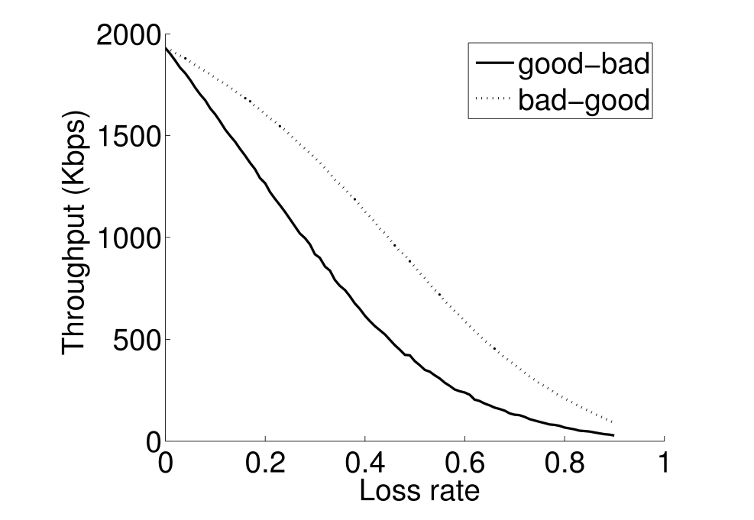
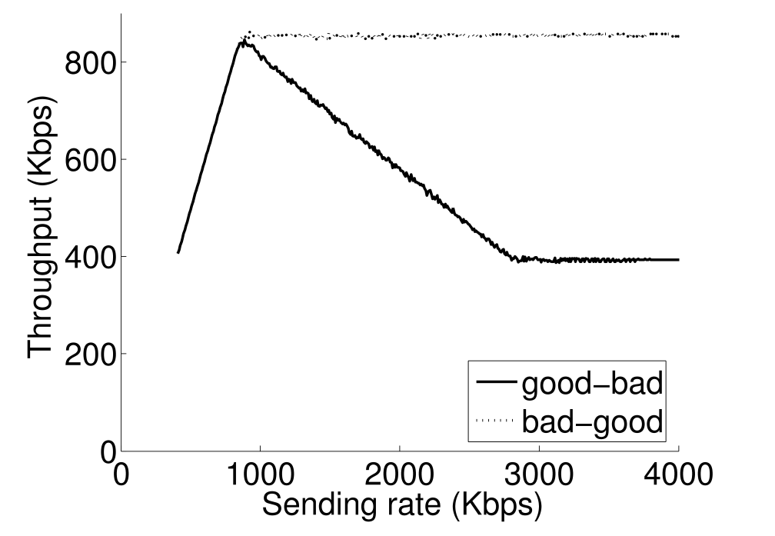
Unpredictable wireless performance
Bad
Good
Source
Relay
Sink
Good
Bad
Source
Relay
Sink
bad-good
bad-good
UDP throughput (Kbps)
UDP throughput (Kbps)
2x
good-bad
good-bad
Loss rate on the bad link
Source rate (Kbps)

Slide 41
Predictable performance optimization
Measure the RF profile of the network
Constraints on sending rate and loss rate of each link
Find compliant source rates that meet the objective
[Predictable performance optimization for wireless networks, SIGCOMM 2008]

Slide 42
Measurements
Measure the RF profile of the network
One or two nodes broadcast at a time
Yields information on loss and deferral probabilities
Constraints on sending rate and loss rate of each link
Find compliant source rates that meet the objective

Slide 43
Modeling
Measure the RF profile of the network
O(n²) constraints
Link throughput is a function of loss rate and tx probability
Link tx probability is a function of tx probability of other links and deferral probability
Link loss rate depends on tx probability of other links
Tx probability is bounded by a function of loss rate
Constraints on sending rate and loss rate of each link
Find compliant source rates that meet the objective

Slide 44
Optimization
Measure the RF profile of the network
Inputs:
Traffic matrix
Routing matrix
Optimization objective
Output:
Per-flow source rate
Constraints on sending rate and loss rate of each link
Find compliant source rates that meet the objective

Slide 45
Benefit of predictable optimization

Slide 46
Leveraging wireless broadcast
A
2
B
3
1
Traditional routing
dst
src
C
A
B
An opportunity
dst
src
C

Slide 47
ExOR: Extremely opportunistic routing
Source identifies and prioritized list of relays
Source groups packets into a batch and transmits
Nodes run an agreement protocol
  The highest priority relay announces what it received
  The next relay transmits packets not received by higher priority relays
  Finally, the source retransmits what nobody got
[Opportunistic Routing in Multi-Hop Wireless Networks, SIGCOMM 2005]

Slide 48
ExOR: Initial transmission
9
8
7
6
5
4
3
2
1
0
9
8
7
6
5
4
3
2
1
0
A
B
9
8
7
6
5
4
3
2
1
0
dst
src
C
9
8
7
6
5
4
3
2
0
9
8
7
6
5
4
3
2
1
0
Source transmits the entire batch

Slide 49
ExOR: Agreement protocol
Step4:
Transmit 6
Ack 0,1,2,3,5,6,7,9
Step2:
Transmit 1,2,5,7
Ack 0,1,2,3,5,7
9
8
7
6
5
4
3
2
1
0
9
8
7
6
5
4
3
2
1
0
A
B
9
8
7
6
5
4
3
2
1
0
dst
src
C
9
8
7
6
5
4
3
2
0
Step5:
Transmit 4,8
9
8
7
6
5
4
3
2
1
0
Step1:
Ack 0, 3
Step3:
Transmit 9
Ack 0,1,2,3,5,7,9

Slide 50
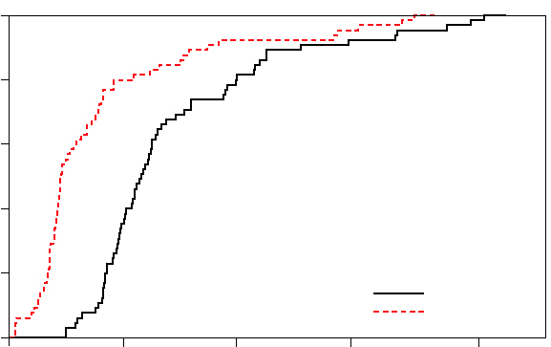
ExOR performance improvement
1.0
0.8
0.6
Cumulative Fraction of Node Pairs
0.4
0.2
ExOR
Traditional
0
0
200
400
600
800
Throughput (Kbits/sec)

Slide 51
Question
Is ExOR a forwarding or a routing protocol? (Or, is it a MAC-layer protocol?)

Slide 52
Wireless handoff
A special case of routing, with one mobile node
  How to provide connectivity to the node as it moves?
?

Slide 53


Hard handoff: one BS at a time
Select BS based on
Signal strength (SNR)
Loss rate
Combination of factors

Slide 54
Soft handoff: use multiple BSes
Adds reliability by leveraging diversity
The mobile node does not depend on only one BS

Slide 55
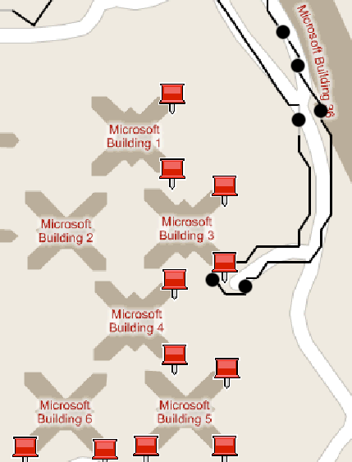
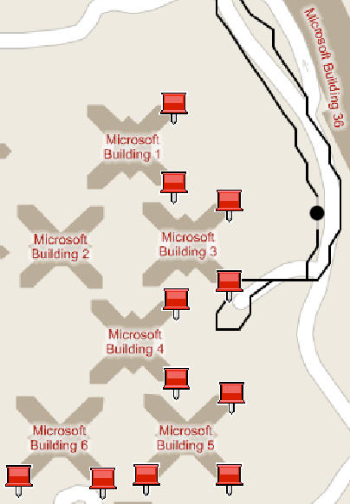
The handoff methods in a real setting
Soft handoff
(ViFi)
Hard handoff

Slide 56
Soft handoff questions
How to pick multiple BSes?
  A generalization of picking one
  Usually, two or three BSes suffice
What to do when multiple BSes hear a packet from the mobile?
  The BS backplane may be bandwidth-limited
How do multiple BSes send packet to the mobile?
  Simultaneous transmissions may collide

Slide 57
ViFi overview
Designed with the vehicular setting in mind but the underlying problem is more general
Vehicle chooses anchor BS
  Anchor responsible for vehicle’s packets
Vehicle chooses a set of BSes in range to be auxiliaries
  ViFi leverages packets overheard by auxiliaries
C
A
B
D
Internet

Slide 58
ViFi protocol
C
Source
Source transmits a packet
If destination receives, it transmits an ack
If auxiliary overhears packet but not ack, it probabilistically relays to destination
If destination received relay, it transmits an ack
If no ack within retransmission interval, source retransmits
A
B
Dest
Downstream: Anchor to vehicle
D
C
Upstream:
Vehicle to anchor
A
B
Source
Dest
D

Slide 59
Why is relaying effective?
Losses are bursty
Losses are independent
    Different senders → receiver
    Sender → different receivers
C
C
A
B
A
B
D
D
Downstream
Upstream

Slide 60
Determining relaying probability
    Goal: Compute relaying probability R_{B} of auxiliary B such that
      Total # of relays are limited
      Prefer auxiliaries with better connectivity to destinations
      Avoid per-packet coordination
    1: The probability that auxiliary B is considering relaying
      C_{B} = P(B heard the packet) . P(B did not hear ack
    2: The expected number of relays by B is E(B) = C_{B} x R_{B}
      3: Formulate ViFi probability equation, ∑ E(x) = 1
        To solve uniquely, set R_{B} proportional to P(destination hears B)
      4: B estimates P(auxiliary considering relaying) and
      P(destination heard auxiliary) for each auxiliary

Slide 61
ViFi reduces disruptions to apps
TCP
VoIP
> 100%
# of transfers before disruption
(seconds)
> 100%
Length of call before disruption
(seconds)
Hard
handoff
ViFi
Hard
handoff
ViFi

Slide 62
Other handoff challenges
Finding nearby BSes
  Scanning can be time consuming
Overhead of switching BSes
  Can involve association, authentication, DHCP, etc.

Slide 63
Summary
Forwarding and routing protocols enable you to construct bigger networks
  Seemingly simple protocols but complex dynamics
The wireless medium bring challenges of its own that forwarding and routing must address
Next week (tom @ UW):
how to communicate reliably and efficiently when so much can go wrong inside a network?

