Slide 1
P561: Network Systems
Week 8: Content distribution
Tom Anderson
Ratul Mahajan
TA: Colin Dixon

Slide 2
Today
Scalable content distribution
  Infrastructure
  Peer-to-peer
Observations on scaling techniques

Slide 3

The simplest case: Single server
DNS
1. Where is cnn.com?
2. 204.132.12.31
Web
3. Get index.html
4. Index.html

Slide 4


Single servers limit scalability
.
.
.
Vulnerable to flash crowds, failures

Slide 5
Solution: Use a cluster of servers
Content is replicated across servers
Q: How to map users to servers?

Slide 6
Method 1: DNS
S1
DNS
S1
S2
S2
S3
S3
DNS responds with different server IPs

Slide 7
Implications of using DNS
Names do not mean the same thing everywhere
Coarse granularity of load-balancing
  Because DNS servers do not typically communicate with content servers
  Hard to account for heterogeneity among content servers or requests
Hard to deal with server failures
Based on a topological assumption that is true often (today) but not always
  End hosts are near resolvers
Relatively easy to accomplish

Slide 8
Method 2: Load balancer
Load balancer
Load balancer maps incoming connections to different servers

Slide 9
Implications of using load balancers
Can achieve a finer degree of load balancing
Another piece of equipment to worry about
  May hold state critical to the transaction
  Typically replicated for redundancy
  Fully distributed, software solutions are also available (e.g., Windows NLB) but they serve limited topologies

Slide 10
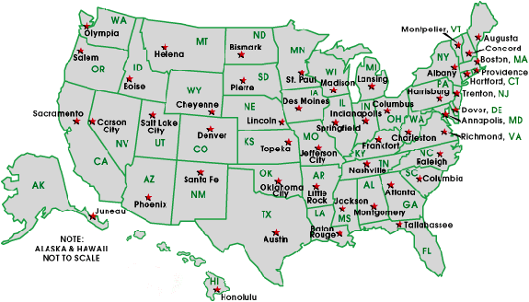
Single location limits performance
.
.
.

Slide 11
Solution: Geo-replication

Slide 12
Mapping users to servers
Use DNS to map a user to a nearby data center
  Anycast is another option (used by DNS)
Use a load balancer to map the request to lightly loaded servers inside the data center
In some case, application-level redirection can also occur
  E.g., based on where the user profile is stored

Slide 13
Question
Did anyone change their mind after reading other blog entries?

Slide 14
Problem
It can be too expensive to set up multiple data centers across the globe
  Content providers may lack expertise
  Need to provision for peak load
Unanticipated need for scaling (e.g., flash crowds)
Solution: 3rd party Content Distribution Networks (CDNs)
  We’ll talk about Akamai (some slides courtesy Bruce Maggs)

Slide 15
Akamai
Goal(?): build a high-performance global CDN that is robust to server and network hotspots
Overview:
  Deploy a network of Web caches
  Users fetch the top-level page (index.html) from the origin server (cnn.com)
  The embedded URLs are Akamaized
    The page owner retains controls over what gets served through Akamai
  Use DNS to select a nearby Web cache
    Return different server based on client location

Slide 16
Akamaizing Web pages
Embedded URLs are Converted to ARLs
<html>
<head>
<title>Welcome to xyz.com!</title>
</head>
<body>
<img src=“
<img src=“
<h1>Welcome to our Web site!</h1>
<a href=“page2.html”>Click here to enter</a>
</body>
</html>
ak
http://www.xyz.com/logos/logo.gif”>
http://www.xyz.com/jpgs/navbar1.jpg”>

Slide 17
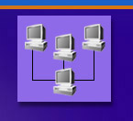



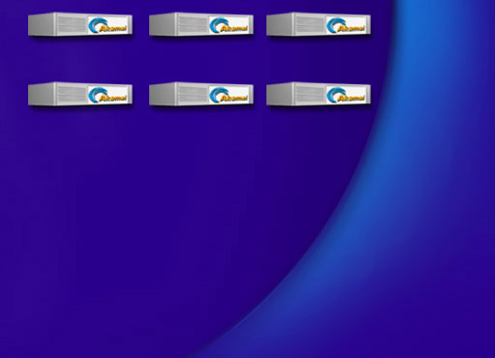


Akamai DNS Resolution
4
xyz.com
.com .net
Root
(InterNIC)
5
10.10.123.5
xyz.com’s nameserver
akamai.net
a212.g.akamai.net
8
7
9
6
15.15.125.6
ak.xyz.com
Akamai High-Level DNS Servers
10
g.akamai.net
20.20.123.55
11
12
a212.g.akamai.net
30.30.123.5
13
End User
Local Name Server
Akamai Low-Level DNS Servers
14
16
1
3
2
Browser’s Cache
15
OS

Slide 18


DNS Time-To-Live
Time To Live
1 day
Root
30 min.
HLDNS
30 sec.
LLDNS
TTL of DNS responses gets shorter further down the hierarchy

Slide 19
DNS maps
Map creation is based on measurements of:
  Internet congestion
  System loads
  User demands
  Server status
Maps are constantly recalculated:
  Every few minutes for HLDNS
  Every few seconds for LLDNS

Slide 20
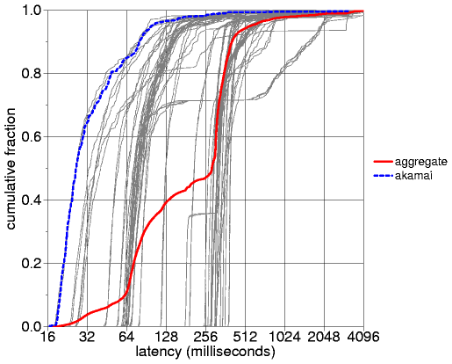
Measured Akamai performance
(Cambridge)
[The measured performance of content distribution networks, 2000]

Slide 21
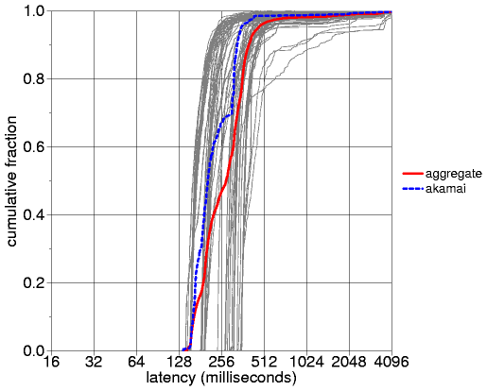
Measured Akamai performance
(Boulder)

Slide 22
Key takeaways
Pretty good overall
  Not optimal but successfully avoids very bad choices
  → This is often enough in many systems; finding the absolute optimal is a lot harder
Performance varies with client location

Slide 23
Aside: Re-using Akamai maps
Can the Akamai maps be used for other purposes?
  By Akamai itself
    E.g., to load content from origin to edge servers
  By others

Slide 24
Aside: Drafting behind Akamai (1/3)
[SIGCOMM 2006]
Destination
Peer 1
……..
Peer
Peer
Source
Goal: avoid any congestion near the source by routing through one of the peers

Slide 25
Aside: Drafting behind Akamai (2/3)
Destination
Peer 1
Replica 1
……..
Peer
Replica 2
Peer
Replica 3
Source
Solution: Route through peers close to replicas suggested by Akamai
DNS Server

Slide 26
Aside: Drafting behind Akamai (3/3)
Taiwan-UK
UK-Taiwan
80% Taiwan
15% Japan
5 % U.S.
75% U.K.
25% U.S.

Slide 27

Why Akamai helps even though the top-level page is fetched directly from the origin server?
Total page 87,550 bytes
Total Akamai Served 68,756 bytes
Banner Ads 16,174 bytes
Logos
3,395 bytes
Gif links
22,395 bytes
Navigation Bar
9,674 bytes
Fresh Content
17,118 bytes
78%
Page Served by Akamai

Slide 28
Trends impacting Web cacheability (and Akamai-like systems)
Dynamic content
Personalization
Security
Interactive features
Content providers want user data
New tools for structuring Web applications
Most content is multimedia

Slide 29
Peer-to-peer content distribution
When you cannot afford a CDN
  For free or low-value (or illegal) content
Last week:
  Napster, Gnutella
  Do not scale
Today:
  BitTorrent (some slides courtesy Nikitas Liogkas)
  CoralCDN (some slides courtesy Mike Freedman)

Slide 30
BitTorrent overview
Keys ideas beyond what we have seen so far:
Break a file into pieces so that it can be downloaded in parallel
Users interested in a file band together to increase its availability
“Fair exchange” incents users to give-n-take rather than just take

Slide 31
BitTorrent terminology
Swarm: group of nodes interested in the same file
Tracker: a node that tracks swarm’s membership
Seed: a peer that has the entire file
Leecher: a peer with incomplete file

Slide 32
Joining a torrent
1
metadata file
website
new leecher
2
join
peer list
3
data
request
seed/leecher
tracker
4
Metadata file contains
The file size
The piece size
SHA-1 hash of pieces
Tracker’s URL

Slide 33


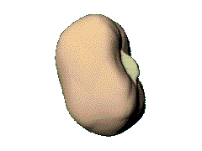
Downloading data
leecher B
leecher A
I have
!
seed
leecher C
● Download pieces in parallel
● Verify them using hashes
● Advertise received pieces to the entire peer list
● Look for the rarest pieces

Slide 34
Uploading data (unchoking)
leecher B
leecher A
seed
leecher C
leecher D
● Periodically calculate data-receiving rates
● Upload to (unchoke) the fastest k downloaders
  Split upload capacity equally
● Optimistic unchoking
▪ periodically select a peer at random and upload to it
▪ continuously look for the fastest partners

Slide 35
Incentives and fairness in BitTorrent
Embedded in choke/unchoke mechanism
  Tit-for-tat
Not perfect, i.e., several ways to “free-ride”
  Download only from seeds; no need to upload
  Connect to many peers and pick strategically
  Multiple identities
Can do better with some intelligence
Good enough in practice?
  Need some (how much?) altruism for the system to function well?

Slide 36
BitTyrant [NSDI 2006]

Slide 37
CoralCDN
Goals and usage model is similar to Akamai
  Minimize load on origin server
  Modified URLs and DNS redirections
It is p2p but end users are not necessarily peers
  CDN nodes are distinct from end users
Another perspective: It presents a possible (open) way to build an Akamai-like system

Slide 38
CoralCDN overview
Origin
Server
Browser
Coral
httpprx
dnssrv
Coral
httpprx
dnssrv
Coral
httpprx
dnssrv
Browser
Coral
httpprx
dnssrv
Coral
httpprx
dnssrv
Coral
httpprx
dnssrv
Browser
Browser
Implements an open CDN to which anyone can contribute
CDN only fetches once from origin server

Slide 39
CoralCDN components
Origin
Server
?
httpprx
✗
?
dnssrv
httpprx
Fetch data
from nearby
DNS Redirection
Return proxy,
preferably one
near client
Cooperative
Web Caching
Resolver
Browser
www.x.com.nyud.net
216.165.108.10

Slide 40
How to find close proxies and cached content?
DHTs can do that but a straightforward use has significant limitations
How to map users to nearby proxies?
  DNS servers measure paths to clients
How to transfer data from a nearby proxy?
  Clustering and fetch from the closest cluster
How to prevent hotspots?
  Rate-limiting and multi-inserts
Key enabler: DSHT (Coral)

Slide 41
DSHT: Hierarchy
Thresholds
None
< 60 ms
< 20 ms
A node has the same Id at each level
Notes:
Extend white line…

Slide 42
DSHT: Routing
Thresholds
None
< 60 ms
< 20 ms
Continues only if the key is not found at the closest cluster
Notes:
Extend white line…

Slide 43
DSHT: Preventing hotspots
Proxies insert themselves in the DSHT after caching content
  So other proxies do not go to the origin server
Store value once in each level cluster
  Always storing at closest node causes hotspot
NYU
…
Notes:
Make hotspot faster

Slide 44
DSHT: Preventing hotspots (2)
…
…
Halt put routing at full and loaded node
  Full → M vals/key with TTL > ½ insertion TTL
  Loaded → β puts traverse node in past minute
Notes:
Make hotspot faster

Slide 45
DNS measurement mechanism
Server probes client (2 RTTs)
Browser
Coral
httpprx
dnssrv
Resolver
Coral
httpprx
dnssrv
Return servers within appropriate cluster
  e.g., for resolver RTT = 19 ms, return from cluster < 20 ms
Use network hints to find nearby servers
  i.e., client and server on same subnet
Otherwise, take random walk within cluster

Slide 46
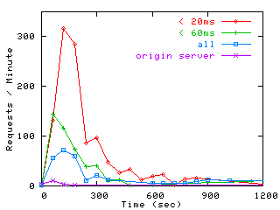
CoralCDN and flash crowds
Coral hits in
20 ms cluster
Local caches begin to handle most requests
Hits to origin web server

Slide 47
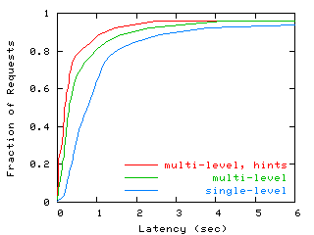
End-to-end client latency

Slide 48
Scaling mechanisms encountered
Caching
Replication
Load balancing (distribution)

Slide 49
Why caching works?
Locality of reference
  Temporal
    If I accessed a resource recently, good chance that I’ll do it again
  Spatial
    If I accessed a resource, good chance that my neighbor will do it too
Skewed popularity distribution
  Some content more popular than others
  Top 10% of the content gets 90% of the requests

Slide 50
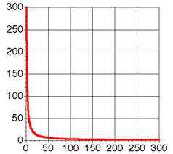
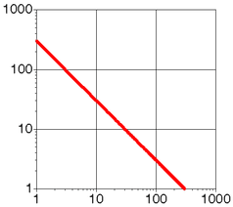
Zipf’s law
Zipf’s law: The frequency of an event P as a function of rank i P_{i} is proportional to 1/i^{α} (α = 1, classically)

Slide 51
Zipf’s law
Observed to be true for
  Frequency of written words in English texts
  Population of cities
  Income of a company as a function of rank
  Crashes per bug
Helps immensely with coverage in the beginning and hurts after a while

Slide 52
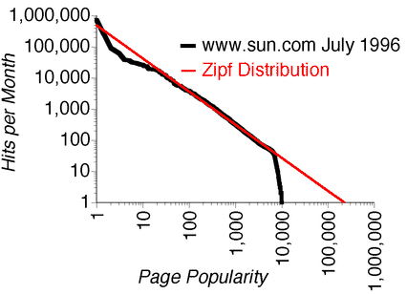
Zipf’s law and the Web (1)
For a given server, page access by rank follows a Zipf-like distribution (α is typically less than 1)

Slide 53
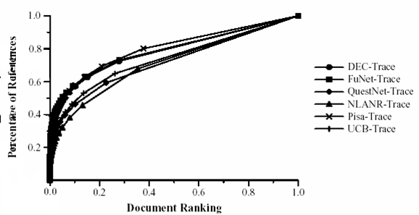
Zipf’s law and the Web (2)
At a given proxy, page access by clients follow a Zipf-like distribution (α < 1; ~0.6-0.8)

Slide 54
Implications of Zipf’s law
For an infinite sized cache, the hit-ratio for a proxy cache grows in a log-like fashion as a function of the client population and the number of requests seen by the proxy
The hit-ratio of a web cache grows in a log-like fashion as a function of the cache size
The probability that a document will be referenced k requests after it was last referenced is roughly proportional to 1/k.

Slide 55
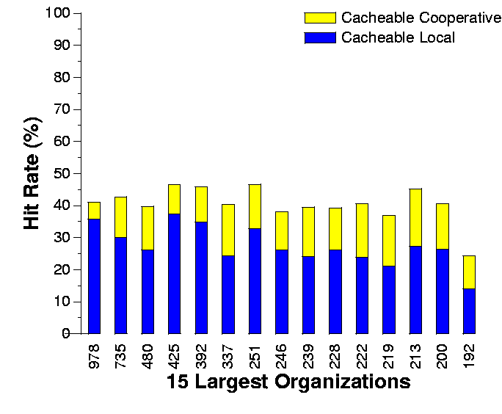
Cacheable hit rates for UW proxies
Cacheable hit rate – infinite storage, ignore expirations
Average cacheable hit rate increases from 20% to 41% with (perfect) cooperative caching

Slide 56
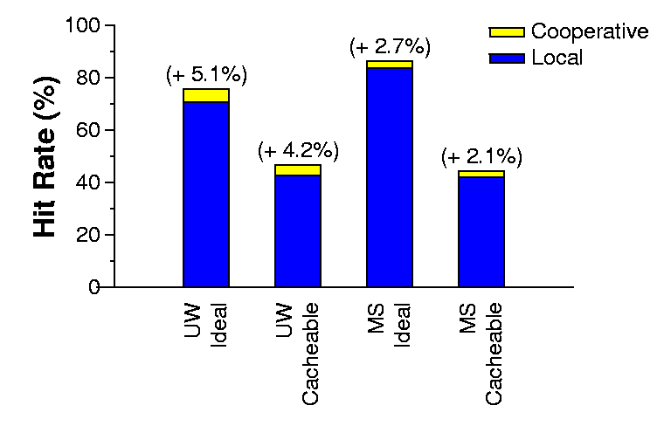
UW & MS Cooperative Caching

Slide 57
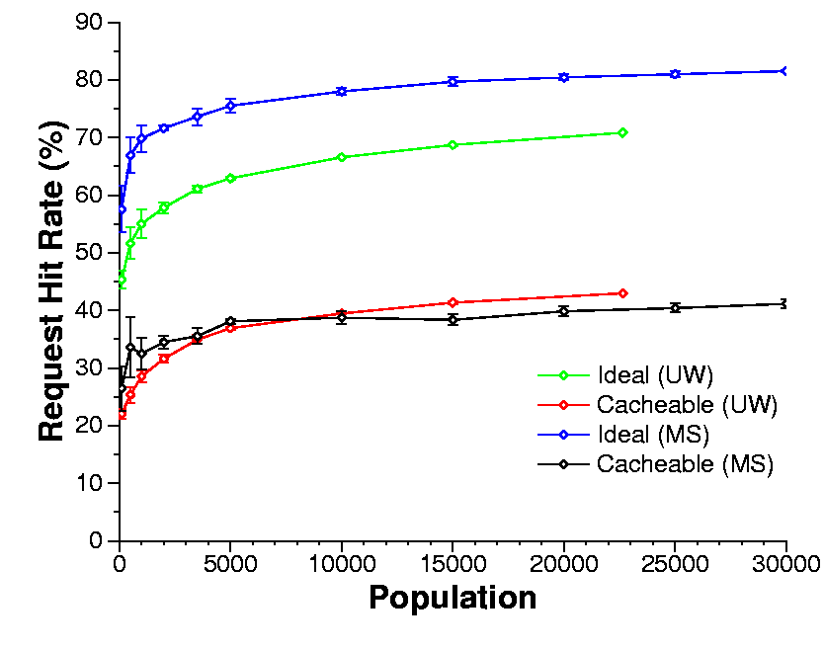
Hit rate vs. client population
Small organizations
  Significant increase in hit rate as client population increases
  The reason why cooperative caching is effective for UW
Large organizations
  Marginal increase in hit rate as client population increases

Slide 58
Zipf and p2p content [SOSP2003]
Zipf: popularity(n^{th} most popular object) ~ 1/n^{α}
Kazaa: the most popular objects are 100x less popular than Zipf predicts
Kazaa: the most popular objects are 100x less popular than Zipf predicts

Slide 59
Another non-Zipf workload
video store rentals
box office sales
Video rentals

Slide 60
Reason for the difference
Fetch-many vs. fetch-at-most-once
Web objects change over time
  www.cnn.com is not always the same page
  The same object is fetched may be fetched many times by the same user
P2p objects do not change
  “Mambo No. 5” is always the same song
  The same object is not fetched again by a user

Slide 61
Caching implications
In the absence of new objects and users
  fetch-many: hit rate is stable
  fetch-at-most-once: hit rate degrades over time

Slide 62
New objects help caching hit rate
New objects cause cold misses but they replenish the highly cacheable part of the Zipf curve
Rate needed is proportional to avg. per-user request rate

Slide 63
Cache removal policies
What:
  Least recently used (LRU)
  FIFO
  Based on document size
  Based on frequency of access
When:
  On-demand
  Periodically

Slide 64
Replication and consistency
How do we keep multiple copies of a data store consistent?
  Without copying the entire data upon every update
Apply same sequence of updates to each copy, in the same order
  Example: send updates to master; master copies exact sequence of updates to each replica
Master
x” x’ z y x
x” x’ z y x
Replica
Replica

Slide 65
Replica consistency
While updates are propagating, which version(s) are visible?
DNS solution: eventual consistency
  changes made to a master server; copied in the background to other replicas
  in meantime can get inconsistent results, depending on which replica you consult
Alternative: strict consistency
  before making a change, notify all replicas to stop serving the data temporarily (and invalidate any copies)
  broadcast new version to each replica
  when everyone is updated, allow servers to resume

Slide 66
Eventual Consistency Example
t+5:x’
Server
replicas
t+1: get x
t:x’
t+3:get x
t+2: x
t+4:x’
clients
x’

Slide 67
Sequential Consistency Example
t+1:x’
Server
replicas
t+4:ack
t+2:x’
t:x’
t+1:x’
t+3:ack
t+2:ack
t+5:ack
clients
x’
Write doesn’t complete until all
copies invalidated or updated

Slide 68
Consistency trade-offs
Eventual vs. strict consistency brings out the trade-off between consistency and availability
Brewer’s conjecture:
  You cannot have all three of
    Consistency
    Availability
    Partition-tolerance

Slide 69
Load balancing and the power of two choices (randomization)
Case 1: What is the best way to implement a fully-distributed load balancer?
Randomization is an attractive option
  If you randomly distribute n tasks to n servers, w.h.p., the worst-case load on a server is log n/log log n
  But if you randomly poll k servers and pick the least loaded one, w.h.p. the worst-case load on a server is (log log n / log d) + O(1)
  ➔ 2 is much better than 1 and only slightly worse than 3

Slide 70
Load balancing and the power of two choices (stale information)
Case 2: How to best distribute load based on old information?
Picking the least loaded server leads to extremely bad behavior
  E.g., oscillations and hotspots
Better option: Pick servers at random
  Considering two servers at random and picking the less loaded one often performs very well

