Slide 1
Upcoming UW CSE courses on Coursera: What and How Dan Grossman October 24, 2012

Slide 2
Overview
What is a MOOC?
Why are we doing them?
What courses?
How are we pulling this off?
Broader thoughts on MOOCs
Caveats:
Work-in-progress: having a blast making it up as we go along
Focus here on CSE perspective more than UW perspective

Slide 3
What makes a MOOC a MOOC
Semi-synchronous courses
Social cohorts with modern lives
Online
Video, discussion board, etc.
Scale
Past, say, 5,000 students, more students makes a class better
Nothing can flow through the course staff
Free
Can talk monetization strategies if you want, but not my role
UW offering “enhanced versions” for credit if you pay

Slide 4
Recent history
Last year:
3 CS MOOCs from Stanford go viral, hit NYT, etc.
(Also Khan Academy, Code Academy, …)
This year:
Coursera, Udacity, EdX, Stanford, …
UW signs non-exclusive agreement with Coursera
Coursera: > 1M students, > 30 universities, > 200 courses
Everybody is talking about it
All of academia, from presidents on down
Much of the software industry
Friends I haven’t seen in 10 years, strangers, my parents, …

Slide 5
My role
Teaching Programming Languages on Coursera, January 2013
https://www.coursera.org/course/proglang
200-500 sign-ups per day (already > 30,000)
Leading department’s efforts to offer 5 courses this year
This term: 0 courses but 5 TAs
https://www.coursera.org/uw (includes other UW courses)
Why me?
Good question. ☺
Never underestimate a small naïve team.

Slide 6
Why I’m excited
I believe I have a superior course and want to have impact
Far more students in one term than in last decade combined
Influence among other educators
More fun, less work, more effective than writing a textbook
Fame (not fortune)
Be part of academic change
Not read about in NYT, CACM
No substitute for first-hand-experience
My concerns
“Stage actor fails in transition to television”
Grading scripts
Errors for the world to see

Slide 7
My take on department’s reasons
Can have amazing impact
Teach 1000s of people amazing and useful stuff
Be bigger worldwide leaders in CSE education
“MOOCs” might [not] change how universities work in N years
We need experience in online courses
Improve CSE and UW reputation
Feedback to improve conventional courses
New modalities (video)
Massive data
Impetus for error-free instructions
Yes, this costs money, but remarkably little

Slide 8
Does free mean doom?
“If these courses are free, why are people paying tuition?”
Coherent 4-year curriculum
Personal interaction with course staff
Homeworks graded by humans
Open-ended design and free-response questions
Credit because we know you actually learned the material
Courses adapt to student needs on the fly
Plus other reasons to be at a university:
social support, job fairs, advisors,
independent study/research, etc.

Slide 9
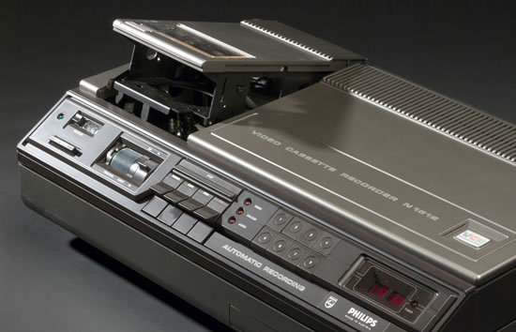
Perspective
It is plausible that MOOCs will kill universities as we know them (!)
But none of these did:
Plus: iTunes U, UW TV, course web pages, books, …

Slide 10
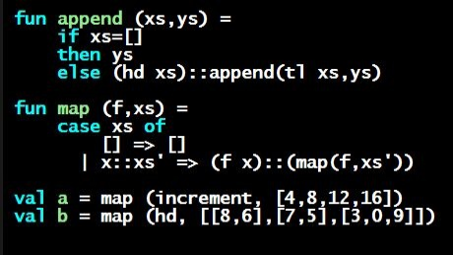
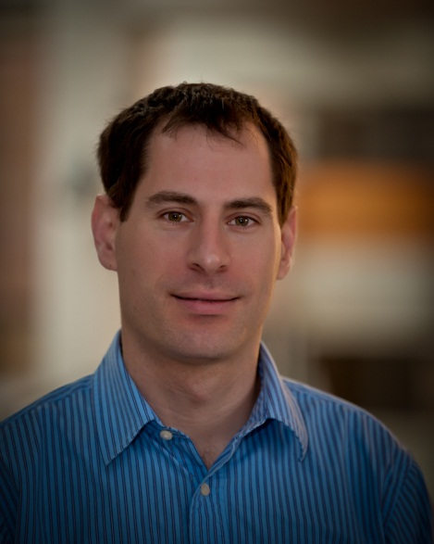
The courses
Programming Languages a la CSE341
https://www.coursera.org/course/proglang, starts January

Slide 11
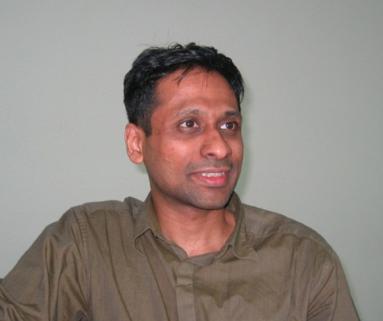
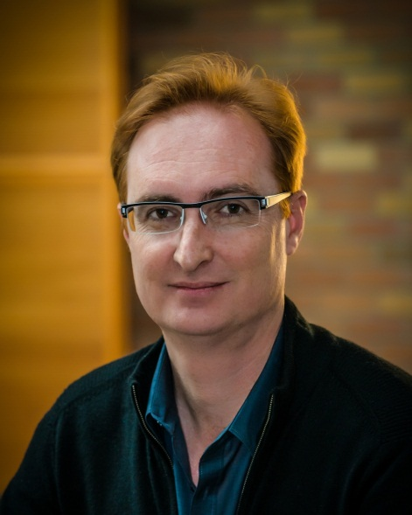
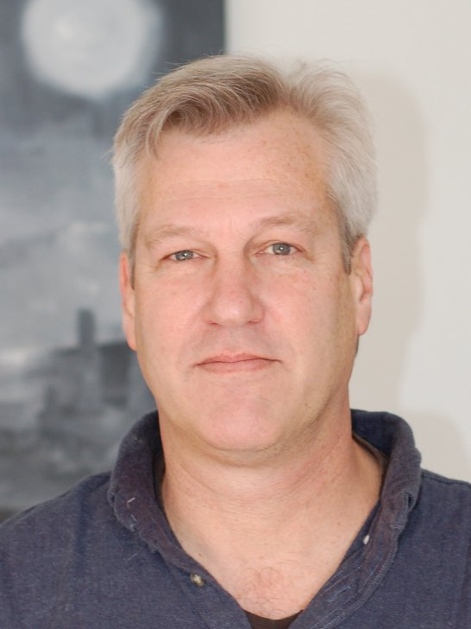
The courses
Computer Networks a la CSE461
https://www.coursera.org/course/comnetworks, starts January

Slide 12
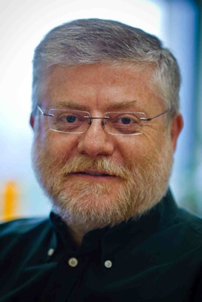
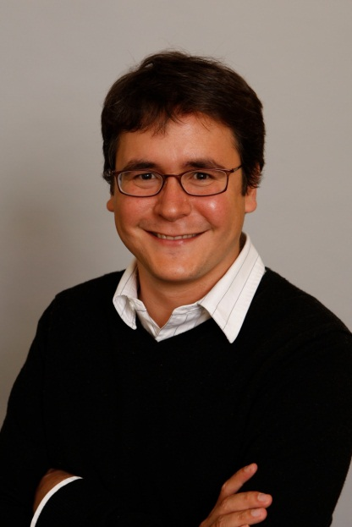
The courses
The Hardware/Software Interface a la CSE351
https://www.coursera.org/course/hardware, starts April

Slide 13
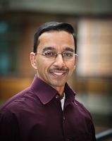
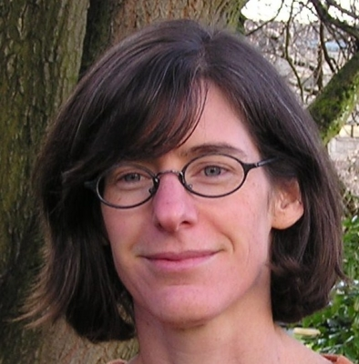
The courses
Computational Neuroscience
https://www.coursera.org/course/compneuro, starts April

Slide 14
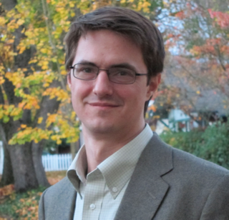
The courses
Introduction to Data Science
https://www.coursera.org/course/datasci, starts April

Slide 15
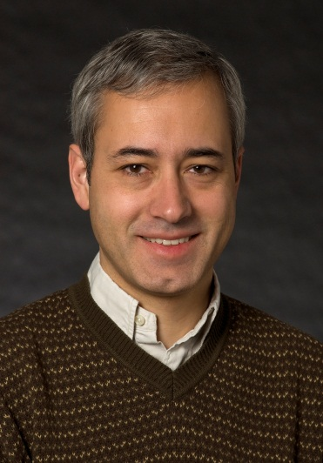
And next year…
Next academic year: probably more interested faculty
Already known to include:
Machine Learning
https://www.coursera.org/course/machlearning

Slide 16
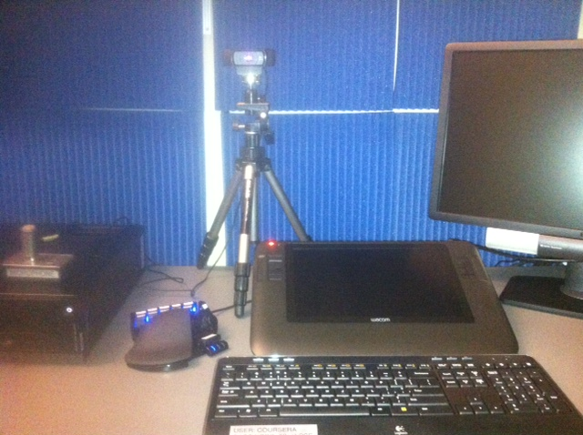
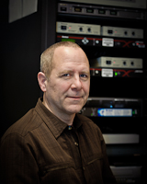
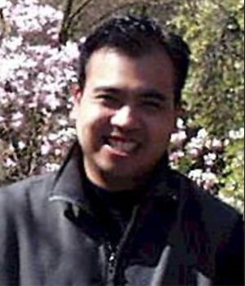
How do we do this?
Record videos in our new CSE recording studio
You could afford your own at home ☺
Design homeworks / exams that can be autograded
Coursera platform for scalability (EC2)
Plus judicious “peer assessment”
Trust the crowd to help and self-organize
Focus on providing a great course, not “grading”

Slide 17
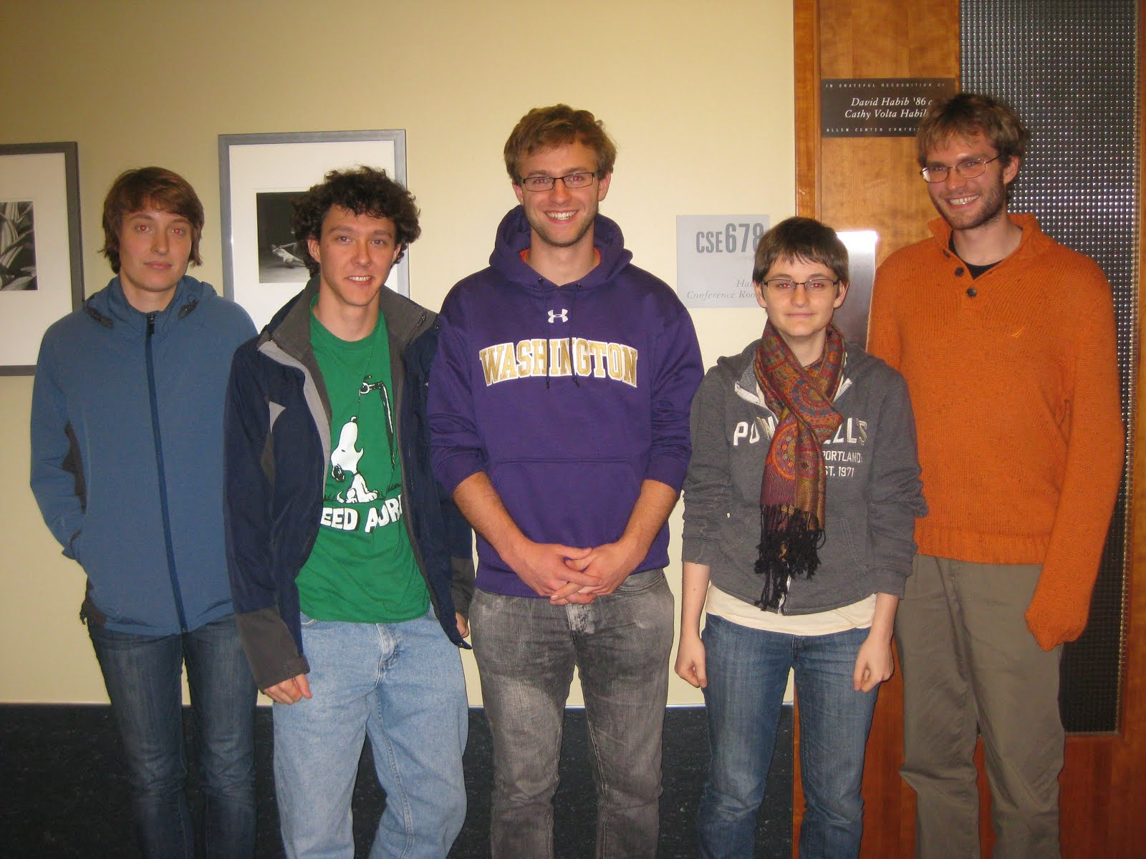
A ton of work
Our secret weapon for learning the platform, writing scripts, and much, much more:
No way I could do this without them: 5 students helping us get ready for 100K+ interested people
“Sherpas” deserve the credit
(L to R)
Claire McQuin
Cody Schroeder
Max Forbes
Rachel Sobel
Eric Mullen

Slide 18
Numerators and denominators
A note on reality with numbers of students:
Pro-MOOC people say “50,000 signed up”
Skeptical people say “< 10% finish a course”
Both are right!
Many reasons not to finish: < 50% ever do anything
What do you expect when “sign-up” is a mouse-click?
May be unprepared, have other priorities, etc.
But the numerator matters: 0.1 * 50K is more students than I have taught in the last decade combined

Slide 19
Will they learn?
My MOOC students will likely learn less and be less impacted by me than my conventional 50-70 students
That’s not my goal: I want more impact than writing a book
The comparison is moot: We don’t have capacity and students don’t have the flexibility to make that choice

Slide 20
Some real concerns
Financial model for higher ed if you move the 1,000-person lecture courses to MOOCs
The certification / assessment issues
Rampant cheating
Too little free-response, design, iterative assignments, …
How many FieldX 101 lecturers do we need?
Argument for “flipped classroom”? (Not my immediate plan)
Problems lessen if we stick to viewing MOOCs as “a better textbook” with a “huge social component”

Slide 21
So…
We are excited
We are making some great classes available
We don’t know yet how MOOCs will change us in 5 years…
… but what better way to start figuring it out than by having faculty and TAs gain experience in the next few months

