Slide 1
Using My MOOC Materials On Campuses: Little Stuff That Matters Dan Grossman J. Ray Bowen Professor for Innovation in Engineering Education Department of Computer Science & Engineering University of Washington March 7, 2015

Slide 2
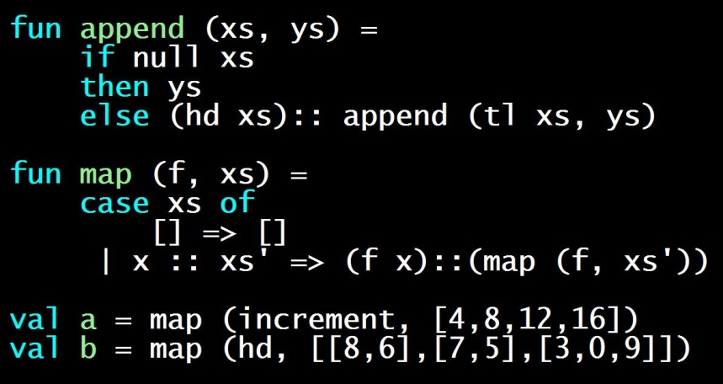
Context
MOOC initially taught Jan-Mar 2013
Coursera
Reoffered Fall 2013, Fall 2014
Programming languages (content not relevant to my remarks)
https://www.coursera.org/course/proglang

Slide 3
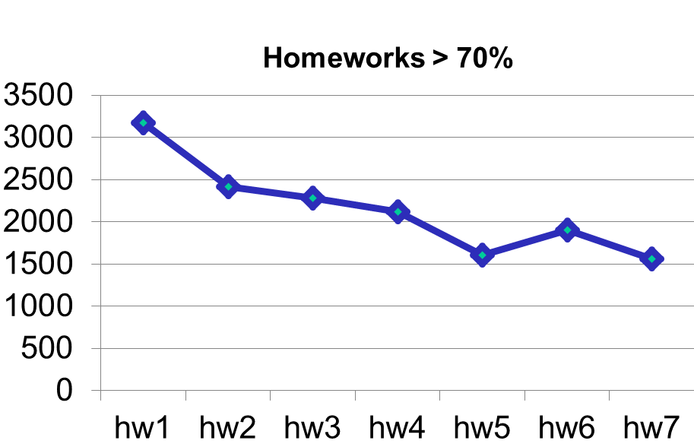
Did it for “massive” and “open”
First offering (or others, multiply by ~0.65):

Slide 4
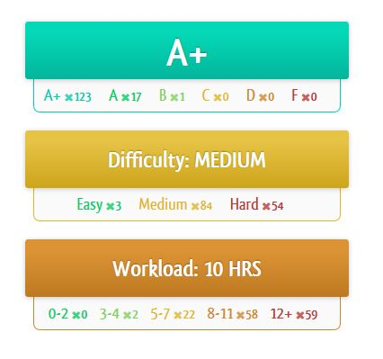
Success

Slide 5
What we have
25-30 hours of video for 10+ weeks of content
Some Powerpoint, lots of writing/running code
“Weapons grade” homegrown autograder
Testing, language features used
Reading notes with very few typos left
Peer-assessment rubrics for style
Practice problems contributed by volunteers
More data than I know what to do with
On-campus
use
No campus
use yet,
but I should!

Slide 6
Use when…
I teach the course
Others at UW teach the course
Others elsewhere use the materials

Slide 7
Videos
Everything about videos is minor compared to two things:
Have not “flipped” but:
Students love videos and come to class
Don’t fall behind when miss
Makes class time and schedule more flexible [like textbook]

Slide 8
Autograder
TAs [still] grade homework by hand
Use autograder to understand the code’s correctness

Slide 9
Student reaction
Initial worry: Why am I paying for a free class?
First day: Emphasize class benefits beyond the MOOC
Reality: Complaints-to-date: 0
“VIP version of famous course” known to friends and employers
Complete, polished materials
Course already popular

Slide 10
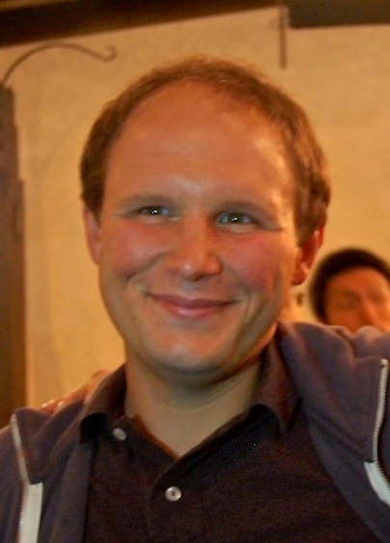
Zach
New faculty member learning the course
Same use of videos, autograder
He watched the videos at double-speed
He did more flipped classroom: advanced examples, exercises
And/but… he went slower, dropping last ~20% [personal style]
Prediction: Will evolve away from “my stuff” over time [good!]

Slide 11
Other campuses
Most significant use: Jerry
Email from ~12 other faculty
Eagerly send them solutions, sources, etc.
Videos get “Wikipedia-style use” I don’t know about
Colleagues lurk in the MOOC or just know about it
Influence hard to measure but important

Slide 12
Downside: cheating
Despite some effort, homework solutions easy to find online
Even unintentionally
This is what I gave up with the MOOC
It’s an issue ☹
It was worth it
Could write new homeworks, but may lose autograder, polish

Slide 13
Legalities [I Am Not a Lawyer]
Videos, homeworks, and reading notes available on a public UW web-page with no license restrictions
Only “in-video questions” are Coursera-platform-only
Share autograder with educators who ask for it
What you can’t do: Give credit or take money while using Coursera’s platform without Coursera’s permission
Who owns the materials?
Not Coursera (100% clear!)
Me or UW? Nobody knows; your campus might have a policy

Slide 14
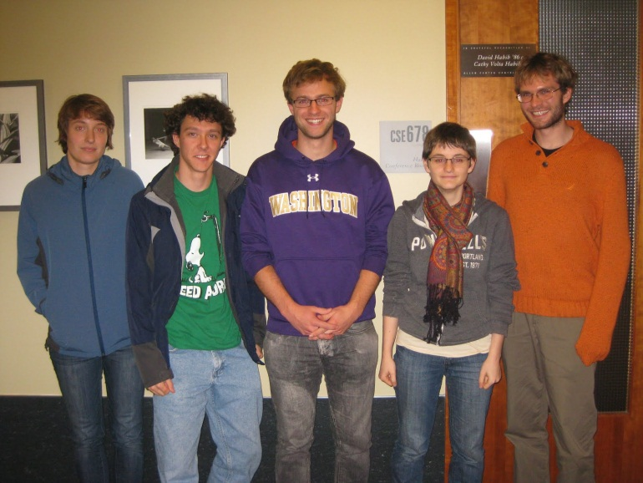
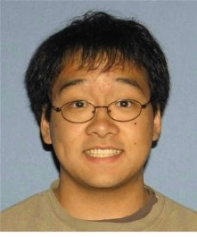
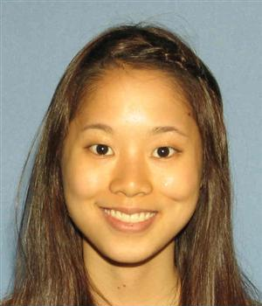
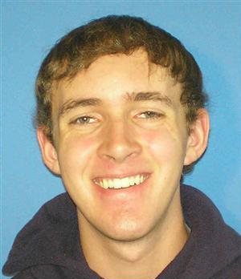
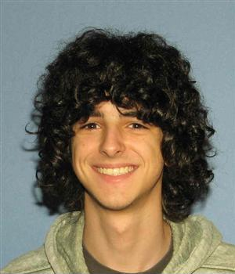
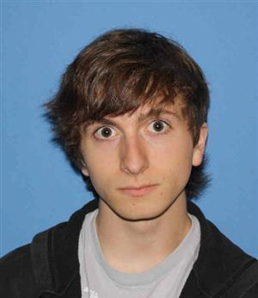
Thanks
http://homes.cs.washington.edu/~djg/
https://www.coursera.org/course/proglang
Vow: always thank the sherpas behind the scenes
Did the autograder, quiz questions, and much more!

Slide 15
[back-up slides]

Slide 16
The open question
Have the materials contributed to student learning?
I don’t know. Probably?

Slide 18
